Slide 1

Hypnosis for Weight Loss:
Leveraging the power of mind
Mark Pettus MD
November 1, 2017
www.thehealthedgepodcast.com

Slide 2
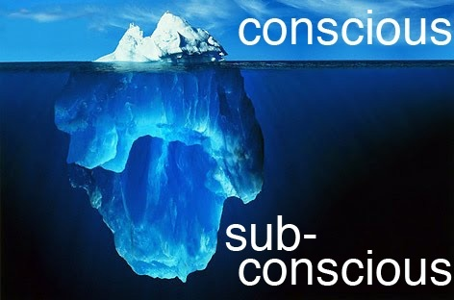

Slide 3
Hypnosis
A state of altered consciousness
All hypnosis is self-hypnosis…I am your guide
Deeper relaxation without the background noise makes “planting” suggestions easier.
Desired behaviors with less effort and more ease
This is not magic
Best as part of a holistic lifestyle

Slide 4


Slide 5
Suggestions
Ditch the carbs e.g. sugar, flour, refined grains, soft drinks, artificial sweeteners
Eat healthier fats e.g. eggs, full fat organic dairy, butter, nuts, avocados, fatty fish, grass-fed meats, full fat cheese, extra virgin olive oil.
Unlimited veggies… color and variety are best
Taking back control of your environment and life
Pleasure vs. Happiness
Eat to be healthy vs. eating to lose weight
Self-love compassion

