Slide 1

Health and the Gut Microbiome:
Restoring a Lost Legacy
Mark Pettus MD
Director of Medical Education and Population Health
Berkshire Health Systems
March 27, 2017

Slide 2
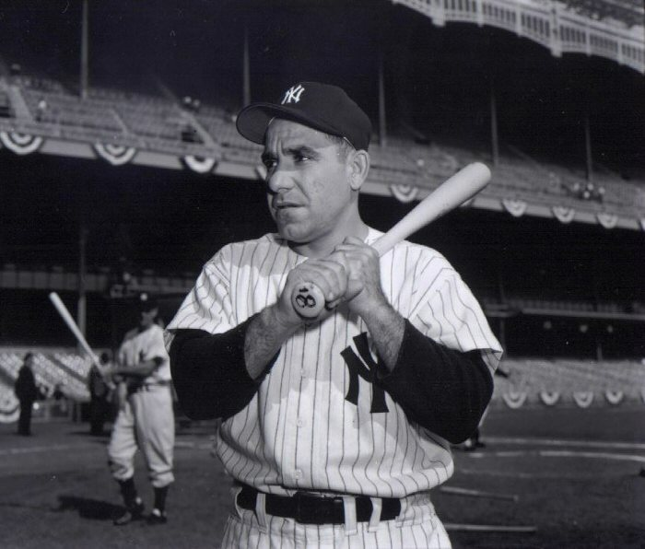
“The future ain’t what it used to be.”
Yogi Berra

Slide 3
Learning objectives
Participants will understand the contributors to a less diverse and balanced microbiome in industrialized countries.
Participants will understand the mechanisms that link alterations of the microbiome with human health.
Participants will take away 3 lifestyle interventions to restore balance and health to the gut microbiome.

Slide 4
Environment
Life
Epigenome
Microbiome
Consciousness-Spirit

Slide 5
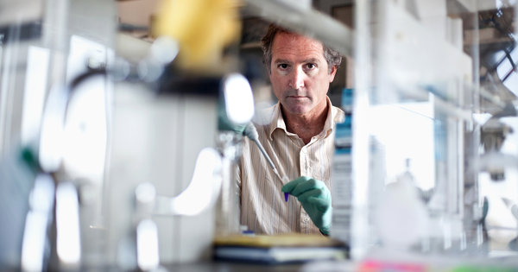
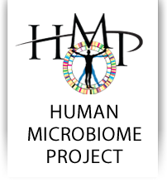
99% genome from microbes
Digestion-caloric extraction
Detoxification
Epigenomic expression e.g., butyrate
and histone deacetylase inhibition
Immunomodulatory cell signaling
Cytokine modulation – insulin/leptin
Vitamin modification
Neurotransmitters
SCFAs and gut hormones/permeability
Talk to the vagus nerve

Slide 8
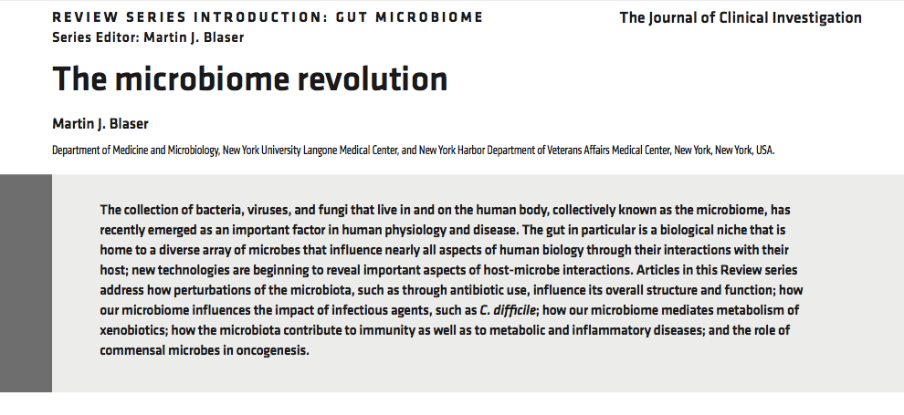

Slide 9
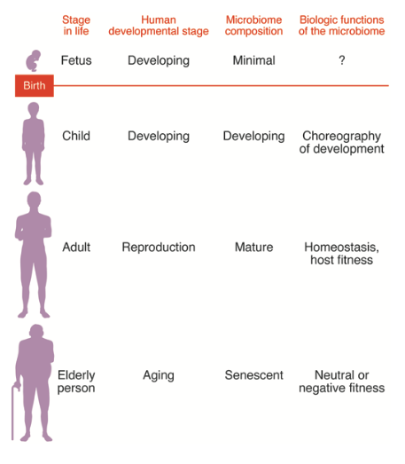

Slide 14
Problems with gut health can promote inflammation:
Weight Gain
Asthma-allergies
Autoimmunity
Arthritis
Metabolic Bone disease
Skin problems e.g. eczema, rosacia
Mood disorders
Cognitive decline-Alzheimers
Cancer

Slide 15
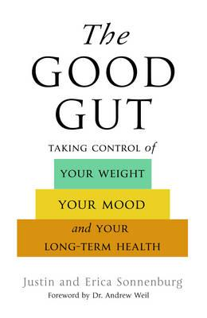

Slide 18
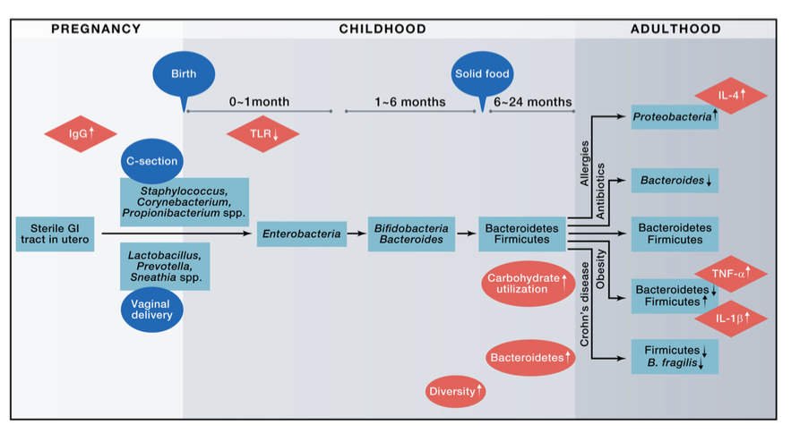

Slide 19
Noteworthy contributions to alterations of the human microbiome
Dietary changes e.g. refined, processed simple starches and sugars “carbohydrate-dense” foods
Marked decreases in fermentable fiber
Antibiotic use in prescriptions and in industrialized foods
Glyphosate as an anti-microbial
Hygiene hypothesis
Prior GI infections; H. pylori; systemic infections SIBO-small intestinal bacterial overgrowth
Medications e.g. PPIs, steroids, chemotherapy

Slide 20
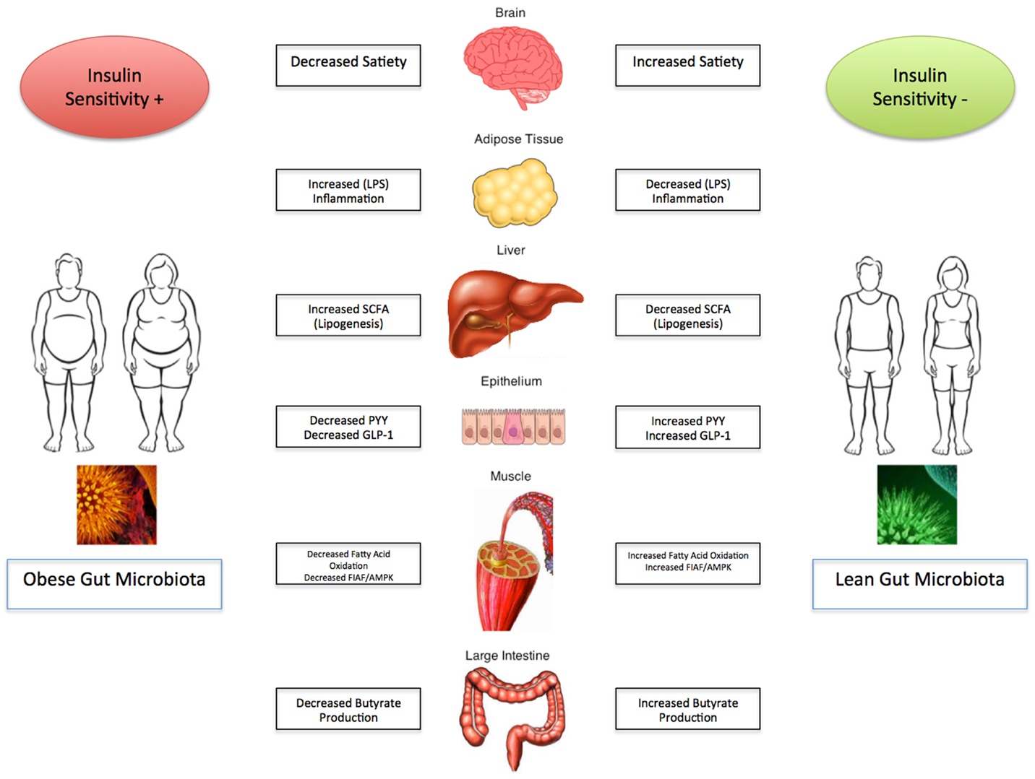

Slide 21
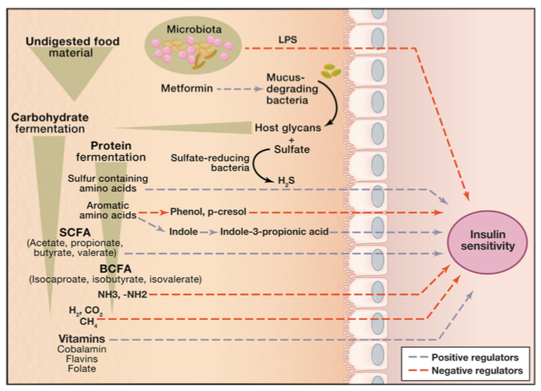

Slide 22
“The connection between the gut microbiota and energy homeostasis and inflammation and its role in the pathogenesis of obesity-related disorders are increasingly recognized. The role of the Western diet, antibiotics and lifestyle in promoting an obesogenic microbiota is increasingly clear.”

Slide 23
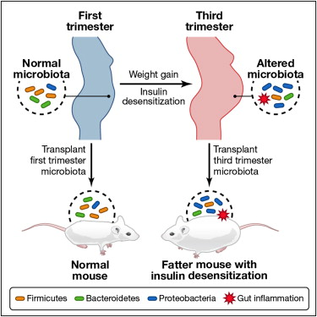
Cell 150, 470–480, August 3, 2012 ª2012 Elsevier Inc.

Slide 26
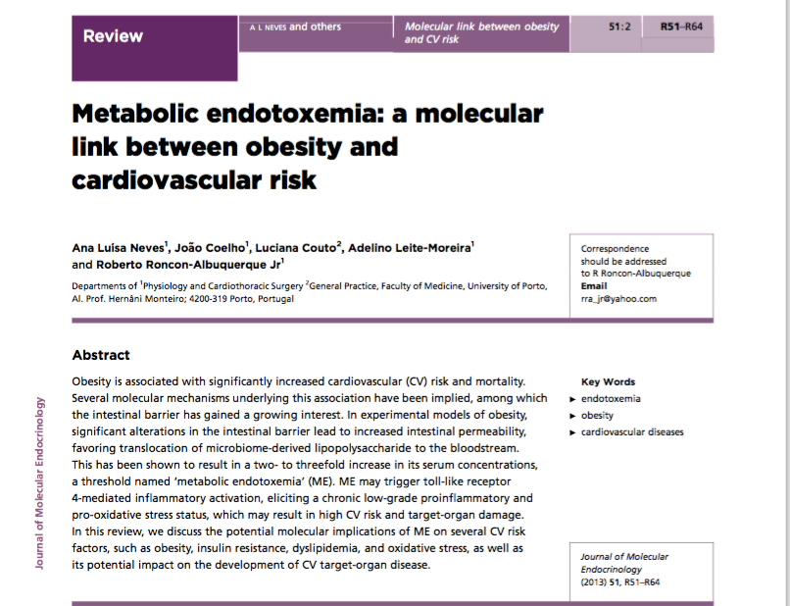
Journal of Molecular Endocrinology (2013) 51, R54-R61

Slide 27
VAT
SAD
Dysbiosis
SIBO
Food sens
Journal of Molecular Endocrinology (2013) 51, R54-R61

Slide 28
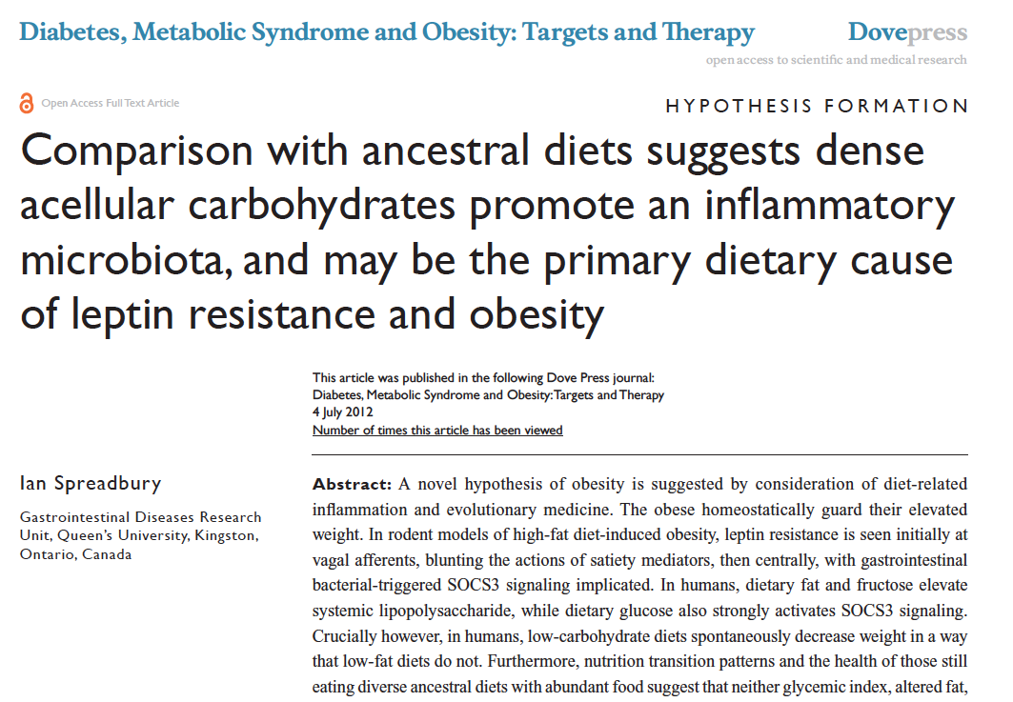

Slide 29
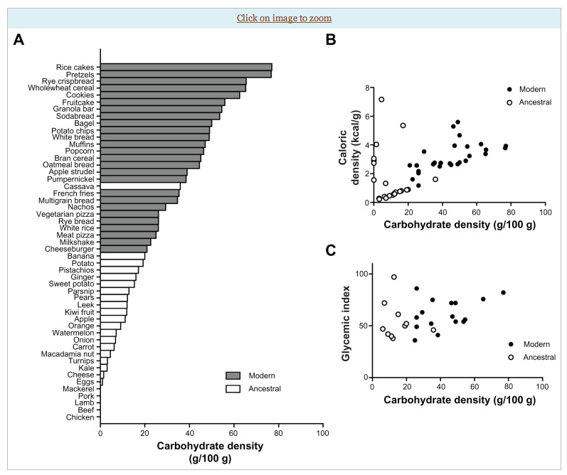

Slide 30
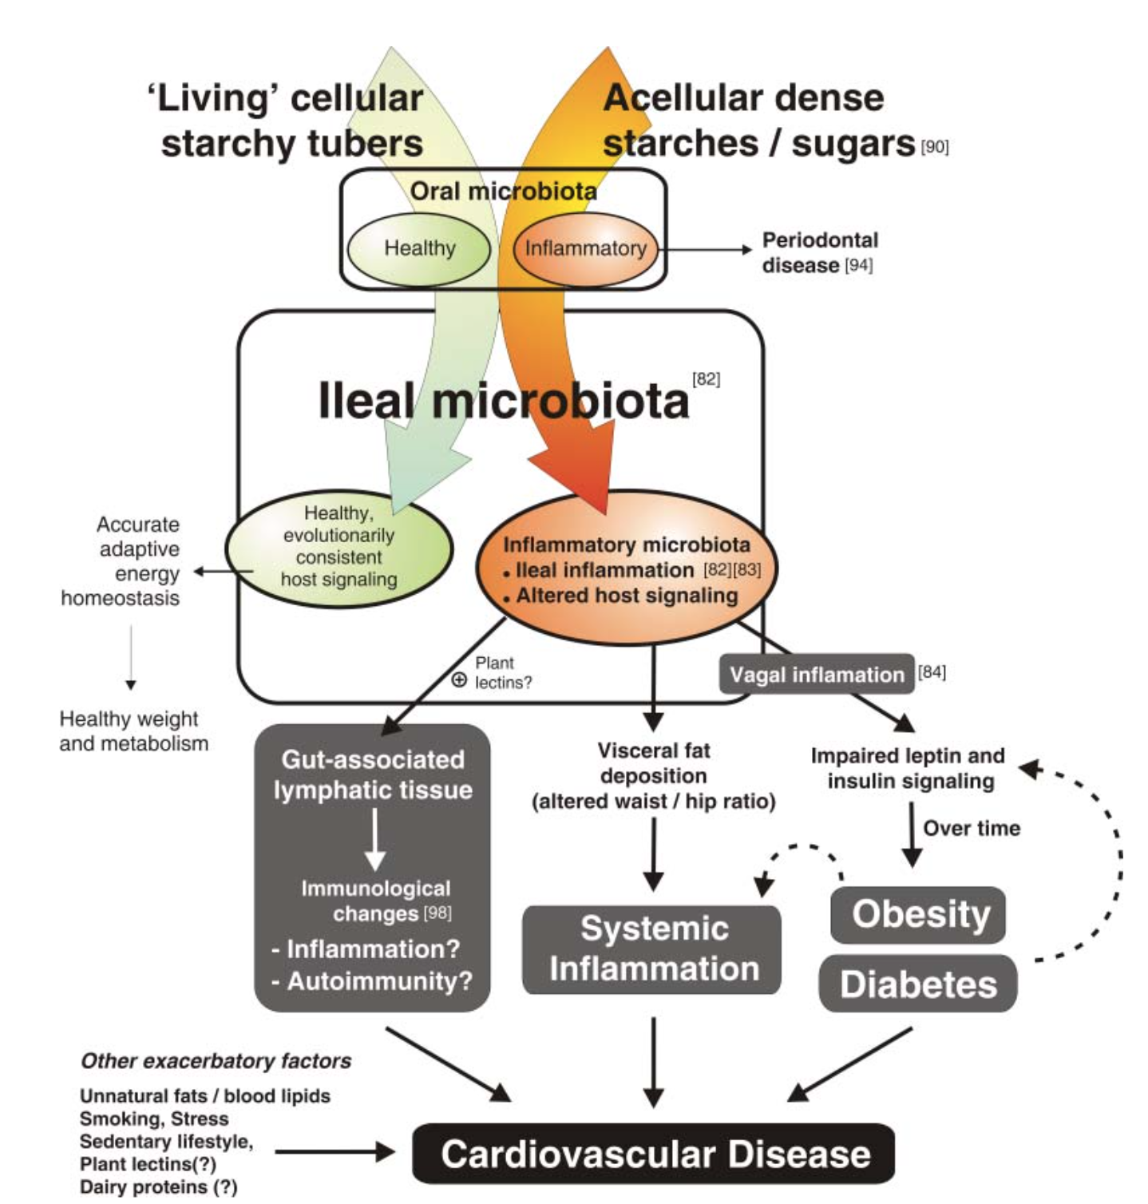
Courtesy Ian Spreadbury PhD
Cancer

Slide 31
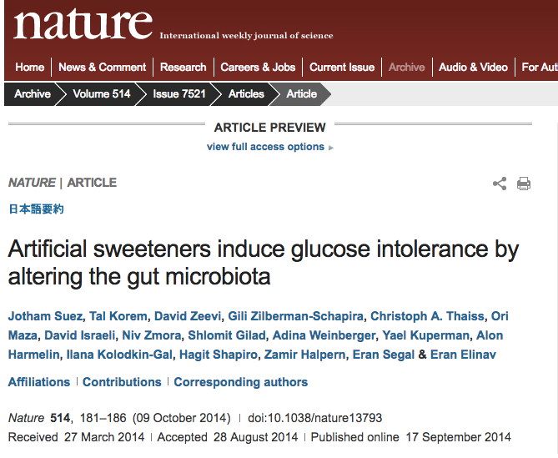
Giving NNS to mice induced changes in their gut microbiome
These changes were associated with glucose intolerance and insulin resistance
These metabolic effects were ameliorated with Abx
These metabolic effects were transferred when stool from mice receiving the NNS were transplanted into germ-free mice

Slide 32
Summary: Dysbiosis, SIBO, Increased Intestinal Permeability
LPS via TLR4 activates stellate cells
Systemic Inflammation
Insulin Resistance
Hepatic inflammation
Altered Mitochondrial function
FFA oxidation
PGC1-alpha
Obesity
VAT
Insulin Resistance
DM
NASH
FIAF LPL
Increased FFA uptake
Carbohydrate dense foods
Sugar/Fructose
Increased hepatic lipogenesis
Bile Acid Changes/PPIs
Bacteriostasis
SIBO

Slide 33
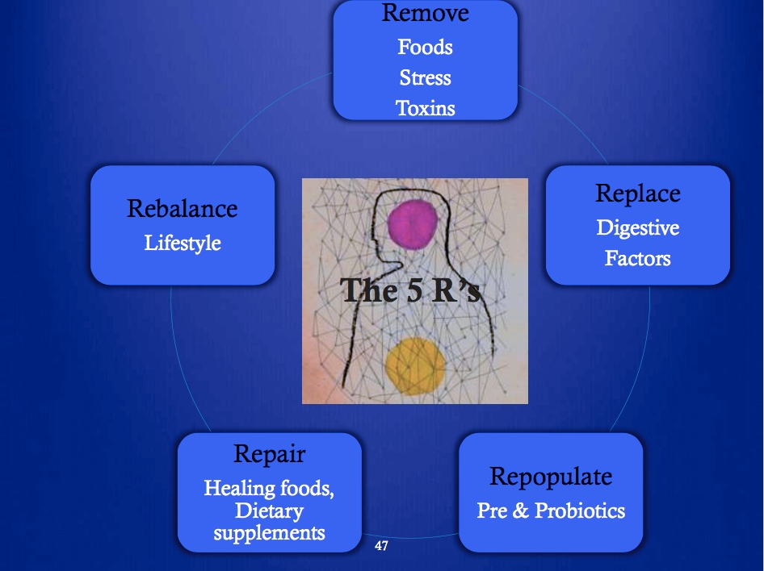
Courtesy Kathie Swift MS RDN LDN FAND EBQ

Slide 34
Microbiota Accessible Carbohydrates
Soluble fibers
Fruits and vegetables e.g. apples, pears, berries, carrots, squash, zucchini, sweet potato
Non-starch polysaccharides
Long chain carbohydrates that are not starch e.g. onions, garlic, Jerusalem artichoke, leeks
Resistant starch
Non-soluble fiber e.g. beans, legumes, lentils, cooked-cooled potatoes, plantains

Slide 35
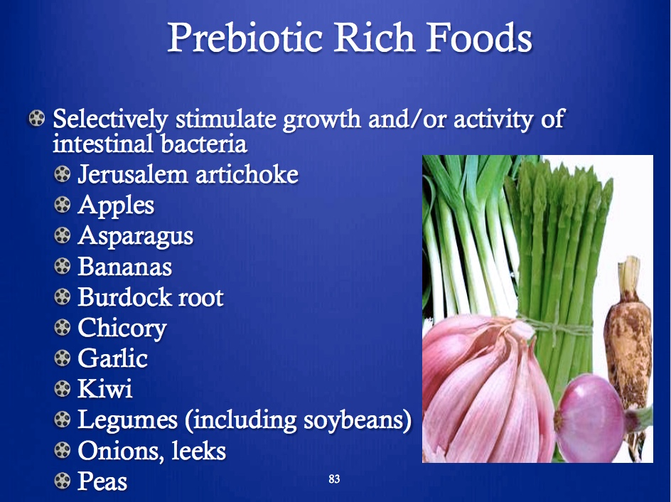
Courtesy Kathie Swift MS RDN LDN FAND EBQ

Slide 36
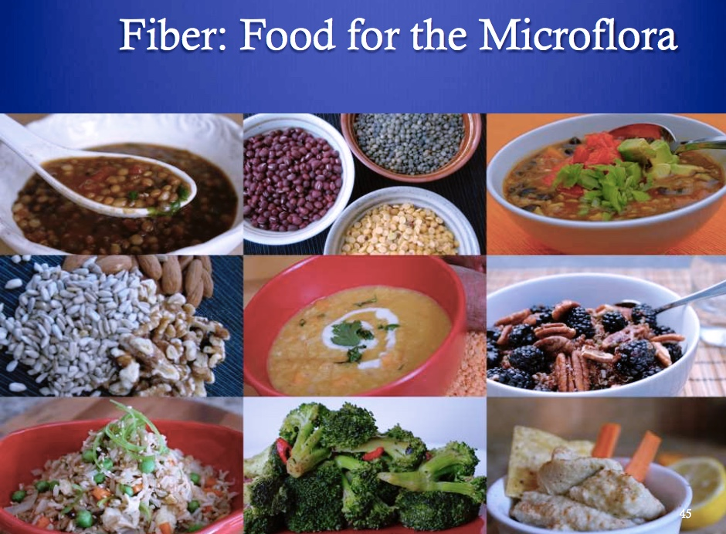
Courtesy Kathie Swift MS RDN LDN FAND EBQ

Slide 37
In animal models, giving VSL#3 probiotics modulates microbiota induction of butyrate and GLP-1.
These metabolic changes enhance insulin signaling, increase fat oxidation, decrease appetite, improve colonic epithelial function-integrity and barrier function.

Slide 38
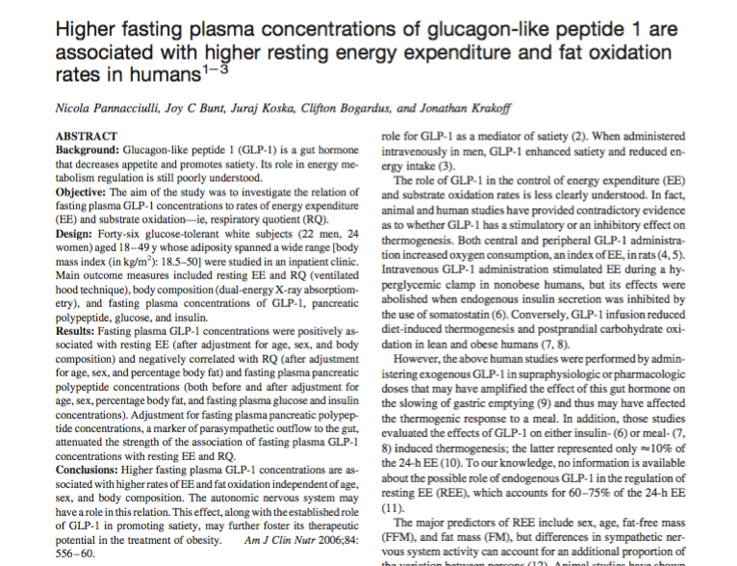
Fasting GLP-1 levels were associated with higher rates of TEE and fat oxidation, independent of age, sex and body composition.
^{Am J Clin Nutr 2006;84:556–60}

Slide 40
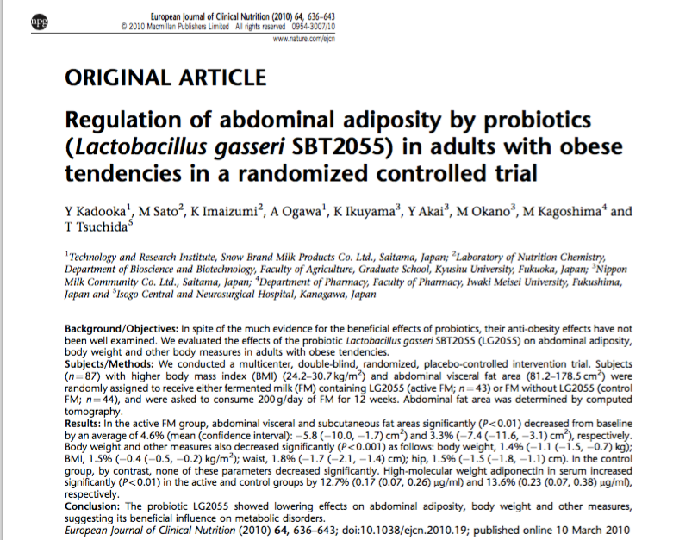
Multi-center, double-blinded randomized, placebo-controlled intervention trial
87 subjects with high BMI and VAT
FM vs. placebo for 12 weeks
Improved wt. loss and body comp in treated group compared with control
Higher adiponectin in treated group. Enhanced insulin sensitivity, glucose regulation and fat oxidation

Slide 41
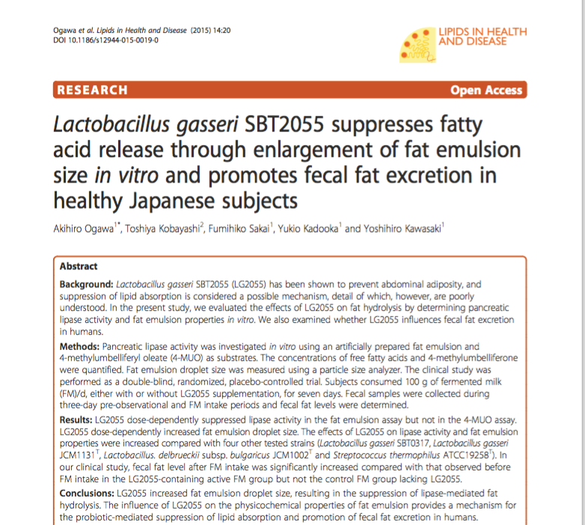
Greater fecal fat excretion seen in those supplemented with L. gasseri. This effect was mediated by suppression of lipase-mediated lipid absorption.

Slide 42
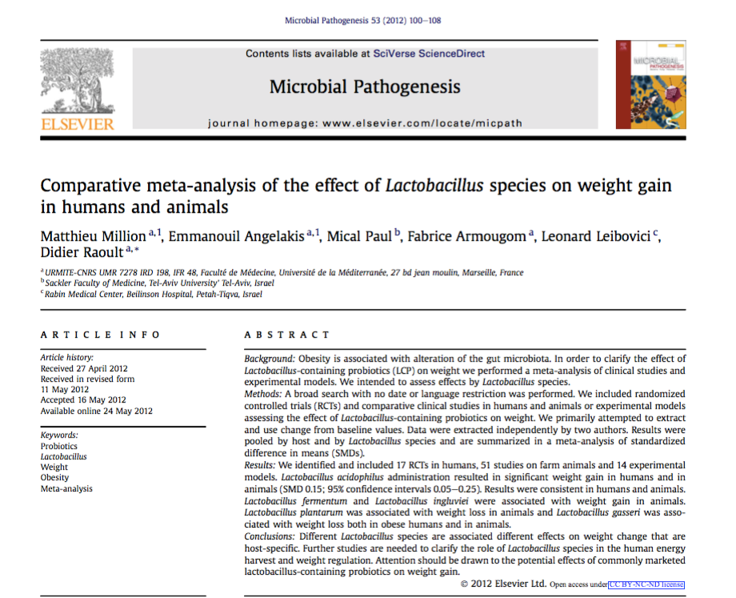
Different Lactobacillus species appear to have varied effects on metabolism and weight loss.
Review of 17 RCTs in human adults reveal positive effects with L plantarum and L gasseri with weight gain with L acidophilus.

Slide 43
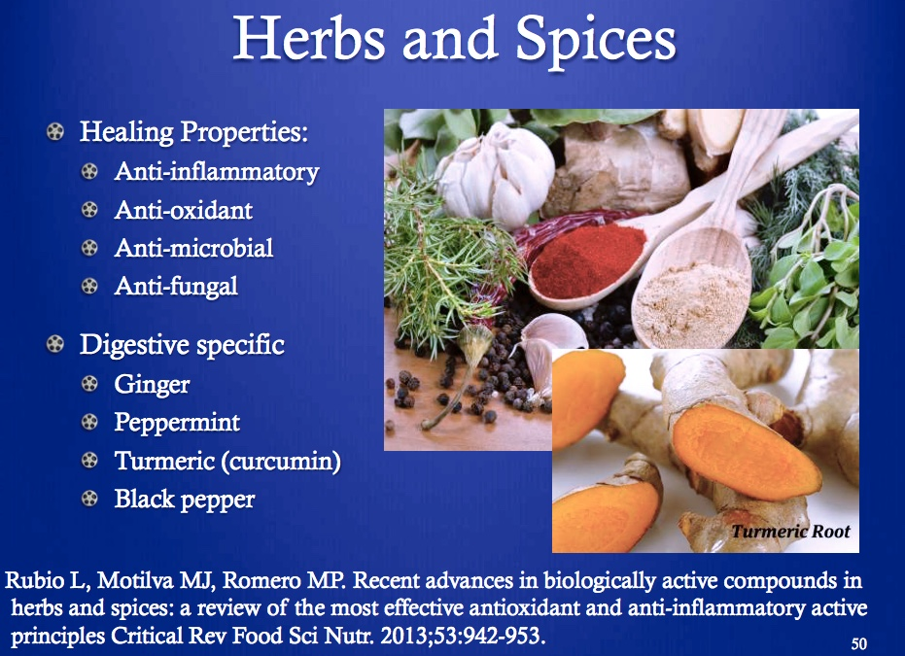
Courtesy Kathie Swift MS RDN LDN FAND EBQ

Slide 44
Multi-center, double-blinded randomized, placebo-controlled intervention trial
87 subjects with high BMI and VAT
FM vs. placebo for 12 weeks
Improved wt. loss and body comp in treated group compared with control
Higher adiponectin in treated group. Enhanced insulin sensitivity, glucose regulation and fat oxidation

Slide 45
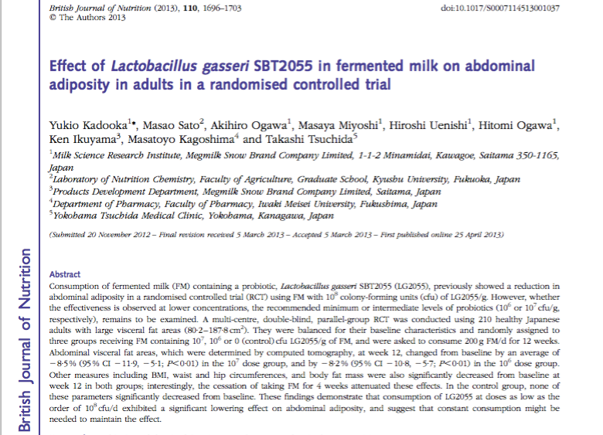
Intervention with FM in 210 healthy overweight adults.
Significant lowering of abdominal adiposity was seen.
Effects were reversed after discontinuation of FM

Slide 46
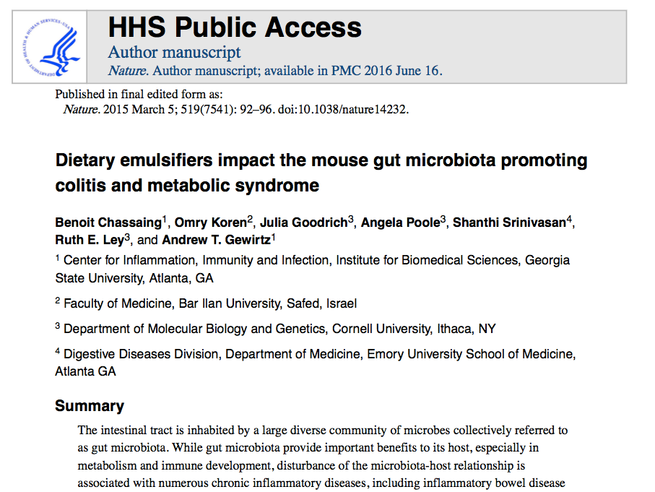

Slide 47
Lifestyle changes to bring diversity and balance to the gut microbiome
Diminish sugar and processed refined, carbohydrate-dense foods. Grains, gluten and glyphosate exposures
Increase fermentable plant-based fiber and fermentable foods
Whenever possible, go organic, GMO-free (glyphosate)
Cautious with prescribed antibiotics and feedlot meats, poultry, and eggs
Minimize NNS, emulsifiers, thickeners
Consider testing, diagnosis and treatment of dysbiosis-SIBO (breath testing; CDSA; H. pylori)
Probiotics
Taper, d/c PPIs
? Future of fecal microbiota transplants

Slide 48

Thank You

