Slide 1
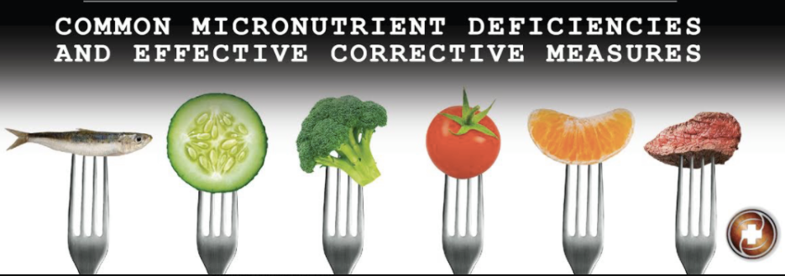
Mark Pettus MD
May 31, 2017
Medical Director Functional Formularies
Director Medical Education, Wellness and Population Health
Berkshire Health Systems

Slide 2
Learning Objectives
Review the prevalence and of important nutrient deficiencies in the general population
Review the contributing factors to the growing prevalence of important nutrient deficiencies.
Review nutritional and supplement considerations for addressing common nutrient deficient states

Slide 4
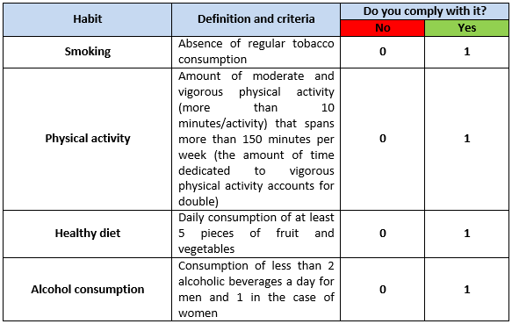
Optimal Lifestyle Metrics

Slide 8
Standard American Diet
51% of energy obtained is from foods that are refined and processed with minimal nutrient density
< 14% Americans consume recommended daily servings of vegetables
< 18% Americans consume recommended daily servings of fruits

Slide 9
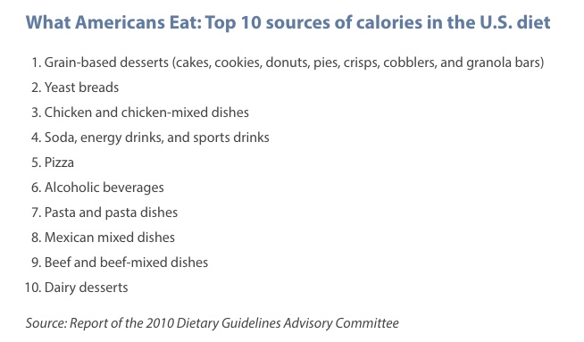

Slide 10
Center for Disease Control (testing blood and urine)
90 million Americans deficient in vitamin D
30 million Americans deficient in vitamin B6
18 million Americans deficient in vitamin B12 (using MMA)
16 million Americans deficient in vitamin C
8 million Americans deficient in iron; Latinos 12%; blacks 16%; children ages <5 years of age 7-10%
Many women ages 25-39 with “borderline”low iodine levels

Slide 11
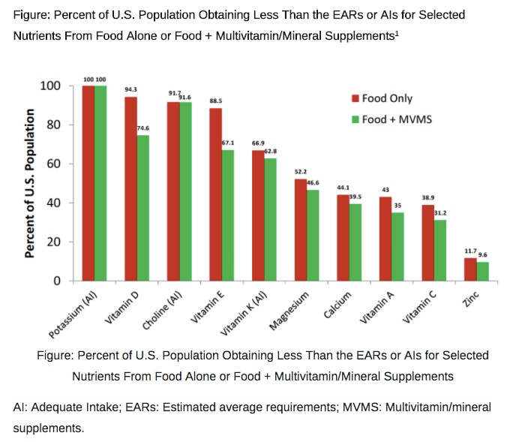

Slide 12
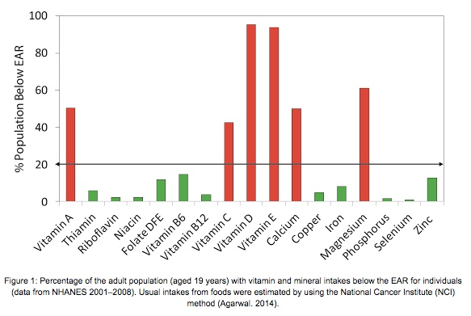

Slide 13
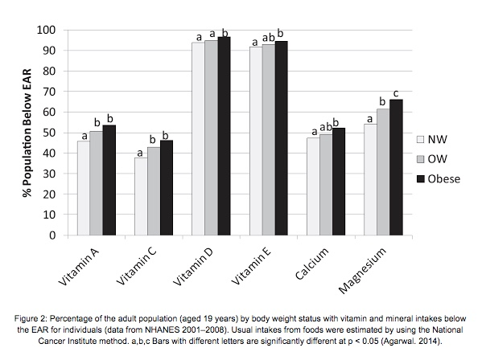

Slide 15
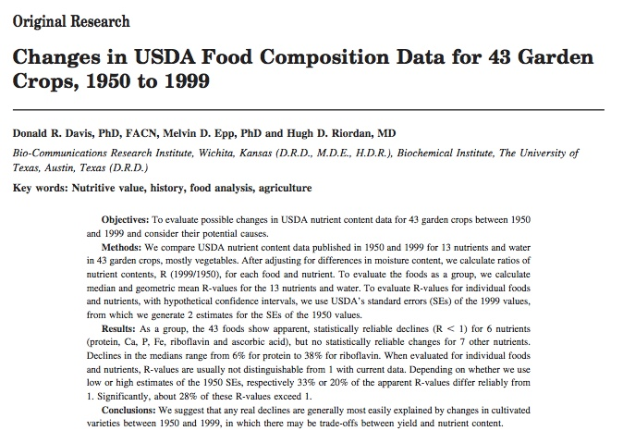

Slide 16
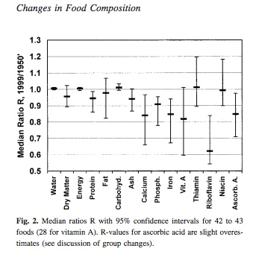

Slide 17
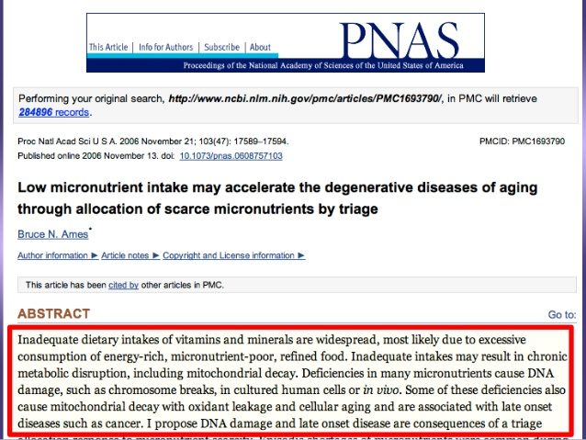

Slide 20
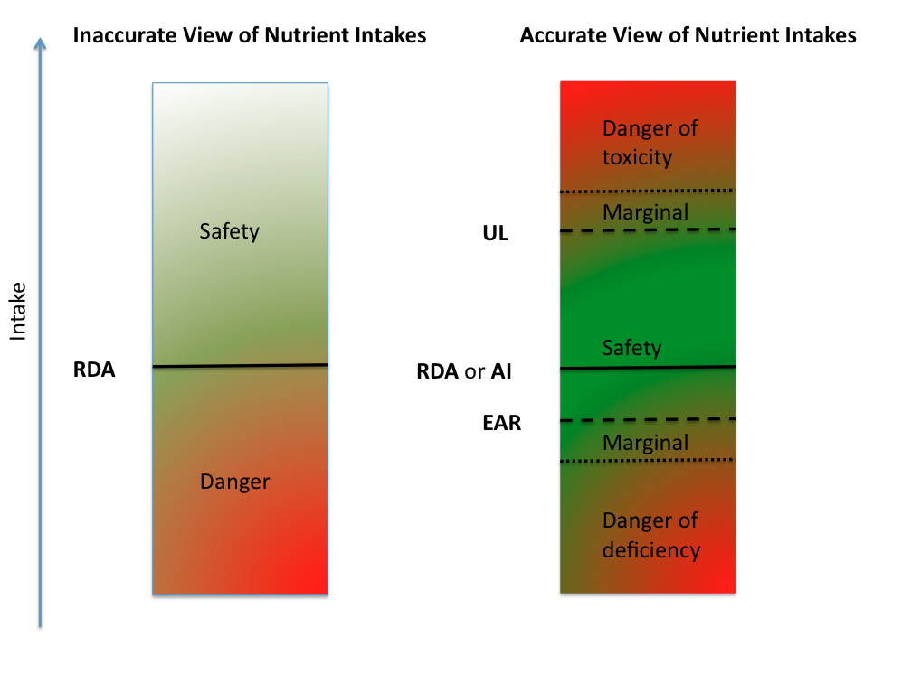

Slide 21
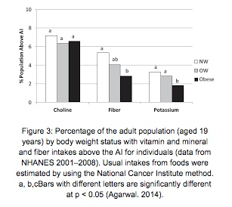

Slide 22
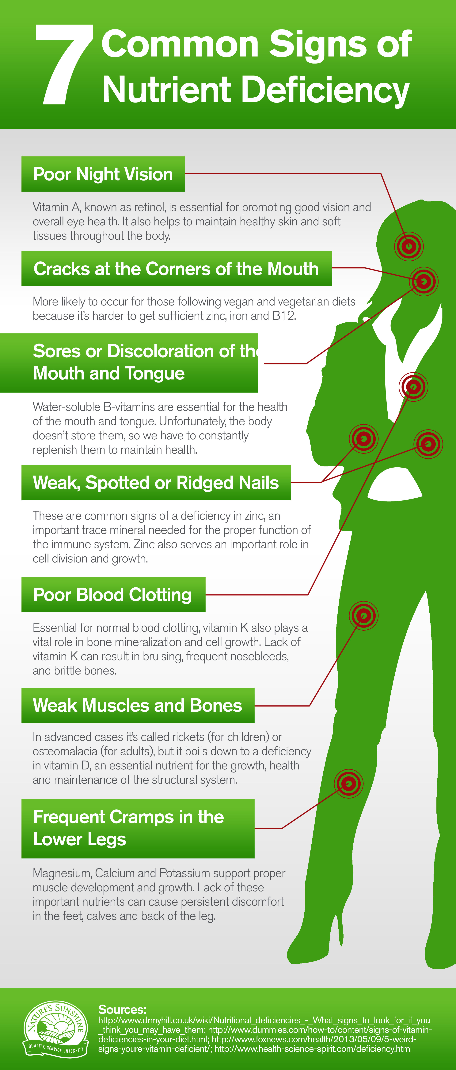
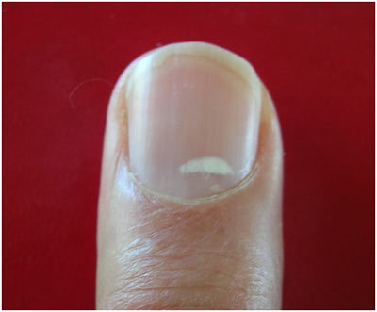

Slide 23
We need a broad spectrum of micronutrients for optimal function
Biochemical individualization
Compress morbidity
Goal to assist optimal biologic function e.g. identify “relative deficiencies”.
Our needs change over time…a very dynamic metabolic landscape
Moving beyond vitamins and minerals e.g. sufficient fermentable fiber and phytonutrients

Slide 24
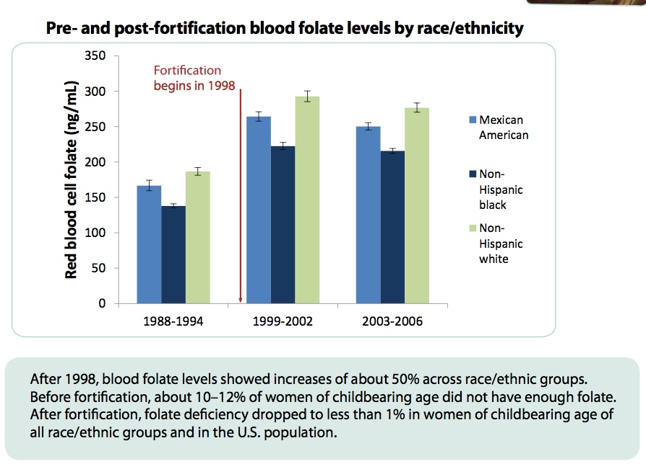

Slide 25
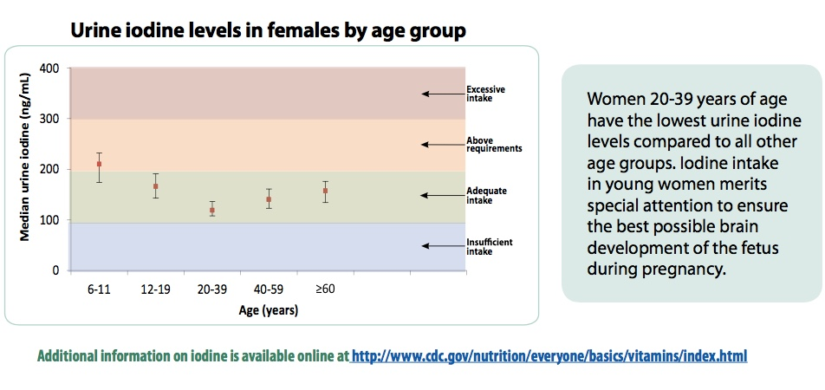

Slide 26
NHANES data (2003-2004) show 7% of Americans aged 6 years or older are deficient in vitamin C, based on the standard serum concentration cut off of <11.4 μmol/L. Lower rates of deficiency are found among men and women who used any vitamin C-containing VMS compared to those who did not: 2% (both genders) vs. 16% and 11%, respectively).16
NHANES data (2003-2006) show that, while only 1% of Americans age 20 years or more have serum levels of vitamin E meeting the criterion for clinical deficiency (α-tocopherol < 12 μmol/L), 81% of dietary supplement non-users have vitamin E “inadequacy” compared to 46% of users. In this analysis, vitamin E inadequacy was defined as a serum α-tocopherol level below that associated with consuming the EAR and with the lowest mortality rate in a major interventional trial (< 30 μmol/L).17,18

Slide 27
NHANES data (2001-2006) show the prevalence of vitamin D deficiency, based on serum levels of 25-hydroxyvitamin D <30 nmol/L, is 14% among individuals two or more years of age who do not take a dietary supplement compared to 5% among those who do. 14
Based on a standard definition for vitamin B12 deficiency (serum B12 < 258 pmol/L or methylmalonic acid > 0.21 μmol/L), NHANES data (1999-2002) show 38% of adults age 60 years or more are deficient, but the rate is 30% among those who took any B12-containing VMS. This definition of deficiency was also associated with significantly increased risks for peripheral neuropathy and disabilities.15

Slide 28
Drug-Nutrient Interactions
Alcohol- zinc, magnesium, phosphorous, B1, B2, B6 and Folate
Antibiotics – Vitamin K
Diuretics – potassium, magnesium, zinc, B6
Metformin – B12
Trimethoprim - Folate

Slide 29
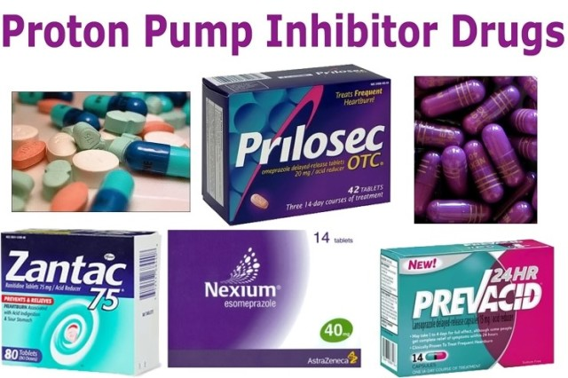
Proton pump inhibitors not only block the release of stomach acid but also something else called “intrinsic factor,” making it impossible to absorb vitamin B12.
It’s well known that calcium is best absorbed in the presence of acid.
Proton pump inhibitors are thought to inhibit active transport of magnesium in the intestine, leading to deficiencies and potentially serious health outcomes.

Slide 30
Your absorption of folic acid is inhibited, disrupting the production of new cells, which helps your body grow and repair itself.
The absorption of zinc is impaired, which is needed for many enzyme reactions in the body.
The inhibition of dietary iron can contribute to anemia over a long period of time

Slide 31
Labs
25 hyroxy-vitamin D
B12 and Methylmalonic acid
Folate
MTHFR
RBC magnesium and zinc
Omega 3/6 Index (want 8+ %)
Urine iodine
Urinary Organic Acids-Metabolic Profile

Slide 32
Ferritin/B6
Best biomarker for iron stores
Should check in children with ADHD; adults with anemia; RLS
Iron deficiency and hypothyroidism
B6 (pyridoxine) important for neurotransmitters, folate synthesis, conversion of ALA to DHA
Decreased with inflammation-conditionally essential-triage
Pyridoxine and Riboflavin (B2-dairy) to Pyridoxyl-5 phosphate (PLP)
? RDA higher e.g. 4-6 mg
Vitamin C lower in chronic inflammatory and stress states

Slide 33
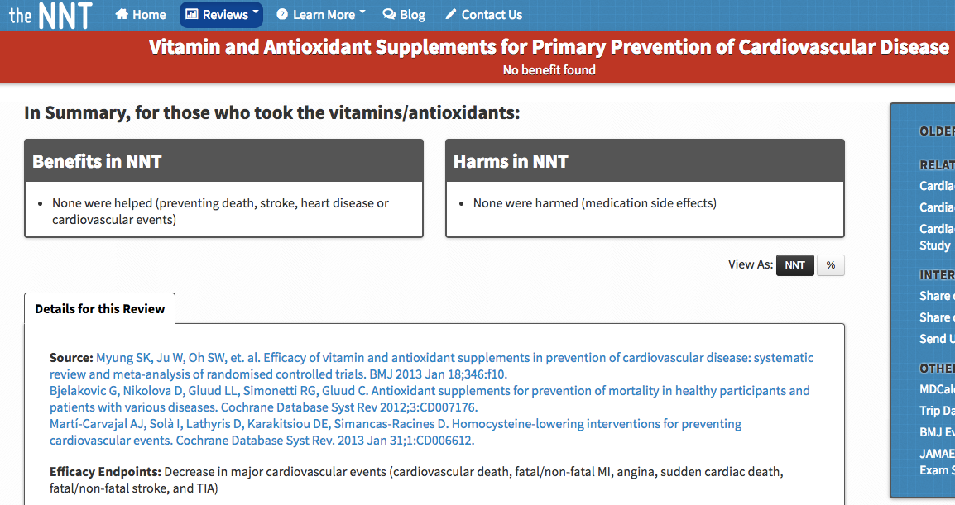
Multivitamin-mineral supplements

Slide 35
Nutragenomics
Folate and MTHFR: Thymine synthesis and methylation
40% population heterozygous which results in a 40% reduction in functional MTHFR
10% homozygous with 80-90% reduction in the functional efficiency of MTHFR
Supplementation with L­methyltetrahydrofolate
Vitamin B12 and FUT2: 49% population might have reduced absorption of B12
Vitamin A and BCMO1: 20-40% population with trouble converting provitamin A carotenoids to active form of vitamin A retinol

Slide 36
Nutragenomics
Vitamin D and CYP2R1: converts D3 into 25-hydroxy D3; consider if someone’s serum levels are not increasing as predicted by supplementation dose
APOE4: lipoprotein made in the liver that binds to cholesterol and recycles it in the liver. It also transports cholesterol (astrocytes) to neurons in the brain.
25% heterozygote resulting in higher LDL which usually increases on a more liberal fat diet. 3-fold increase risk of Alzheimer’s

Slide 41
Skikne BS, Lynch SR, Cook SD. Role of gastric acid in food iron absorption. Gastroenterology. 1981 Dec;81(6):1068-71.
McColl KE. Effect of proton pump inhibitors on vitamins and iron. Am J Gastroenterol. 2009 Mar;104 Suppl 2:S5-9.
Ito T, Jensen RT. Association of long-term proton pump inhibitor therapy with bone fractures and effects on absorption of calcium, vitamin B12, iron, and magnesium. Curr Gastroenterol Rep. 2010 Dec;12(6):448-57.
Oh S. Proton pump inhibitors--uncommon adverse effects. Aust Fam Physician. 2011 Sep;40(9):705-8.
Saltzman JR, Kemp JA, Golner BB, et al. Effect of hypochlorhydria due to omeprazole treatment or atrophic gastritis on protein-bound vitamin B12 absorption. J Am Coll Nutr. 1994;13:584-91.
Alleyne M, Horne MK, Miller JL. Individualized treatment for iron-deficiency anemia in adults. Am J Med. 2008;121:943-8.
Bronner F, Pansu D. Nutritional aspects of calcium absorption. J Nutr. 1999 Jan;129(1):9-12.
Hess MW, Hoenderop JG, Bindels RJ, Drenth JP. Systematic review: hypomagnesaemia induced by proton pump inhibition. Aliment Pharmacol Ther. 2012;36:405-13.
Russel RM, Golner BB, Krasinski SD, et al. Effect of antacid and H2 receptor antagonists on the intestinal absorption of folic acid. J Lab Clinc Med. 1988; 112:458-63.
Iskandar BJ, Nelson A, Resnick D, et al. Folic acid supplementation enhances repair of the adult central nervous system. Ann Neurol. 2004 Aug;56(2):221-7.
Sturniolo GC, Montino MC, Rosettol, Martin A, D Inca R. Inhibition of gastric acid secretion reduces zinc absorption in man. J Am Coll Nutr. 1991 Aug;10(4): 372-5.

Slide 42
Agarwal, Sanjiv, et al. "Comparison of Prevalence of Inadequate Nutrient Intake Based on Body Weight Status of Adults in the United States: An Analysis of NHANES 2001–2008." Journal of the American College of Nutrition ahead-of-print (2014): 1-9.
Heitmann, Berit Lilienthal, and Lauren Lissner. "Dietary underreporting by obese individuals--is it specific or non-specific?." Bmj 311.7011 (1995): 986-989.
Meng, X., et al. "Under-reporting of energy intake in elderly Australian women is associated with a higher body mass index." The journal of nutrition, health & aging 17.2 (2013): 112-118.
Poppitt, S. D., et al. "Assessment of selective under-reporting of food intake by both obese and non-obese women in a metabolic facility." International journal of obesity and related metabolic disorders: journal of the International Association for the Study of Obesity 22.4 (1998): 303-311.

Slide 44
Courtesy Kathie Swift MS RDN LDN FAND EBQ

Slide 45
Courtesy Kathie Swift MS RDN LDN FAND EBQ

Slide 46
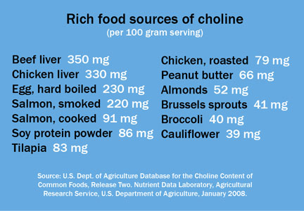

Slide 47
