Slide 1
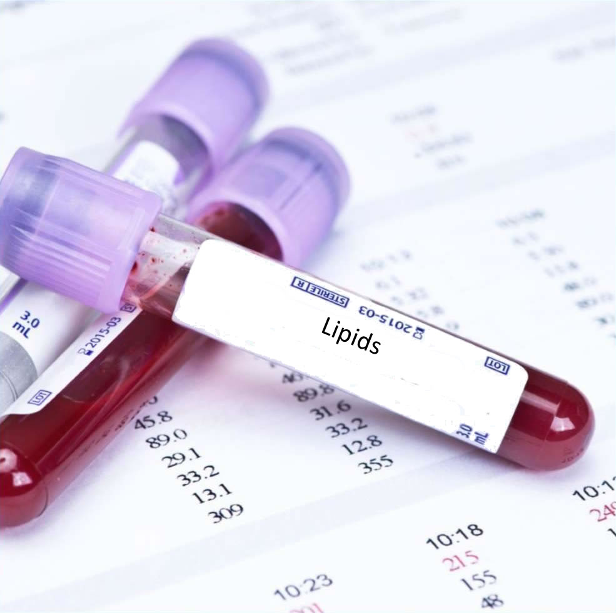
Understanding Blood Lipids and Their Relationship to Health
Mark Pettus MD
Medical Director Functional Formularies
Director Medical Education, Wellness and Population Health
Berkshire Health Systems

Slide 2
Learning Objectives
Understand the shortcomings of the diet-heart hypothesis from contemporary nutritional intervention evidence for lipid management and cardiovascular disease risk reduction.
Understand the macronutrient-micronutrient influencers on lipids, cardiovascular health and disease.
Consider lipids as part of a broader metabolic landscape with many contributors to cardiovascular risk i.e., inflammation; HPA axis; gut-barrier integrity; insulin resistance; mitochondrial function

Slide 3
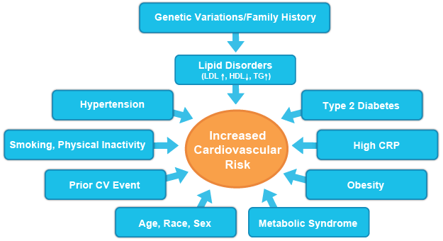

Slide 4
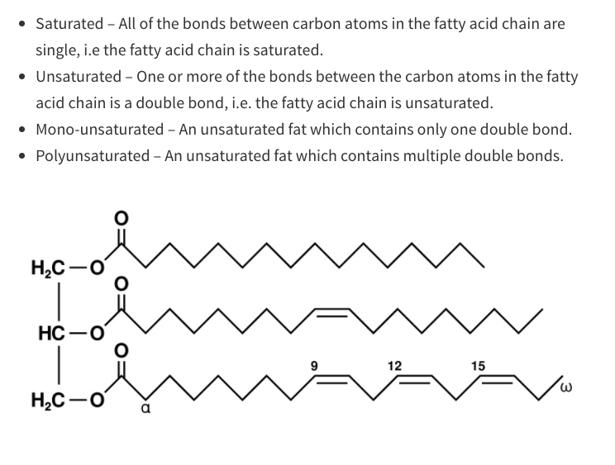

Slide 6
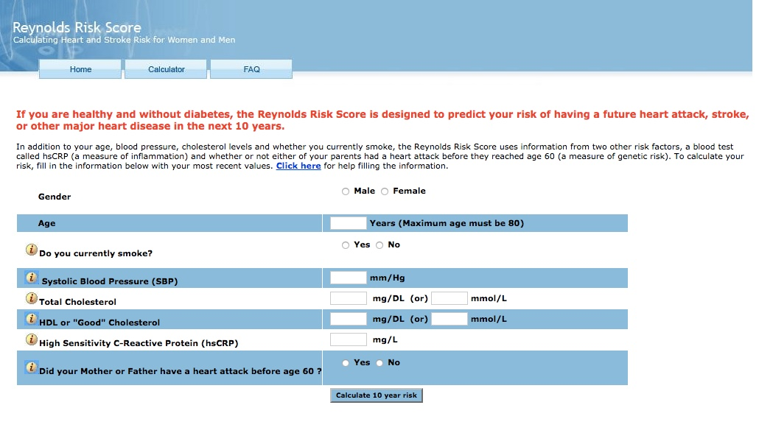

Slide 14
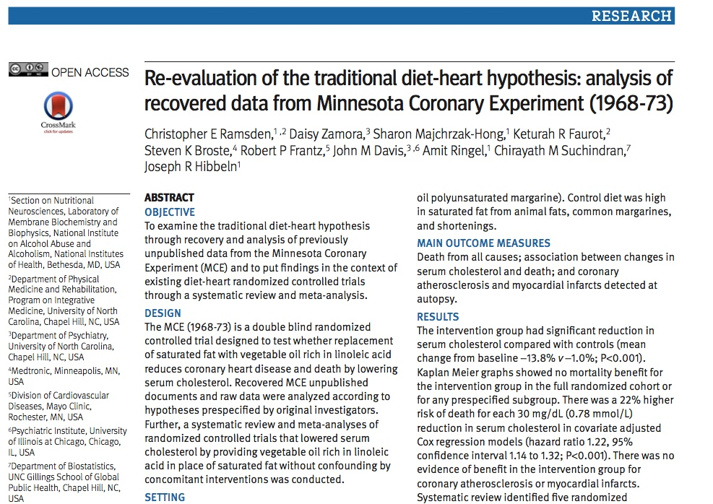

Slide 16
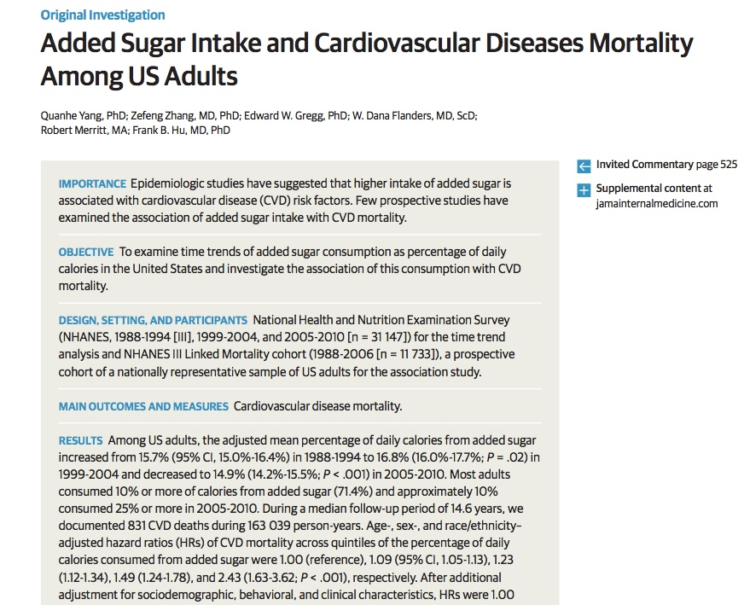

Slide 17
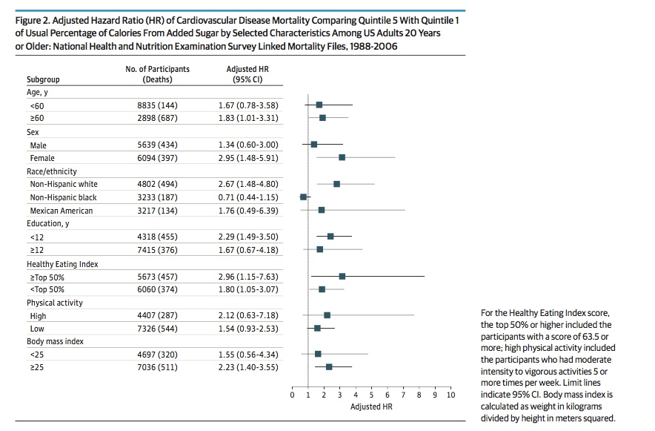

Slide 18
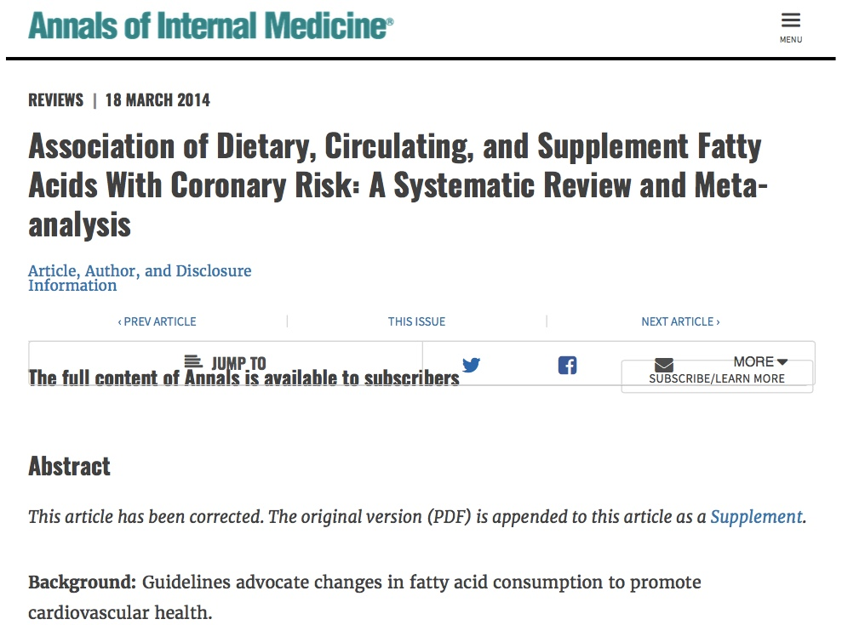
32 observational studies and 27 RCTs
“Current evidence does not support cardiovascular guidelines that encourage high consumption of polyunsaturated fatty acids and low consumption of saturated fats.”

Slide 19
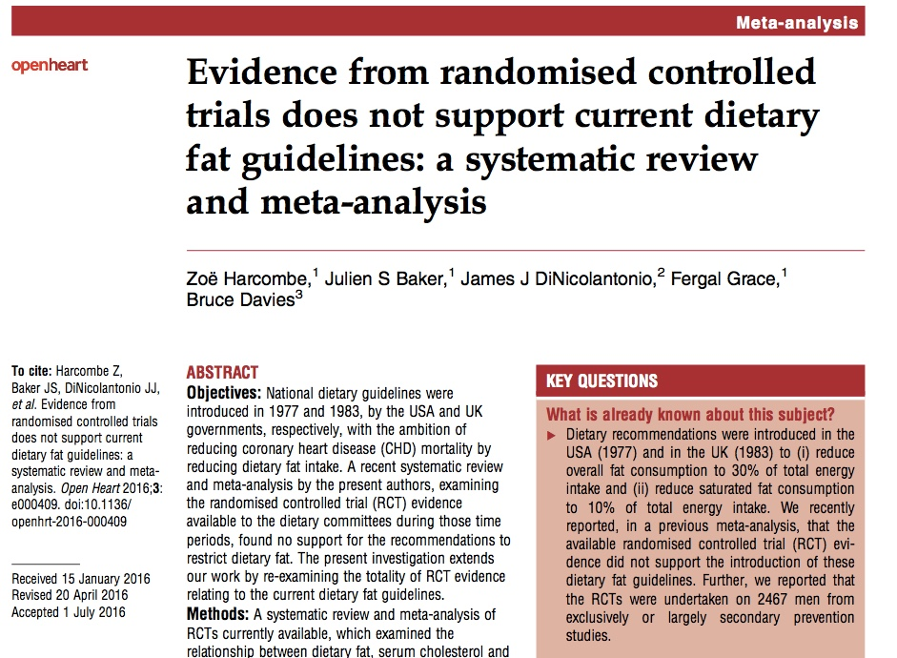
“RCT evidence currently available does not support the current recommendations to restrict dietary fat. “

Slide 20
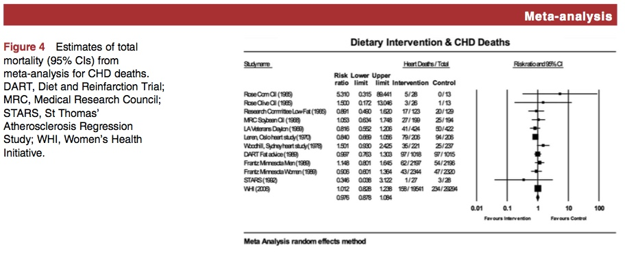

Slide 23
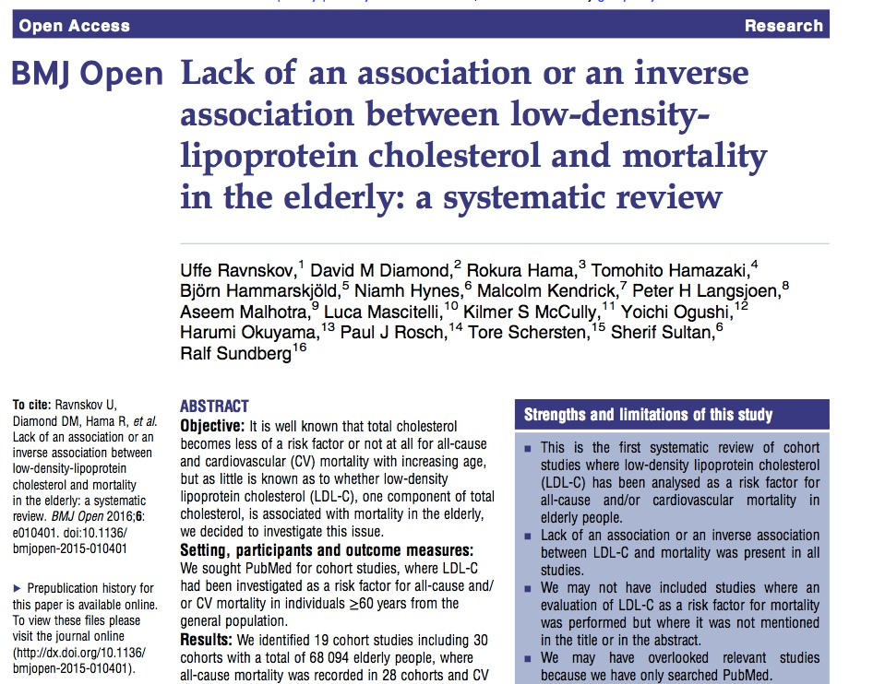
Conclusions: High LDL-c is inversely associated with mortality in most people over 60 years. This finding is inconsistent with the cholesterol hypothesis. Since elderly people with high LDL-c live as long or longer than people with lower LDL-c, our analysis provides sufficient evidence to question the cholesterol hypothesis. Moreover our study provides the rationale for a re-evaluation of guidelines recommending pharmacological lowering of cholesterol as central to CVD risk reduction.

Slide 28
HDL predicts CVD risk independent of LDL

Slide 29
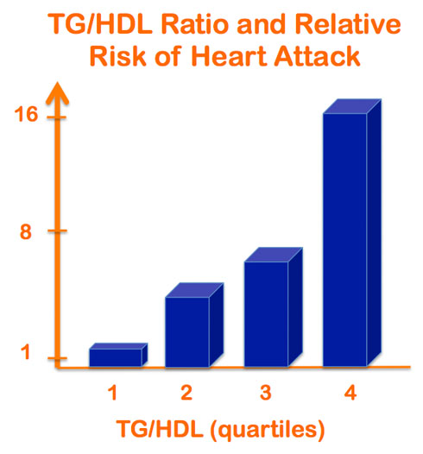

Slide 31
Westman, E et al. Nutrition 31 (2015) 1-13

Slide 32
Westman, E et al. Nutrition 31 (2015) 1-13

Slide 34
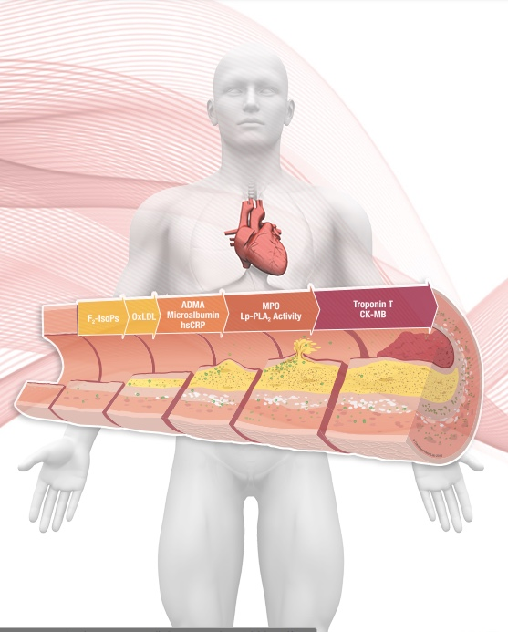
Biomarkers
hsCRP an acute-phase protein released into the blood by the liver during inflammation, which has been associated with the presence of heart disease
F2-Isoprostanes prostaglandin-like compounds formed from the free radical-mediated oxidation of arachidonic acid
Oxidized LDL measures protein damage due to the oxidative modification of the ApoB subunit on LDL cholesterol.

Slide 35
Biomarkers
Lp-PLA2 an acute phase reactant. When disease is active in the artery, increased levels of Lp-PLA2 are produced by macrophages and foam cells within the intima of the artery.
ADMA/SDMA ADMA (asymmetric dimethylarginine) and SDMA (symmetric dimethylarginine), its structural isomer, are metabolites of L-arginine, an amino acid that is catalyzed to L-citrulline and NO by nitric oxide synthase (NOS)

Slide 36
Biomarkers
Microalbumin can be used to identify microvascular endothelial dysfunction.
Myeloperoxidase (MPO) a white blood cell-derived inflammatory enzyme and measures disease activity from the luminal aspect of the arterial wall.
Apolipoprotein B (ApoB) and A1 (ApoA1) ApoB is the primary apolipoprotein found on the surface of LDL (the carrier of “bad” cholesterol). ApoA1 is the major apolipoprotein of HDL

Slide 37
Biomarkers
Small-Dense LDL (sdLDL) sdLDL is more easily oxidized, has a higher affinity for vessel walls, and remains in the circulation longer because it is less likely to be cleared by the liver, making it more atherogenic than larger LDL particles.
Lipoprotein (a) (Lp(a)) Lp(a) is a plasma lipoprotein consisting of a cholesterol-rich LDL particle attached to an additional apolipoprotein called apo(a). Lp(a) levels are genetically determined and not affected by changes in lifestyle.

Slide 38
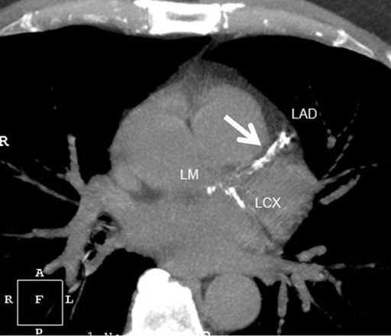
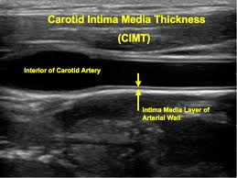
Biomarkers
Coronary Calcium Score
Carotid Intimal Medial Thickness (CIMT)

Slide 39
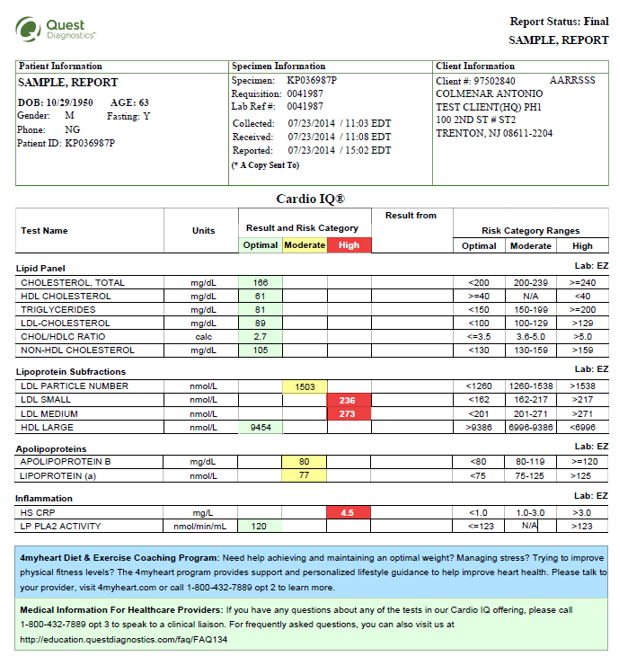

Slide 43
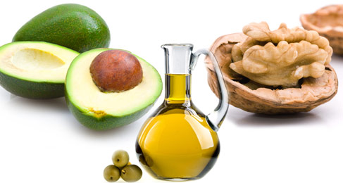
More quality fat sources
Pasture-raised eggs
Fatty fish e.g. salmon, sardines, anchovies, mackeral, trout
Grass-fed butter; ghee
Whole fat dairy, yogurt
Extra virgin olive oil
Extra virgin coconut oil
Avocados, olives
Nuts - almonds, macadamia, walnuts

Slide 45
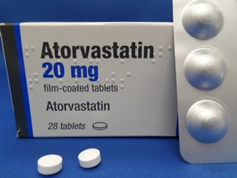
Statins
Greatest risk reduction in secondary prevention trials
? Anti-inflammatory effects, independent of LDL lowering
Variable and under-reported side effects e.g. muscle aches, activity intolerance, changes in cognition, insulin resistance
No effects on TGAs; modest reductions in HDL

Slide 46
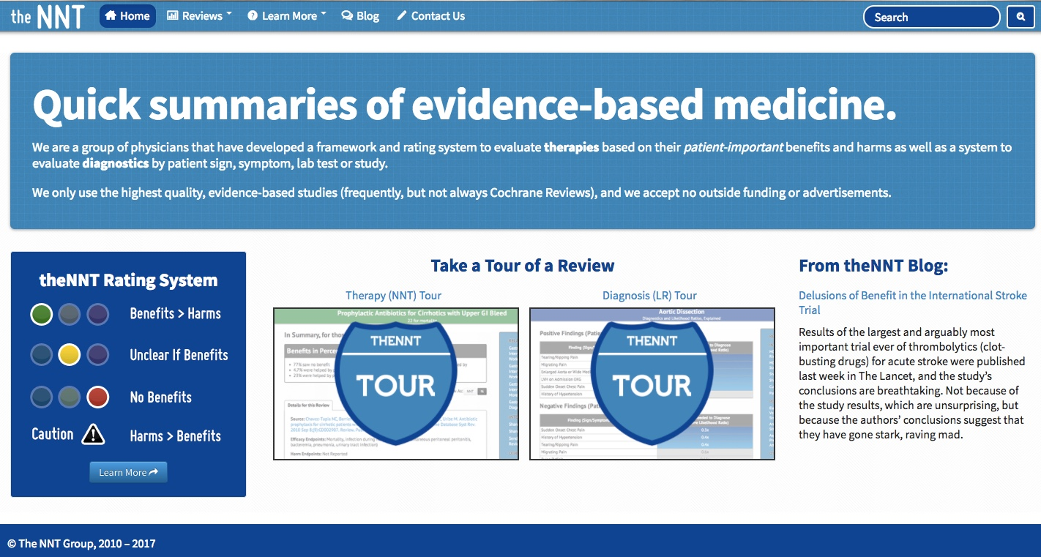

Slide 47
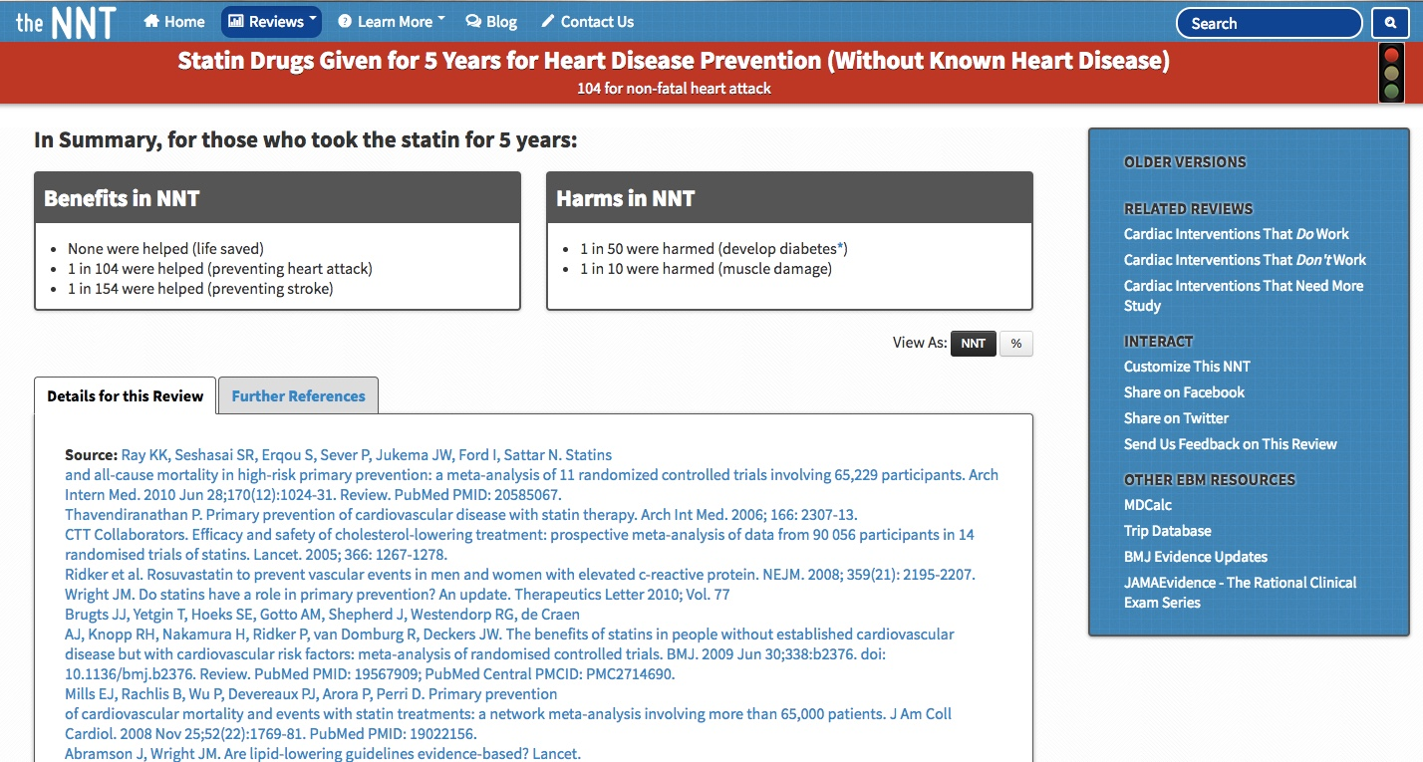

Slide 48
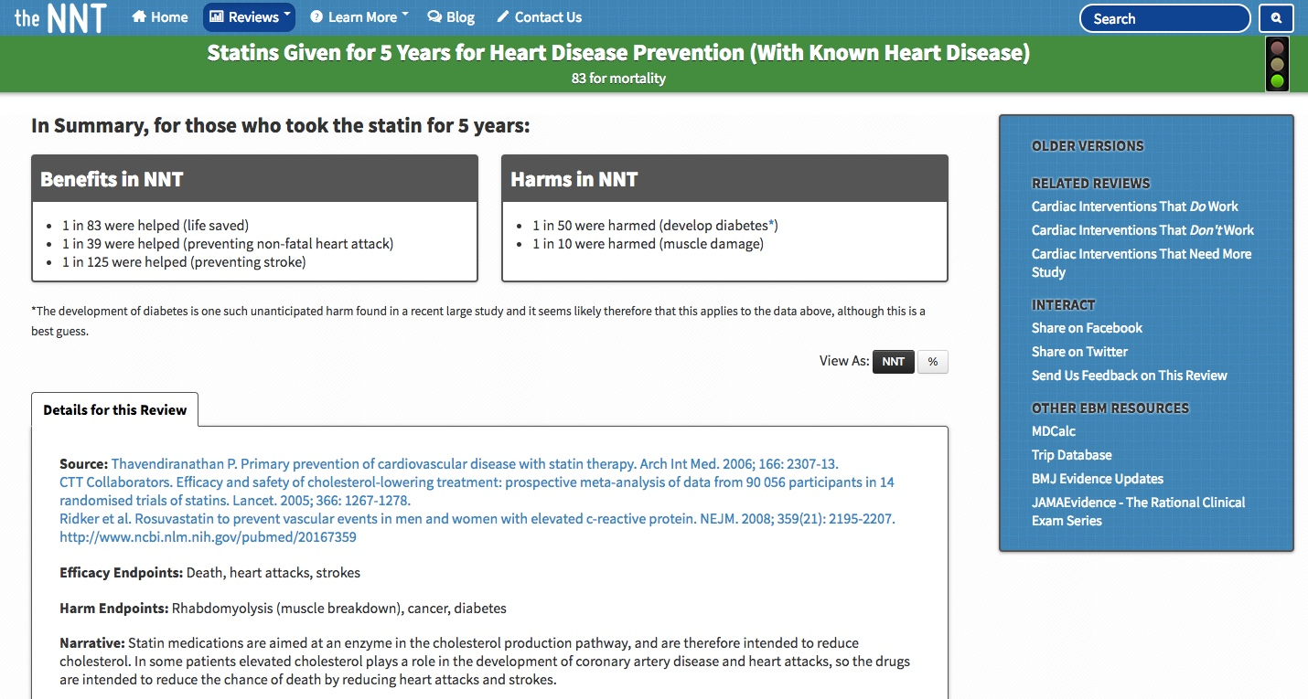

Slide 49
Summary
Lipid profile sufficient for most as an initial screen
For CVD risk 10+% over 10 years or consideration of statin Rx, recommend lipid sub-fractions: Ion Mobility Cardio IQ testing to include other biomarkers.
Repeat testing in 12 weeks after dietary-lifestyle changes
hsCRP; HbA1c; HOMA-IR score very helpful
Goal TGA/HDL <2; HOMA < 2.5; HbA1c < 5.7; hsCRP <1
Reduce-eliminate sugar, refined flour foods
More abundant healthier fats; butyrate and vitamin K2 in dairy fat
Reduce processed seed-based omega 6 vegetable oils
Plant-based fiber –MACs
Phytonutrient-dense foods to reduce inflammation; improve insulin sensitivity
Anti-inflammatory Lifestyle interventions

Slide 50
Thank You!

