Slide 1
DNA is Not Your Destiny:
Can you improve the cards you are holding?
Mark C. Pettus MD
April 29, 2017
Director Medical Education and Population Health
Berkshire Health Systems
Clinical Associate Professor of Medicine
University of Massachusetts Medical School

Slide 2
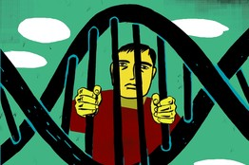
“It’s not what we don’t know that gets us into trouble. It’s what we know that ain’t so.”
Will Rogers
So what do we know that ain’t so?
There’s not much I can do about my DNA!

Slide 3
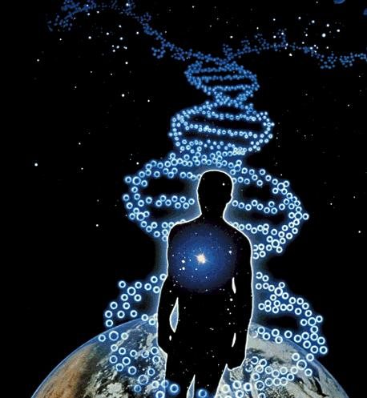
Epigenetics: Connecting the macro to the molecular

Slide 4
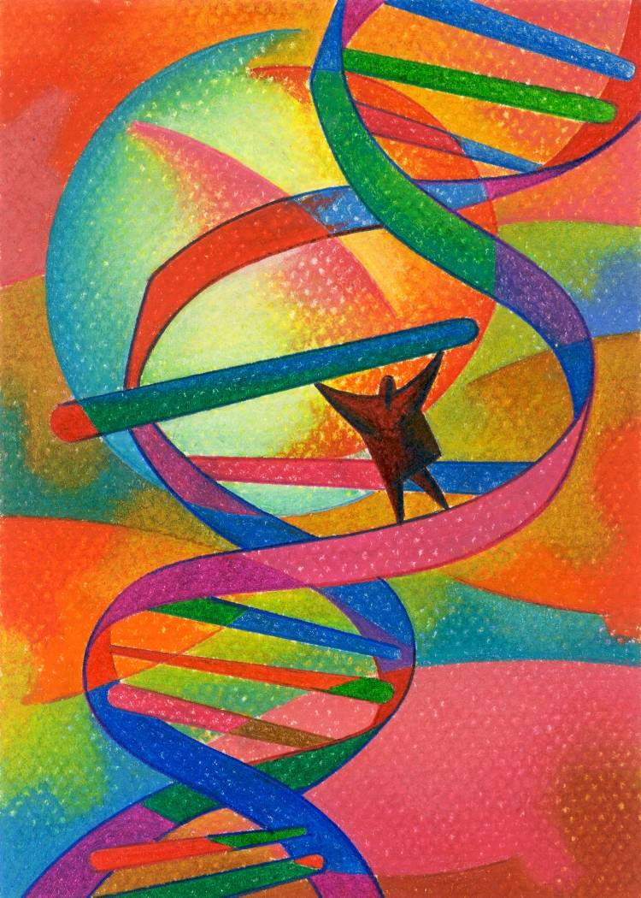
Learning Objectives
Explore the emerging science of epigenetics i.e., “how the outside gets inside”
Review some examples of epigenetics as expressed through food, movement, connection, and mindfulness.
Take away 5 accessible lifestyle strategies for creating and maintaining optimal health by “upgrading” your gene expression

Slide 5
Environment
Life
Epigenome
Microbiome
Consciousness-Spirit

Slide 6
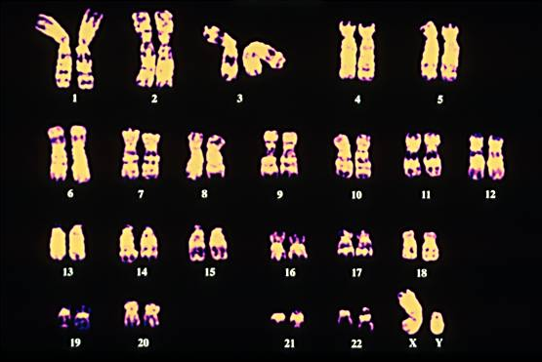
Your “Book of Life” in 23 Chapters

Slide 7
What have we learned from the human genome project?
The genome has far fewer genes than expected ~ 23k
The variation of the genes is far greater than expected with 3 million SNPs
There are only a small number specific “disease genes”.
Our phenotype results from genes and environment that work through our epigenome, nature via nurture

Slide 8
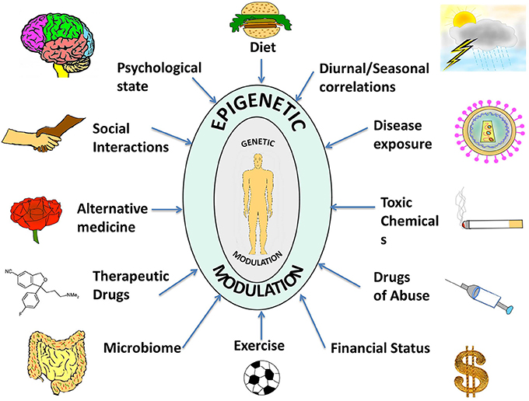

Slide 9
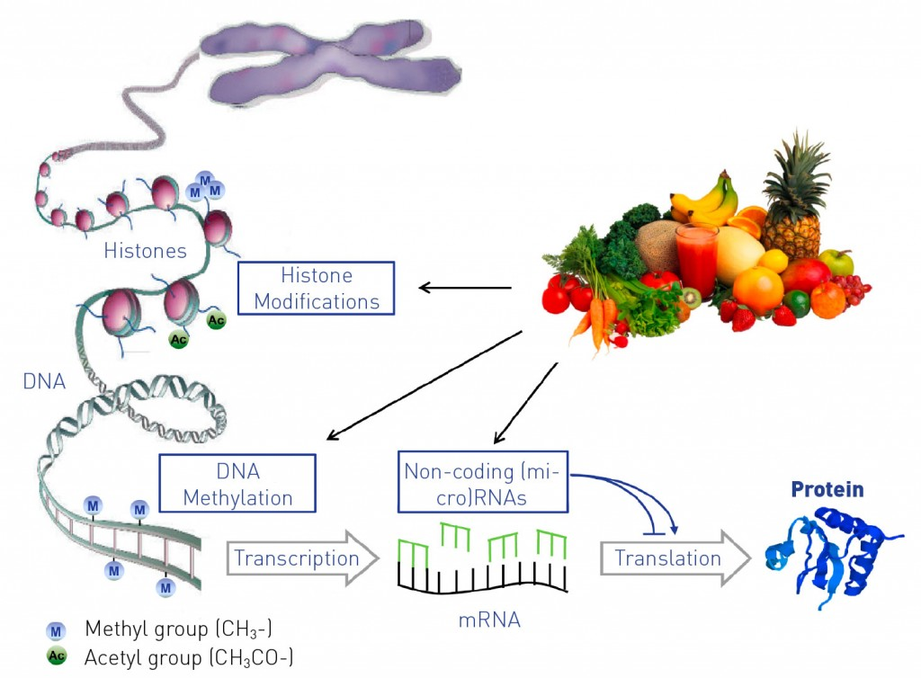
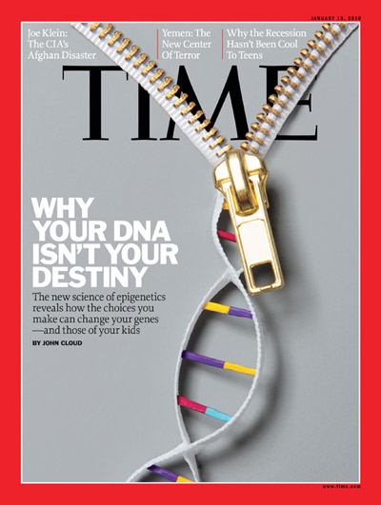

Slide 10
Integrative Medicine
Systems Biology Model
Disease (how things appear)
Pre-diabetes, Diabetes, Obesity, Metabolic Syndrome, Heart Disease, Stroke, Depression, Autoimmunity, Alzheimer’s, Cancer, Fibromyalgia, Chronic fatigue
ADDHD, Autism spectrum
Core Metabolic Imbalances (what drives them) Gut Barrier Function
Inflammation and oxidative stress
Stress HPA Axis (fight-flight)
Mitochondria-Bioenergetics
Insulin Resistance
Root Causes (what are their origins)
Microbiome-Gene-Epigenome-Environment
Nutrition Movement Stress Response Environmental toxins Sleep Social Connection Trauma Conflict Management Mindfulness Spirituality-Meaning in Work, Love, Play
Social determinants

Slide 11
Health as a byproduct of gene-environment compatibility

Slide 12
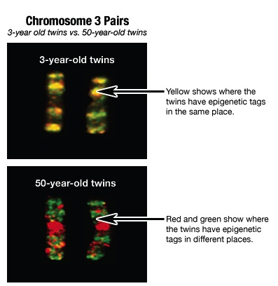
While genes of identical twins may be the same, their epigenome changes throughout life.

Slide 13
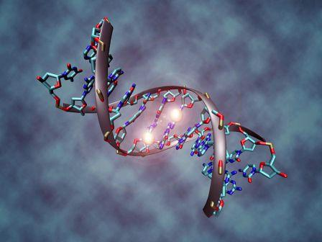
Representative Clinical Conditions Suggested to Have Epigenetic Origins
Obesity
Type 2 DM and Metabolic Syndrome
Coronary artery disease
Autoimmune Diseases
Cancer
Allergic Disorders
Depression
Neurologic: Alzheimer’s, PD, ALS, Autism

Slide 15
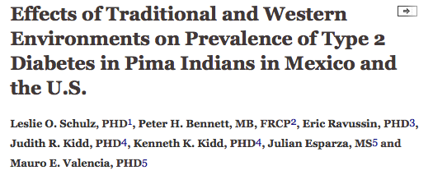
Prevalence of type 2 DM 5 times higher in Arizona Pima’s compared to Mexican Pima’s.
Diabetes Care August 2006 vol. 29 no. 8 1866-1871

Slide 16
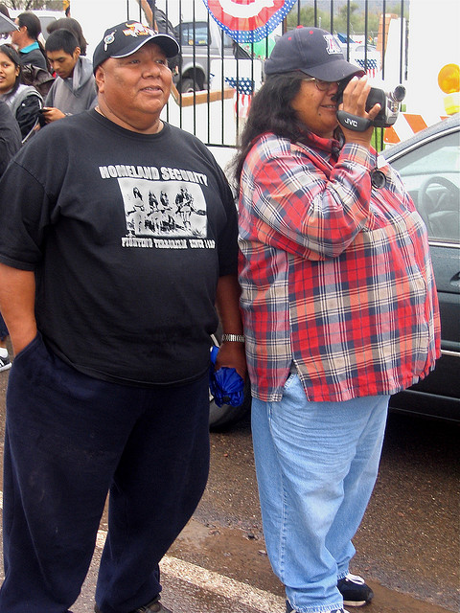

Slide 20
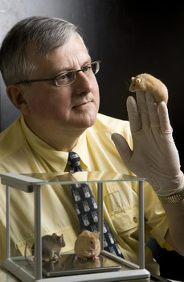
Nutritional Epigenetics
Randy Jirtle PhD
Relationship between nutrition, methylation and gene expression
Protection against BPA toxicity in nutrient-methylation models

Slide 22
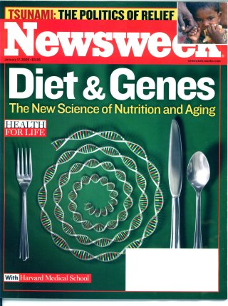

Slide 23
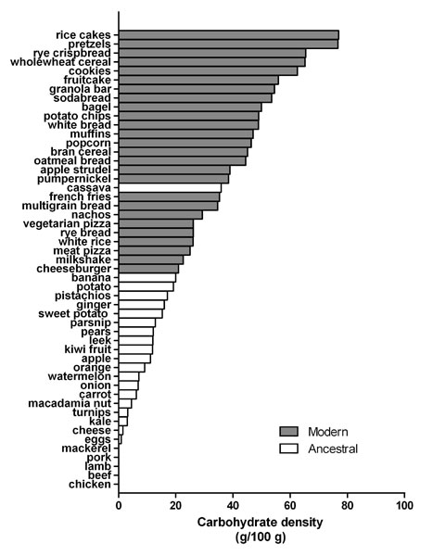
Reduce acellular carbohydrate-dense foods
Major contributor of obesity, insulin resistance, dyslipidemia, inflammation, and alterations of the human microbiome
A huge area of opportunity in individuals with increased visceral fat, pre-diabetes or diabetes…these are phenotypes of carbohydrate intolerance.
For most, sugar and refined, grain-based foods are problematic: eliminate and observe.
Ian Spreadbury Diabetes, Metabolic Syndrome and Obesity Dove Press 2012

Slide 24
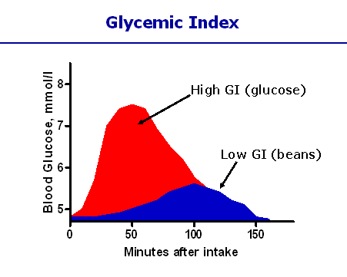
Different carbohydrates produce unique genomic responses!
High Glycemic Carbs Low Glycemic Carbs
62 genes regulating Same genes turned off;
Inflammation, stress, Genes regulating same insulin signaling production turned off. gene responses activated.
Kalle et al. Am J Clin Nutr;2007:851:1417-27

Slide 27
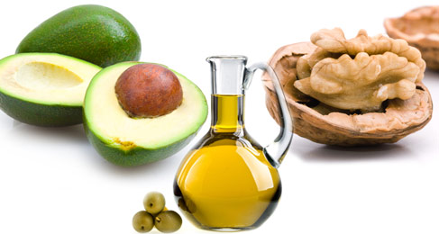
More quality fat sources
Pasture-raised eggs
Fatty fish e.g. salmon, sardines, mackeral
Grass-fed butter
Ghee
Whole fat yogurt, kefir
Extra virgin olive oil
Extra virgin coconut oil
Avocados, olives
Nuts - almonds, macademia, walnuts

Slide 28
Take care of your microbiome
An emerging major contributor to human health and disease
Be prudent with antibiotics; GMOs and glyphosate
Prebiotics are critical: Plant-based fiber produces butyric acid from bacterial fermentation
Probiotics for some
Feed-lot beef, poultry with antibiotic residues

Slide 29
Michael Skinner PhD
Transgenerational Epigenomics
“The ability of environmental factors to promote a disease state not only for the individual but also subsequent progeny for successive generations is termed transgenerational inheritance.”
“Epigenetic changes in methylation of the genome of germ cells after specific environmental toxin exposure that become permanently programmed allow transmission of epigenetic transgenerational phenotypes.
M Skinner Scientific American 2013

Slide 30
Environmental Programming of Gene Activity- Bonding
Glucocorticoid Receptor Gene
Child Abuse
Bonding
GR Gene
GR Gene
GR Receptors
GR Receptors
Stress Response
Stress Response
McGowan PO, Sasaki A, D’Alessio AC, Dymov S, Labonte B, Szyf M, Turecki G, Meaney MJ. Epigenetic regulation of the glucocorticoid receptor in human brain associates with childhood abuse. Nat Neurosci. 2009;12(3):342-348.

Slide 31
Conclusions
“These data provide first evidence in humans supporting the conclusion that PNMS results in a lasting, broad, and functionally organized DNA methylation signature in several tissues in offspring. We can infer that the epigenetic effects found in Project Ice Storm are due to objective levels of hardship experienced by the pregnant women.”

Slide 32
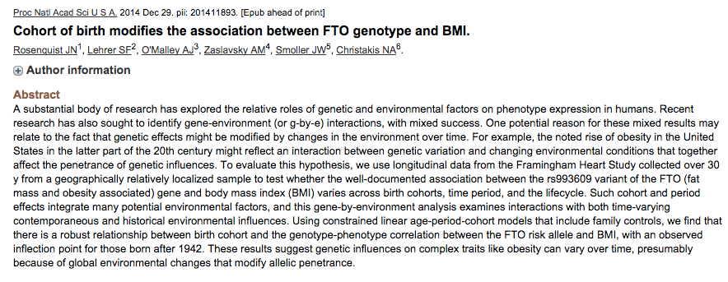
FTO genotype did not predict obesity in people born before 1942
Higher risk when born after 1972
Greatest risk when born after 2000
As it turns out, it’s not just about who you are but in addition, when you are!

Slide 34
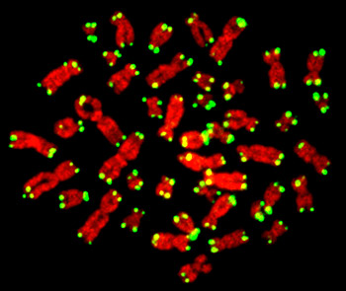

Slide 36
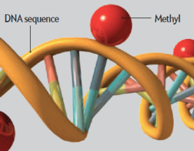
MBSR and Reduction in Inflammatory Biomarkers
Several randomized controlled trials demonstrating alterations in gene expression of NFkB, IL-6 with meditation compared to controls (Benson et al)
Increased expression of telomerase and maintenance
of telomere length (Blackburn and Ornish)
Treatment group scored better on emotional wellness
C-reactive protein reduced

Slide 37
Motion is the lotion !

Slide 38
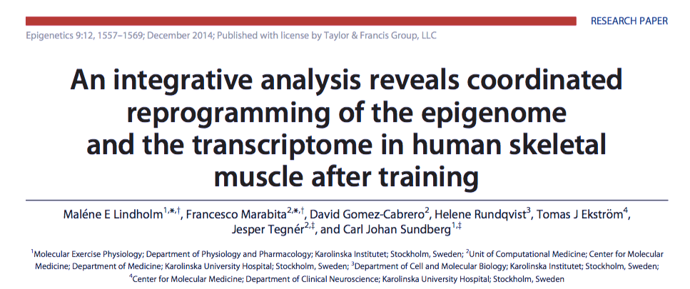
Examined methylation patterns in skeletal muscle of sedentary men and women before and after 45 minutes of moderate-intense exercise.
Methylation patterns changed significantly in genes coding for PPAR gamma, NfΚB and IL-6
Suggestive of more favorable gene expression patterns as they relate to inflammation and insulin signaling.
Lindholm et al. Epigenetics December 2014

Slide 39
A Script for Epigenetic Health
Whole foods with reductions in sugar, refined grain-based flour, acellular carbohydrate dense foods
More healthy fats e.g. olive oil, coconut oil, nuts, avocados, butter, fatty fish, eggs (yolks are best)
Plant-based fiber for the microbiome
Cruciferous, allium, berries great for detoxification
Elimination trial e.g. gluten, grains, casein
Liberal outdoor, full-spectrum light exposure
Motion is the lotion!
Stress management e.g. yoga, tai chi, music, breath, meditation
Connection with others: we are born to bond !
Notes:
(Stephanie Senef PhD: Entropy 2012, 14, 2265-2290; doi:10.3390/e14112265) GMO

Slide 40
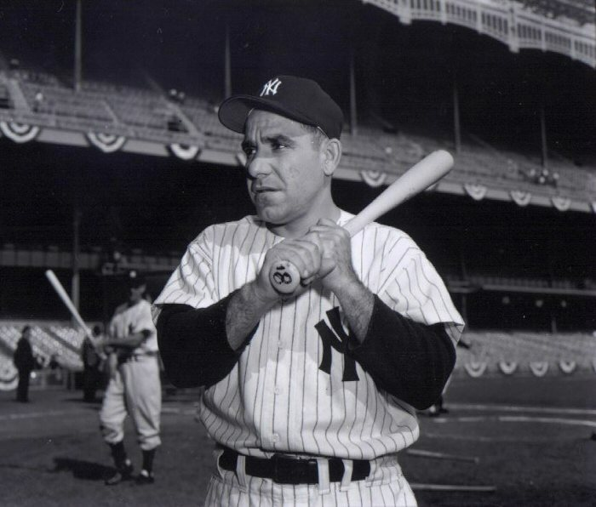
“The future ain’t what it used to be.”
Yogi Berra

Slide 41
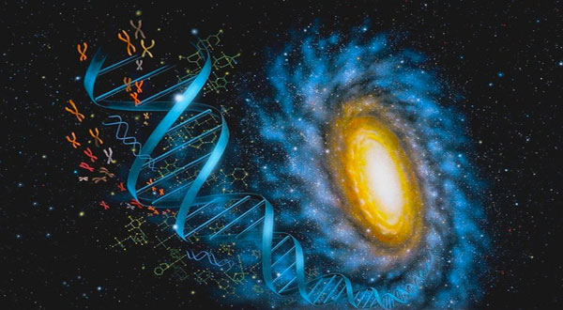
Thank You
www.thehealthedgepodcast.com

Slide 42
10: Consider Organic for the Dirty Dozen and go to town with the Clean 15

Slide 43
4: Sleep Hygiene
Loss of entrainment as a major contributor to disease risk and diminished quality of life
Circadian genes
Maximally darkened room for sex and sleep
Consistent timing
Filter blue light after sundown (f•lux); orange lens glasses
Cooler temp - 64°
No caffeine after 2p
Avoid late night dining-snacking

Slide 44
Motion is the Lotion
Walk continuously
Be efficient with exercise dose-response e.g. small doses of HIT, functional resistance with emphasis on core. PAI-Physical Activity Intelligence
Dance to the music you love!
The Holy Grail from a disease risk-reduction perspective
Prolonged sitting is dangerous and not “undone” with regular exercise
Improved mood, resilience, less pain, less inflammation, improved insulin sensitivity, decreased anxiety

Slide 45
Embracing the moment you are in: The Power of the Breath
Mindfulness practices powerfully proven to reduce disease risk
Epigenetic effects shown to reduce inflammation, improve insulin sensitivity
Improved mood, resilience, reduced anxiety
Improved performance, creativity and problem-solving capacity
MBSR, meditation, prayer, yoga, journaling, tai chi

Slide 46
6: Play Outdoors (and don’t be afraid of dirt)
Loss of circadian entrainment associated with a host chronic health challenges and quality of life.
Full spectrum light exposure associated with a host of health benefits including improved mood, pain reduction, diminished inflammation, and greater health resiliency.
Connection between soil and human microbiome

Slide 47
7: Social Connection and Health
From an evolutionary biologic perspective we are born to bond
Reduced stress states
Improved coping and resiliency
Reductions in disease risk
Greater longevity and quality of life

