Slide 1


Slide 2
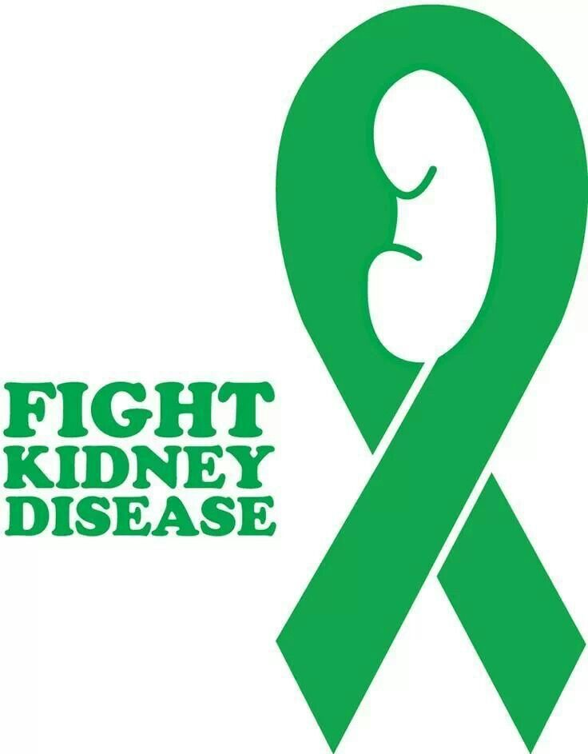

Slide 3

Breast Cancer Prevention and Management: Lifestyle and Metabolic Considerations
Mark Pettus MD
Director Medical Education, Wellness and Population Health
Berkshire Health Systems

Slide 4
Disclosures
Consultant for Functional Formularies
Consultant for DPV Ventures-Novalux Lighting technologies

Slide 5
Learning objectives
Examine breast cancer as a metabolic disease i.e., how what happens outside the nucleus impacts what happens inside the nucleus
Review the research associating weight, inflammation and insulin resistance (oncometabolic microenvironment) with breast cancer risk-prognosis
Review the epidemiology of vitamin D and breast cancer risk-prognosis
Review Lifestyle considerations in breast cancer risk reduction and management

Slide 6
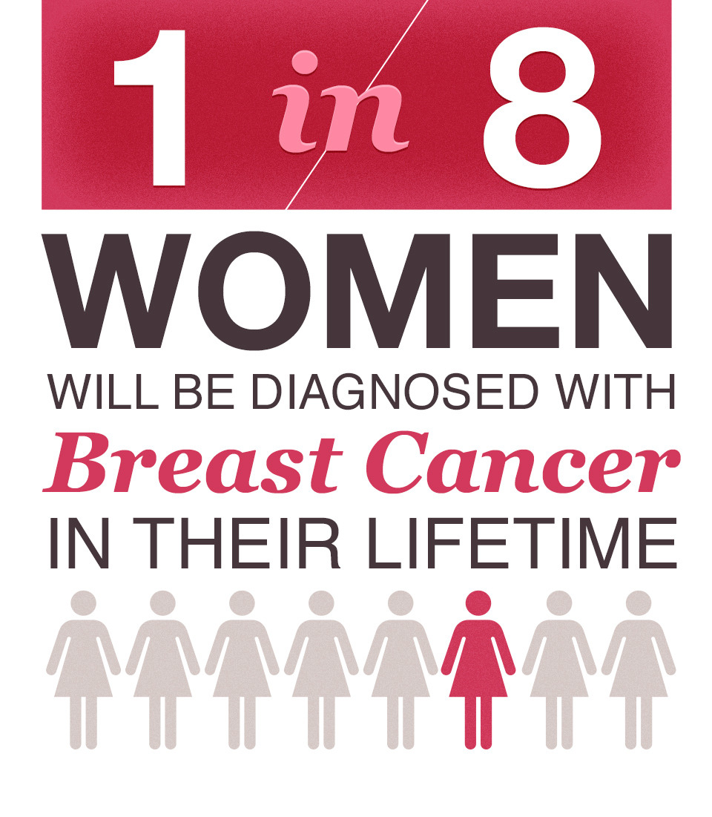
Cancer as a modifiable chronic disease

Slide 7
Is is possible to modulate these metabolic signaling pathways through lifestyle?
Notes:
mTOR/PI3K/Akt are intracellular signalling pathways that regulate the cell cycle
HIF – Hypoxia induced factor
5' AMP-activated protein kinase or AMPK or 5' adenosine monophosphate-activated protein kinase is an enzyme (EC 2.7.11.31) that plays a role in cellular energy homeostasis.

Slide 8
Environmental Inputs
Poor Nutrition (SAD)
Smoking
Lack of Movement
Chronic Stress Response
Poor Sleep Hygiene
Social Isolation
Meaning in work, love, play
Environmental Toxins
Full-spectrum light (nature) deprivation
Weight
Inflammation
Insulin
Resistance
Notes:
Endocrine disruptors tied to 300billion in annual healthcare costs
Organophophate disruptors; glyphosate; BPA; pthalates; PTFO flame retardants

Slide 9
Obesity and Cancer Risk Mechanisms
Insulin resistance and proinflammatory mediators
Increased oxidative stress
Adipokine upregulation e.g. inflammatory cytokines
Aromatase and estrogen
Alterations of apoptosis, cell proliferation, angiogenesis
Annu Rev Med. 2015;66:297-309. Obesity and cancer: local and systemic mechanisms
Horm Mol Biol Clin Investig. 2015 Jan;21(1):57-74.
Adipose tissue, obesity and adipokines: role in cancer promotion
Physiol Rev. 2015 Jul;95(3):727-48.
Obesity and Diabetes: The Increased Risk of Cancer and Cancer-Related Mortality.
Gallagher EJ, LeRoith D Author information: Icahn School of Medicine at Mount Sinai, New York

Slide 11
Up to 6% all cancers worldwide directly attributable to weight after correcting for other risk factors. In U.S> 8.5-12.5% !

Slide 12
J Natl Cancer Inst. 2015 Mar 10;107(2). pii: djv088.
Adult weight gain and adiposity-related cancers: a dose-response meta-analysis of prospective observational studies. Keum N, Greenwood DC, Lee DH, Kim R, Aune D
Author information: Departments of Nutrition and Epidemiology (NK, DHL, FBH, ELG) and Department
of Social and Behavioral Sciences (RK), Harvard School of Public Health, Boston, MA; Division of Biostatistics, University of Leeds, Leeds, UK
RESULTS: A total of 50 studies were included. For each 5 kg increase in adult weight gain, the summary relative risk was 1.11 (95% CI = 1.08 to 1.13) for postmenopausal breast cancer. Among low-hormone replacement therapy (HRT) users, 1.39 (95% CI = 1.29 to 1.49)

Slide 13
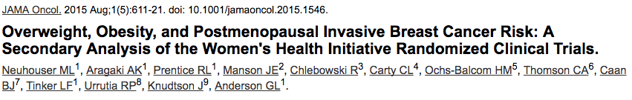
A BMI of 35.0 or higher was strongly associated with risk for estrogen receptor–positive and progesterone receptor–positive breast cancers (HR, 1.86; 95% CI, 1.60-2.17) but was not associated with estrogen receptor–negative cancers. Obesity grade 2 plus 3 was also associated with advanced disease, including larger tumor size (HR, 2.12; 95% CI, 1.67-2.69; P = .02), positive lymph nodes (HR, 1.89; 95% CI, 1.46-2.45; P = .06), regional and/or distant stage (HR, 1.94; 95% CI, 1.52-2.47; P = .05), and deaths after breast cancer (HR, 2.11; 95% CI, 1.57-2.84; P < .001).

Slide 14
Insulin Resistance
Many studies (epidemiologic and case-controlled) suggest as much as a doubling of breast cancer risk in diabetics, increasing risk with poorer control
Increased mortality and tumor burden
Metformin shown to have benefit in many studies
Eur J Intern Med. 2016 Oct;34:89-93.
Metabolic syndrome, obesity, and the risk of cancer development.
Bitzur R, Brenner R, Maor E, Antebi M, Ziv-Baran T, Segev S
BMC Cancer. 2016 Oct 10;16(1):785.
Risk factors for cancer development in type 2 diabetes: A retrospective case-control study.
Dąbrowski M, Szymańska-Garbacz E, Miszczyszyn Z, Dereziński T, Czupryniak L
. Panminerva Med. 2015 Sep;57(3):101-8.
Diabetes mellitus is associated with breast cancer: systematic review, meta-analysis, and in silico reproduction.
Zhou Y, Zhang X, Gu C, Xia J.

Slide 15
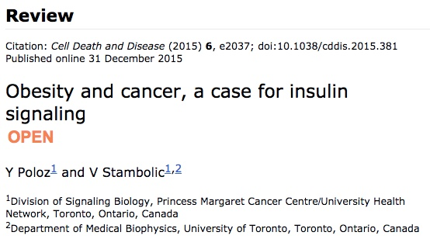

Slide 16
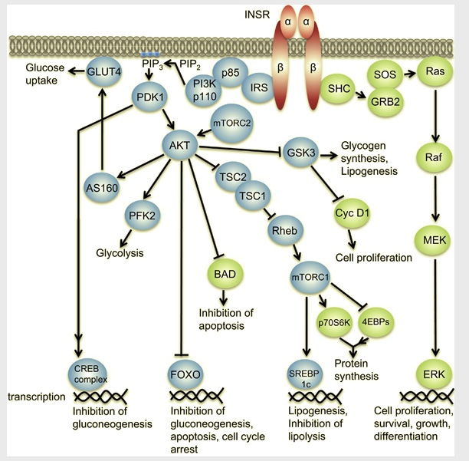
Notes:
AKT-Protein Kinase B

Slide 17
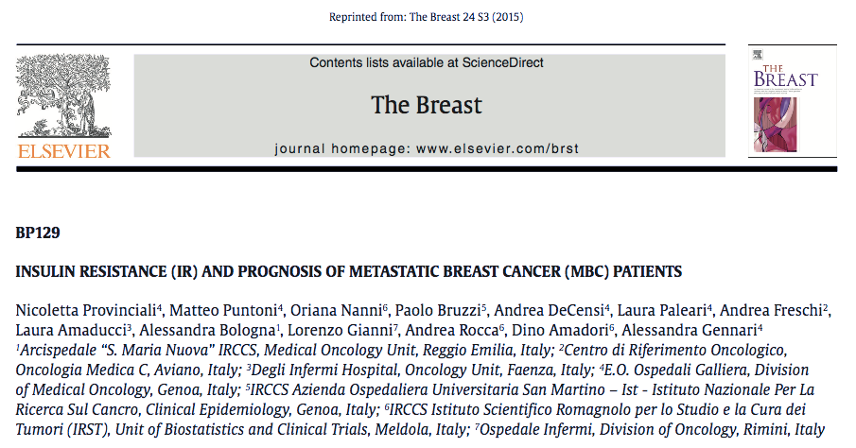
IR status (HOMA Index > 2.5) associated with a worst prognosis (HR=2.28) in women with HER2 negative metastatic disease.

Slide 19
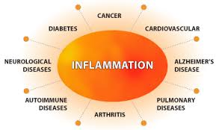
Inflammation
Weak predictor of Breast Cancer Risk in postmenopausal women
Stronger predictor of outcomes, natural history

Slide 20
Biochem Biophys Res Commun. 2016 Apr 8;472(3):401-9.
Current perspectives of molecular pathways involved in chronic inflammation-mediated breast cancer.
Suman S, Sharma PK, Mishra
Author information: Proteomics & Environmental Carcinogenesis Laboratory, Food, Drug and Chemical
Toxicology Group, CSIR-Indian Institute of Toxicology Research, Mahatma Gandhi Marg, India;
Immunomodulation mediated by cytokines, chemokines and several other growth factors present in the tumor microenvironment regulate chronic inflammatory response and alter crosstalk among various signaling pathways such as NF-κB, Nrf-2, JAK-STAT, Akt and MAPKs involved in the progression of breast cancer.
Notes:
JAK-STAT, Protein Kinase B (AKT) cell signaling from extracellular environment-cytoplasm to nucleus in key metabolic processes including glucose metabolism, apoptosis, inflammation, cell proliferation, transcription and cell migration, detoxification, dna-cellular repair processes

Slide 21
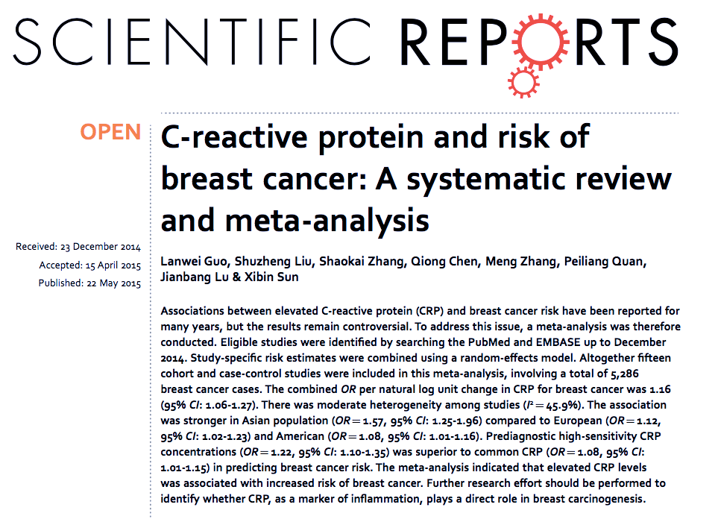
Prediagnostic high-sensitivity CRP concentrations (OR = 1.22, 95% CI: 1.10-1.35) was superior to common CRP (OR = 1.08, 95% CI: 1.01-1.15) in predicting breast cancer risk. The meta-analysis indicated that elevated CRP levels was associated with increased risk of breast cancer

Slide 22
Cancer Epidemiol Biomarkers Prev. 2015 Oct;24(10):1439-49.
Circulating C-Reactive Protein and Breast Cancer Risk-Systematic Literature Review and Meta-analysis of Prospective Cohort Studies. Chan DS, Bandera EV, Greenwood DC, Norat T
Author information: Imperial College London
Twelve out of 15 studies identified were included in the meta-analysis on any breast cancers (3,522 cases; 69,610 women) and nine on postmenopausal breast cancer (2,516 cases; 36,847 women). For each doubling of CRP concentration, a 7% [95%
confidence interval (CI), 2%-12%] and 6% (95% CI, 1%-11%) increased risk was observed

Slide 23
J Natl Cancer Inst. 2015 Jul 16;107(9).
Circulating Adipokines and Inflammatory Markers and Postmenopausal Breast Cancer Risk.
Gunter MJ, Wang T, Cushman M, Xue X, Wassertheil-Smoller S
Author information: Imperial College, London, UK; Albert Einstein College of Medicine, Bronx, NY
RESULTS: The association between plasma CRP levels and breast cancer risk was
dependent on hormone therapy (HT) use at baseline (P interaction = .003). In a
model that controlled for multiple breast cancer risk factors including body mass
index (BMI), estradiol, and insulin, CRP level was positively associated with
breast cancer risk among HT nonusers (hazard ratio for high vs low CRP levels =
1.67, 95% confidence interval = 1.04 to 2.68, P trend = .029). CONCLUSION: These data indicate that CRP is a risk factor for postmenopausal
breast cancer among HT nonusers. Inflammatory mediators, together with insulin
and estrogen, may play a role in the obesity-breast cancer relation.
CONCLUSION: These data indicate that CRP is a risk factor for postmenopausal breast cancer among HT nonusers. Inflammatory mediators, together with insulin and estrogen, may play a role in the obesity-breast cancer relation.

Slide 24
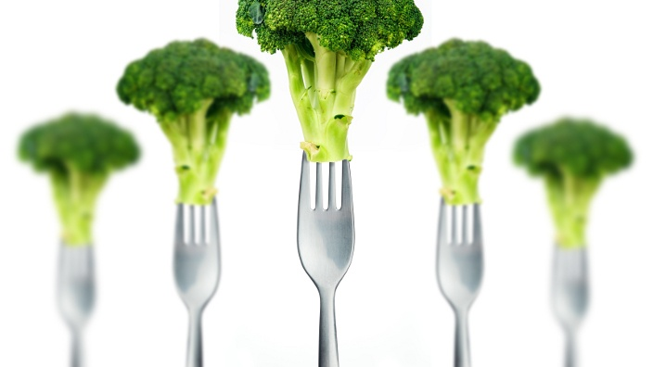
Nutrition

Slide 27
Is there a Rational for concern about poor quality carbohydrates?
If we are focusing on carbohydrates with specific reference to influencing cancer growth then there are at least 4 potential mechanisms worthy of consideration:
The role of glucose as an energy source e.g. ATP via glycolysis – The Warburg effect
The role of glucose as a fundamental building blocks for cell growth e.g. Pentose Phosphate pathway
The role of blood glucose in regulating insulin and its effects as a hormone signal to stimulate growth
Effects of acellular carbs on a pro-inflammatory microbiota

Slide 29
Spreadbury, Diabetes, Obesity and Metabolic Syndrome: Targets and Therapy 2013

Slide 30
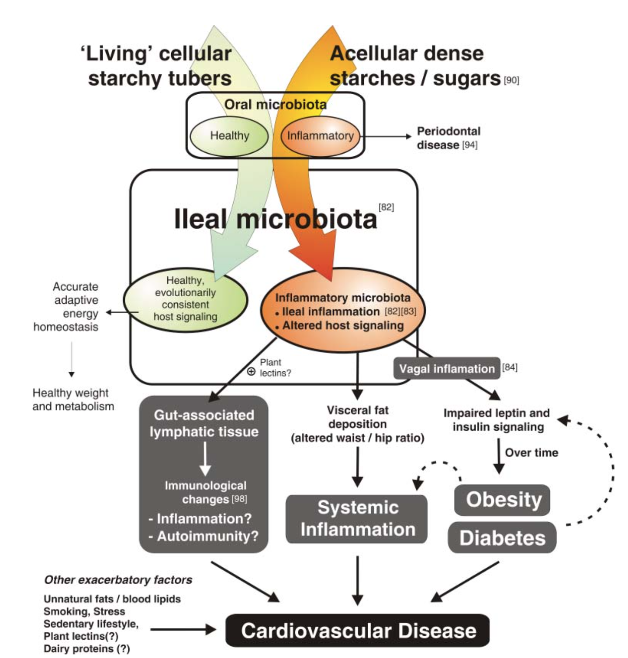
Courtesy Ian Spreadbury PhD
Cancer

Slide 31
Poor Quality Carbs
Acellular carbohydrate density
Inflammation
Stress
Sleep disruption
Altered gut-permeability/microbiome
Social isolation
Toxin excess
Sedentary states
VAT
Excess Insulin
VAT Fat storage-lipogenesis
Down-regulation of insulin receptors
Insulin Resistance
Leptin resistance
Cell regulation and growth

Slide 33
Minimize-avoid sugar and refined starches

Slide 35
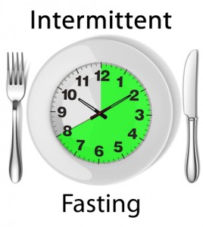
Time-restricted feeding
Time restricted feeding (10-12 hrs) or complete periods of fasting for 24 hrs.
Decreases in body weight and visceral fat
Improved cardiovascular disease risk profile
Decreased inflammation (Biogerontology. 2015 Dec;16(6):775-88)
Upregulated Autophagy (Autophagy, 2014;10:11, 1879-1882)
Notes:
Yoshinori Ohsumi Tokyo Institute Technology

Slide 36
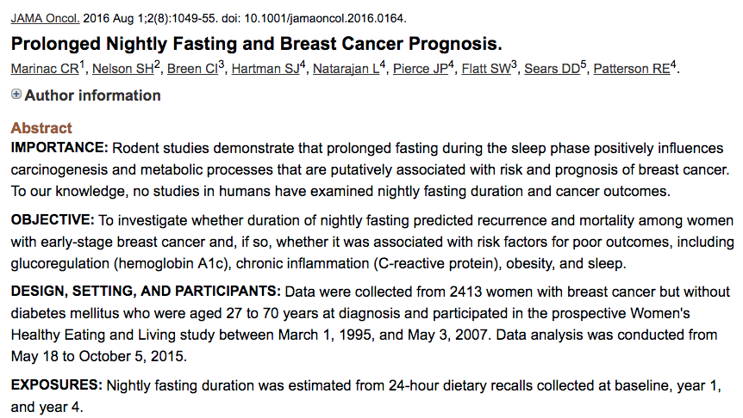

Slide 37
RESULTS:
The cohort of 2413 women (mean [SD] age, 52.4 [8.9] years) reported a mean (SD) fasting duration of 12.5 (1.7) hours per night. In repeated-measures Cox proportional hazards regression models, fasting less than 13 hours per night (lower 2 tertiles of nightly fasting distribution) was associated with an increase in the risk of breast cancer recurrence compared with fasting 13 or more hours per night (hazard ratio, 1.36; 95% CI, 1.05-1.76). Nightly fasting less than 13 hours was not associated with a statistically significant higher risk of breast cancer mortality (hazard ratio, 1.21; 95% CI, 0.91-1.60) or a statistically significant higher risk of all-cause mortality (hazard ratio, 1.22; 95% CI, 0.95-1.56). In multivariable linear regression models, each 2-hour increase in the nightly fasting duration was associated with significantly lower hemoglobin A1c levels (β = -0.37; 95% CI, -0.72 to -0.01) and a longer duration of nighttime sleep (β = 0.20; 95% CI, 0.14-0.26).

Slide 39
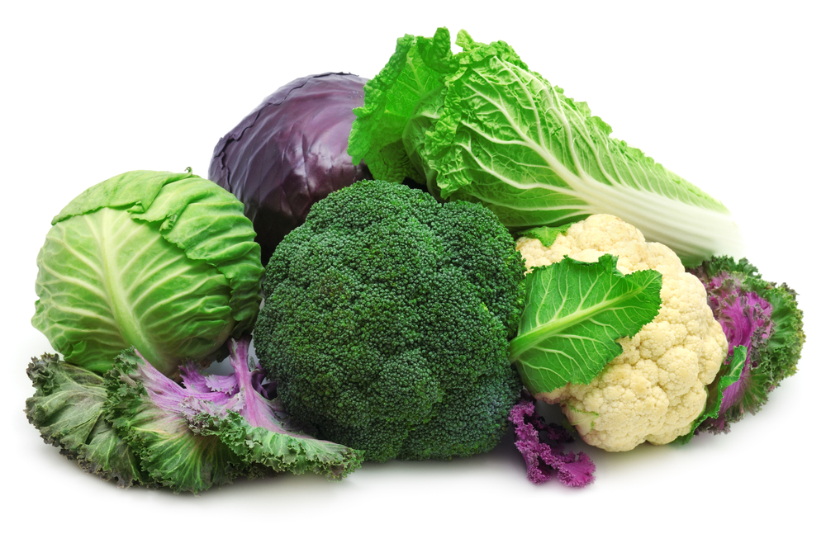
Breast. 2013 Jun;22(3):309-13. Cruciferous vegetables intake is inversely associated with risk of breast cancer: a meta-analysis. Liu X, Lv K.
Author information: Department of Gastrointestinal Surgery, The First Affiliated Hospital, School of Medicine, Zhejiang University, China.
RESULTS: Thirteen epidemiologic studies (11 case-control and 2 cohort studies) were included in the meta-analysis. The combined results from all studies indicated that high cruciferous vegetables intake was significantly associated
with reduced breast cancer risk (RR = 0.85, 95% CI = 0.77-0.94).
Sulfurophanes and isothiocyanates upregulate tumor suppressor genes and promote apoptosis.

Slide 40
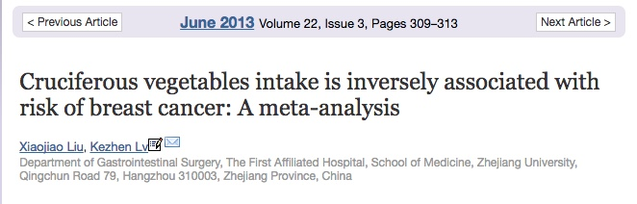
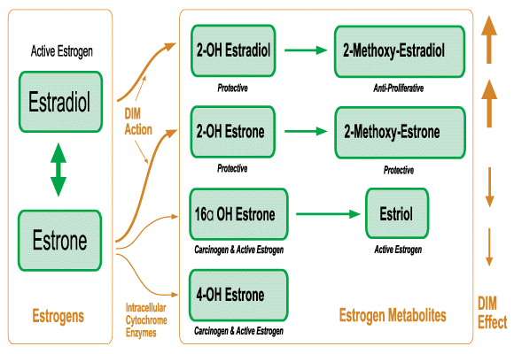

Slide 41
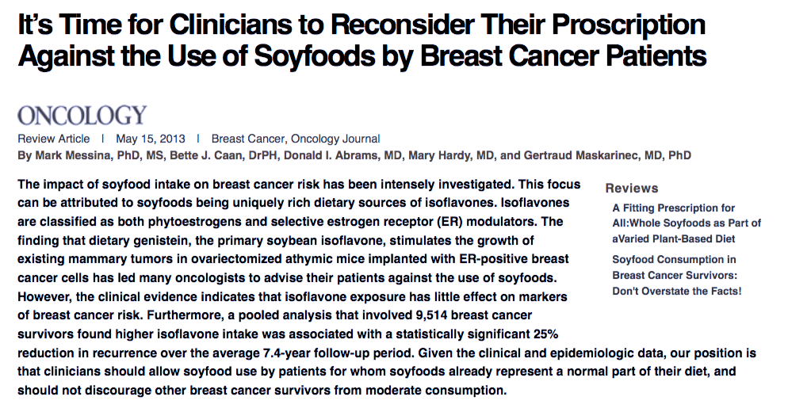
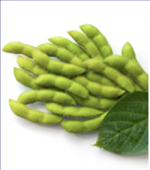

Slide 42
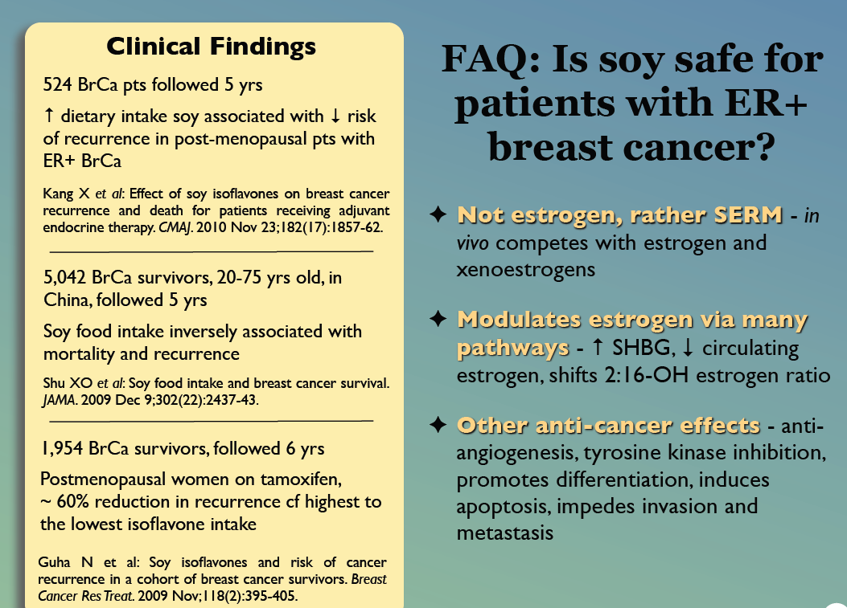

42

Slide 43
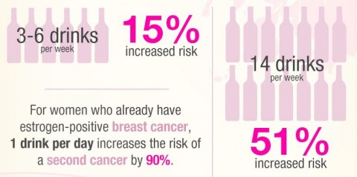
Alcohol and Breast Cancer
Breastcancer.org

Slide 44

Key points from the research
Research from many studies has shown that women with breast cancer are more likely to have low vitamin D levels.
Some research has shown that post-menopausal women who don’t get very much vitamin D may be more likely to develop breast cancer later in life.
Research has shown that women who have breast cancer are more likely to develop bigger tumors and are more likely to have recurrent breast cancer if they have low levels of vitamin D.
Women with higher vitamin D levels are less likely to develop breast cancer and less likely to die from breast cancer.
However, due to limited experimental studies, it’s not possible to say whether low vitamin D levels help cause breast cancer or lead to worse outcomes, and whether or not vitamin D can help to prevent or treat breast cancer.

Slide 45
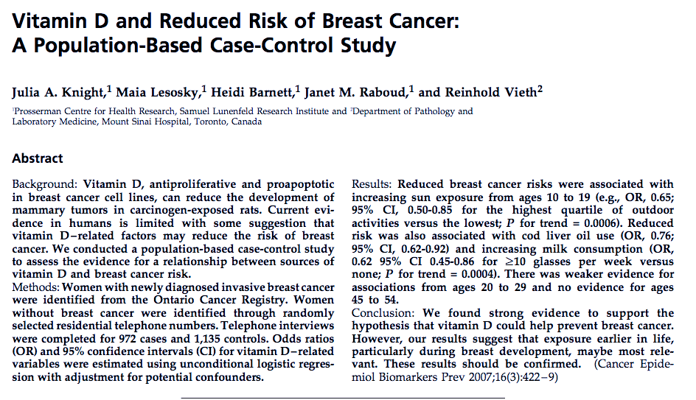
Girls 10-19 yrs most sun 69%
Women 20-29 yrs most sun 51%
Women 45-54 yrs most sun 0.0%
Courtesy Michael Holick MP, PhD

Slide 46

Stress Management
Meditation, prayer, relaxation response, guided imagery, yoga, tai chi, biofeedback, gratitude journal
HRV-HeartMath
Decreased cortisol, flight-fight response, BP,
Increased parasympathetic tone
Improved mood, concentration, pain tolerance, resilience
Positive epigenetic effects on inflammation (NFkB), insulin sensitivity (PPARg)) and energy efficiency e.g. mitochondrial health (PCGa1)
Increase telomere length (Blackburn and Ornish 2014)

Slide 47
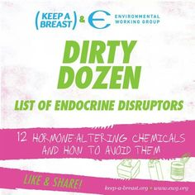

Environmental Working group Ewg.org

Slide 48
Strategies to reduce insulin production and increased insulin sensitivity i.e. lower refined carbohydrate intake, time restricted feeding, and “anti-inflammatory lifestyle interventions e.g. phytonutrient-dense foods, vitamin D, sunlight:
Decrease mTOR
Decrease PI3k/AkT
Decrease VEGFR
Decrease HIF1a
Increase AMPK

Slide 49
From a Lifestyle Medicine Perspective
Improve insulin signaling – lower insulin levels
Assure adequate nutrient density:
Modulate inflammatory response
Limit burden of ROS
Provide more plant-based fermentable fiber
Reduce VAT: enhance lipolysis
Regulate HPA axis
Synchronize chronobiology
Enhance systems for apoptosis and autophagy
Support mitochondrial function

Slide 50
Summary: Lifestyle considerations
For abdominal obesity and insulin resistance, restrict sugar, carbohydrate dense grains and liberalize healthy fat sources
Nutrient-dense vegetables, plant-based fermentable fiber (microbiome diversity-balance)
Cruciferous and Allium family
Time-restricted feeding e.g. 13-hr overnight
Alcohol moderation (no more than 3 drinks/week)
Anti-inflammatory botanicals e.g. curcumin, green tea, basil, sage, oregano, cinnamon
Vitamin D to levels 40-50 ng/ml

Slide 51
Summary: Lifestyle considerations
Reduce endocrine-disruptive toxin exposure– ewg.org
Full-spectrum light exposure-forest bathing
Motion is the lotion
Stress reduction techniques e.g. breath, meditation, prayer, yoga, tai chi
Connection to others

Slide 52
Thank you!

Slide 53

Ewg.org

Slide 54

Disrupted Sleep
Loss of Entrainment
15% Americans experience chronic insomnia
1 out of 3 has sleep disruption on one or more nights each week
Major risk factor for many chronic complex diseases
Neuro-endocrine-immune disruption
Obstructive sleep apnea underdiagnosed (neck circumfrence 16+” in women)

Slide 55
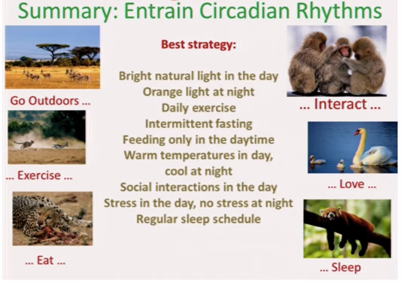

Slide 56
The OR for breast cancer from the lowest to the highest quartile of 25-OH Vitamin D was 2.5

Slide 57
Fasting-Mimetic Time restricted eating reproduces CR

Slide 58
Spreadbury, Diabetes, Obesity and Metabolic Syndrome: Targets and Therapy 2013

Slide 59
Cancer Epidemiol Biomarkers Prev. 2013 Jul;22(7):1319-24.
Adipocytokines, inflammation, and breast cancer risk in postmenopausal women: a prospective study.
Gross AL, Newschaffer CJ, Hoffman-Bolton J, Rifai N, Visvanathan K.
Author information: Department of Epidemiology, Johns Hopkins Bloomberg School of Public Health,
Baltimore, MD
sTNF-R2 and leptin were independently positively associated with breast cancer risk in adjusted models.
The OR for breast cancer comparing the highest to lowest tertile was 2.44 (95% CI: 1.30-4.58) for sTNF-R2 and 1.98 (95% CI: 1.20-3.29) for leptin. While higher
levels of adiponectin were protective (OR for the lowest tertile = 1.63; 95% CI: 1.02-2.60)

Slide 60
Cancer Causes Control. 2013 Dec;24(12):2117-28. Fruit and vegetable intake and breast cancer risk defined by estrogen and progesterone receptor status: the Japan Public Health Center-based Prospective
Study. Suzuki R, Iwasaki M, Hara A, Inoue M, Sasazuki S, Sawada N, Yamaji T, Shimazu
Cruciferous vegetable intake was associated with a statistically significant decrease in risk of premenopausal breast cancer [multivariable-RRQ4 vs. Q1 = 0.64
(95 % CI = 0.38-1.10; p trend = .046)] and showed a marginally inverse association with ER+ PR+ tumors [RRper 100 g increment = 0.64 (95 % CI =0.41-1.00)].
Sulfurophanes and isothiocyanates upregulate tumor suppressor genes and promote apoptosis.

Slide 61
Boscoe FP, Schymura MJ. Solar ultraviolet-B exposure and cancer incidence and mortality in the United States, 1993–2002. BMC Cancer 2006;6: 264.
National Health and Nutrition Examination Survey. Cancer Epidemiol Biomarkers Prev 1999;8:399 – 406.
Goodwin PJ, Ennis M, Pritchard KI et al. Prognostic effects of 25-hydroxyvitamin D levels in early breast cancer. J Clin Oncol 2009;27:3757– 3763.
Kim Y, Je Y. Vitamin D intake, blood 25(OH)D levels, and breast cancer risk or mortality: a meta-analysis. Br J Cancer. 2014 May 27;110(11):2772-84. doi: 10.1038/bjc.2014.175. Epub 2014 Apr 8.
Lim ST, Jeon YW, Suh YJ. Association between alterations in the serum 25-hydroxyvitamin d status during follow-up and breast cancer patient prognosis. Asian Pac J Cancer Prev. 2015;16(6):2507-13.
.

Slide 63
Carcinogenesis. 2015 Oct;36(10):1121-8.
Prediagnostic serum inflammatory markers in relation to breast cancer risk, severity at diagnosis and survival in breast cancer patients. Wulaningsih W, Holmberg L, Garmo H, Malmstrom H
Author information: Division of Cancer Studies, King's College London, Cancer Epidemiology Group, Bermondsey Wing, Guy's Hospital, London UK,
Our findings indicate that prediagnostic serum inflammatory markers were weakly linked to incident breast cancer but corresponded to worse survival after diagnosis.

Slide 64
Environment
Inputs
Life
Gene-Epigenome
Microbiome
Spirit-Meaning
Notes:
Humans as a composite organism

Slide 65
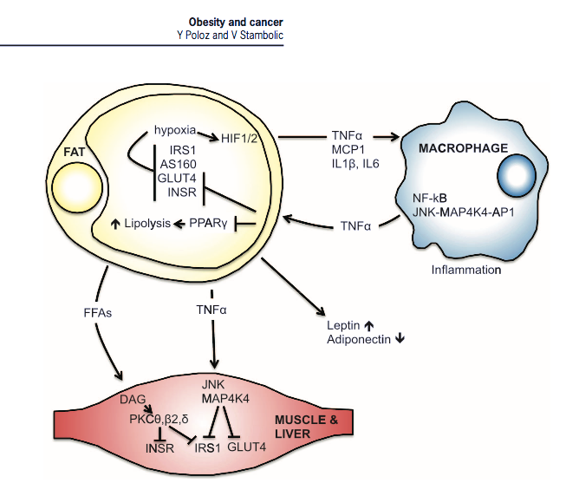

Slide 66
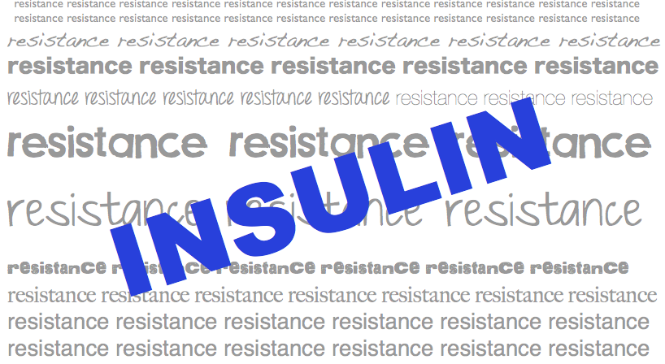
Insulin Resistance

Slide 67
CONCLUSIONS: This comprehensive prospective analysis suggests women with higher circulating levels of α-carotene, β-carotene, lutein+zeaxanthin, lycopene, and total carotenoids may be at reduced risk of breast cancer.

Slide 68
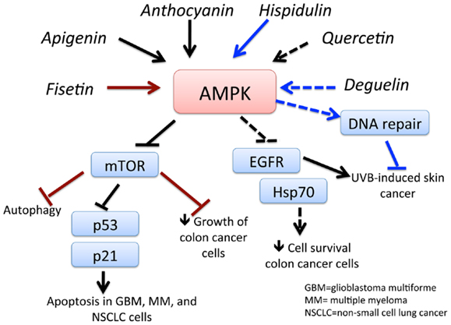

Slide 69
Boscoe FP, Schymura MJ. Solar ultraviolet-B exposure and cancer incidence and mortality in the United States, 1993–2002. BMC Cancer 2006;6: 264.
National Health and Nutrition Examination Survey. Cancer Epidemiol Biomarkers Prev 1999;8:399 – 406.
Goodwin PJ, Ennis M, Pritchard KI et al. Prognostic effects of 25-hydroxyvitamin D levels in early breast cancer. J Clin Oncol 2009;27:3757– 3763.
Kim Y, Je Y. Vitamin D intake, blood 25(OH)D levels, and breast cancer risk or mortality: a meta-analysis. Br J Cancer. 2014 May 27;110(11):2772-84. doi: 10.1038/bjc.2014.175. Epub 2014 Apr 8.
Lim ST, Jeon YW, Suh YJ. Association between alterations in the serum 25-hydroxyvitamin d status during follow-up and breast cancer patient prognosis. Asian Pac J Cancer Prev. 2015;16(6):2507-13.
.

Slide 70
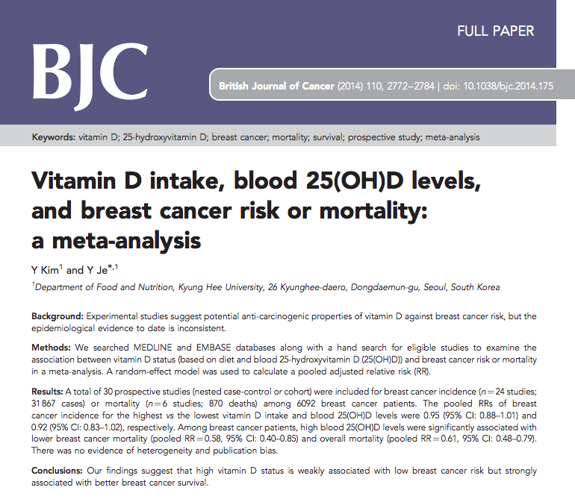
30 Prospective trials examining breast cancer incidence and mortality in relationship to 25 OH vitamin D status. Weak association with lower breast cancer risk and strong association with breast cancer survival.

Slide 71
Am J Clin Nutr. 2016 Jan;103(1):168-77. Vegetable and fruit consumption and the risk of hormone receptor-defined breast cancer in the EPIC cohort. Emaus MJ, Peeters PH, Bakker MF, Overvad K
Author information: Julius Center for Health Sciences and Primary Care, University Medical Center
Utrecht, Utrecht, Netherlands
RESULTS: After a median follow-up of 11.5 y (IQR: 10.1-12.3 y), 10,197 incident invasive breast cancers were diagnosed [3479 estrogen and progesterone receptor positive (ER+PR+); 1021 ER and PR negative (ER-PR-)]. Compared with the lowest quintile, the highest quintile of vegetable intake was associated with a lower risk of overall breast cancer (HRquintile 5-quintile 1: 0.87; 95% CI: 0.80,0.94)

Slide 72
