Slide 1
A Functional Integrative Approach to Weight Loss and Metabolism
Mark C Pettus MD, FACP
Director of Medical Education and Population Health
Berkshire Health Systems
Associate Dean of Medical Education
University of Massachusetts Medical School

Slide 2
Learning Objectives
Examine the systems-biologic fault-lines (root causes) that an integrative functional approach to the lifestyle management of weight would address.
Examine the relationship between macronutrient content, lipogenesis (the biologic imperative to store fat) and leptin-insulin resistance
Review some lifestyle medicine strategies for facilitating and maintaining weight loss.

Slide 3
Four essential clinical pearls
Calorie restriction decreases metabolic rate, enhances hunger and reduces the drive to move. For most, eat less-do more is not a sustainable strategy.
Food is information. Different macronutrients and micro-phytonutrients produce different effects on metabolism e.g. in thermogenesis, neuroendocrine-immune regulation, and on the microbiome.
The biology one hopes to achieve is one that reduces oxidative stress, inflammatory drive, mitochondrial inefficiency and leptin and insulin resistance.
There are many evidence-based and modifiable lifestyle interventions known to achieve this.

Slide 4
Prevailing View
Obesity occurs when a person consumes more calories from food than he or she burns.
National Institute of Health 2008
Overweight is the result of caloric imbalance (too few calories expended for the amount of calories consumed) and is mediated by genetics and health.
US Surgeon General 2008

Slide 5
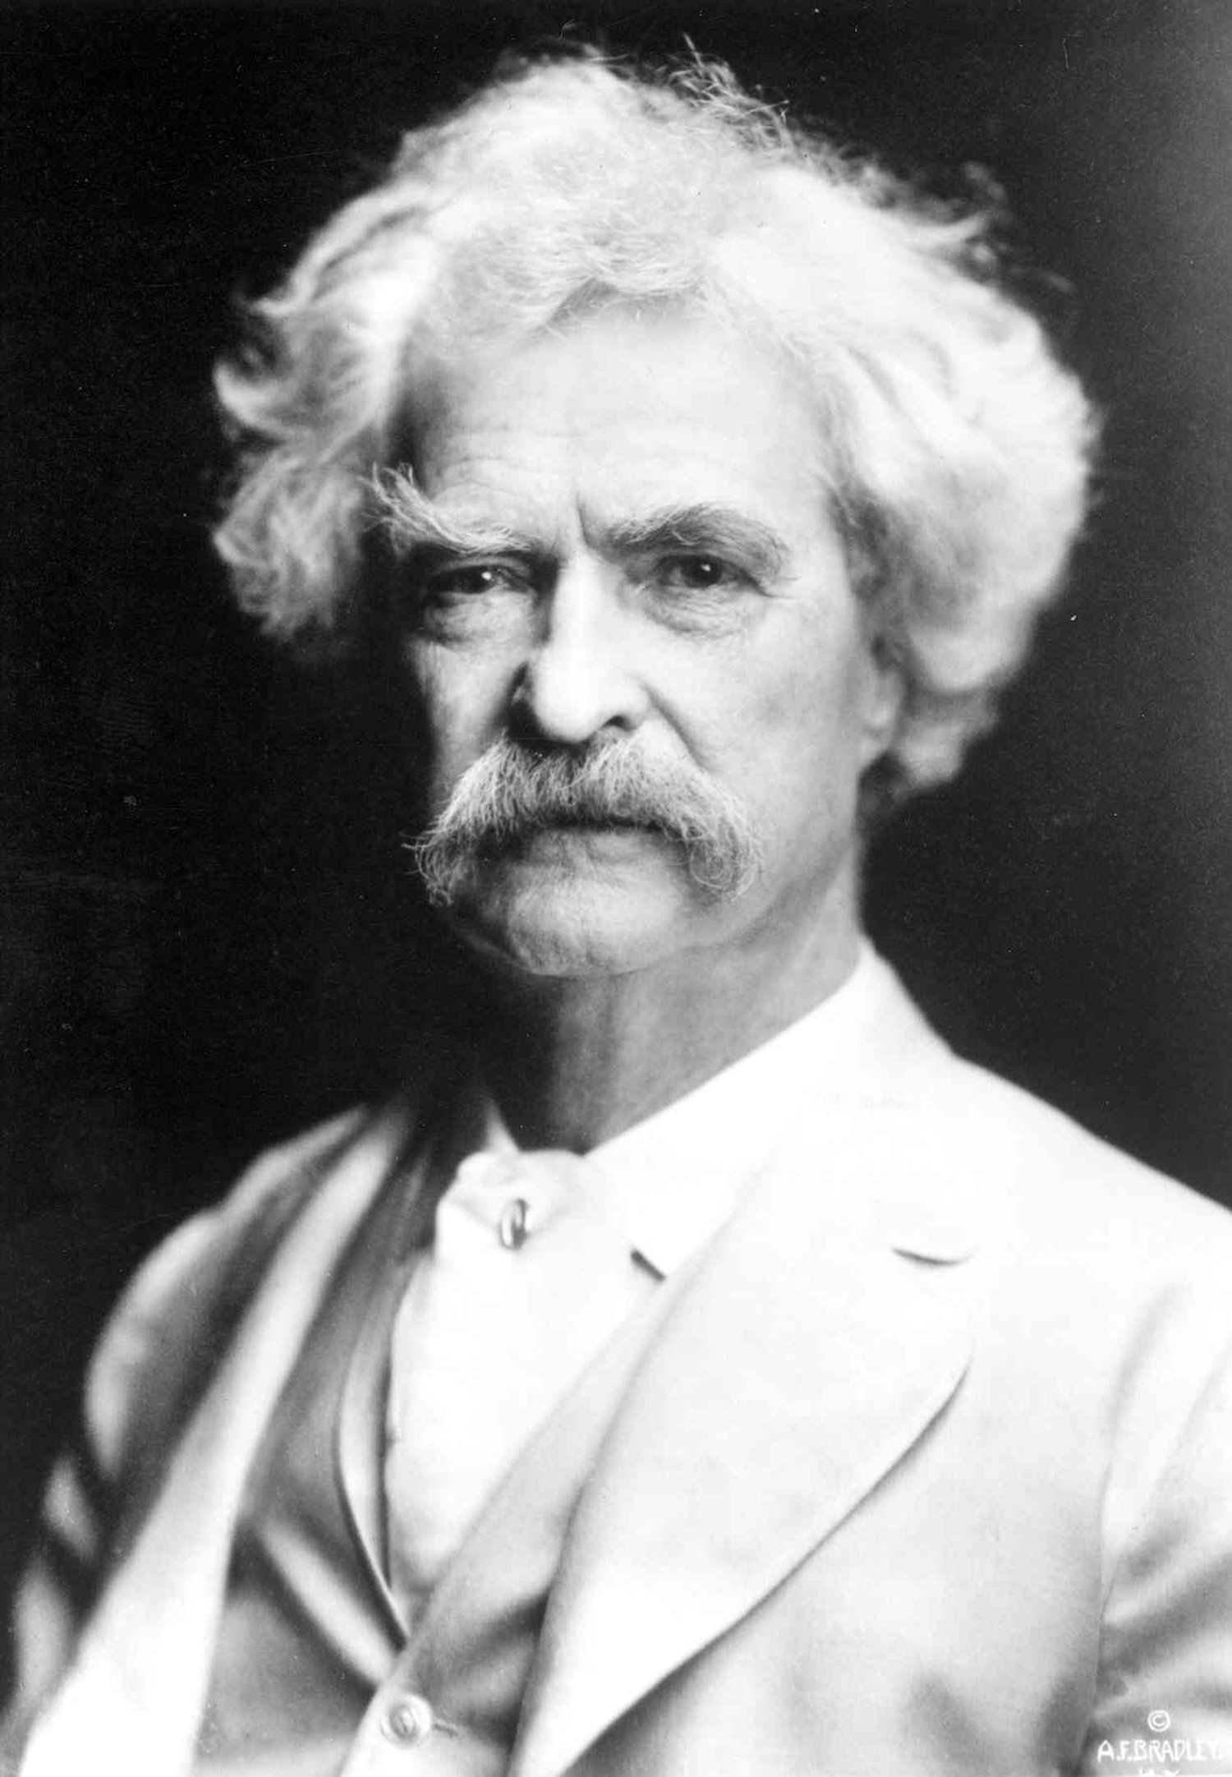
“It’s not what we don’t know that gets us into trouble, it’s what we know that ain’t so”
Mark Twain

Slide 6
Environment
Life
Epigenome
Microbiome
Consciousness

Slide 8
USDA Recommendations 1970s
Low-fat emphasis

Slide 11
Limitations of Weight and BMI
BMI of limited sensitivity with higher lean body mass
Body composition
VAT vs. SAT
Most adipose is VAT
Most adipose is SAT
Same weight and waist circumference:
Different metabolic risks!

Slide 12
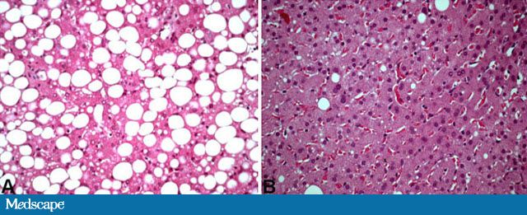
NAFLD
Has become one of the most common diseases in America from not having been described until 1980.
45% of all Latinos
33% of all Caucasians
25% of all African Americans
5% of all progress to NASH
25% NASH progress to cirrhosis
Preventable

Slide 13
Health as a byproduct of gene-environment compatibility

Slide 14
Courtesy Loren Cordain PhD

Slide 18
From Robert Sapolsky PhD

Slide 19
From Robert Sapolsky PhD

Slide 20
Robert Sapolsky PhD Stanford

Slide 21
Robert Sapolsky PhD Stanford

Slide 22
From Robert Sapolsky PhD

Slide 23
Heavier with increased BMI
Metabolic Syndrome
Insulin resistance with elevated fasting and post-prandial insulin levels
Increased TGAs
Move less
Socialize and play less
Infertility
Die younger
From Robert Sapolsky PhD

Slide 25
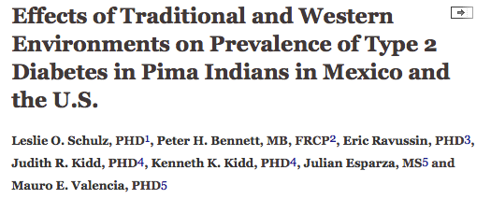
Prevalence of type 2 DM 5 times higher in Arizona Pima’s compared to Mexican Pima’s.
Diabetes Care August 2006 vol. 29 no. 8 1866-1871

Slide 26
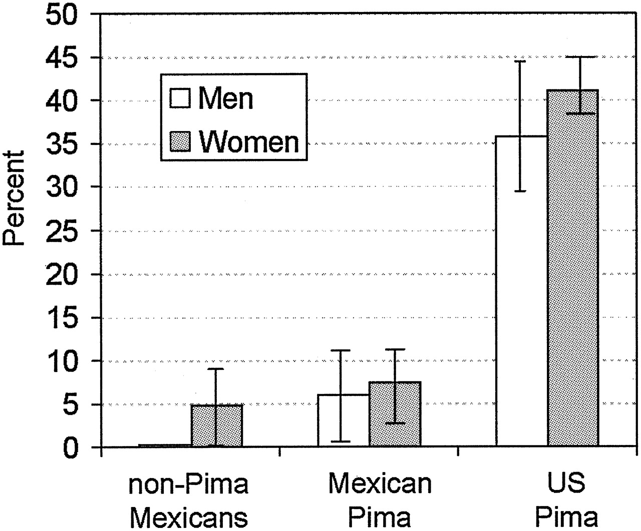
Age-adjusted prevalence (±95% CIs) of diabetes in non-Pima Mexicans, Mexican Pima Indians, and U.S. Pima Indians.
Schulz L O et al. Dia Care 2006;29:1866-1871
Copyright © 2011 American Diabetes Association, Inc.
Notes:
Age-adjusted prevalence (±95% CIs) of diabetes in non-Pima Mexicans, Mexican Pima Indians, and U.S. Pima Indians.

Slide 28
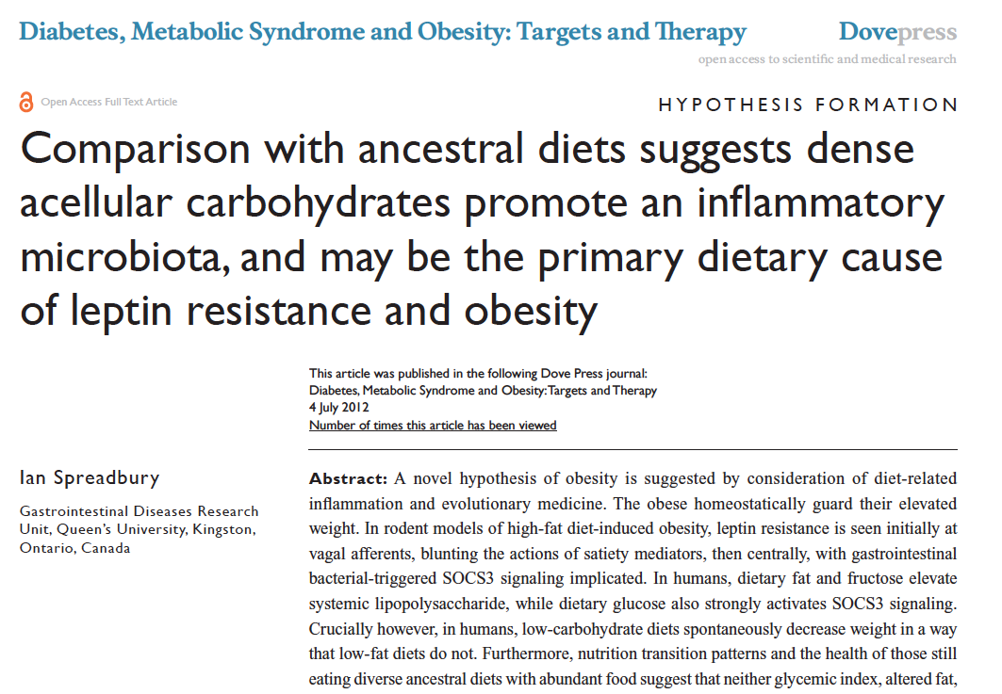
Diabetes, Metabolic Syndrome and Obesity: Targets and Therapy 2012:5 175–189

Slide 29
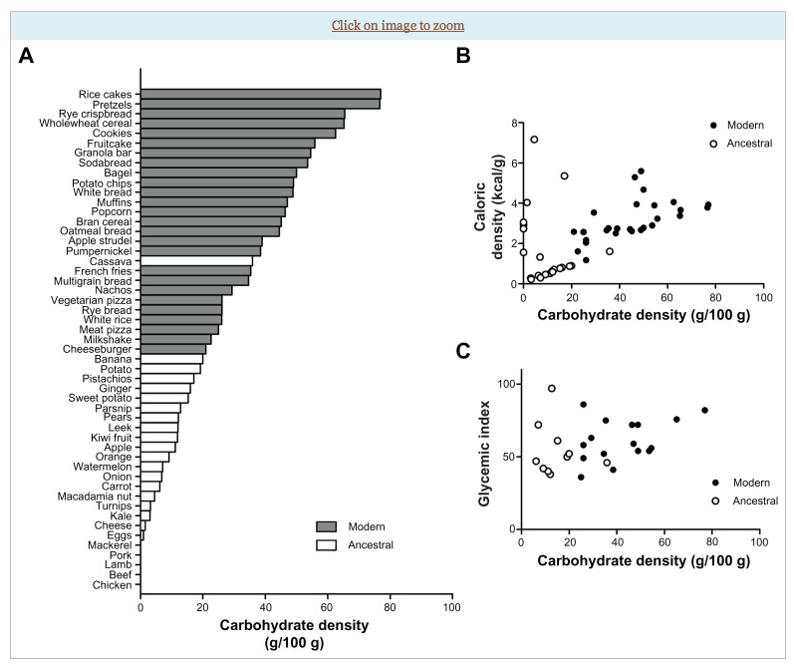
Diabetes, Metabolic Syndrome and Obesity: Targets and Therapy 2012:5 175–189

Slide 30
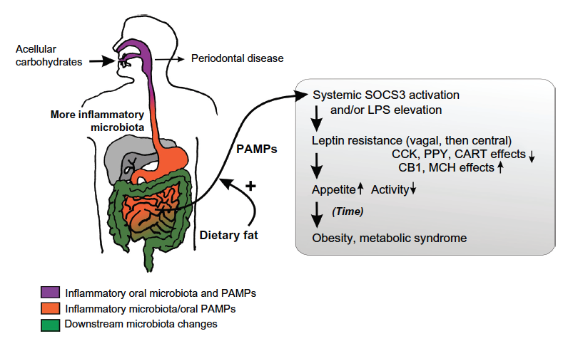
Increased Inflammation
Insulin driving lipogenesis
Insulin resistance in muscle and liver
Inhibits mobilization of fat as a fuel
source
NF-kappa B upregulation
Increased LPS
Cytokine upregulation
Leptin resistance
Shift to fat storage increases appetite
and decreases energy expenditure
Diabetes, Metabolic Syndrome and Obesity: Targets and Therapy 2012:5 175–189

Slide 31
Hyperinsulinemia
weight gain and abdominal obesity
insulin resistance and diabetes
leptin resistance
hormonal dysfunction/anovulation
independent risk factor for heart disease due to effects of insulin on blood vessels
increased risk of breast, prostate, colon, skin and other cancers
Notes:
women in the upper third for insulin level were more than twice as likely to develop breast cancer compared with women in bottom third for insulin level 2009 Intl Journal of cancer
JNCI 1999 >5000 colon cancer assoc w/ elevations in fasting and post prandial BS and insulin levels

Slide 32
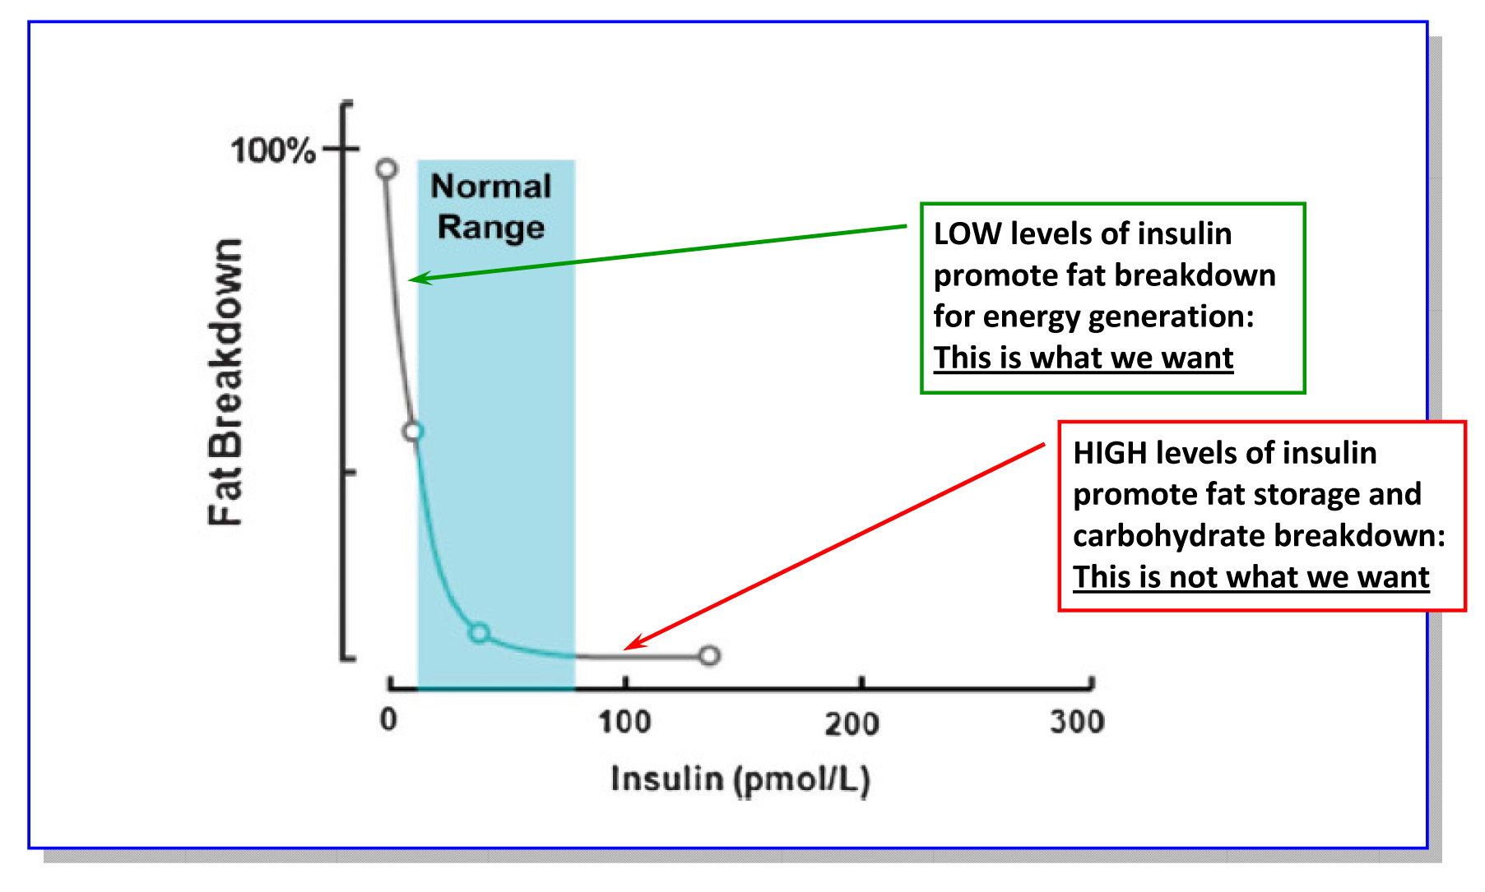
Lipolysis vs. Lipogenesis

Slide 33
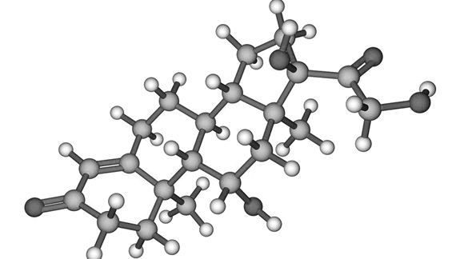
Leptin
Signals satiety in the brain (hypothalamus)
Signals “readiness” to move
Leptin resistance = weight gain, hard to control hunger, and a deep desire to minimize activity
Inflammation is associated with insulin resistance
Insulin resistance is associated with leptin resistance

Slide 34
Poor Quality Carbs
Acellular carbohydrate density
Inflammation
Stress
Sleep disruption
Altered gut-permeability/microbiome
Social isolation
Toxin excess
Sedentary states
VAT
Excess Insulin
VAT Fat storage-lipogenesis
Down-regulation of insulin receptors
Insulin Resistance
Leptin resistance
Eat more and do less

Slide 35
“ Are we fat because we eat too much or do we eat too much because we are fat ?”

Slide 36
From: Increasing Adiposity: Consequence or Cause of Overeating?
JAMA. 2014;():. doi:10.1001/jama.2014.4133
Copyright © 2014 American Medical Association. All rights reserved.

Slide 37
A calorie is not a calorie…
Effects of Dietary Composition on Energy Expenditure During Weight-Loss Maintenance
Cara B. Ebbeling, PhD; David S. Ludwig, MD, PhD et al
Conclusion: Among overweight and obese young adults compared with pre–weight-loss energy expenditure, isocaloric feeding following 10% to 15% weight loss resulted in decreases in REE and TEE that were greatest with the low-fat diet, intermediate with the low–glycemic index diet, and least with the very low-carbohydrate diet.
Remarkable range between individuals.
TEE: - 423 [–606 to –239] kcal/d for low fat diet
- 97 [–281 to 86] kcal/d for low carb diet
Equivalent of 1-hr moderate effort cardio
JAMA. 2012;307(24):2627-2634. doi:10.1001/jama.2012.6607
Notes:
TEE differed by approximately 300 kcal/d between these low fat and low carb diets, an effect corresponding with the amount of energy typically expended in 1 hour of moderate-intensity physical activity.

Slide 38
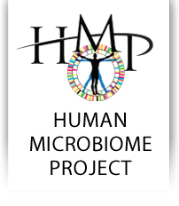
99% genome from microbes
Digestion-caloric extraction
Detoxification
Epigenomic expression e.g., butyrate
and histone deacetylase inhibition
Immunomodulatory cell signaling
Cytokine modulation – insulin/leptin
Vitamin modification
Neurotransmitters
SCFAs and gut hormones/permeability
Talk to the vagus nerve

Slide 39
Mechanisms that link alterations of the microbiome with weight and metabolism
Increased energy harvest from the diet
Altered fatty acid metabolism in liver, muscle, and fat tissue
Modification of gut hormones e.g. cholecystikinin, peptide YY and GLP-1
Activation of LPS- TLR 4 axis and cytokine expression
Altered gut barrier function and molecular trafficking
Bile acid metabolism
SCFA production

Slide 43
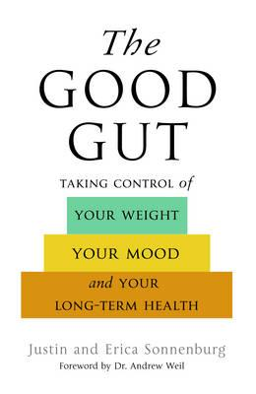

Slide 46
“The connection between the gut microbiota and energy homeostasis and inflammation and its role in the pathogenesis of obesity-related disorders are increasingly recognized. The role of the Western diet, antibiotics and lifestyle in promoting an obesogenic microbiota is increasingly clear.”

Slide 48
In animal models, giving VSL#3 probiotics modulates microbiota induction of butyrate and GLP-1. These metabolic changes enhance insulin signaling, increase fat oxidation, decrease appetite, improve colonic epithelial function-integrity and barrier function.

Slide 49
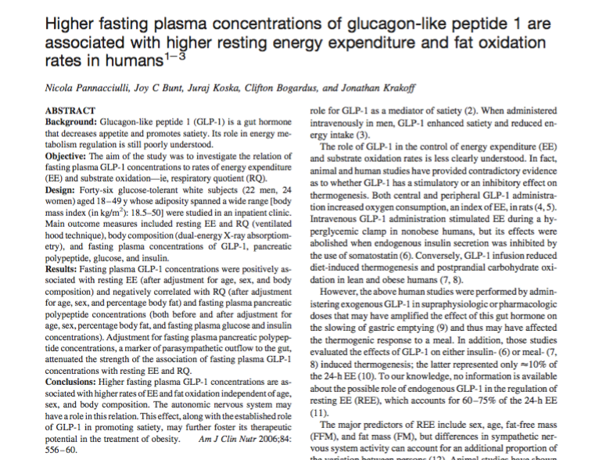
Fasting GLP-1 levels were associated with higher rates of TEE and fat oxidation, independent of age, sex and body composition.
^{Am J Clin Nutr 2006;84:556–60}

Slide 51
Immune Network 2014:14(6) 277-288

Slide 52
Summary: Dysbiosis, SIBO, Increased Intestinal Permeability
LPS via TLR4 activates stellate cells
Systemic Inflammation
Insulin Resistance
Hepatic inflammation
Altered Mitochondrial function
FFA oxidation
PGC1-alpha
Obesity
VAT
Insulin Resistance
DM
NASH
FIAF LPL
Increased FFA uptake
Carbohydrate dense foods
Sugar/Fructose
Increased hepatic lipogenesis
Bile Acid Changes
Bacteriostasis
SIBO

Slide 53
Research linking modulation of the microbiome with weight loss/maintenance

Slide 54
GI Flora Affect Metabolic Syndrome in Humans
18 obese men with metabolic syndrome
Duodenal intubation and PEG lavage
Fecal transplantation (autologous vs. allogenic from lean males)
Allogenic microbial transplants reduced fasting triglycerides and increased insulin sensitivity at 6 weeks post-transplant
Diabetologia (2010) 53:Suppl1, S44

Slide 55
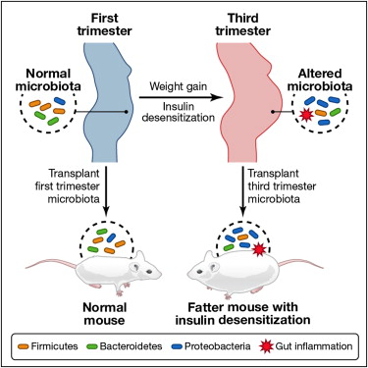
Cell 150, 470–480, August 3, 2012 ª2012 Elsevier Inc.

Slide 56
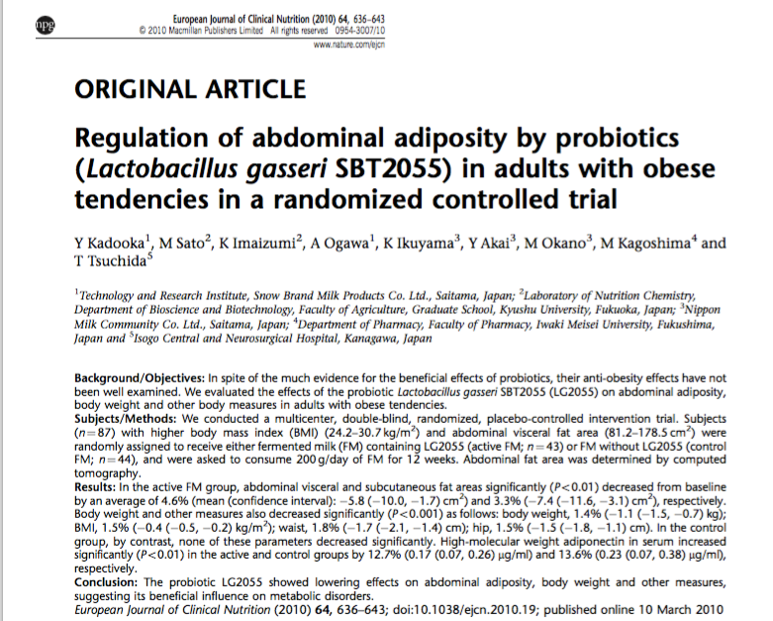
Multi-center, double-blinded randomized, placebo-controlled intervention trial
87 subjects with high BMI and VAT
FM vs. placebo for 12 weeks
Improved wt. loss and body comp in treated group compared with control.
Higher adiponectin in treated group. Enhanced insulin sensitivity, glucose regulation and fat oxidation.

Slide 57
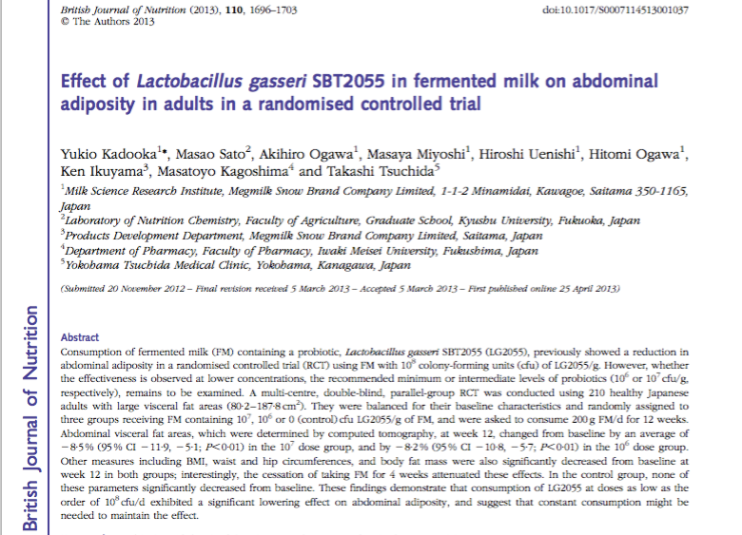
Intervention with FM in 210 healthy overweight adults.
Significant lowering of abdominal adiposity was seen.
Effects were reversed after discontinuation of FM

Slide 58
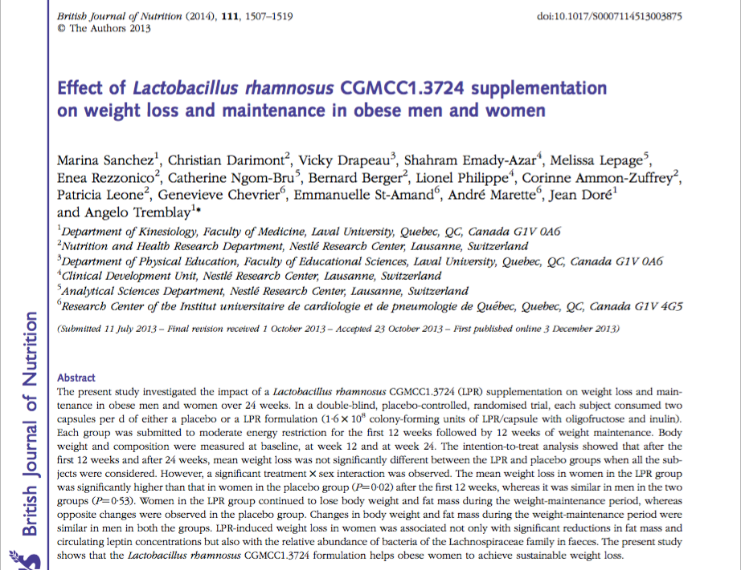
Double-blind, randomized, placebo-controlled trial in obese men and women
Probiotic supplementation with L rhamnosus for 24 weeks
Each group had moderate caloric restriction
Treatment effect more pronounced in women: greater weight loss, reduced fat mass and leptin levels

Slide 59
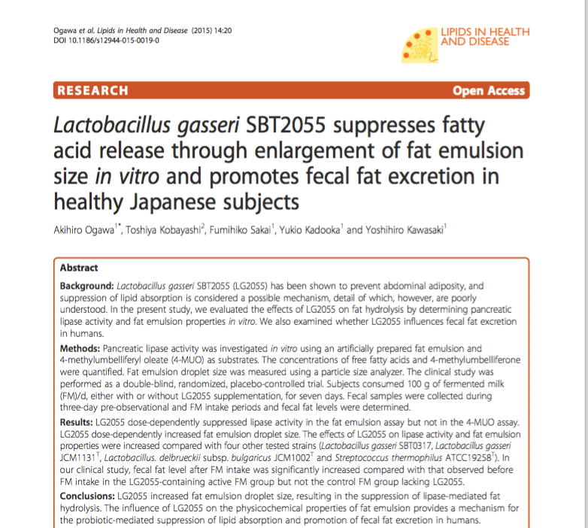
Greater fecal fat excretion seen in those supplemented with L. gasseri. This effect was mediated by suppression of lipase-mediated lipid absorption.

Slide 60
Different Lactobacillus species appear to have varied effects on metabolism and weight loss. Review of 17 RCTs in human adults reveal positive effects with L plantarum and L gasseri with weight gain with L acidophilus.

Slide 61
Low fat versus Low carb-high fat
The data…

Slide 63
Westman, E et al. Nutrition 31 (2015) 1-13

Slide 64
Westman, E et al. Nutrition 31 (2015) 1-13

Slide 65
Westman, E et al. Nutrition 31 (2015) 1-13

Slide 66
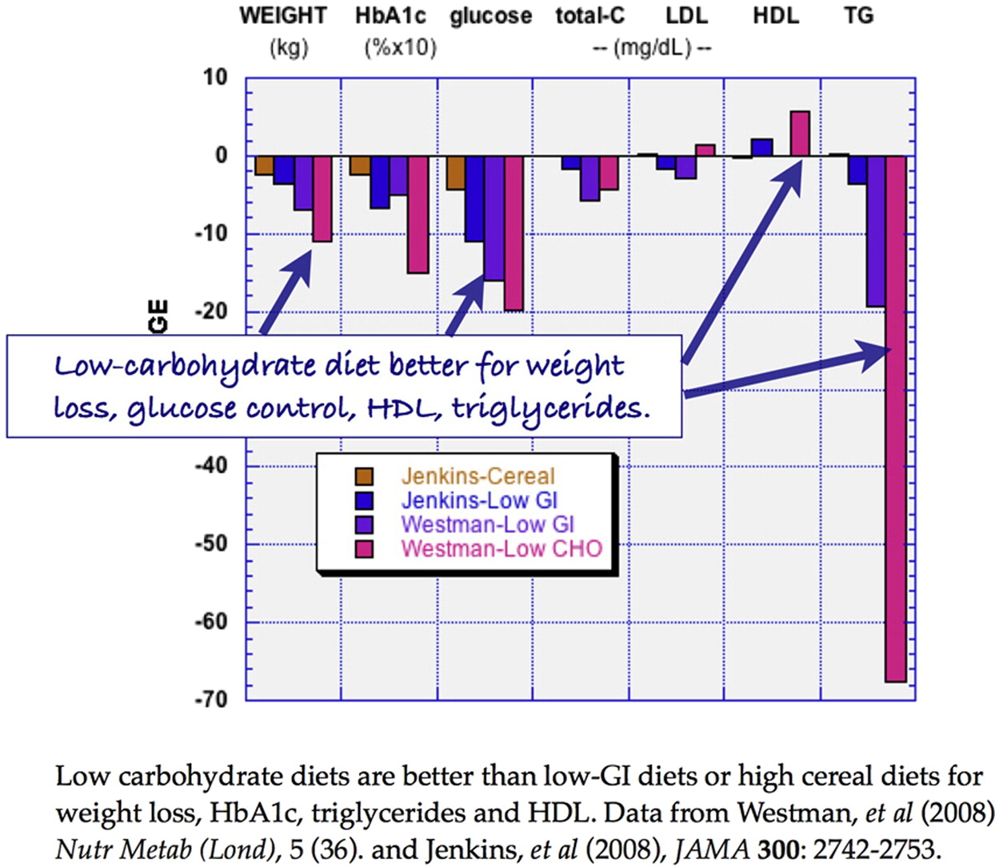
Nutrition 2015 31, 1-13DOI: (10.1016/j.nut.2014.06.011)

Slide 67
In weight loss trials, low-carbohydrate interventions led to significantly greater weight loss (along with better metabolic RF reduction) than did the low-fat interventions. When compared with dietary interventions of similar intensity, evidence from RCTs does not support low-fat diets over other dietary interventions for long-term weight loss.
Lancet Diabetes Endocrionol 2015 Dec:3(12)

Slide 68
Meta-analysis comparing VLCHF (no more than 50g CHO/day)with traditional calorie restricted low fat (< 30% calories from fat for weight loss and CV RF modification efficacy. 13 RCTs with at least 12-month f/u. Individuals assigned to a VLCHF achieve greater weight loss than those assigned to a LFD
Br J Nutr 2013 Oct: 110(7)

Slide 69
Examined wt. loss trials with outcomes at 3-months or longer. Main outcomes weight loss and BMI at 6 and 12 months. Largest weight loss associated with low-carbohydrate though overall differences were small between groups e.g. Atkins with 1.7 kg greater than Zone.

Slide 71
Food and Reward

Slide 72
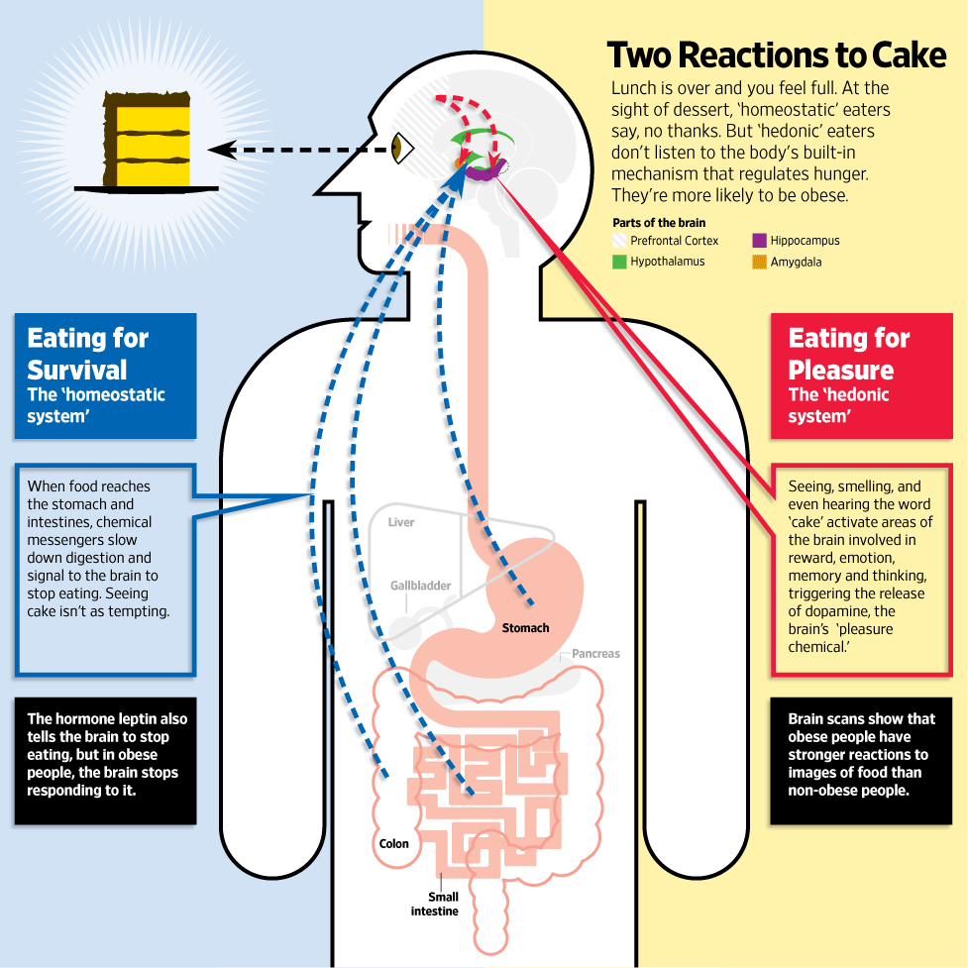
Jabr F, SA Mind December 2015

Slide 75
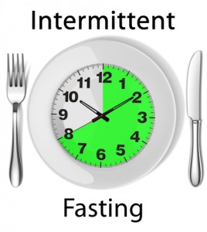
Intermittent fasting
Time restricted feeding (6-8 hrs) or complete periods of fasting for 24 hrs.
Decreases in body weight and visceral fat
Improved cardiovascular disease risk profile
Decreased inflammation (Biogerontology. 2015 Dec;16(6):775-88)
Decreased neuroinflammation (Neurobiol Aging. 2015 May;36(5):1914-23)
Autophagy (Autophagy, 2014;10:11, 1879-1882)

Slide 79
Disrupted Sleep
Loss of entrainment
15% Americans experience chronic insomnia
1 out of 3 has sleep disruption on one or more nights each week
Major risk factor for many chronic complex diseases
Neuro-endocrine-immune disruption
Sleep hygiene
Obstructive sleep apnea underdiagnosed (neck circumfrence 16+” in women and 17+” in men)
Avoid pitfalls of sleeping medications

Slide 80
Curr Opin Endocrinol Diabetes Obes. 2014 August ; 21(4): 293–298.

Slide 81
^{SLEEP, Vol. 31, No. 5, 2008}

Slide 83
Stress Management
Meditation, prayer, relaxation response, guided imagery, yoga, tai chi, biofeedback, gratitude journal
HRV-HeartMath
Decreased cortisol, flight-fight response, BP,
Increased parasympathetic tone
Improved mood, concentration, pain tolerance, resilience
Positive epigenetic effects on inflammation, insulin sensitivity and energy efficiency e.g. mitochondrial health
Decreased cardiovascular risk
Enhanced neuroplasticity

Slide 84
MBSR and Reduction in Inflammatory Biomarkers
Randomized controlled trial of 40 individuals
Half received training in MBSR techniques
Treatment group scored better on emotional wellness
Down regulation of inflammatory gene expression
patterns
Diminished NF-kappa B expression
C-reactive protein reduced

Slide 85
Thyroid Balance
Many people in low end of “normal” and symptomatic
Want TSH < 2.5
Free T3 and Free T4 at least 50th percentile
Do you have TPO or Thyroglobulin Antibodies?
Armour thyroid vs. synthetic T4

Slide 86
Environmental Toxins and Obesity
Unprecedented exposures to toxins in our environment
Hepatic phase 2 biotransformation polymorphisms
Toxins impact central neuro- regulatory systems, appetite
Disruption of hormonal regulation
Disruption of inflammatory response, cytokines
Mitochondrial and oxidative stress; altered redox balance
Alterations of the human microbiome with adverse metabolic sequelae
Detoxification strategies are an important adjunct to a functional-integrative lifestyle approach to weight loss-maintenance
Hyman M Alternative Therapies April 2012
Environmental Health Perspectives • VOLUME 123 | NUMBER 7 | July 2015
Endocrine Reviews, August 2014, 35(4):557–601
^{PLOS ONE | www.plosone.org 10} January 2014 | Volume 9 | Issue 1

Slide 87
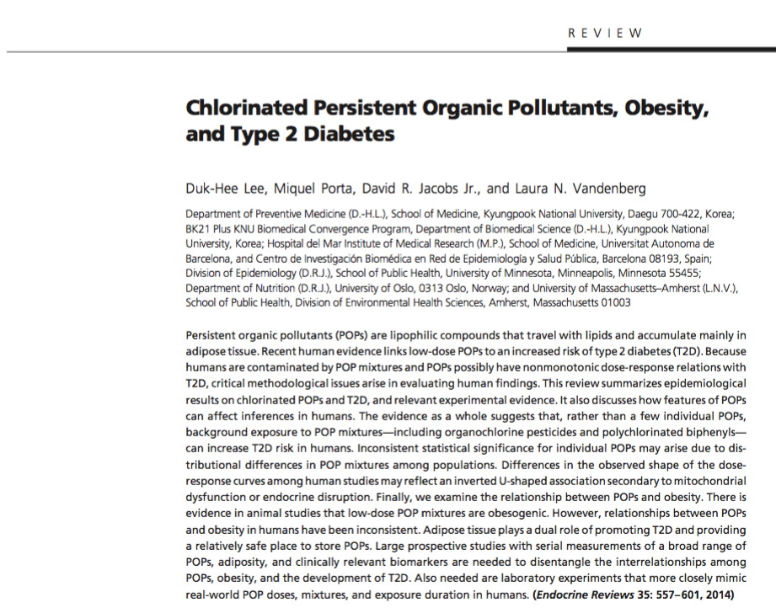

Slide 88
Endocrine Reviews, August 2014, 35(4):557–601

Slide 89
Summary: Enhancing metabolic efficiency: …. Reduce inflammation, insulin and leptin resistance
Cut – reduce sugar-fructose in all it’s forms
Eliminate-reduce refined grain flours, and carbohydrate-dense processed foods.
Reduce omega-6 containing oils, replacing them with healthy fats e.g. extra virgin olive oil, grass-fed butter and coconut oil; lard, tallow, ghee, avocados, nuts (almonds and macademia)
OK to Consume pasture-raised meats, salmon, shellfish, eggs, organ meats
Gut health-microbiome: dysbiosis, SIBO, intestinal barrier function
Motion is the lotion
Lower stress response e.g. meditation, yoga, tai chi, chi gong, HRV
Environmental toxins e.g. Dirty Dozen, support detoxification
Circadian rhythm – sleep entrainment
Thyroid: TSH < 2.5
Supplements: Glucomannan, green tea, green coffee beans

