Slide 1
Metabolic Tune-Up for Brain Health
Mark C. Pettus MD, FACP
Clinical Associate Professor of Medicine
University of Massachusetts Medical School

Slide 2
Learning objectives
Explore the emerging interconnections between lifestyle and micronutrient status, the microbiota balance, and mitochondrial health.
Review the concept of mitohormesis and the central role that mitochondrial dysfunction plays in alterations of brain health, mind and mood.
Consider lifestyle medicine strategies for more effective mitochondrial and metabolic function …a metabolic tune-up.

Slide 3
A Health Promoting Metabolic Tune-Up of the Mind-Brain-Body Would Include:
Reduced inflammatory burden
Reduced insulin resistance
Reduced toxic burden
Reduced allostatic load- maladapted stress response
Optimal micronutrient status (“Metabolic Tune-Up Bruce Ames)
Balanced oxidative stress (mitohormesis)
Enhanced mitochondrial function
More diverse microbiome (gut-brain axis)

Slide 4
Environment
Life
Epigenome
Microbiome
Consciousness

Slide 5
Ristow M et al. Int Dose Res Soc 2014

Slide 6
Ristow M et al. Int Dose Res Soc 2014

Slide 7
Ristow M et al. Int Dose Res Soc 2014

Slide 8
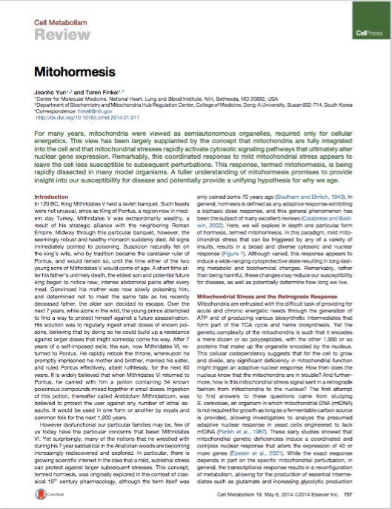
Yun J et al. Cell Metabolism 19, May 6 2014

Slide 9
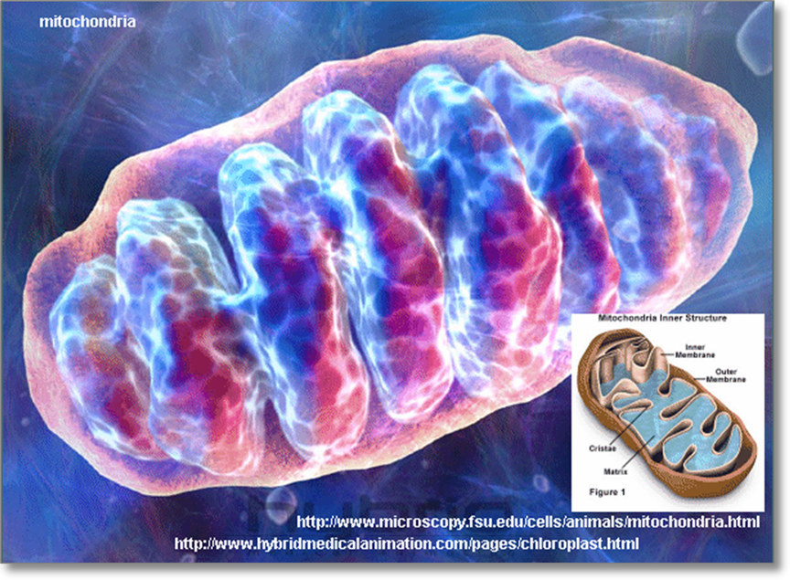
Parkinson’s, Autism, ALS, MS, Alzheimer’s
Fibromyalgia
Chronic fatigue
Depression
Complex pain syndromes
Congestive heart failure
Obesity/Pre-diabetes/diabetes
Biotoxin- toxicant Syndromes

Slide 10
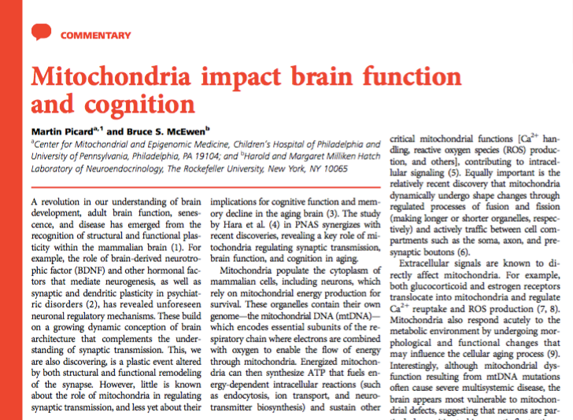
PNAS | January 7, 2014 | vol. 111 | no. 1 | 7–8

Slide 11
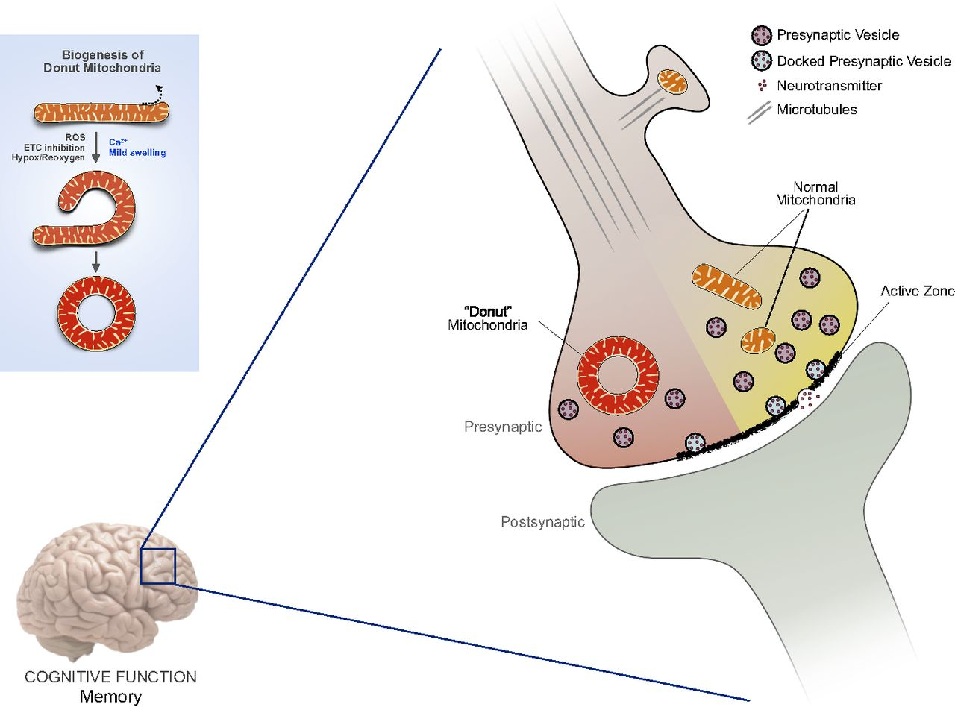
Schematic representation of presynaptic mitochondria in the mammalian brain and their effect on synaptic remodeling.
Martin Picard, and Bruce S. McEwen PNAS 2014;111:7-8
©2014 by National Academy of Sciences
Notes:
Schematic representation of presynaptic mitochondria in the mammalian brain and their effect on synaptic remodeling. Donut-shaped mitochondria are negative neuromodulators associated with smaller active zones and fewer docked vesicles in the dorsolateral prefrontal cortex (dlPFC) of monkeys and correlated with poor delayed response memory. (Inset) Donut mitochondria form by curvature and self-fusion of preexisting mitochondrial tubules (10, 11).

Slide 12
Micronutrient Status

Slide 13
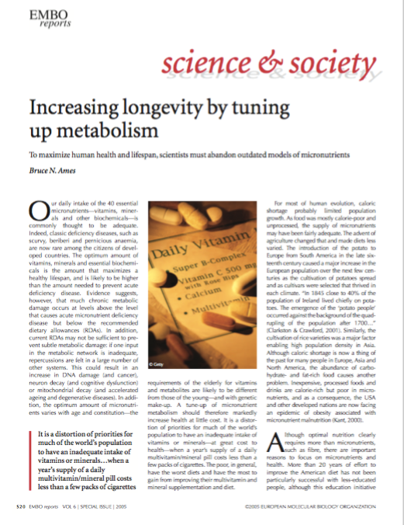

Slide 14
Mitochondrial Decay
Oxidative stress damages key enzymes, mitochondrial DNA, altered repair capacity
KM concept: Michaelis constant or decreased binding affinity for co-enzymes involved with ATP synthesis
Central in the influence of chronic complex disease and degenerative neurologic diseases, mild cognitive impairment and Alzheimers
KM restored in animal models using a mitochondrial cocktail
30% Americans < 50% RDI levels of key micronutrients
Methylation-transulfuration SNPs in 30-40% Americans (Ogino S , Wilson RB. Genotype and haplotype distributions of MTHFR677C>T and 1298A>C single nucleotide polymorphisms: a meta-analysis. J Hum Genet. 2003;48:1-7)
M. Lin, M. Beal, Mitochondrial dysfunction and oxidative stress in neurodegenerative diseases, Nature 443 (2006) 787–795.
Curr Treat Options Neurol. 2009 Nov; 11(6): 414–430.

Slide 15
Microbiome-Metabalome-Brain Health

Slide 16
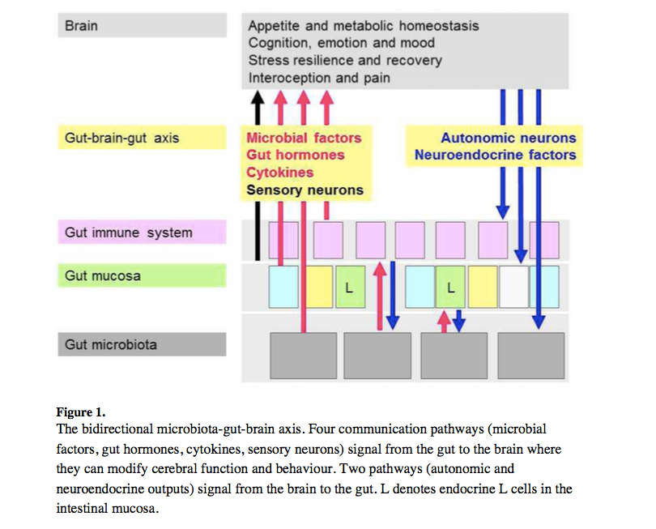
Microbiome-Metabalome-Brain Health

Slide 21
Neurogastroenterol Motil (2011) 23, 187–192

Slide 22
The Journal of Neuroscience, November 12, 2014 • 34(46):15490 –15496

Slide 23
The Journal of Neuroscience, November 12, 2014 • 34(46):15490 –15496

Slide 25
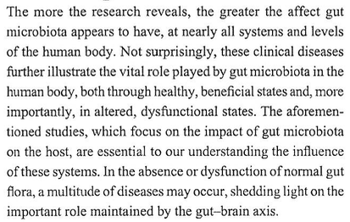
Neuropsychiatric Disease and Treatment 2015:11

Slide 32
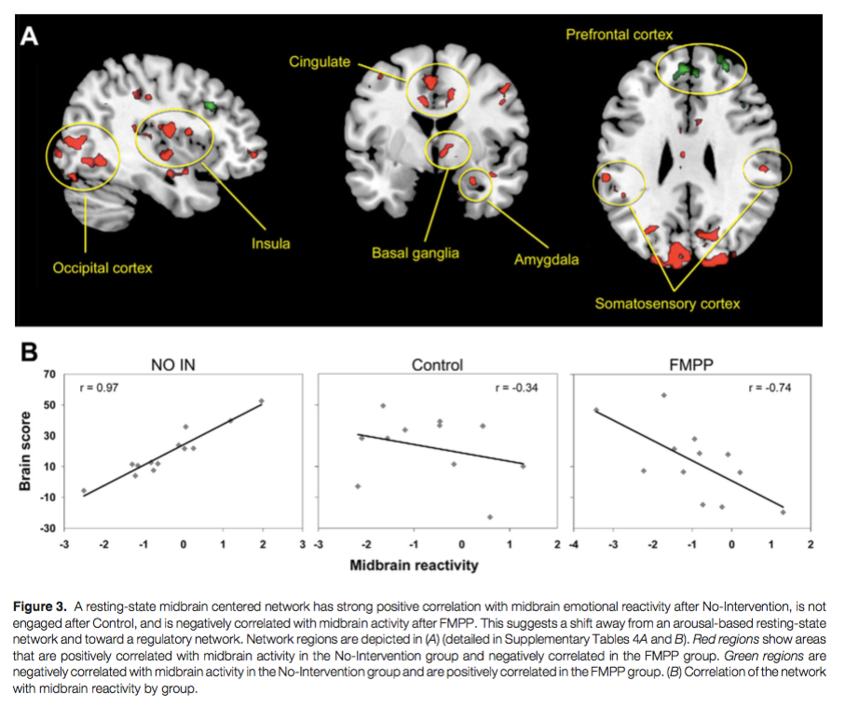

Slide 33
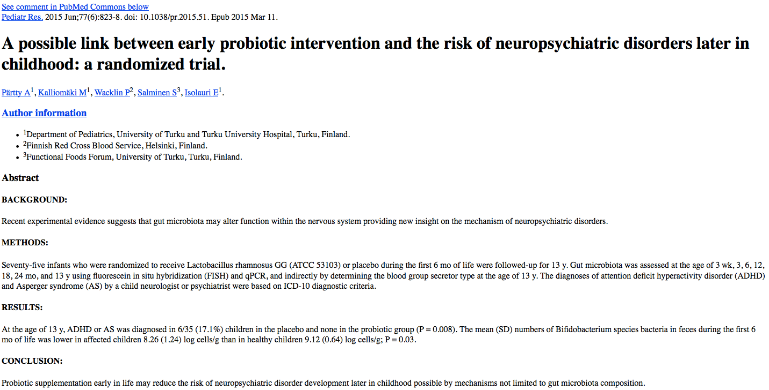
75 infants randomized to receive Lactobacillus rhamnosis or placebo during the first 6 months of life
Followed up to age 13
Gut microbiota assessed at 3wk, 3,6,12,18,24 mo and 13 yrs using PCR
At age 13 y, ADHD or AS was diagnosed in 17% in placebo and none in the probiotic group
Lower # Bifidobacterium in the symptomatic children
Pediatric Res. 2015 Jun;77(6):823-8

Slide 34
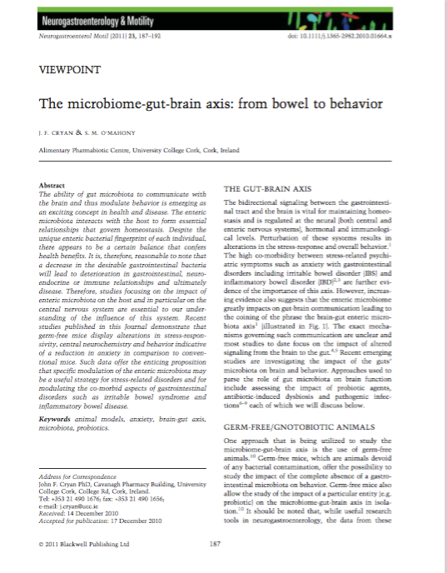
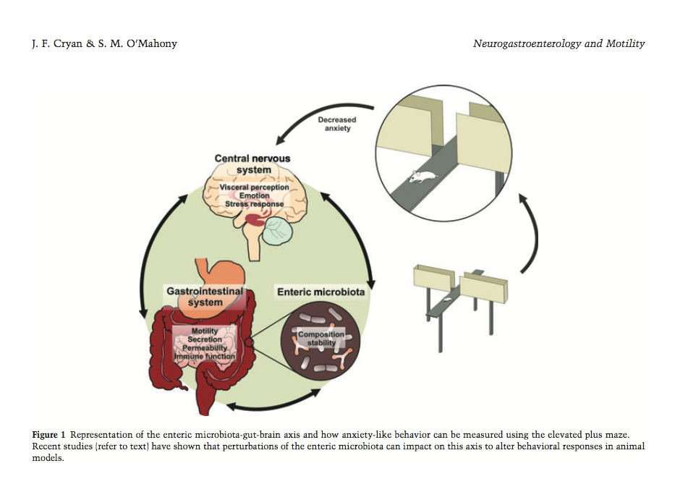

Slide 36
Psychobiotics: a novel class of psychotropic.
Biol Psychiatry. 2013 Nov 15;74(10):720-6. doi: 10.1016/j.biopsych.2013.05.001. Epub 2013 Jun10.

Slide 37
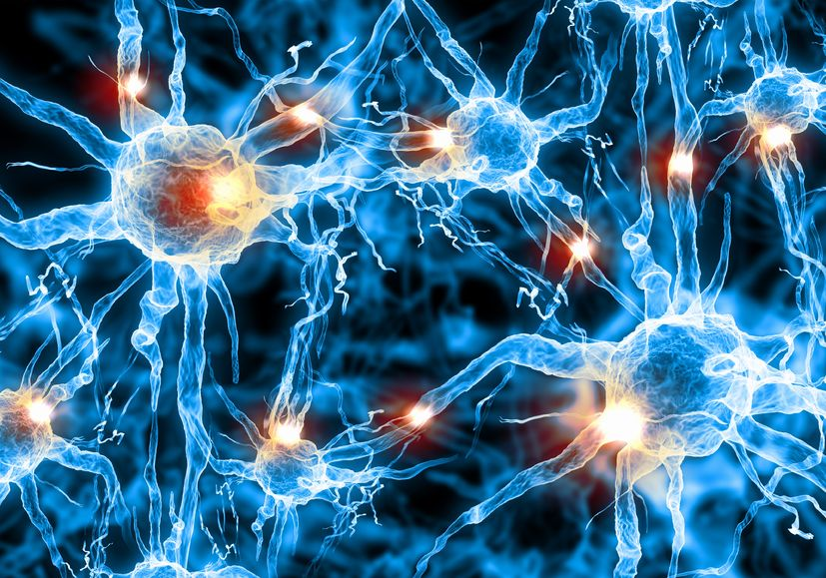
Psychobiotics: Summary
Protection of intestinal barrier function
Influence on local and systemic antioxidant status
Direct neurochemical production e.g. Gamma Amino Butyric Acid
Indirect influence on neurotransmitter function
Prevention of stress-induced alterations in microbiota
Direct activation of neural pathways between gut and brain
Modulation of inflammatory cytokines
Modulation of Brain derived neurotrophic factor (BDNF)
Limitation of small intestinal bacterial overgrowth (SIBO)
The Gut Microbiome and Diet in Psychiatry: Focus on Depression
Sarah Dash; Gerard Clarke; Michael Berk; Felice N. Jacka
Curr Opin Psychiatry. 2015;28(1):1­6.
Fermented foods, microbiota, and mental health: ancient practice meets nutritional psychiatry
Eva M Selhub1*†, Alan C Logan2† and Alison C Bested3
Journal of Physiological Anthropology 2014, 33:2
Psychobiotics and the gut-brain axis: in the pursuit of happiness.
Zhou L and Foster J
Neuropsychiatirc Dis and Treatment 2015: 11 715-23

Slide 38
Serum Brain-Derived Neurotrophic Factor and the Risk for Dementia – The Framingham Heart Study
2131 dementia free subjects
Age > 60 years
BDNF at baseline
Development of dementia
JAMA Neurology January 2014 Volume 71, Number 1

Slide 39
JAMA Neurology January 2014 Volume 71, Number 1

Slide 42
Disrupted Sleep
Loss of entrainment
15% Americans experience chronic insomnia
1 out of 3 has sleep disruption on one or more nights each week
Major risk factor for many chronic complex diseases
Neuro-endocrine-immune disruption
Sleep hygiene
Obstructive sleep apnea
Avoid pitfalls of sleeping medications

Slide 44
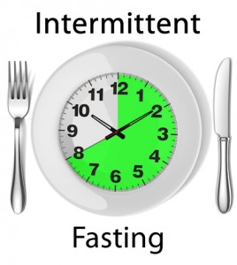
Intermittent fasting
Time restricted feeding (6-8 hrs) or complete periods of fasting for 24 hrs.
Decreases in body weight and visceral fat
Improved cardiovascular disease risk profile
Decreased inflammation (Biogerontology. 2015 Dec;16(6):775-88)
Decreased neuroinflammation (Neurobiol Aging. 2015 May;36(5):1914-23)
Autophagy (Autophagy, 2014;10:11, 1879-1882)

Slide 46
Modern Environments Create a “Primal Deficit Syndrome”
Compared to ancestral life, a modern human may experience:
Less natural light synchronization
Less darkness at night
Less physical activity in natural environments
Less natural outdoor multi-sensory stimulus
Less intake of unprocessed foods, fiber and phytonutrients
Less contact with non-pathogenic microbial diversity
Less meaningful social connection
Less opportunity to function/sleep in electromagnetic environments that remain unaltered by human intervention
Less community celebration

Slide 47
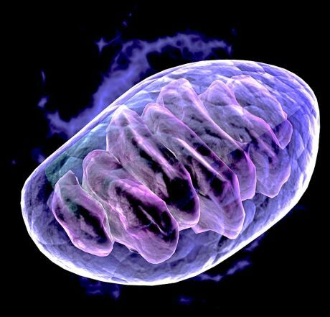
Mitochondrial Health
D: Digestion and detoxification I: Inflammation and oxidative stress
S: Stress HPA Axis (fight-flight)/Sleep
H: Hormones
Elimination trial e.g. gluten, dairy, ? grains
Digestion e.g. gluten/grain; SIBO; dysbiosis; leaky gut
Detox e.g. heavy metals, mold, toxicants and decreased elimination
Nutrient deficiencies: B vitamins, A, D, E, K, Mg, Zn, fermentable fiber, O-3, choline
Hormonal e.g. HPAGT axis; Insulin-leptin resistance; sex hormones
Chronic infections e.g. Lyme, CMV, EBV, HHV 6
Social Isolation
Sedentary states
Disrupted sleep patterns

Slide 48
Mitochondrial Cocktail
MVI-mineral supplement
Coenzyme Q 10 (ubiquinol) Mito Q 2 daily
Acetyl-L-Carnitine (ALC) 500-1000 mg twice daily
Alpha Lipoic Acid 200 mg twice daily
Creatine Krealkalyn Pro 2 caps/twice daily
N-Acetyl Cysteine (NAC) 600 mg twice daily
NT factor (cardiolipin)
Adv Drug Deliv Rev. 2008 Oct-Nov;60(13-14):1561-7. doi: 10.1016/j.addr.2008.05.001. Epub 2008 Jul 4.
Curr Treat Options Neurol. 2009 Nov; 11(6): 414–430.

Slide 49
Pyrroloquinoline quinone (PQQ)
PQQ reverses cognitive impairment caused by chronic oxidative stress and improve performance on memory tests in animal models.
PQQ supplementation stimulates the production and release of nerve PQQ protects against the self-oxidation of the DJ-1 gene, an early step in the onset of Parkinson’s disease.
PQQ blocks the formation of inducible nitric oxide synthase (iNOS), a major source of reactive nitrogen species (RNS) that are so damaging to brain cells.
PQQ protects the brain against neurotoxicity induced by other powerful toxins, including mercury
PQQ also protects nerve cells from the damaging effects of the beta-amyloid-protein linked with Alzheimer’s disease.
Nunome K, Miyazaki S, Nakano M, Iguchi-Ariga S, Ariga H. Pyrroloquinoline quinone prevents oxidative stress-induced neuronal death probably through changes in oxidative status of DJ-1. Biol Pharm Bull. 2008 Jul;31(7):1321-6.
Chowanadisai W, Bauerly KA, Tchaparian E, et al. Pyrroloquinoline quinone stimulates mitochondrial biogenesis through cAMP response element-binding protein phosphorylation and increased PGC-1alpha expression. Journal of Biological Chemistry 2010;285(1): 142–52
Rucker R, Chowanadisai W, Nakano M. Potential physiological importance of pyrroloquinoline quinone. Altern Med Rev. 2009 Sep;14(3):268-77.

Slide 50
60 yo woman with the following:
Longstanding intermittent depression, on Celexa
Anxiety, at times debilitating in social scenarios
Struggling with weight BMI 35 (waist circumference 38)
Type 2 DM on Metformin
Rheumatoid arthritis on disease-modifiers and TNF inhibitors
IBS - Miralax
GERD on PPI
Insomnia-Disrupted sleep patterns on Trazadone
Hypercholesterolemia on atorvastatin
BP 136/84 Waist-Hip 1.4
Skin: Mild rosacea; Patches of eczema on UEs
HEENT: Many amalgam fillings
Neck circumference 16”

Slide 51
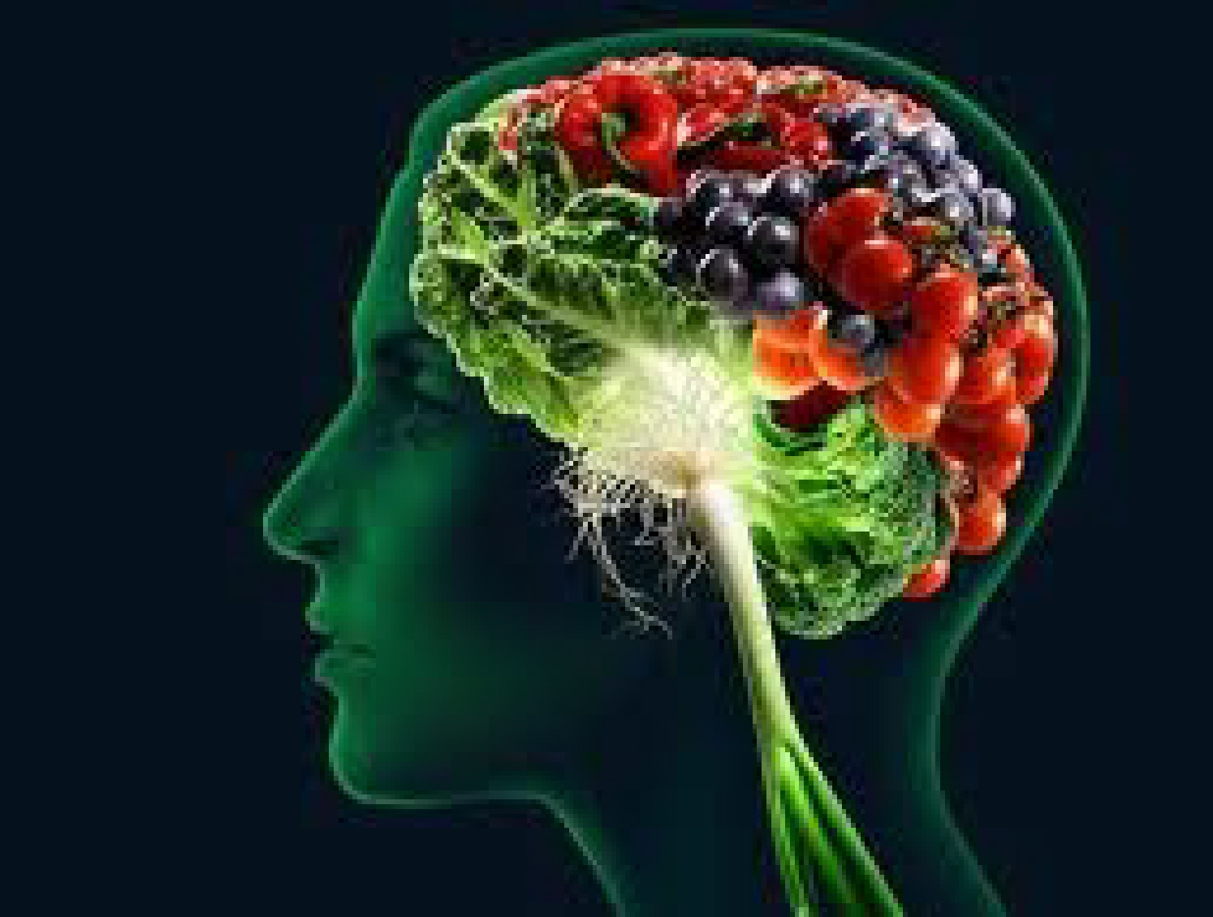
Integrative Lifestyle Medicine Strategy
Elimination trial e.g. wheat, grains (carbohydrate-dense foods), sugar
Breath test + for SIBO (hydrogen and methane), Rx with Xifaxin and Neomycin
Nutrient-dense fermentable fiber, “anti-inflammatory diet”
Spices-herbs e.g. turmeric, rosemary, basil
Probiotics: VSL 3, high-potency
Taper, d/c PPI: Digestive enzymes, zinc carnosine, melatonin
Ubiquinol while on statin (mitochondria)
Breath, meditation, heart rate variability
Full-spectrum light exposure
Sleep hygiene
Walking, yoga

Slide 52
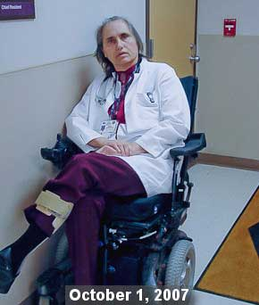

Slide 53
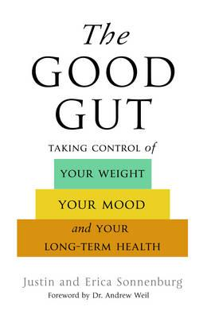
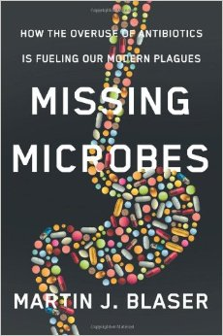
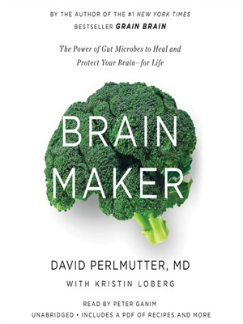
Good Books

Slide 54
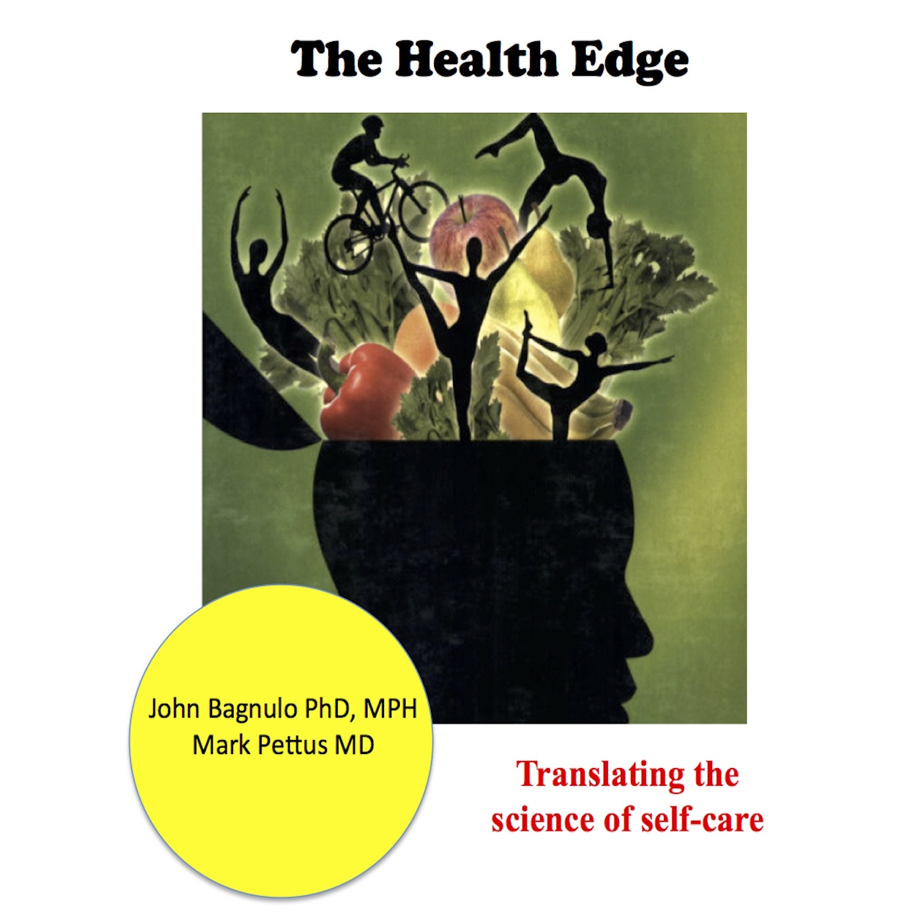
Thank you!
www.thehealthedgepodcast.com

