Slide 1
Ten Evidence-Based (and powerful) Lifestyle Interventions
November 24, 2015
Mark Pettus MD
Clinical Associate Professor of Medicine
University of Massachusetts Medical School

Slide 2
10: Play Outdoors (and don’t be afraid of dirt)
Loss of circadian entrainment associated with a host chronic health challenges and quality of life.
Full spectrum light exposure associated with a host of health benefits including improved mood, pain reduction, diminished inflammation, and greater health resiliency.
Connection between soil and human microbiome

Slide 3
9: Social Connection and Health
From an evolutionary biologic perspective we are born to bond
Reduced stress states
Improved coping and resiliency
Reductions in disease risk
Greater longevity and quality of life

Slide 4
8: Motion is the Lotion
Walk continuously
Be efficient with exercise dose-response e.g. small doses of HIT, functional resistance with emphasis on core
Dance to the music you love!
The Holy Grail from a disease risk-reduction perspective
Prolonged sitting is dangerous and not “undone” with regular exercise
Improved mood, resilience, less pain, less inflammation, improved insulin sensitivity, decreased anxiety

Slide 5
7: Laughter Really is Good Medicine
Amazing capacity to reduce stress response
Social connection greatly enhanced
Lower markers of inflammation, pain, and anxiety
Enhanced secretory IgA production

Slide 6
6: Embracing the moment you are in
Mindfulness practices powerfully proven to reduce disease risk
Epigenetic effects reduce inflammation, improve insulin sensitivity
Improved mood, resilience, reduced anxiety
Improved performance, creativity and problem-solving capacity
MBSR, meditation, prayer, yoga, journaling, tai chi

Slide 7
5: Consider Organic for the Dirty Dozen and go to town with the Clean 15

Slide 8
4: Sleep Hygiene
Loss of entrainment as a major contributor to disease risk and diminished quality of life
Circadian genes
Maximally darkened room
Consistent timing
Filter blue light after sundown (f•lux); orange lens glasses
Cooler temp - 64°
No caffeine after 2p
Avoid late night dining-snacking

Slide 9
3: Take care of your microbiome
An emerging major contributor to human health and disease
Be prudent with antibiotics
SIBO: 20% population and majority of those with IBS…think breath test for hydrogen and methane
Prebiotics are critical: Fermentable plant-based fiber
Probiotics for some
FMT an emerging “technology”

Slide 10
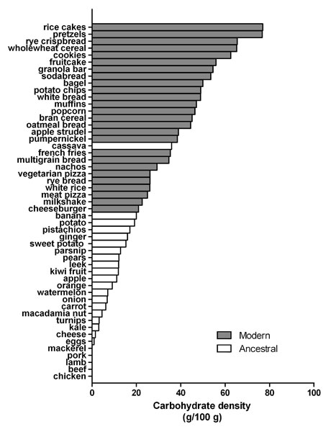
2: Reduce acellular carbohydrate-dense foods
Major contributor of obesity, insulin resistance, dyslipidemia, inflammation, and alterations of the human microbiome
A huge area of opportunity in individuals with increased visceral fat, pre-diabetes or diabetes…these are phenotypes of carbohydrate intolerance.
For many, wheat-based foods are problematic: eliminate and observe.

Slide 11
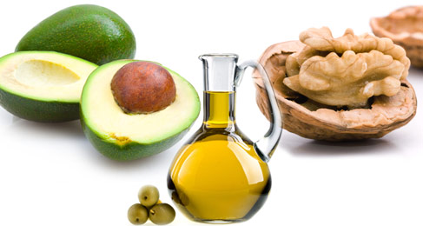
1: More quality fat sources
Pasture-raised eggs
Grass-fed butter
Ghee
Whole fat yogurt, kefir
Extra virgin olive oil
Extra virgin coconut oil
Avocados
Nuts - almonds, macademia

