Slide 1

Metabolic Tune-Up for Brain Health
A Case-Based Review
Mark C. Pettus MD, FACP
Clinical Associate Professor of Medicine
University of Massachusetts Medical School

Slide 2
Learning objectives
Using an actual case we will apply the HANDS tool for extracting-organizing the critical clinical information.
We will review the clinical reasoning-testing of the key core imbalances impacting brain health, mood, and quality of life.
Understand the rationale for applied, integrated personalized lifestyle medicine strategies for producing a more balanced metabolic landscape…a metabolic tune-up.

Slide 3

Long-Latency Diseases
Disease (how things appear)
Diabetes, Obesity, Metabolic Syndrome, Depression, Autoimmunity, Fibromyalgia, Chronic fatigue
GAD, GERD, IBS, OSA (obstructive Sleep Apnea)
Core Metabolic Imbalances (what drives them)
DISH
D: Digestion and detoxification
I: Inflammation and oxidative stress
S: Stress HPA Axis (fight-flight)/ Sleep
H: Hormones (insulin, leptin, cortisol, etc.)
Root Causes (what are their origins)
Environment+Epigenome/genes+Microbiome
Nutrition Movement Stress Response Environmental toxins Sleep Social Connection Trauma Conflict Management Mindfulness Spirituality-Meaning in Work, Love, Play

Slide 4
48 yo RN with the following:
Longstanding intermittent depression, on Celexa
Anxiety, more frequent in social scenarios
Struggling with weight BMI 35 (waist circumference 38)
Type 2 DM on Metformin
Rheumatoid arthritis on disease-modifiers and TNF inhibitors
IBS – Miralax with constipation-dominance
GERD on PPI e.g. Nexium for many years
Insomnia-Disrupted sleep patterns on Trazadone
Hypercholesterolemia on atorvastatin (Lipitor)

Slide 5
48 yo RN whose health is on a slippery slide
Feeling poorly despite receiving the “best-evidence” interventions by many caring, compassionate caregivers.
Feels she has hit the wall. “I feel out of control of my life”.
“I am told most of this is genetic and otherwise has no identifiable causes.”
She was interested in another strategy for “getting her life back”.

Slide 6
History & Lifestyle
Digestion-Detoxification
GERD on PPI
IBS
Concerns SIBO, leaky gut, dysbiosis
Inflammation-oxidative stress
Rheumatoid Arthritis
Depression-anxiety
Visceral adipose
Stress-Sleep
Insomnia-sleep disruption
Anxiety
Hormone
Insulin resistance
Leptin resistance
Cortisol (adrenal)

Slide 7
Anthropometric and Vitals
High waist-hip ratio (? VAT)
High BMI
Deconditioned
BP 140/90
Resting HR 84

Slide 8
Nutrition-Focused Physical
Alopecia-hair-thinning
Sweaty
Small airway
Multiple dental amalgams
Neck circumference 16”
Skin: occ patches eczema
No thyromegaly-nodules
Heart- rapid w/o murmur
Mild-mod RA changes MCP
No edema

Slide 9
Diet and Food Habits
3-day diet journal
Long-time low fat (30%) higher grain-based diet (55%). Many refined carbs (stress)
Frequent snacking mid-day and evening due to hunger and cravings
Eating out 3-4x/week
Ave. 3-4 servings veggies-fruits/day (poor fiber intake)
“Avoids fat” due to lipids, (on a statin) and due to higher caloric content
Gets good protein sources with most meals
Frustrated “always thinking about food, weight and the guilt that comes with it”.
Limited time outdoors

Slide 11
Pertinent Labs
FBS 110
Fasting Insulin 12
HbA1c 7.0
hsCRP elevated at 22
Thyroid panel wnl
Lipids: Total cholesterol 190; LDL 100; TGA 200; HDL 40
25-hydroxy vitamin D - 18

Slide 12
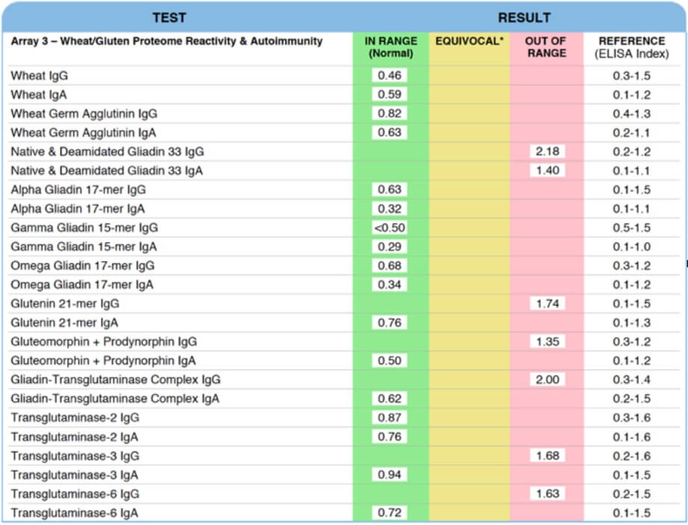

Slide 13
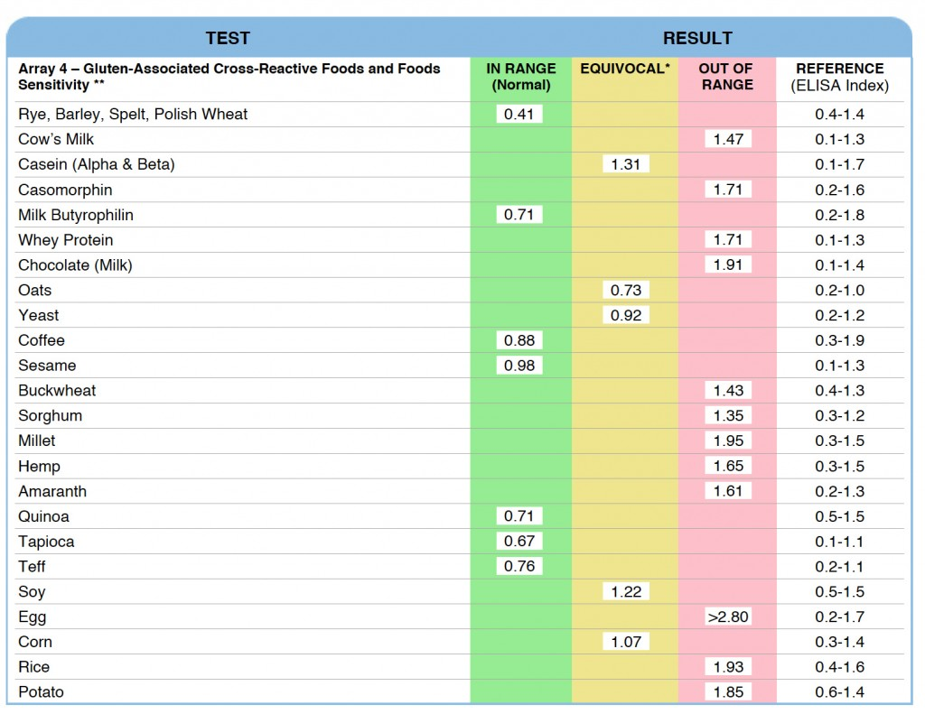

Slide 14
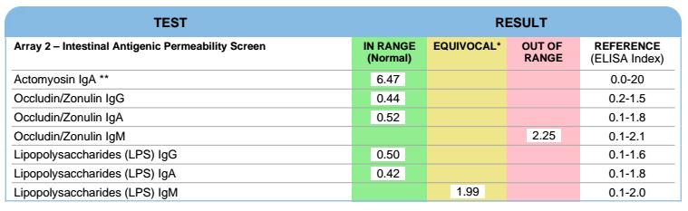

Slide 15
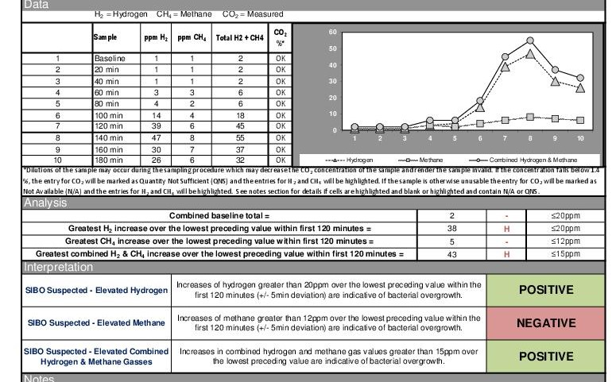

Slide 16
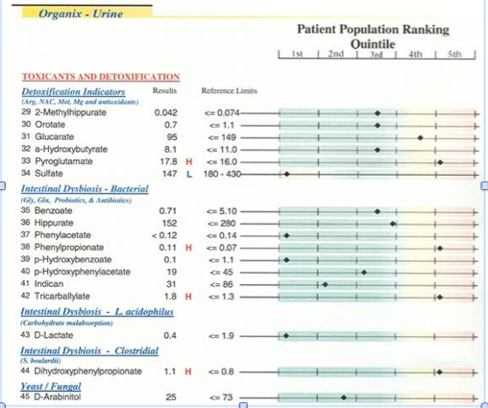

Slide 17
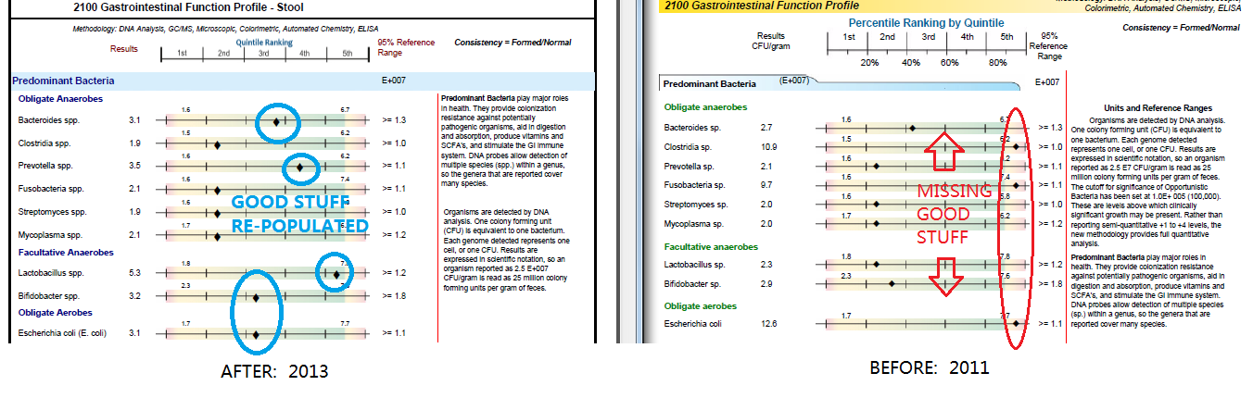

Slide 18
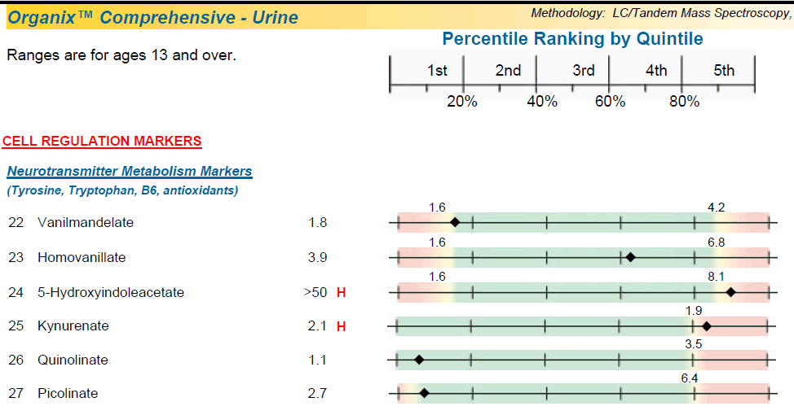

Slide 19
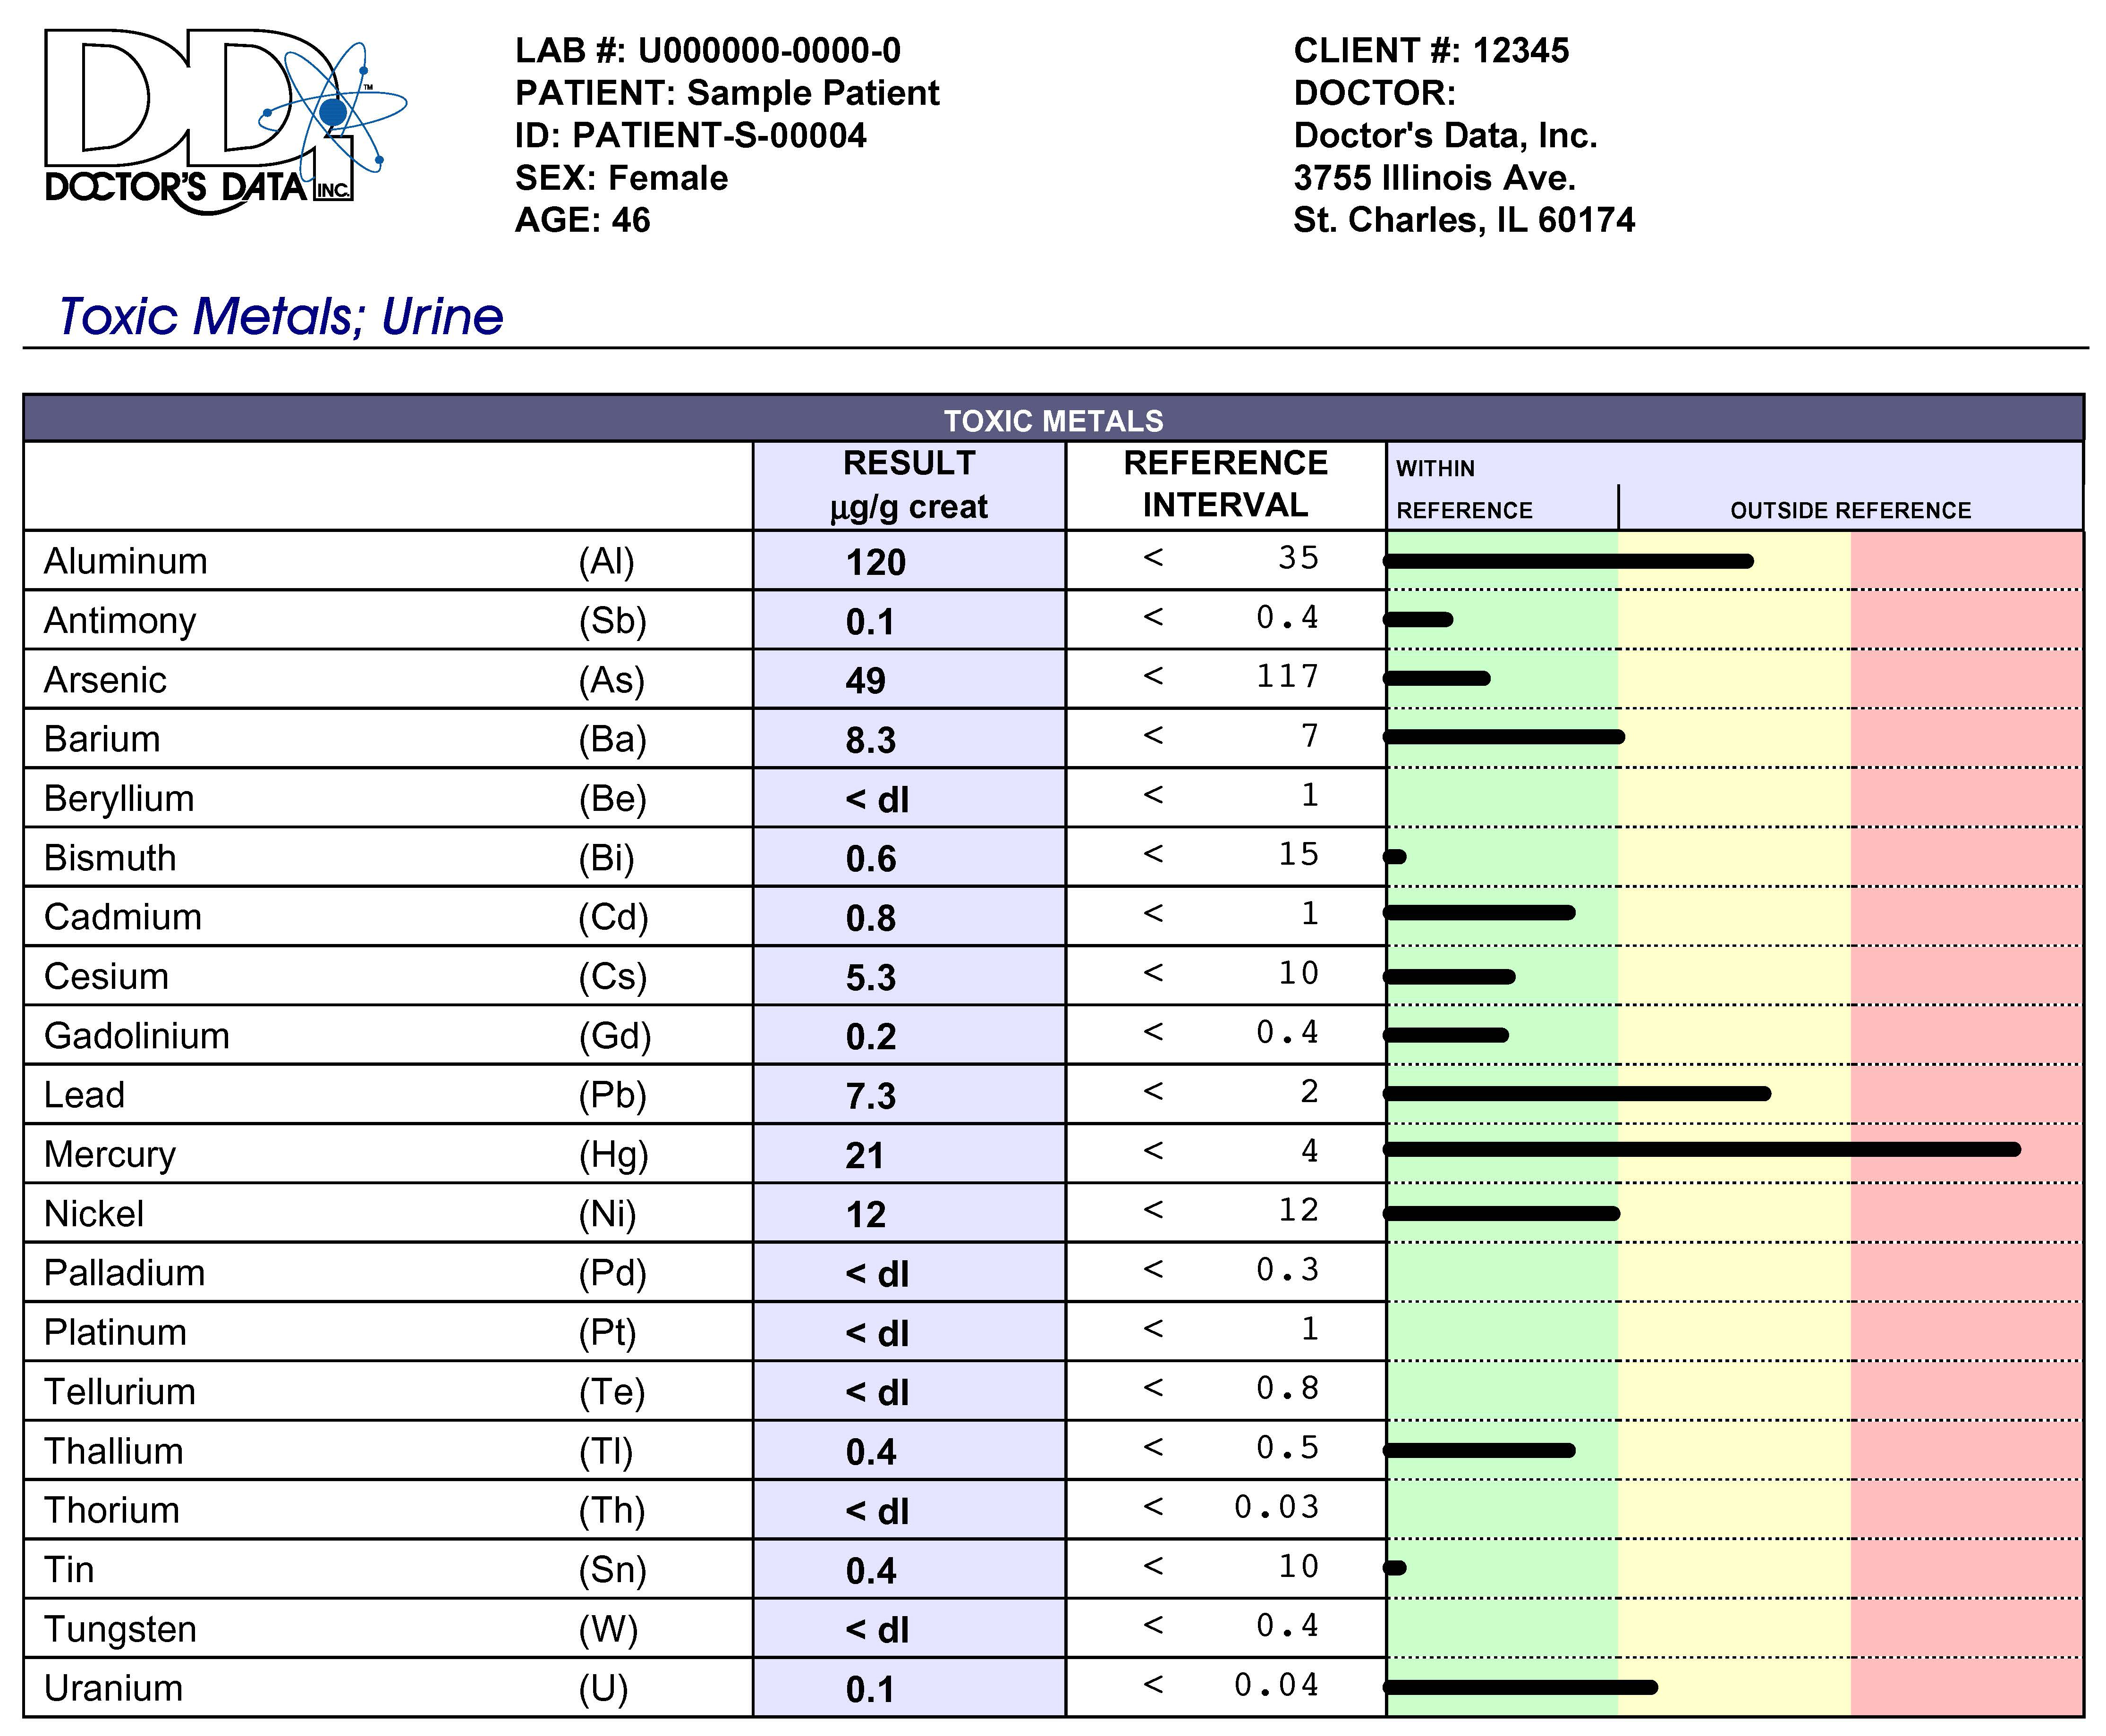

Slide 20
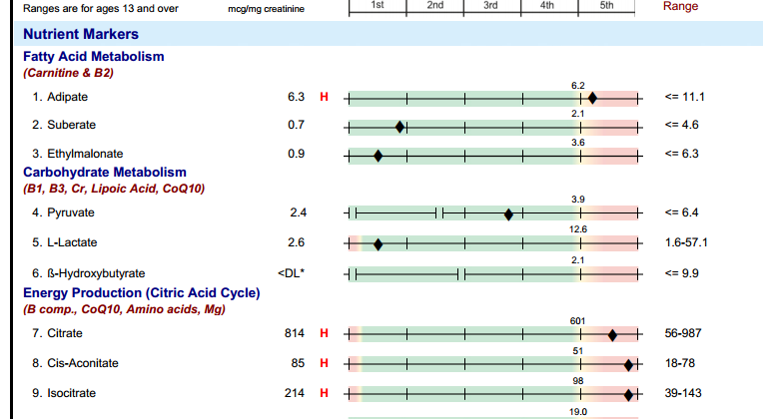

Slide 21
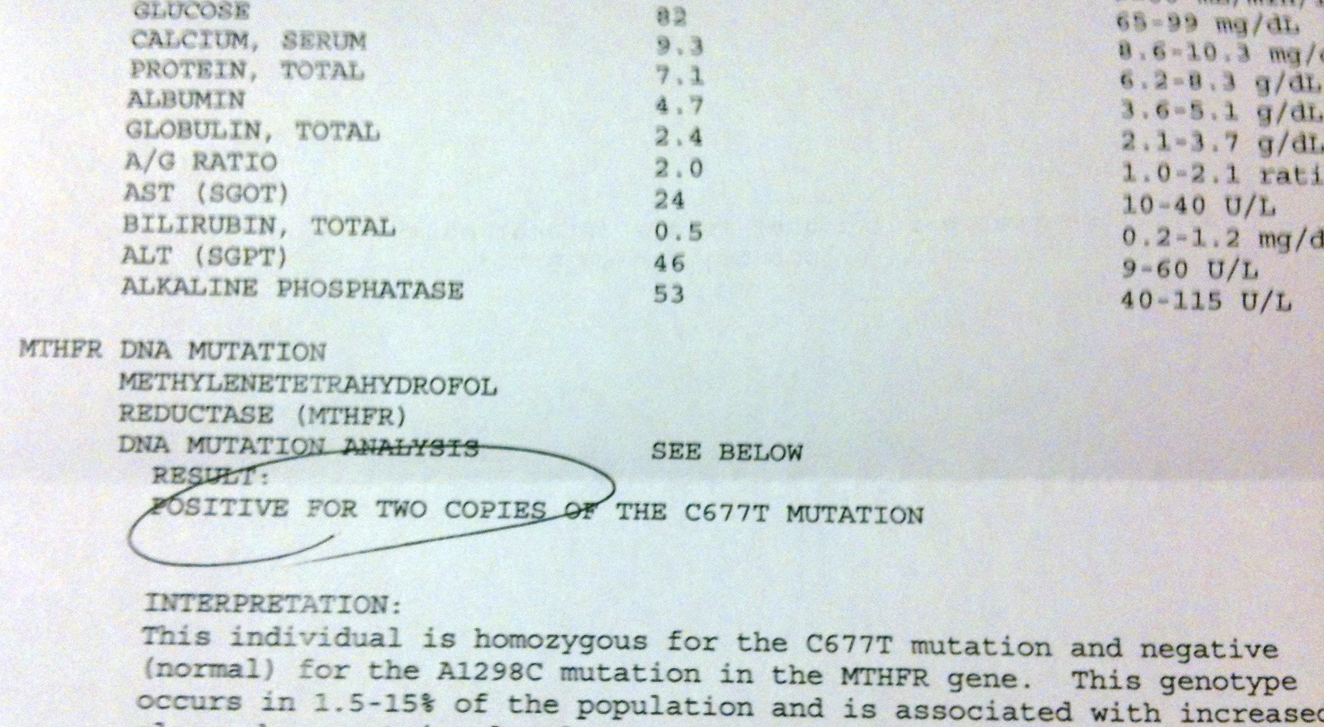

Slide 22
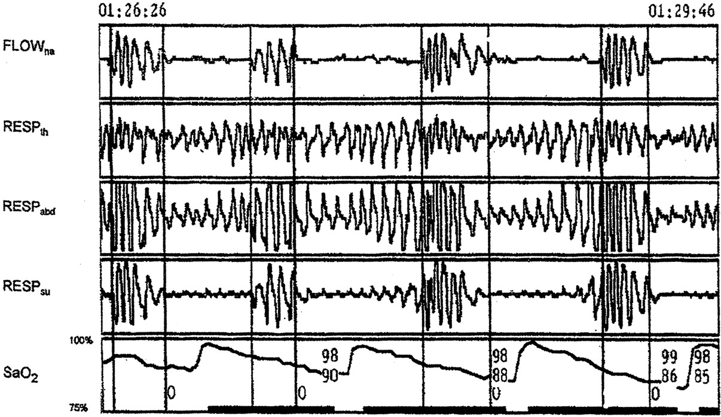
Sleep Study
Frequent episodes of nocturnal hypoxemia that corrected with positive pressure airway support

Slide 23
Nutrition Care and Collaboration
Develop nutritional intervention strategies with e.g. hypoallergenic/anti-inflammatory, low glycemic, nutrient dense and plentiful with microbiota-accessible carbohydrates (MAC)
Concurrent providers of care e.g. primary care, endocrine, rheumatology; pulmonary-sleep referral; GI
Behavioral health, health coach
? Physiatry eval. For deconditioning, chronic musculoskeletal pain
Follow-up as needed

Slide 24
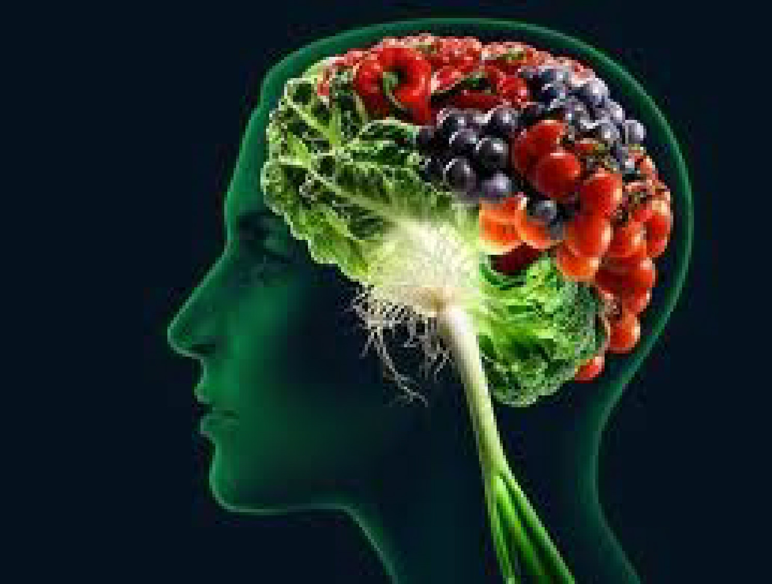
Integrative Lifestyle Medicine Strategy
Nutrition
Elimination trial e.g. gluten, grains (carbohydrate-dense foods), sugar, and casein
More liberal healthy fat sources e.g. Omega-3, nuts, pasture-raised butter and eggs, ghee, olive and coconut oils, avocados
Significant increase in nutrient-dense fermentable fiber, “anti-inflammatory diet” allium/cruciferous vegetables to aid in detoxification, provide more sulfa, diversify microbiome
Spices-herbs e.g. turmeric, rosemary, basil, curcumin, cayenne pepper
Gut
Elimination trial as above
More microbiota accessible carbohydrates (MAC)
Breath test + for SIBO (hydrogen and methane), Rx with Xifaxin and Neomycin
Taper, d/c PPI (Nexium): Digestive enzymes, zinc carnosine,
Probiotics: VSL #3

Slide 25
Stress-Mind and Mood
More time outdoors under full-spectrum light
Soft-belly breath, meditation, heart rate variability
Consider tyrosine and taurine as supplements; SAMe for mood and methylations support
Methylated forms of B12 and folate
Sleep
Pulmonary-sleep lab referral: OSA testing positive
Sleep hygiene: melatonin,
Walking, yoga, journaling, guided imagery
Full-spectrum light exposure; light box in am
Additional Nutrients-Supplementation for consideration
Ubiquinol (Co-Q10) while on statin (mitochondria)
Modified citrus pectin to assist with heavy metal detoxification
Melatonin, l-theonine for sleep
Chamomile tea for sleep

Slide 26



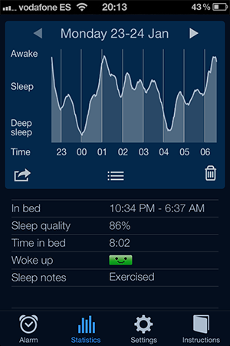
Apps
ewg.org Food Scores, Dirty Dozen, Skin Deep
Sleep Cycle
f•lux (filters blue light)

Slide 27
2 years later
Lost (and sustained) 35 lbs
Diabetes reverse-stopped metformin
BP down without medication
RA Sx “never better”…requiring less medication and more active
Mood and anxiety improved – tapering celexa
Sleeping much better – stopped Trazadone
Lipids much improved i.e., lower TGAs, higher HDL,
fewer # small-dense LDL particles: Tapering Atorvastatin
More active and with more energy
Reflux…”gone” off Nexium
Life has been transformed from one of “demoralizing futility” to one of “hope”.

Slide 28
“My doctors think it’s a miracle!”

Slide 29
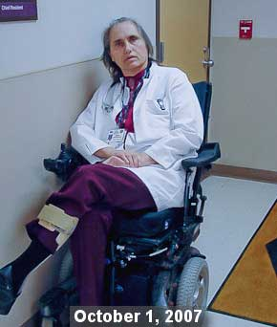



Slide 30
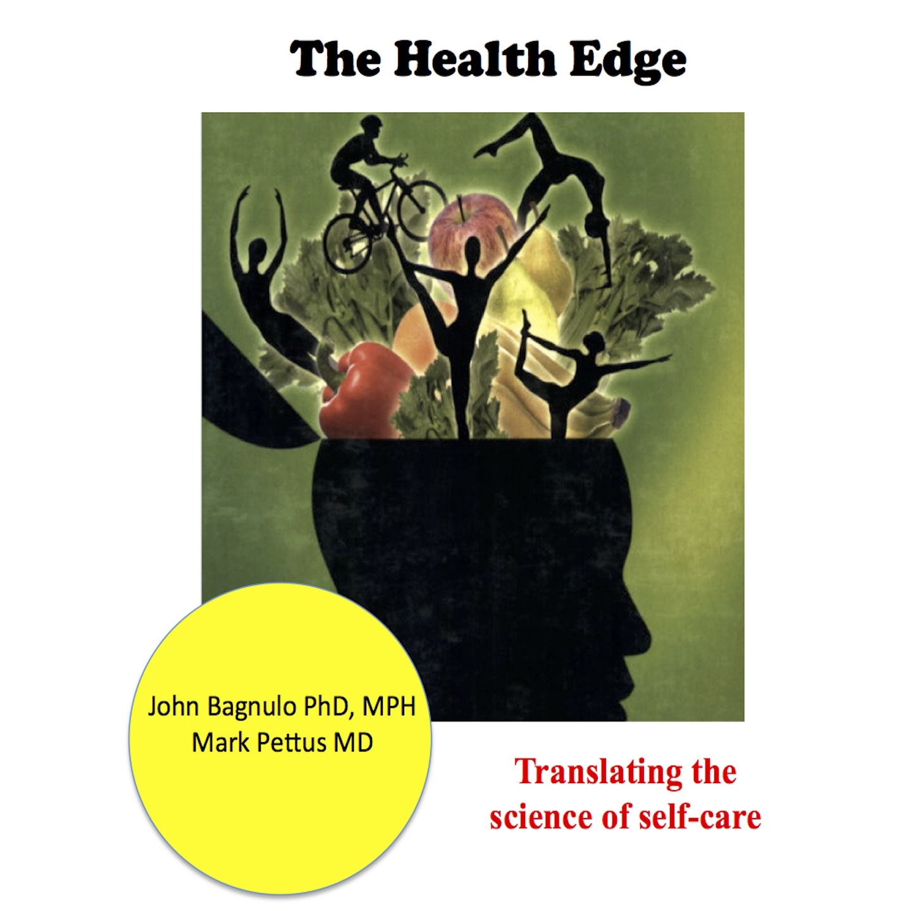
Thank you!
www.thehealthedgepodcast.com

