Slide 1
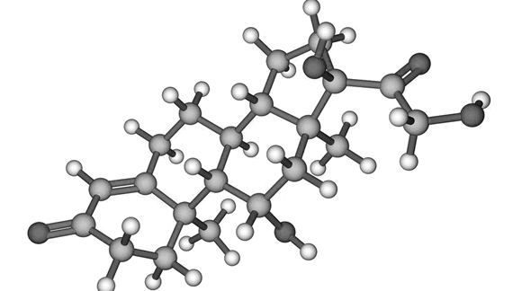
Understanding Metabolism how did the fat switch get turned on?
Mark Pettus MD
February 11, 2014
Director of Medical Education
Population Health
Berkshire Health Systems
www.thehealthedgepodcast.com

Slide 2
The Course
Epigenetics
Metabolism-Insulin resistance/metabolic syndrome
Inflammation
Gut-microbiome barrier function
Environmental toxins- mitochondria
The science of mind
Social connection and health
Spiritual practice and health outcomes

Slide 3
Learning Objectives
Examine the drivers of weight gain, insulin resistance and metabolic syndrome
Examine the relationship between macronutrient content, lipogenesis (the biologic imperative to store fat) and leptin-insulin resistance
Review strategies to achieve more effective metabolic efficiency.

Slide 4
Four essential clinical pearls
Calorie restriction decreases metabolic rate, enhances hunger and reduces the drive to move. For most, eat less-do more is not a successful or sustainable strategy.
Different macronutrients produce different effects in thermogenesis, hormone regulation, and satiety.
Quality of calories is MUCH more important than quantity of calories.
The ultimate biologic endpoint is to reduce insulin levels.

Slide 5
Health as a byproduct of gene-environment compatibility

Slide 6
Environment
Life
Epigenome
Microbiome
Consciousness

Slide 7
Disease (how things appear)
Pre-diabetes, Diabetes, Obesity, Metabolic Syndrome, Heart Disease, Stroke, Depression, Autoimmunity, Alzheimer’s, Cancer, Autism, ADD, Hypertension
Fibromyalgia, CFS, MS, PD
Core Metabolic Imbalances (what drives them)
Inflammation-Immunomodulation
Fight-Flight (HPA axis) Microbiome (Gut-Immune)
Mitochondria-Bioenergetics
Detoxification, Hormonal, Insulin resistance (cell-signalling)
Root Causes (what are their origins)
Gene-Epigenome-Environment
Nutrition Movement Stress Response Environmental toxins Sleep Social Connection Trauma Conflict Management Mindfulness Meaning in Work, Love & Play
Smoking

Slide 8
Obesity Statistics
World Health Organization
& US DHHS. NIH.NIDDK

Slide 9
International Data
Global Problem (2005)
1.6 billion adults overweight (age 15+)
400 million adults obese
20 million children under age 5 overweight
Current Trends – by 2015
2.3 billion adults overweight
700 million - obese

Slide 11
US Data: National Institute of Diabetes, Digestive & Kidney Diseases (NIDDK)
Fast Facts
More than 2 in 3 adults overweight or obese
More than 1 in 3 adults obese
More than 1 in 20 adults – extremely obese
About 1/3 of children adolescents (6-19) are overweight or obese
More than 1 in 6 children considered obese
From National Health and Nutrition Examination Survey (2009-2010)

Slide 12
How do we get FAT?

Slide 13
Prevailing View
Obesity occurs when a person consumes more calories from food than he or she burns.
National Institute of Health 2008
Overweight is the result of caloric imbalance (too few calories expended for the amount of calories consumed) and is mediated by genetics and health.
US Surgeon General 2008

Slide 14
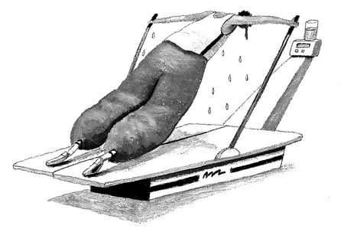

Slide 15
David Ludwig MD, PhD

Slide 16
David Ludwig MD, PhD

Slide 20
Top 20 Sources of Calories in the American diet (2013)
1. Grain-based desserts (138)
2. Yeast breads (129)
3. Chicken & chicken mixed dishes (121)
4. Soda/energy/sports drinks (114)
5. Pizza (98)
6. Alcoholic beverages (82)
7. Pasta & pasta dishes (81)
8. Tortillas, burritos, tacos (80)
9. Beef & beef mixed dishes (64)
10. Dairy desserts (62)
11. Potato/corn/other chips (56)
12. Burgers (53)
13. Reduced-fat milk (51)
14. Regular cheese (49)
15. Ready-to-eat cereals (49)
16. Sausage, franks, bacon & ribs (49)
17. Fried white potatoes (48)
18. Candy (47)
19. Nuts/seeds & nut/seed mixed dishes (42)
20. Eggs & egg mixed dishes (39)
TOTAL 68% OF CALORIES
NHANES 2013 USDA ANALYSIS

Slide 21
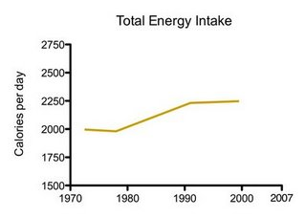

Slide 22
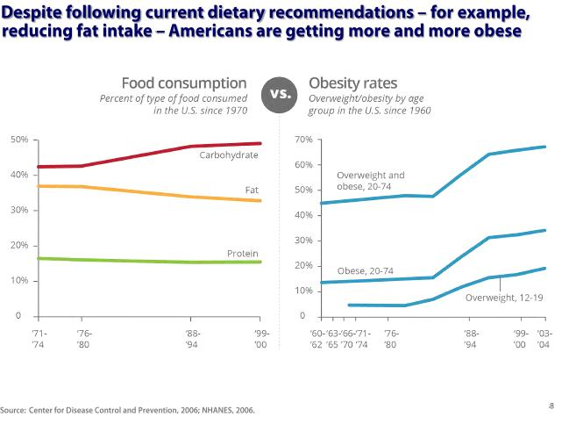

Slide 23
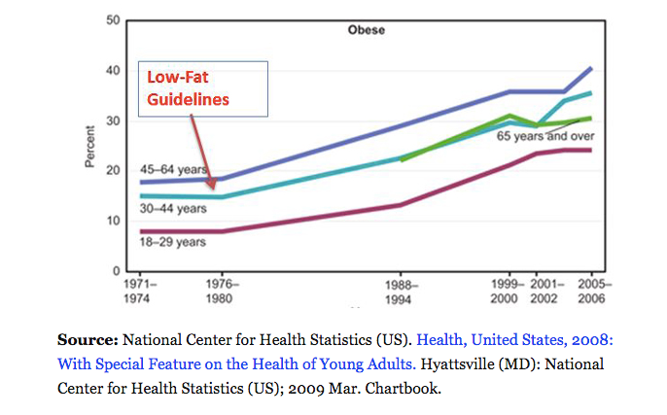

Slide 24
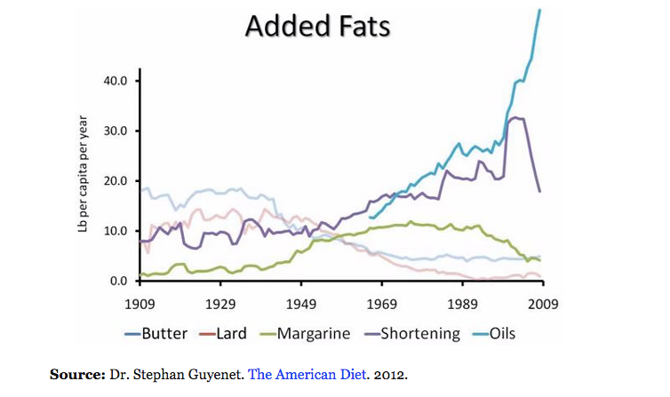

Slide 25
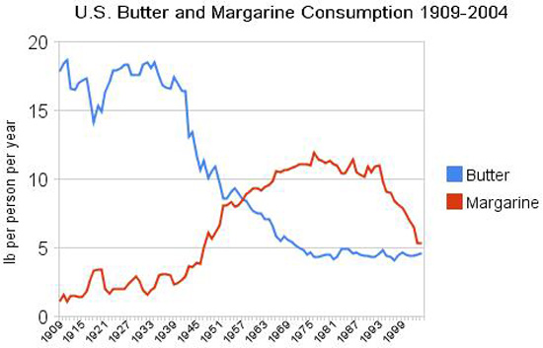

Slide 26
“ Are we fat because we eat too much or do we eat too much because we are fat ?”

Slide 27
How food composition affects metabolism
Different foods produce different:
changes in thermic effect
direct hormonal responses
changes in gene expression patterns (epigenetic response)
Effects on the microbiome
Notes:
TEE differed by approximately 300 kcal/d between these low fat and low carb diets, an effect corresponding with the amount of energy typically expended in 1 hour of moderate-intensity physical activity.

Slide 29
From: Increasing Adiposity: Consequence or Cause of Overeating?
JAMA. 2014;():. doi:10.1001/jama.2014.4133
Copyright © 2014 American Medical Association. All rights reserved.

Slide 30
A calorie is not a calorie…
Effects of Dietary Composition on Energy Expenditure During Weight-Loss Maintenance
Cara B. Ebbeling, PhD; David S. Ludwig, MD, PhD et al
Conclusion: Among overweight and obese young adults compared with pre–weight-loss energy expenditure, isocaloric feeding following 10% to 15% weight loss resulted in decreases in REE and TEE that were greatest with the low-fat diet, intermediate with the low–glycemic index diet, and least with the very low-carbohydrate diet.
TEE differed by approximately 300 kcal/d. people on the low-carb high fat diet burned 300 kcal/day more than those in the low-fat, high-carb group, an effect corresponding with the amount of energy typically expended in 1 hour of moderate-intensity physical activity
Remarkable range between individuals.
TEE: - 423 [–606 to –239] kcal/d for low fat diet
- 97 [–281 to 86] kcal/d for low carb diet
JAMA. 2012;307(24):2627-2634. doi:10.1001/jama.2012.6607
Notes:
TEE differed by approximately 300 kcal/d between these low fat and low carb diets, an effect corresponding with the amount of energy typically expended in 1 hour of moderate-intensity physical activity.

Slide 31
What is metabolic syndrome?
Waist Circumference > 35” in women and > 40” in men
BMI > 30 (= obese)
Elevated blood pressure: > 130/85
High triglycerides: > 150 mg/dL
low HDL: < 40 mg/dL men, < 50 women
Elevated fasting glucose: >100 mg/dL
Source: AHA
Notes:
WHO criteria which added insulin resistance

Slide 32
Prevalence
National Health and Nutrition Examination Survey (NHANES) 2003-2006, >3400 adults over age 20
Overall prevalence 34%
Increased with advancing age, weight
Higher prevalence in black and Mexican American females

Slide 33
Consequences of metabolic syndrome
Type II Diabetes
CVD/CAD
Dementia
Stroke
PCOS and infertility
Fatty Liver (NAFLD)
Breast, colon, prostate & other cancers
Psoriasis, rheumatoid arthritis, gout
Notes:
Among adults with type 2 diabetes, there was an estimated 1.6-fold increased prevalence for cancers of all sites among men and a 1.8-fold increase among women who reported being diagnosed with diabetes 15 or more years ago compared with those reporting diabetes diagnosis less than 15 years ago. Diabetes Care Jan 2013.
For breast cancer, 1.5 – 2.4 risk comparing women with highest levels of insulin to normal levels. Journal of the National Cancer Institute

Slide 34
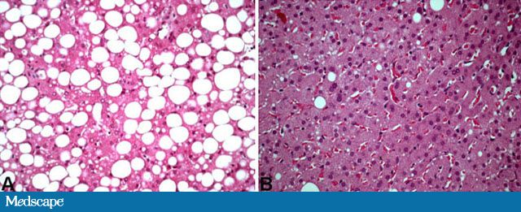
NAFLD
Has become one of the most common diseases in America from not having been described until 1980.
45% of all Latinos
33% of all Caucasians
25% of all African Americans
5% of all progress to NASH
25% NASH progress to cirrhosis
Preventable

Slide 35
Courtesy Dr. Richard Johnson

Slide 36
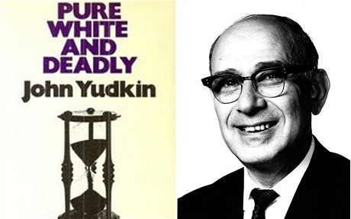

Slide 38
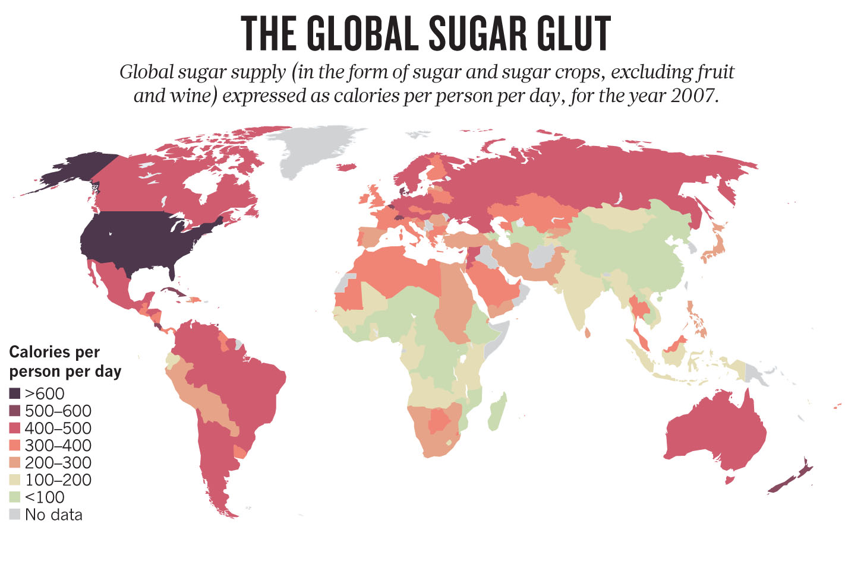

Slide 39
Stanhope KL et al. Consuming fructose-sweetened, not glucose-sweetened, beverages increases visceral adiposity and lipids and decreases insulin sensitivity in overweight/obese humans.
Journal of Clinical Investigation. 2009 May 1; 119(5): 1322–1334
“fasting plasma glucose and insulin levels increased and insulin sensitivity decreased in subjects consuming fructose but not in those consuming glucose.”
“dietary fructose specifically increases DNL, promotes dyslipidemia, decreases insulin sensitivity, and increases visceral adiposity in overweight/obese adults.”

Slide 41
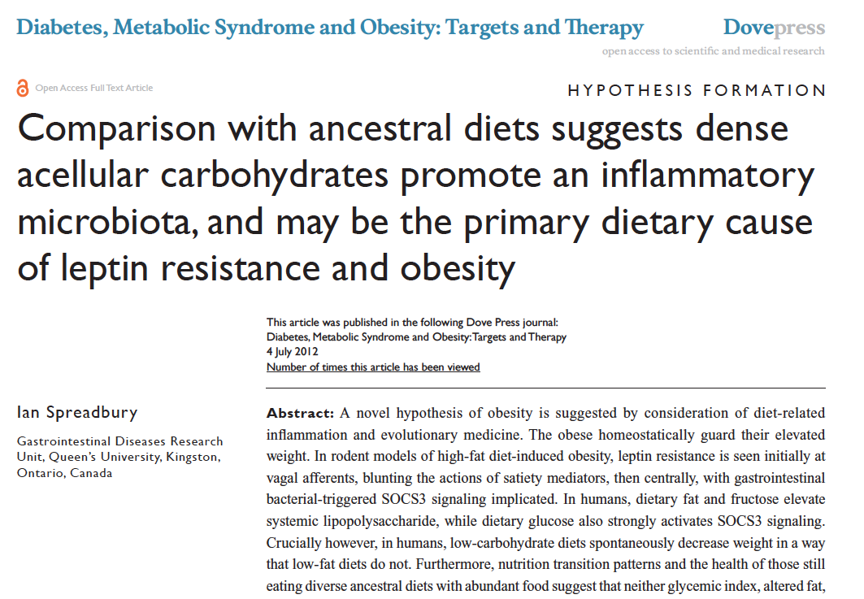

Slide 42
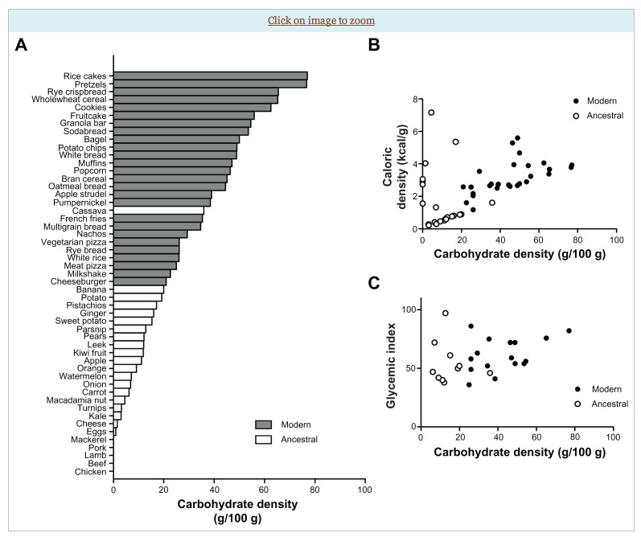

Slide 45
Leptin
Signals satiety in the brain (hypothalamus)
Signals “readiness” to move
Leptin resistance = weight gain, hard to control hunger, and a deep desire to minimize activity
Inflammation is associated with insulin resistance
Insulin resistance is associated with leptin resistance

Slide 46
Poor Quality Carbs
Inflammation
Visceral fat
Stress
Sleep disruption
Altered gut-permeability/microbiome
Social isolation
Toxin excess
Excess Insulin
Fat storage
Down-regulation of insulin receptors
Insulin Resistance
Leptin resistance
Eat more and do less

Slide 48
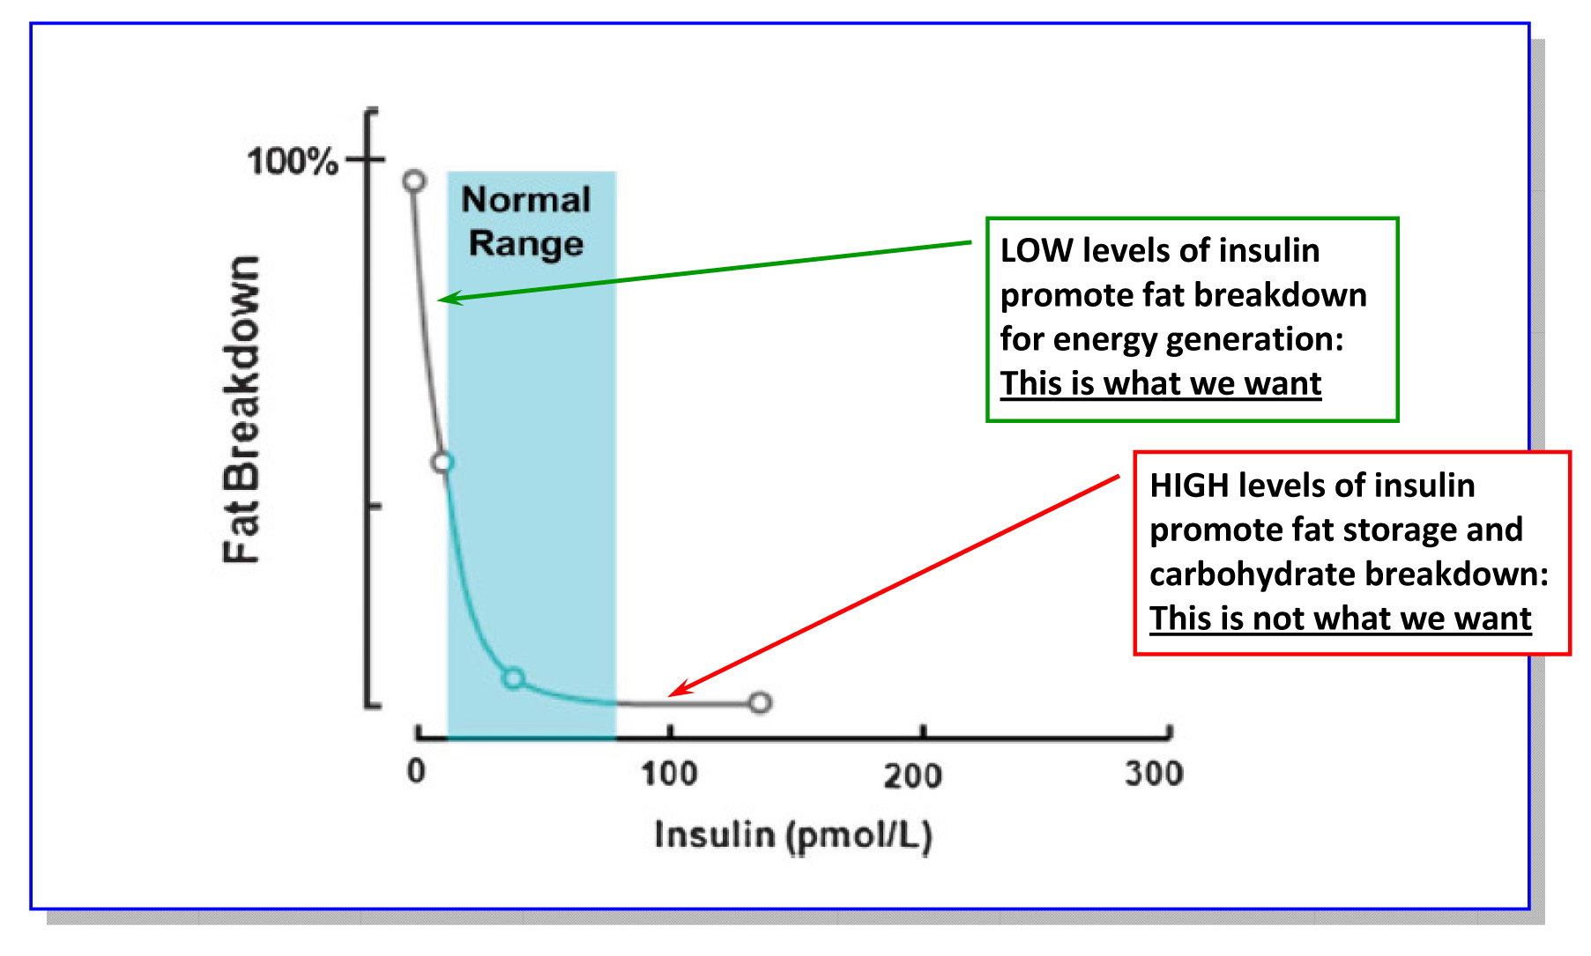
The biologic objective

Slide 49
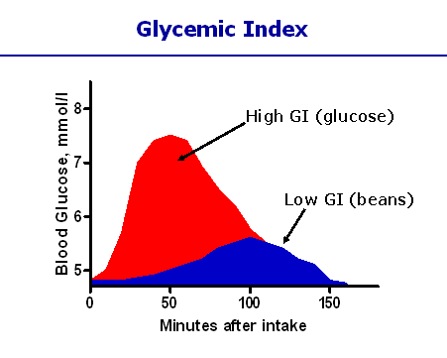
Different carbohydrates produce unique genomic responses!
High Glycemic Carbs Low Glycemic Carbs
62 genes regulating Same genes silenced;
Inflammation, stress, Genes regulating insulin
Immune responses↑↑ production turned off.
Kalle et al. Am J Clin Nutr; 2007:851:1417-27

Slide 50
Environment
Life
Epigenome
Microbiome
Consciousness

Slide 51
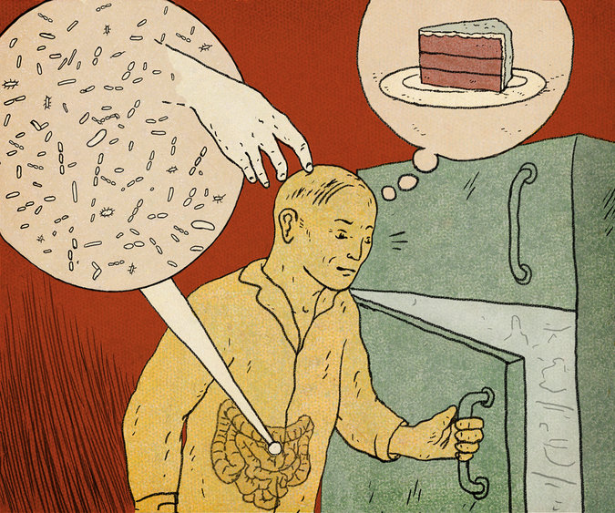
Are we just an elaborate vessel for the propogation of microbes?

Slide 52
The Microbiome…an evolving story
The MB has evolved with humans to allow survival
The MB provides important functions in digestion, immunity, metabolism and detoxification
Increased diversity seen with decreased hygiene
Early and diverse exposure key to a “healthy microbiome”
Getting dirty may be good for you
Increased CHO digesting MB in populations with higher CHO intake
Reduced diversity seen in obesity, IBD, autism spectrum
Diet is a powerful factor that can shift the microbiome

Slide 57
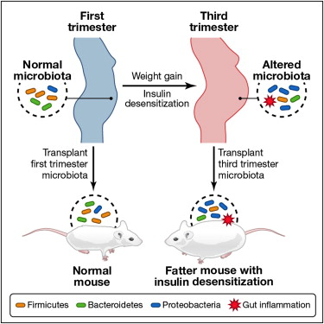

Slide 59
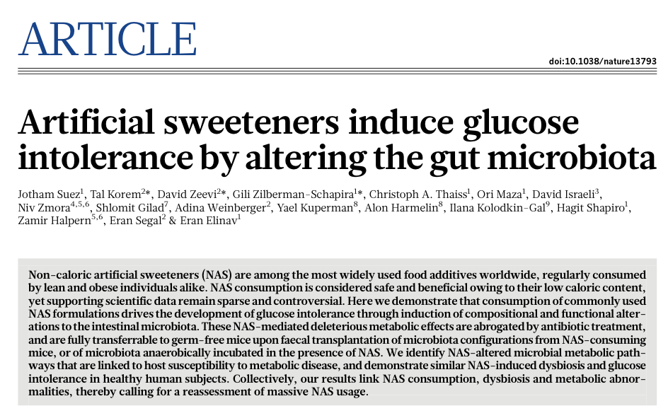

Slide 60
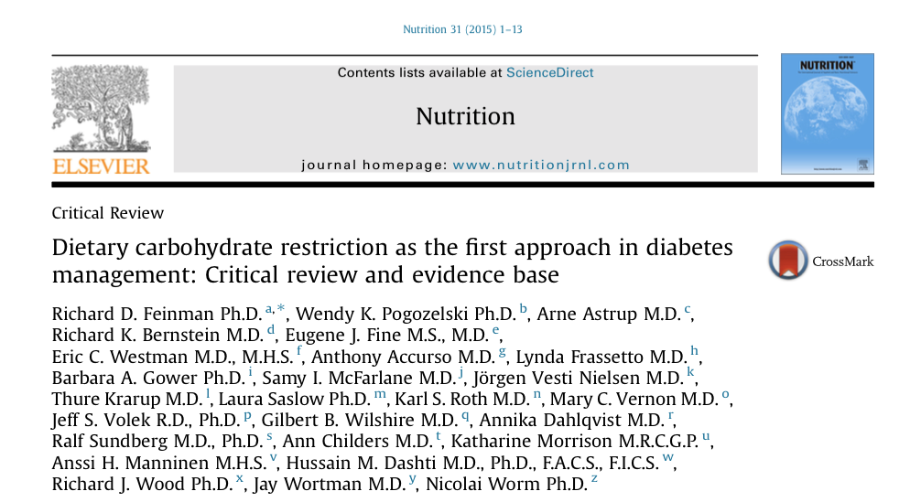
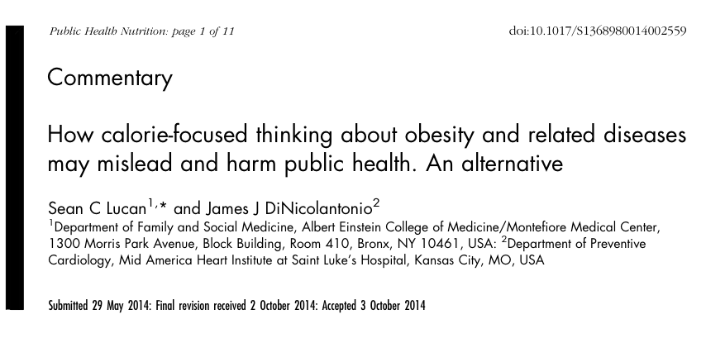

Slide 61
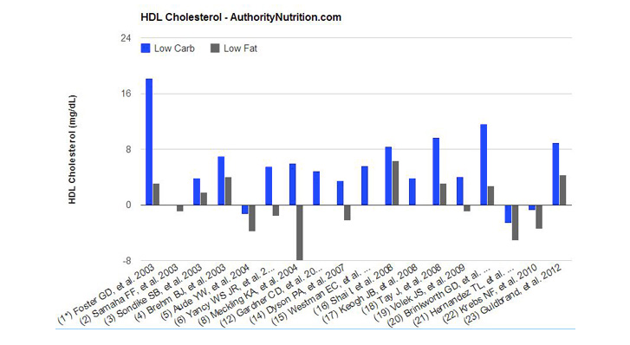

Slide 62
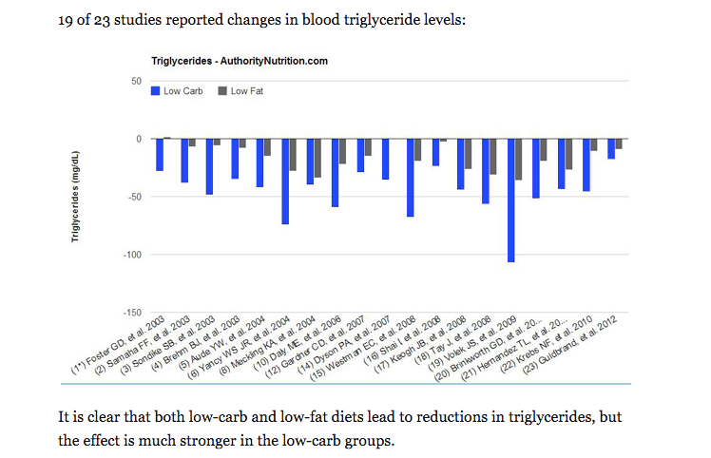

Slide 63
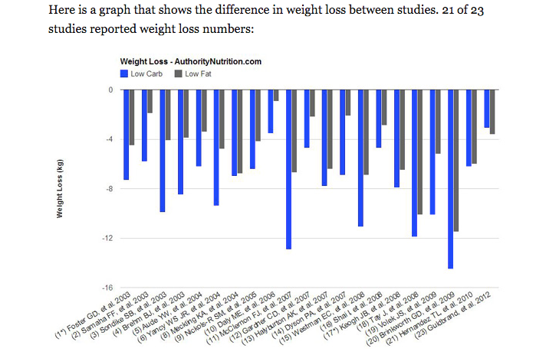

Slide 64
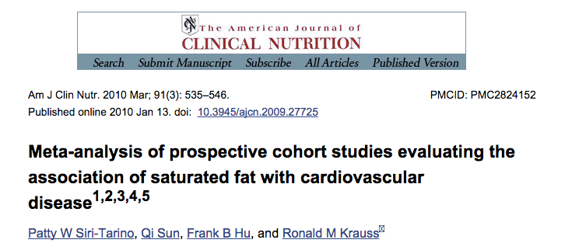

Slide 65
BMJ. 2013 Feb 4;346:e8707. doi: 10.1136/bmj.e8707.
Use of dietary linoleic acid for secondary prevention of coronary heart disease and death: evaluation of recovered data from the Sydney Diet Heart Study and updated meta-analysis.
Ramsden CE, Zamora D, Leelarthaepin B, Majchrzak-Hong SF, Faurot KR, Suchindran CM, Ringel A, Davis JM, Hibbeln JR.
CONCLUSIONS:
Advice to substitute polyunsaturated fats for saturated fats is a key component of worldwide dietary guidelines for coronary heart disease risk reduction. However, clinical benefits of the most abundant polyunsaturated fatty acid, omega 6 linoleic acid, have not been established. In this cohort, substituting dietary linoleic acid in place of saturated fats increased the rates of death from all causes, coronary heart disease, and cardiovascular disease. An updated meta-analysis of linoleic acid intervention trials showed no evidence of cardiovascular benefit. These findings could have important implications for worldwide dietary advice to substitute omega 6 linoleic acid, or polyunsaturated fats in general, for saturated fats.
Conclusion: Substituting polyunsaturated vegetable oils for saturated fats increased cardiovascular risks and deaths from all causes.

Slide 66
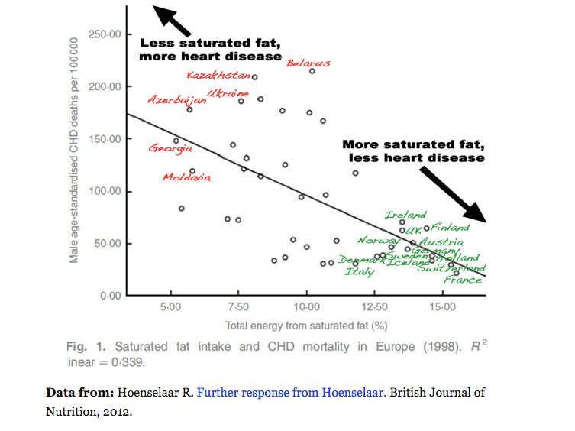

Slide 67
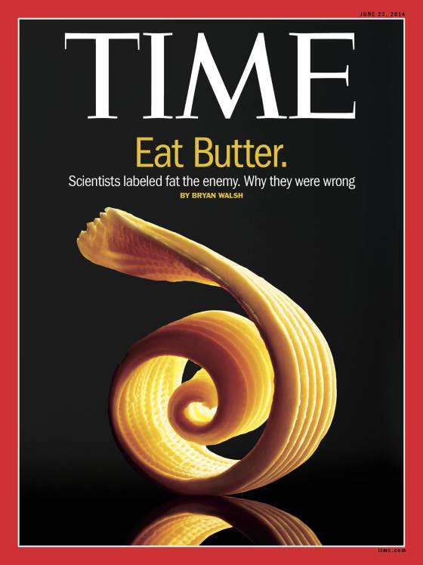
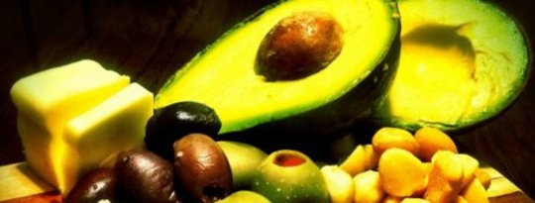

Slide 68
Activity and Movement
Motion is the lotion
HIT - mitochondria, resistance, dance
Muscle as a metabolic engine
↓ cortisol, ↑endorphins and dopamine
Positive Epigenetic effects on reducing inflammation, increasing insulin sensitivity and energy efficiency
Enhanced strength, resilience, balance, concentration, mood
Decreased cardiovascular, diabetes, cancer risk
Longevity and quality of life profoundly enhanced

Slide 69
Stress Management
Meditation, prayer, relaxation response, guided imagery, yoga, tai chi, biofeedback, gratitude journal
HRV-HeartMath (heartmath.com)
Decreased cortisol, flight-fight response, BP,
Increased parasympathetic tone
Improved mood, concentration, pain tolerance, resilience
Positive epigenetic effects on inflammation, insulin sensitivity and energy efficiency e.g. mitochondrial health
Decreased cardiovascular risk
Enhanced neuroplasticity

Slide 70
Sleep
Disrupted Sleep-Loss of entrainment
15% Americans experience chronic insomnia
1 out of 3 has sleep disruption on one or more nights each week
Major risk factor for many chronic complex diseases
Neuro-endocrine-immune disruption
Sleep hygiene
Obstructive sleep apnea
Avoid pitfalls of sleeping medications

Slide 72
Notes:
Jurgen Aschoff german physician-biologist; chronobiology-entrainment

Slide 75
Summary: Nutritional interventions for enhancing metabolic efficiency
Quality of calories trumps quantity of calories
Cut – reduce sugar-fructose in all it’s forms
For obesity, insulin resistance-diabetes, reduce poor quality carbs and introduce more healthy fats
Whole grains trump refined grain flours, and carbohydrate-dense processed foods.
Reduce omega-6 containing processed seed oils, replacing them with healthy fats e.g. extra virgin olive oil, fatty fish e.g. salmon, mackerel, sardines; grass-fed butter and coconut oil; lard, ghee, avocados, nuts and seeds
Pasture-raised eggs are nutrient dense and a great value
OK to Consume pasture-raised meats, small fish, shellfish, organ meats
Dairy: ? full-fat organic; Fermented e.g. yogurt, kefir, cheese
Coconut Oil Lauric acid a safe saturated fat; MCTs, gut permeability improved

Slide 76
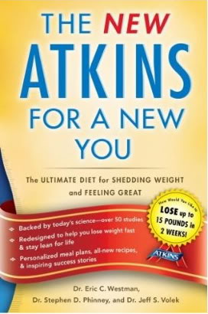
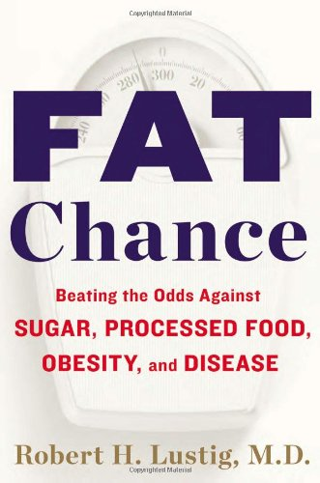
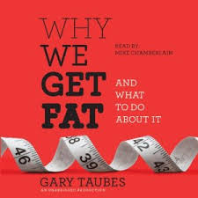

Slide 77
thank you!

Slide 78
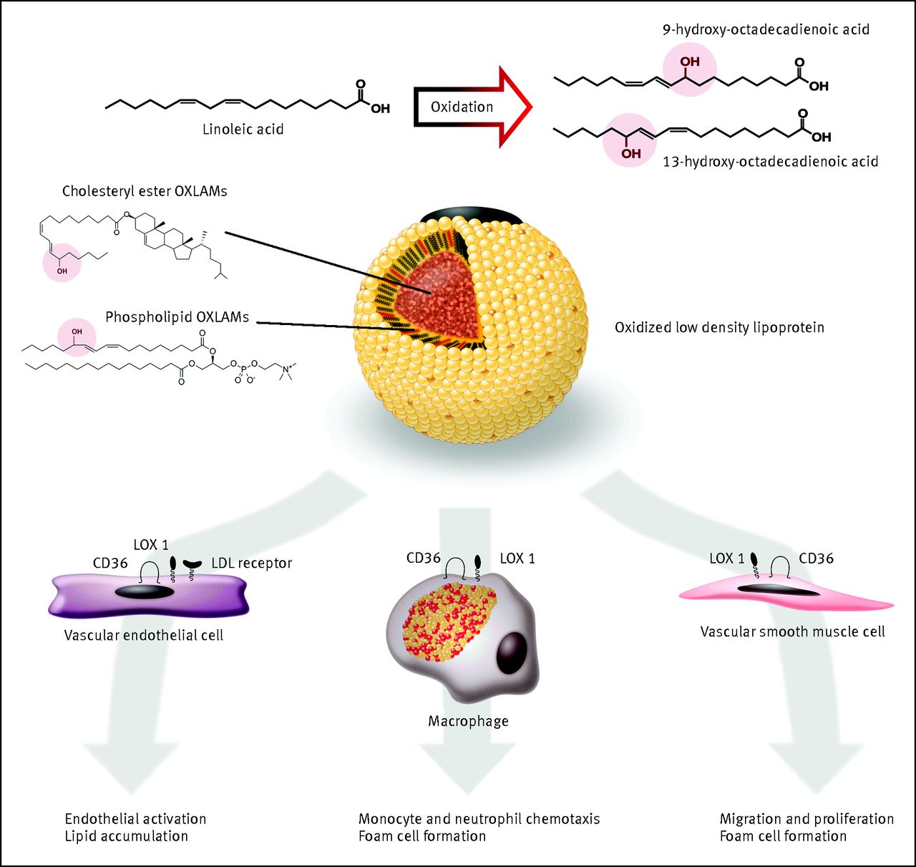
Fig 5 Proposed mechanistic model linking dietary LA to cardiovascular disease pathogenesis.34 35 36 37 38 39 40 41 42 43 44 45 46 47 48 Conversion of LA to OXLAMs can proceed enzymatically, or via free radical mediated oxidative stress.
Ramsden C E et al. BMJ 2013;346:bmj.e8707
©2013 by British Medical Journal Publishing Group
Notes:
Fig 5 Proposed mechanistic model linking dietary LA to cardiovascular disease pathogenesis.34 35 36 37 38 39 40 41 42 43 44 45 46 47 48 Conversion of LA to OXLAMs can proceed enzymatically, or via free radical mediated oxidative stress. Major sources of oxidative stress such as cigarette smoking and chronic alcohol exposure facilitate LA oxidation and production of oxidized low density lipoprotein (LDL). OXLAMs are the most abundant oxidized fatty acids in oxidized LDL and in atherosclerotic lesions. OXLAMs have been mechanistically linked to cardiovascular pathogenesis via multiple mechanisms. LDL=low density lipoprotein; CD36=cluster of differentiation 36 scavenger receptor; LOX 1=lectin like oxidized LDL receptor 1

