Slide 1
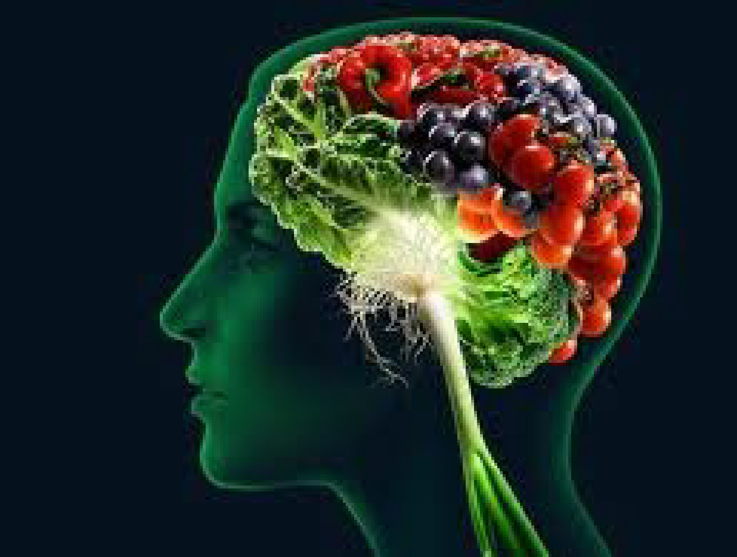
Inflammation: Are you playing with fire?
Mark Pettus MD
February 18, 2015

Slide 2
The Course
Epigenetics
Metabolism
Inflammation
Gut-microbiome barrier function
Environmental toxins- mitochondria
The science of mind
Social connection and health
Spiritual practice and health outcomes

Slide 3
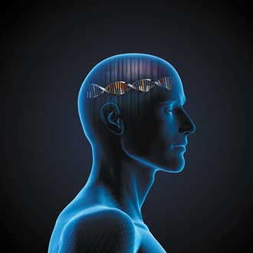
The Contemporary Convergence
Epigenome + Environment + Microbiome = Outcome
i.e. how the outside gets inside

Slide 4
Environment
Life
Epigenome
Microbiome
Consciousness

Slide 5
Learning Objectives
Explore the root causes of inflammation that fuel chronic-complex disease.
Examine the mechanisms that link many common environmental triggers with increased inflammation.
Consider many lifestyle changes that can reduce-reverse inflammation to improve longevity and quality of life.

Slide 6
Causes of Inflammation
Poor Diet
Lack of Movement
Allostatic load: Too much stress to manage
Waistline > 35” in women and 40” in men
Imbalanced Gut ecosystem-barrier function
Disrupted sleep (circadian rhythm)
Social isolation
Environmental toxins e.g. BPA, mold
? Low vitamin D

Slide 7
Inflammation
Evolutionary biologic lens
Modern humans are chronically inflammed like no others before them
Leptin resistance i.e., I can’t stop thinking about food because I’m hungry all the time and I just don’t feel like moving much.
Insulin resistance i.e., if it’s a refined carb e.g. sugar it will soon belong to you in the form of excess body fat and the biologic forces will continue unabated.
Search for the cause

Slide 8
Disease (how things appear)
Pre-diabetes, Diabetes, Obesity, Metabolic Syndrome, Heart Disease, Stroke, Depression, Autoimmunity, Alzheimer’s, Cancer, Fibromyalgia, Chronic fatigue
PS, MS,, GAD, PTSD, Autism spectrum
Core Metabolic Imbalances (what drives them)
Inflammation
Oxidative Stress-Mitochondria
Stress Response (HPA axis)
Microbiome (Gut-Immune-Barrier Function)
Root Causes (what are their origins)
Gene-Epigenome-Environment
Nutrition Movement Stress Response Environmental toxins Sleep Social Connection Trauma Conflict Management Mindfulness Meaning in Work, Love, Play

Slide 9
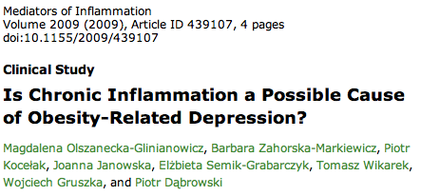
Inflammation

Slide 10
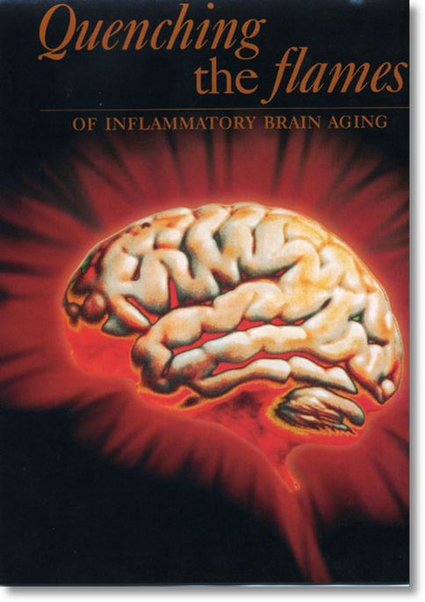
Evidence for increased inflammation in:
Alzheimer’s disease
Depression
Pain
PD
MS
ADD and ADDHD
Brain fog
Anxiety and Panic
Autism spectrum

Slide 11
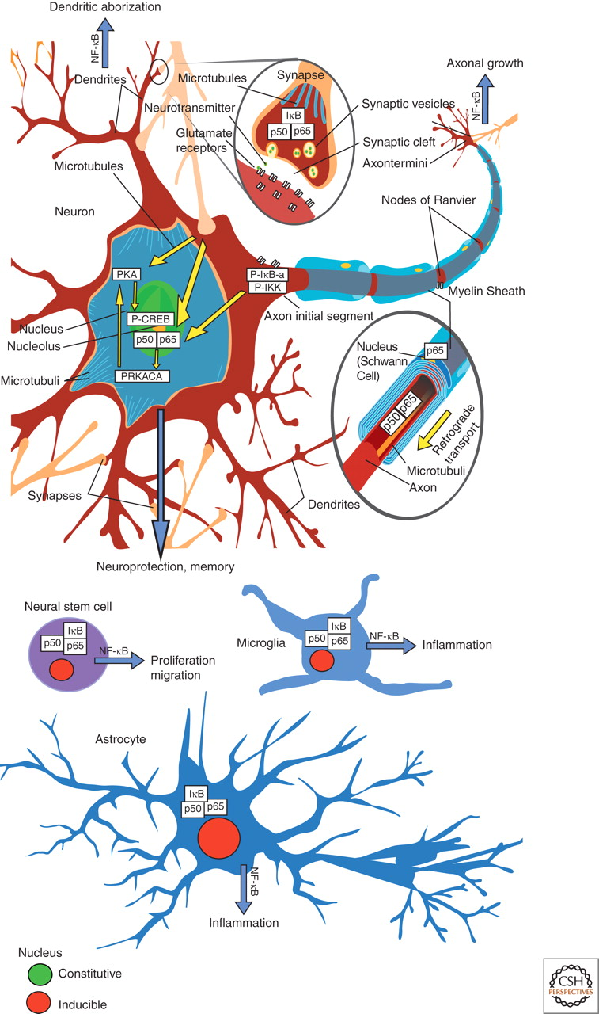
The role of NF-κB within the cellular context of the nervous system.
Upregulation of glutamate and impairment of myelin
Upregulation of pro-inflammatory cytokines with increased conversion of stem cells to activated microglia cells
Pro-inflammatory cytokine upregulation in astrocytes
Kaltschmidt B , and Kaltschmidt C Cold Spring Harb Perspect Biol 2009;1:a001271
©2009 by Cold Spring Harbor Laboratory Press
Notes:
The role of NF-κB within the cellular context of the nervous system. Constitutively activated NF-κB is detected mostly in glutamatergic neurons (green nuclei), whereas NF-κB in glia has a lower basal activity and is heavily inducible (red nuclei). For details, see text.

Slide 12
Slide courtesy Jeanne Wallace PhD
12

Slide 13
Food and Inflammation

Slide 17
Changes in our diet that Trigger Inflammation
Sugar and refined grain flours, processed - high glycemic foods with high “carbohydrate density”.
Fructose from sugar and HFCS
Increased O-6/O-3 EFA intake
Food sensitivities such as gluten or dairy
Not enough vegetables, fiber
Foods contaminated with environmental toxins such as game fish (mercury), non-organic fruits and vegetables with pesticide residues, BPA in plastics
? GMO foods

Slide 18
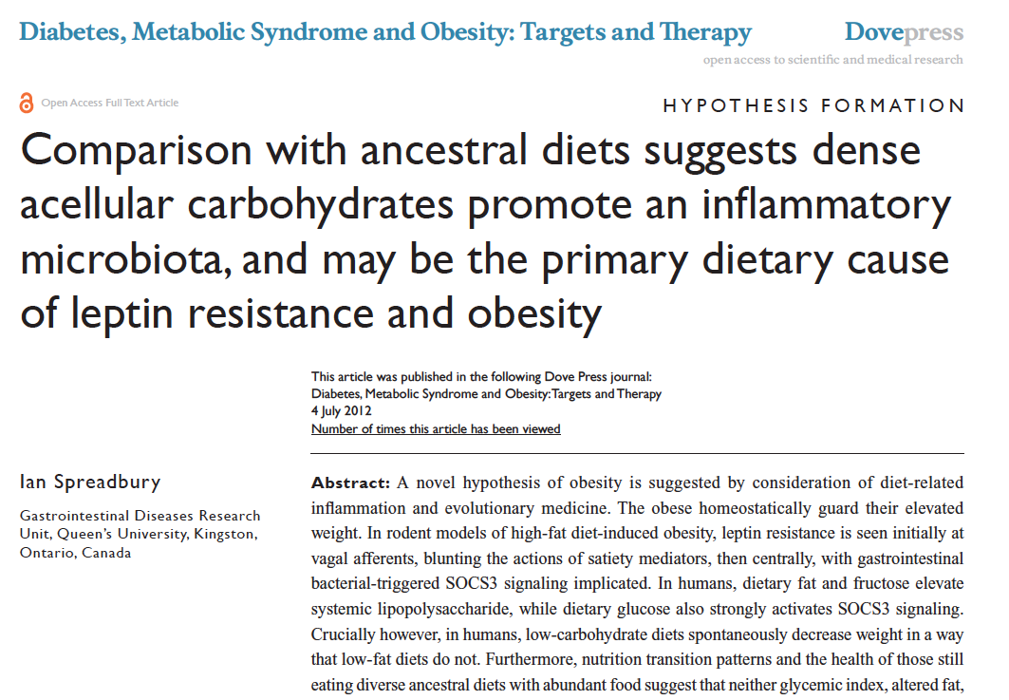

Slide 19
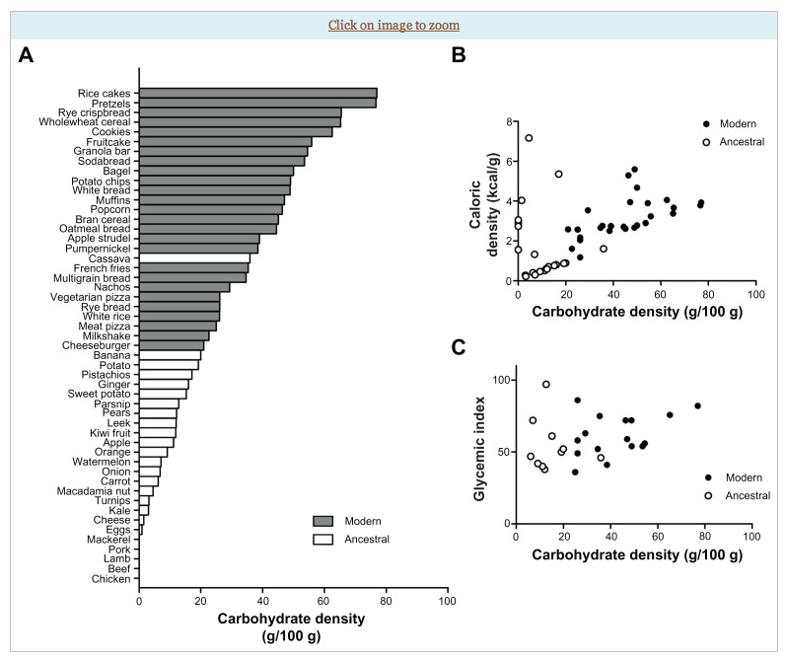

Slide 20
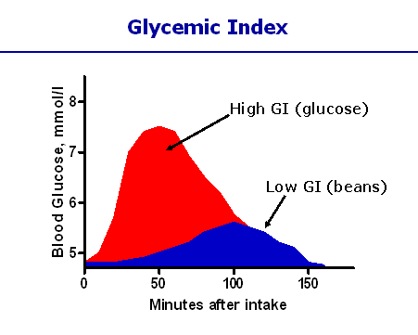
Different carbohydrates produce unique genomic responses!
High Glycemic Carbs Low Glycemic Carbs
62 genes regulating Same genes turned off;
Inflammation, stress, Genes regulating same insulin signaling production turned off. gene responses activated.
Kalle et al. Am J Clin Nutr;2007:851:1417-27

Slide 22
1,230 individuals age 70 and older
4-year follow-up
Individuals with higher carbohydrate intake had nearly
four times the risk of developing Mild Cognitive
Impairment (MCI)
Those individuals with the highest fat intake compared to
the lowest fat intake were 42% less likely to have MCI

Slide 23
BMJ. 2013 Feb 4;346:e8707. doi: 10.1136/bmj.e8707.
Use of dietary linoleic acid for secondary prevention of coronary heart disease and death: evaluation of recovered data from the Sydney Diet Heart Study and updated meta-analysis.
Ramsden CE, Zamora D, Leelarthaepin B, Majchrzak-Hong SF, Faurot KR, Suchindran CM, Ringel A, Davis JM, Hibbeln JR.
CONCLUSIONS:
Advice to substitute polyunsaturated fats for saturated fats is a key component of worldwide dietary guidelines for coronary heart disease risk reduction. However, clinical benefits of the most abundant polyunsaturated fatty acid, omega 6 linoleic acid, have not been established. In this cohort, substituting dietary linoleic acid in place of saturated fats increased the rates of death from all causes, coronary heart disease, and cardiovascular disease. An updated meta-analysis of linoleic acid intervention trials showed no evidence of cardiovascular benefit. These findings could have important implications for worldwide dietary advice to substitute omega 6 linoleic acid, or polyunsaturated fats in general, for saturated fats.
Substituting saturated fats with polyunsaturated vegetable oils not only failed to protect the heart but was associated with more heart disease and increased mortality from all causes!

Slide 24
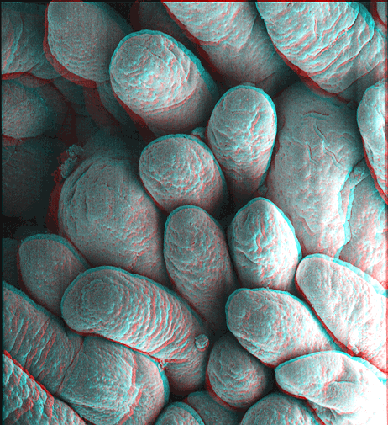
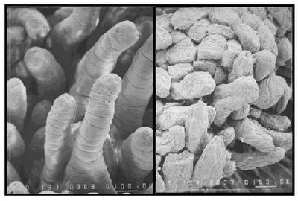
Wheat: A triple threat ?
Amylopectin A (high glycemic carb)
Gluten
Lectins
Notes:
References:(i) Ludvigsson JF, Montgomery SM, Ekbom A, Brandt L, Granath F. Small-intestinal histopathology and mortality risk in celiac disease. JAMA. 2009 Sep 16;302(11):1171-8.(ii) Rubio-Tapia A, Kyle RA, Kaplan EL, Johnson DR, Page W, Erdtmann F, Brantner TL, Kim WR, Phelps TK, Lahr BD, Zinsmeister AR, Melton LJ 3rd, Murray JA. Increased prevalence and mortality in undiagnosed celiac disease. Gastroenterology. 2009 Jul;137(1):88-93(iii) Green PH, Neugut AI, Naiyer AJ, Edwards ZC, Gabinelle S, Chinburapa V. Economic benefits of increased diagnosis of celiac disease in a national managed care population in the United States. J Insur Med. 2008;40(3-4):218-28.(iv) Farrell RJ, Kelly CP. Celiac sprue. N Engl J Med. 2002 Jan 17;346(3):180-8. Review.(v) Sedghizadeh PP, Shuler CF, Allen CM, Beck FM, Kalmar JR. Celiac disease and recurrent aphthous stomatitis: a report and review of the literature. Oral Surg Oral Med Oral Pathol Oral Radiol Endod. 2002;94(4):474-478.(vi) Margutti P, Delunardo F, Ortona E. Autoantibodies associated with psychiatric disorders. Curr Neurovasc Res. 2006 May;3(2):149-57. Review.(vii) Ludvigsson JF, Reutfors J, Osby U, Ekbom A, Montgomery SM. Coeliac disease and risk of mood disorders–a general population-based cohort study. J Affect Disord. 2007 Apr;99(1-3):117-26. Epub 2006 Oct 6.(viii) Ludvigsson JF, Osby U, Ekbom A, Montgomery SM. Coeliac disease and risk of schizophrenia and other psychosis: a general population cohort study. Scand J Gastroenterol. 2007 Feb;42(2):179-85.(ix) Hu WT, Murray JA, Greenaway MC, Parisi JE, Josephs KA. Cognitive impairment and celiac disease. Arch Neurol. 2006 Oct;63(10):1440-6.(x) Bushara KO. Neurologic presentation of celiac disease. Gastroenterology. 2005 Apr;128(4 Suppl 1):S92-7. Review.(xi) Millward C, Ferriter M, Calver S, Connell-Jones G. Gluten- and casein-free diets for autistic spectrum disorder. Cochrane Database Syst Rev. 2004;(2):CD003498. Review.

Slide 26
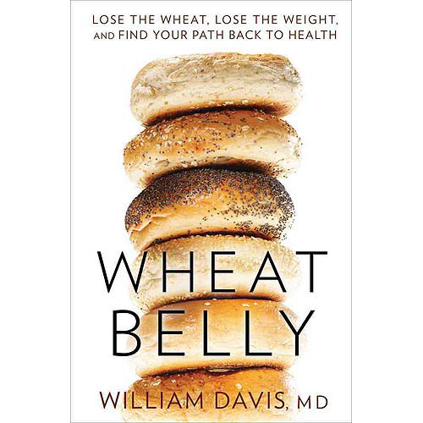
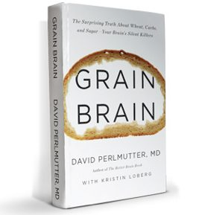

Slide 27
Inflammation
Fat storage when glucose is the predominant fuel
Insulin-Leptin resistance
Really hard to succeed with eat less and do more

Slide 28
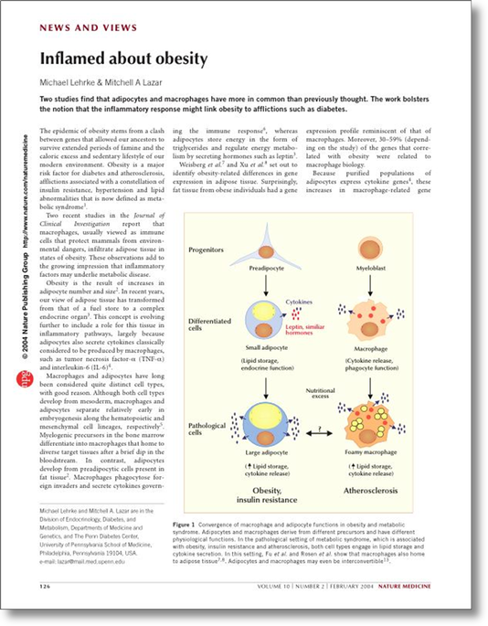
Visceral Adipose Stores
Insulin Resistance
Dyslipidemia
Elevations of BP
Increased risk chronic complex disease
Origins of Health

Slide 29
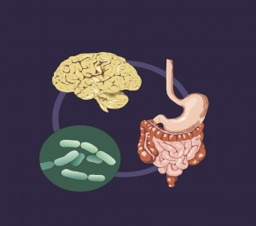
Intestinal Permeability
Uncontrolled Trafficking of Molecules
Food allergies, lectins
Dysbiosis
Acid suppression
Stress response
Environmental toxins
Medications

Slide 31
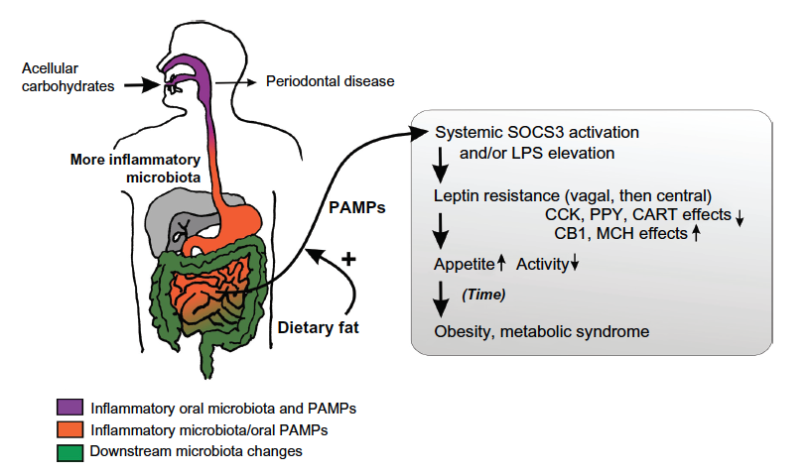
Inflammatory upregulation
Insulin fueling lipogenesis
Insulin resistance in muscle and liver
Inhibits mobilization of fat as a fuel
source
NF-kappa B
Increased LPS
Cytokine upregulation
Leptin resistance
Shift to fat storage increases appetite
and decreases energy expenditure
Increased O-6/O-3

Slide 33
Disease (how things appear)
Pre-diabetes, Diabetes, Obesity, Metabolic Syndrome, Heart Disease, Stroke, Depression, Autoimmunity, ADHD, autism, Cognitive decline-Alzheimer’s, GAD
Core Metabolic Imbalances (what drives them)
Inflammation, Insulin Resistance
Intestinal Barrier Function - microbiome
Root Causes (what are their origins)
Gene-Epigenome-Environment
Nutrition Movement Stress Response Environmental toxins Sleep Social Connection Trauma Conflict Management
Stress Management Meaning in Work, Love, Play

Slide 34
Changes in our diet that Trigger Inflammation and Insulin Resistance: Beware of the “low-fat” diet
Sugar (fructose), refined grain flours, processed - high glycemic foods with high “carbohydrate density”.
Increased O-6/O-3 EFA intake
Food sensitivities such as gluten, FODMAPS
Insufficient vegetables and fiber
GMO and foods contaminated with environmental toxins such as game fish (mercury), non-organic fruits and vegetables with pesticide residues, BPA in plastics

Slide 35
Sugar and Gluten…the bad boys of brain disruption
High glycemic foods raise insulin and leptin levels
Insulin increases Indolamine 2,3 deoxygenase (IDO) which reduces tryptophan, a precursor for serotonin
Sugar-insulin surges increase sympathetic drive over-arousal-destabilization
Depletes Magnesium and B-vitamins
Glucose surges and food sensitivities destabilize the brain with dis-inhibition and arousal.

Slide 36
More on gluten, mind and mood
Celiac associated with many neuropsychiatric diagnoses e.g. ADHD seen in approx. 60%!
Celiac associated with white matter changes on MRI…similar to that seen with MS
Gluten increases insulin resistance in individuals who are sensitive
Brain wave patterns in ADHD improve consistently with gluten restriction
Gluten sensitivity enhances zonulin that increases intestinal permeability
Gluten sensitivity can alter blood flow to frontal lobes

Slide 38
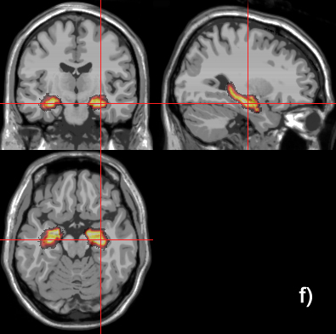
Higher Normal Fasting Glucose is Associated with Hippocampal Atrophy
266 Cognitive healthy adults
Baseline fasting glucose
Baseline MRI scan to measure hippocampus
Repeat MRI at 4 years

Slide 39
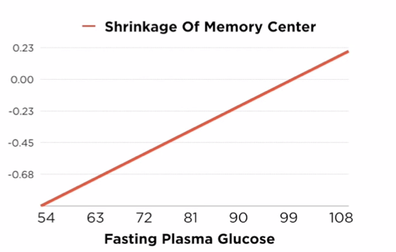

Slide 40
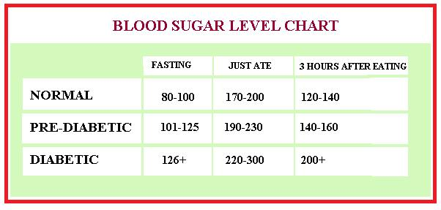
Glucose Levels and Risk For Dementia
2067 participants without dementia
Average age at baseline 76 years
Median follow-up 6.8 years
Baseline glucose
Cognitive assessment every 2 years

Slide 41
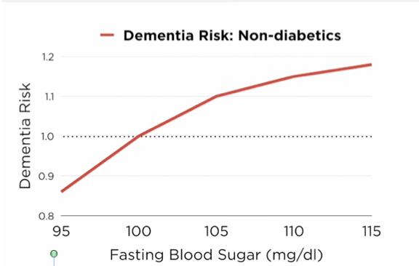

Slide 43
Diabetes in Midlife and Cognitive Change Over 20 Years
A Cohort Study
Prospective cohort study
13,351 black and white adult participants aged 48 to 67 years at baseline (1990-1992)
Measurements of diabetes including history, meds and HbA1c
Cognitive measures including word recall, digit symbol substitution, and word fluency testing.
Ann Intern Med. 2014 Dec 2;161(11)

Slide 44
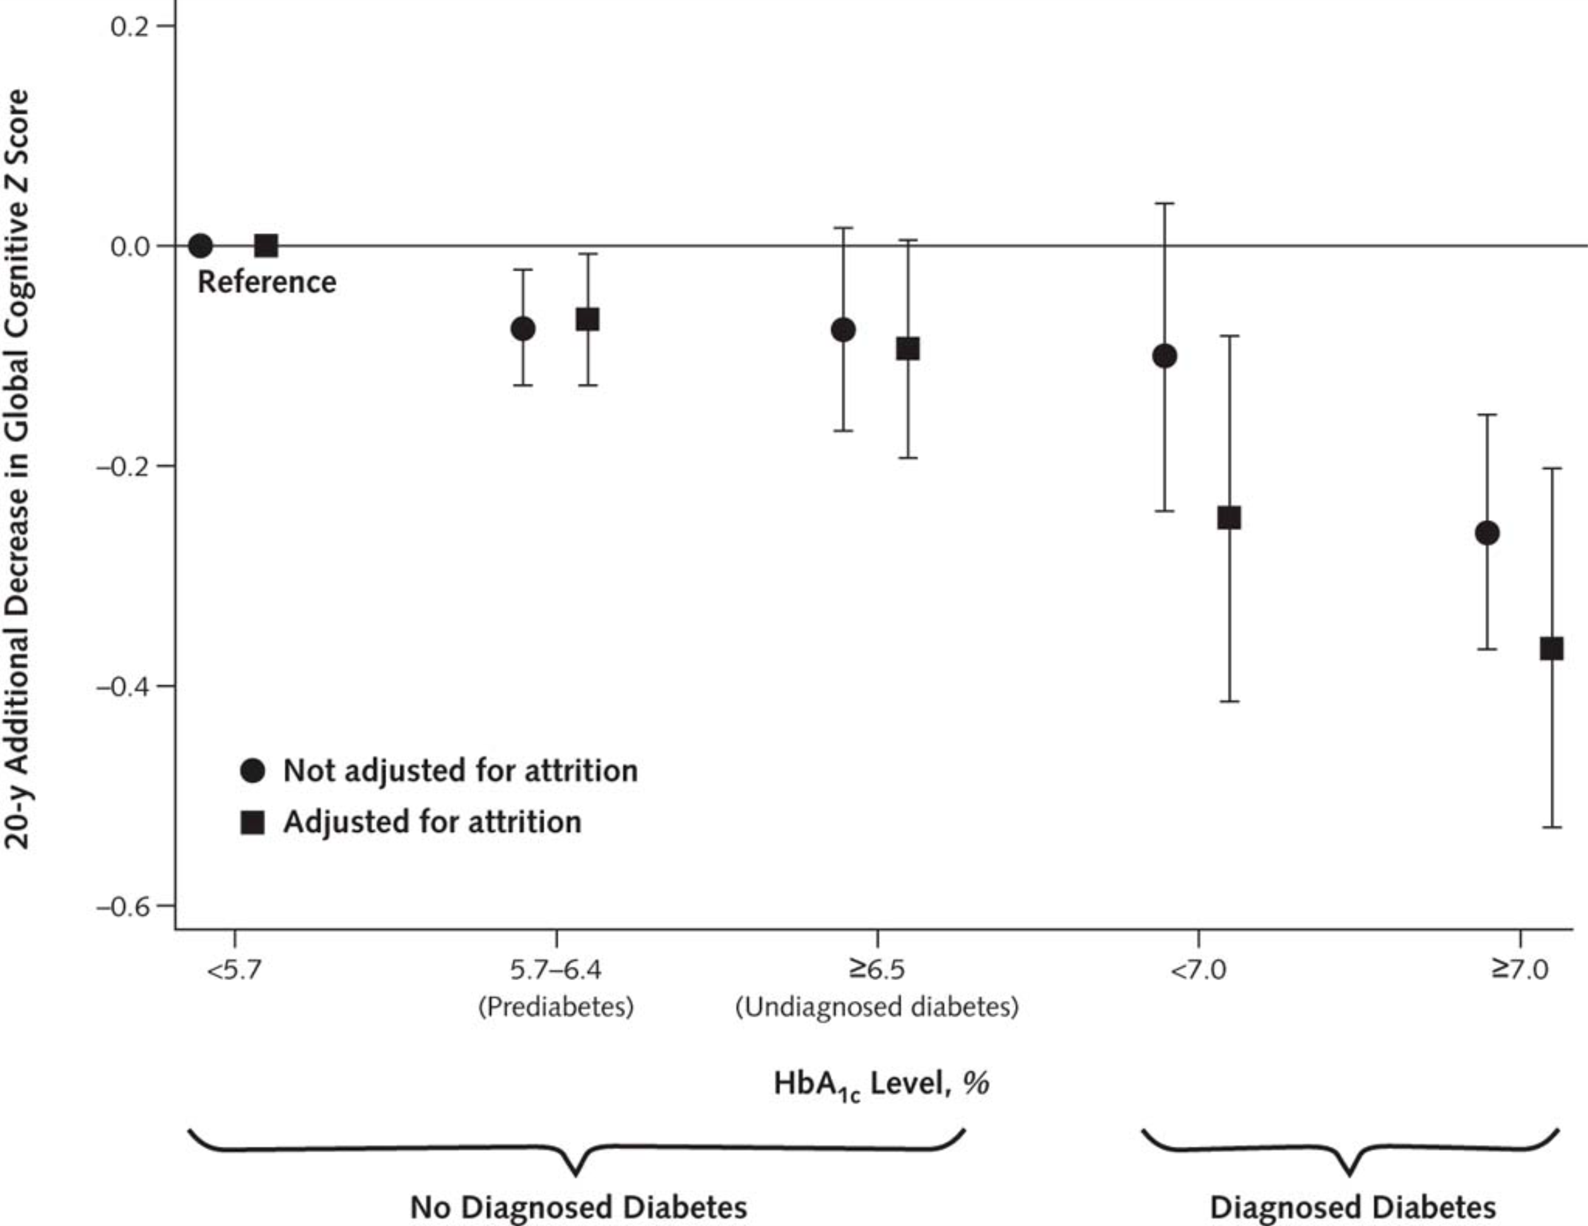
From: Diabetes in Midlife and Cognitive Change Over 20 Years: A Cohort StudyDiabetes in Midlife and Cognitive Change Over 20 Years
Ann Intern Med. 2014;161(11):785-793. doi:10.7326/M14-0737
Copyright © American College of Physicians.

Slide 45
Diabetes in Midlife and Cognitive Change Over 20 Years
A Cohort Study
Diabetes and pre-diabetes prevention and glucose control in midlife may protect against late-life cognitive decline.
Ann Intern Med. 2014 Dec 2;161(11)

Slide 46
Relative Intake of Macronutrients
Impacts Risk of MCI or Dementia
Mayo Clinic study
937 cognitively normal adults
Median age – 75.9 years
Follow-up averaged 3.7 years
Cognitive assessment at baseline and every 15 months
Food-frequency questionnaire at baseline

Slide 47
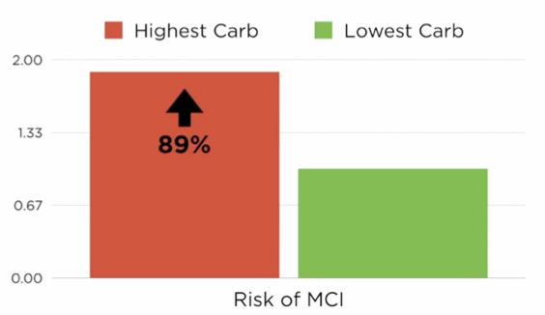

Slide 48
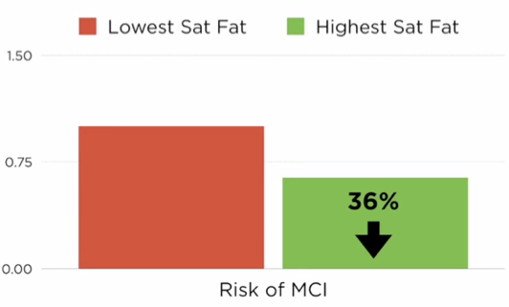

Slide 50
Environment
Life
Epigenome
Microbiome
Consciousness

Slide 52
Source: Ian Spreadbury Diabetes, Metabolic Syndrome and Obesity DovePress 2012

Slide 53
Inflammatory upregulation
Insulin fueling lipogenesis
Insulin resistance in muscle and liver
Inhibits mobilization of fat as a fuel
source
NF-kappa B
Increased LPS
Cytokine upregulation
Leptin resistance
Shift to fat storage increases appetite
and decreases energy expenditure
Increased O-6/O-3

Slide 54
The Microbiome…an evolving story
The MB has evolved with humans to allow survival
The MB provides important functions in digestion, immunity, metabolism and detoxification
Increased diversity seen with decreased hygiene
Early and diverse exposure key to a “healthy microbiome”
Getting dirty may be good for you
Increased CHO digesting MB in populations with higher CHO intake
Reduced diversity seen in obesity, IBD, autism spectrum
Diet is a powerful factor that can shift the microbiome

Slide 56
Speculative Interpretation of current research

Slide 58
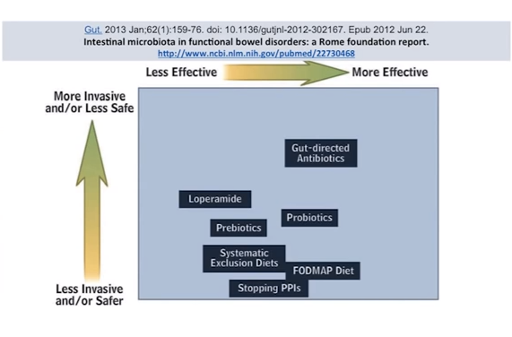

Slide 60
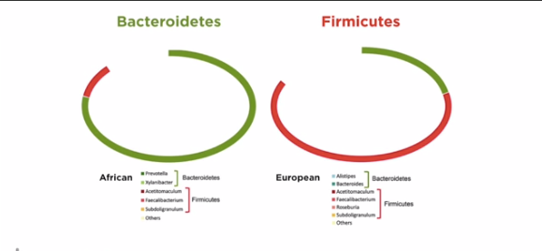

Slide 61
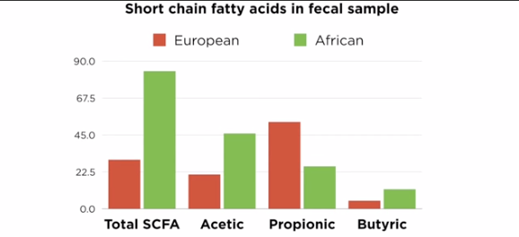

Slide 62
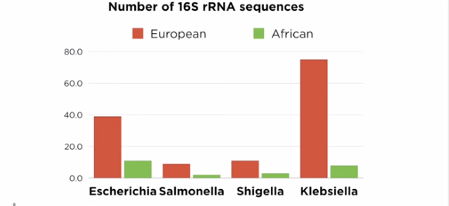

Slide 63
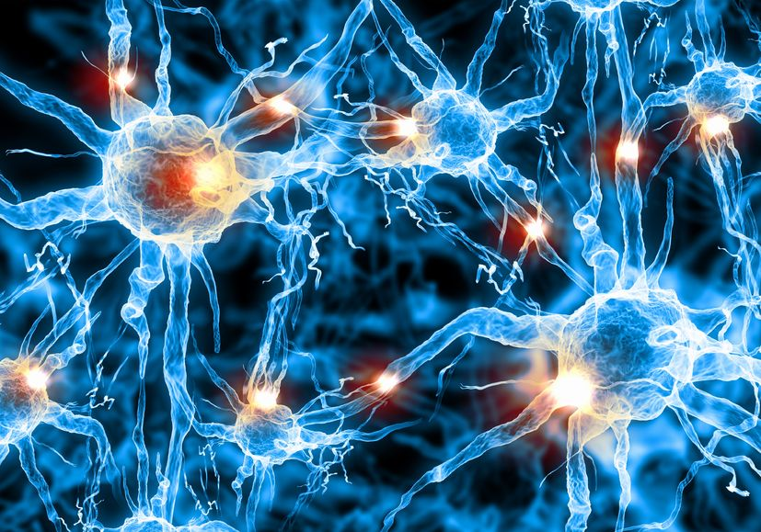
Psychobiotics
Protection of intestinal barrier function
Influence on local and systemic antioxidant status
Direct neurochemical production e.g. Gamma Amino Butyric Acid
Indirect influence on neurotransmitter function
Prevention of stress-induced alterations in microbiota
Direct activation of neural pathways between gut and brain
Modulation of inflammatory cytokines
Modulation of Brain derived neurotrophic factor (BDNF)
Limitation of small intestinal bacterial overgrowth (SIBO)
Psychobiotics: a novel class of psychotropic.
Biol Psychiatry. 2013 Nov 15;74(10):720-6. doi: 10.1016/j.biopsych.2013.05.001. Epub 2013 Jun10.
Fermented foods, microbiota, and mental health: ancient practice meets nutritional psychiatry
Eva M Selhub1*†, Alan C Logan2† and Alison C Bested3
Journal of Physiological Anthropology 2014, 33:2

Slide 64
Motion is the lotion !

Slide 65
Exercise training increases the size of the hippocampus and improves memory
120 older adults, 1 year, stretching vs. aerobic exercise
Measurement of hippocampal volume, BDNF and memory function at baseline, 6 months and 1 year

Slide 66
Exercise training increases the size of hippocampus and improves memory
After 1 year:
Exercisers had marked increase in BDNF
Exercisers showed substantial improvement in memory function

Slide 67
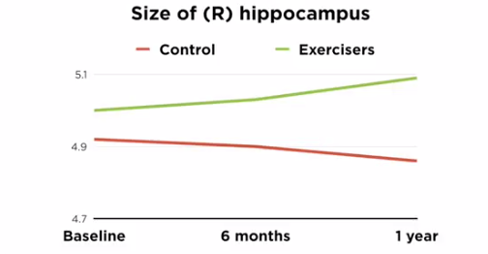
Exercise training increases the size of hippocampus and improves memory

Slide 68
Effect of physical activity on cognitive decline in older adults at risk for Alzheimer’s disease
138 participants
Complained of mild cognitive dysfunction
Intervention- 24 weeks of moderate exercise (142 minutes)
Assessment of ADAS cognitive scale over 18 months
JAMA , September 3, 2008, Vol 300. No 9

Slide 69
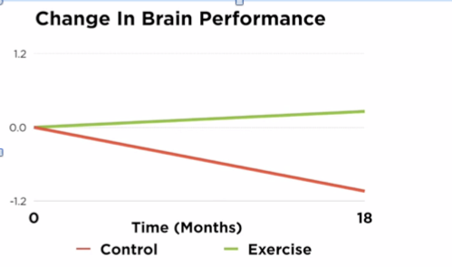
JAMA , September 3, 2008, Vol 300. No 9

Slide 70
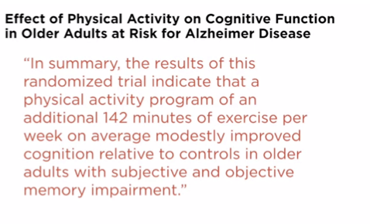
JAMA , September 3, 2008, Vol 300. No 9

Slide 71
A six month exercise intervention influences the genome-wide DNA methylation pattern in human adipose tissue.
24 healthy men with low level baseline activity levels before and after 6-month exercise program
30 controls
Genome-wide methylation patterns examined in adipose tissue
Several patterns changed in exercise group demonstrating reduced lipogenesis and a “silencing” of genes associated with obesity and impaired insulin signaling.
Ronn T et al. PLoS Genet June 2013

Slide 72
Disrupted Sleep-Loss of entrainment
15% Americans experience chronic insomnia
1 out of 3 has sleep disruption on one or more nights each week
Major risk factor for many chronic complex diseases
Neuro-endocrine-immune disruption
Sleep hygiene
Obstructive sleep apnea
Avoid pitfalls of sleeping medications

Slide 73
Vitamin D, Immunity and Depression
Enhance IL-10
Inhibits cortisol
Blocks NMDA
Notes:
BMS Confidential - Not to be distributed
Core slide deck with annotationsCore Slide Deck with Annotations

Slide 74
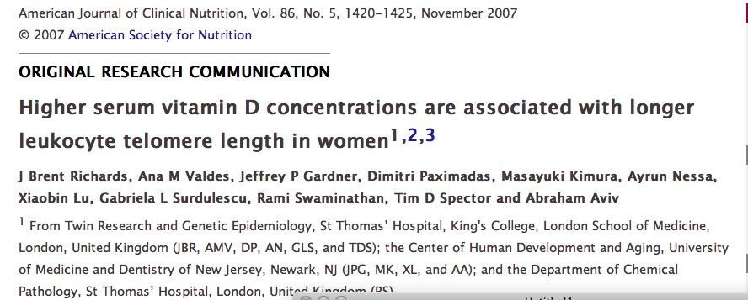
Vitamin D
CV Disease
Cancer
Autoimmunity
Depression
CHF
Osteoporosis
Fall risk
Pain syndromes

Slide 75
Anti-inflammatory lifestyle
Reduce-eliminate sugar; reduce wheat, both whole
grain and refined-processed, grain-based flour
Bread, pasta and many cereal grains are fat-promoting and
pro-inflammatory
Minimize-eliminate sugar-sweetened soft drinks and desserts
Eat as many vegetables, beans, legumes as you want.
Reduce the vegetable oils e.g. corn, safflower, sunflower, canola, peanut
Introduce more healthy fats e.g. grass-fed butter, EVOO, coconut oil, ghee, and an increase in O-3s fatty fish, nuts, seeds, avocados
Moderate red meat (grass fed), eggs
Eat organic for “dirty” produce

Slide 76
Anti-inflammatory Lifestyle continued
Movement…
Motion is the Lotion: walking, aerobic, resistance, yoga, tai chi
Mind-Body
Prayer, Meditation; mindfulness-based stress reduction;
Sleep hygiene
Social connection
Cultivate meaning in work, love, and play

Slide 77
The Script for Healthy Mind and Mood
Whole foods with reductions in sugar, refined grain-based flour, and high-glycemic foods…lower unhealthy carbs
More liberal healthy fats i.e., pasture-raised butter, meats, fatty fish, nuts, seeds, avocados, coconut oil, olive oil
Elimination trial e.g. gluten, FODMAPS, grains
Liberal outdoor, full-spectrum light exposure
Motion is the lotion
Stress reduction strategies
Healing the gut-immune barrier function

Slide 78
Thank you.

