Slide 1
A History of the Human Food Experience: Origins, Evolution, and Influence of the Changing Foodscape
Healthy Food in Healthcare
John Bagnulo MPH, PhD
January 23rd, 2015

Slide 2
Disclosure
Bagnulo, MPH, PhD, John
Indicated no relevant affiliations or financial interests.
Speaker will not discuss off-label or investigational drug use.

Slide 3
Learning Objectives
Identify the common characteristics of pre-agrarian human diets
Illustrate the nutritional and subsequent physiological changes in health that resulted from the shift towards agriculture
Describe the modifications to commonly eaten foods achieved through plant breeding, genetic modification, modern food processing methods
Identify how these modifications have influenced health
Identify minimally processed foods that are more aligned with the diets of early humans and their potential to prevent chronic disease

Slide 4
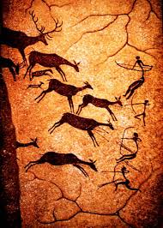
Slide #4

Slide 5
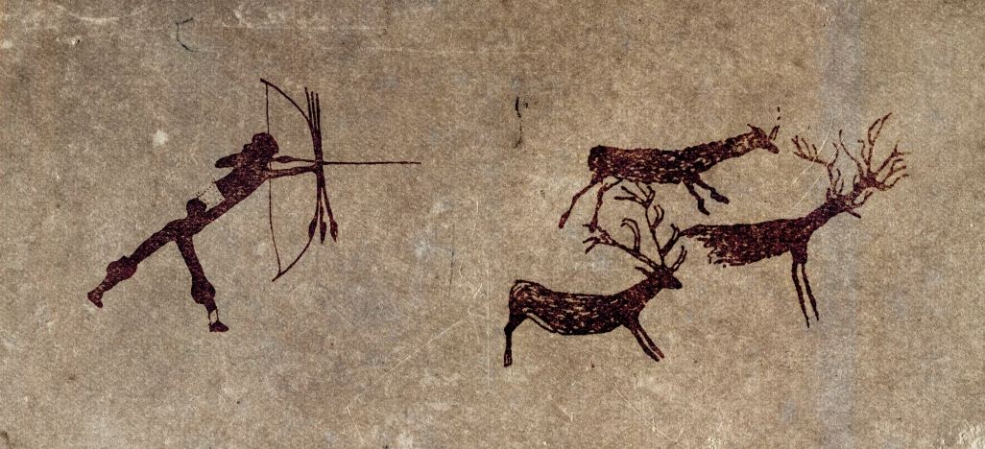

Slide 6
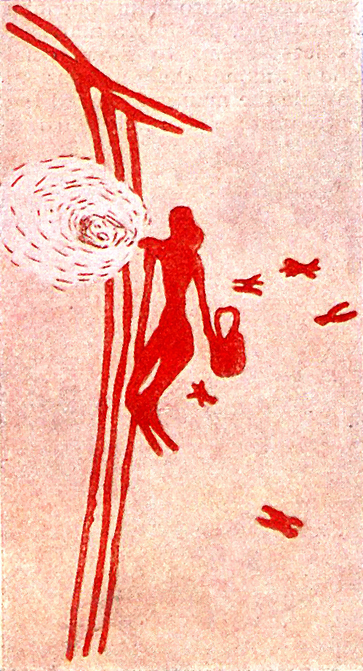

Slide 7
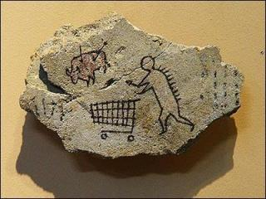

Slide 8
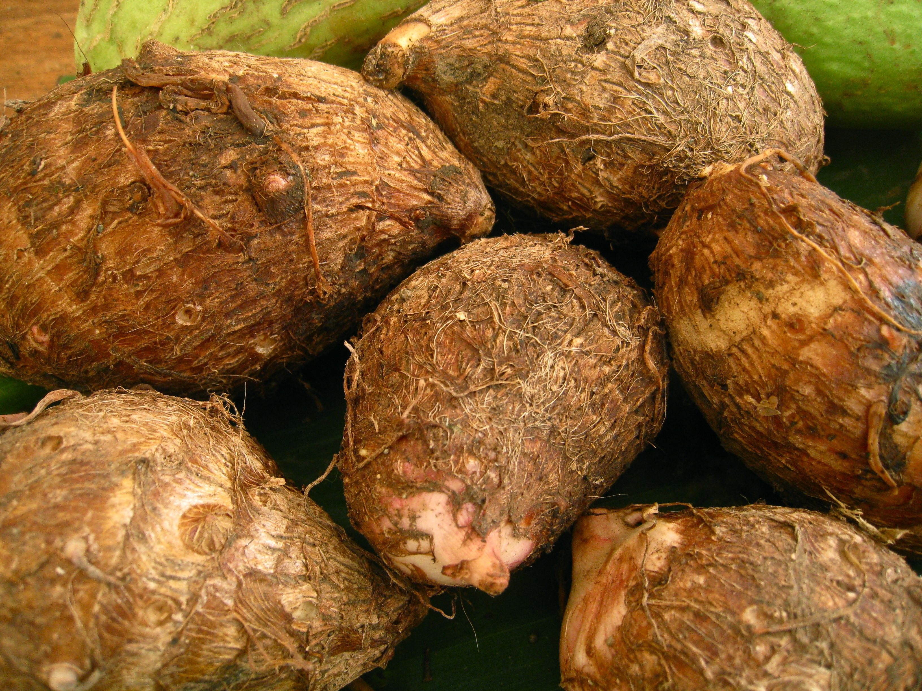
Slide #8

Slide 9
Critical Foods for Human Development
High fat foods (avocados, bone marrow, oily fish, sea mammals, coconut, various cuts from wild game)
High starch content tubers and ancestors to modern day root vegetables
Wide variety of greens, herbs, medicinal leaves and plants
Animal protein with intermittent protein shortages
Very limited and only seasonal dietary fructose

Slide 10
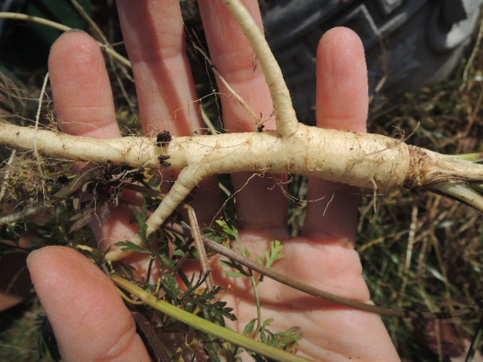
Slide #10

Slide 11
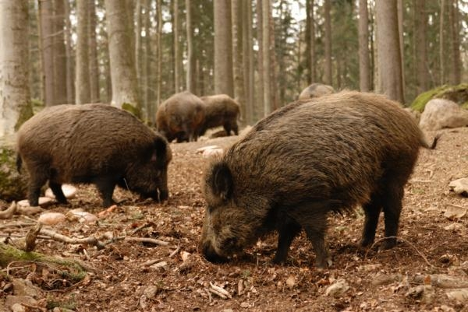
Slide #11

Slide 12
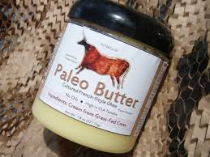

Slide 13
Stone Age Daily Conditions
Long walks
Strenuous work
Regular seasonal food shortages and reduced intake/intermittent fasts
Compliance with circadian rythms
Regular infections
Constant dietary exposure to a wide variety of microorganisms and parasites

Slide 14
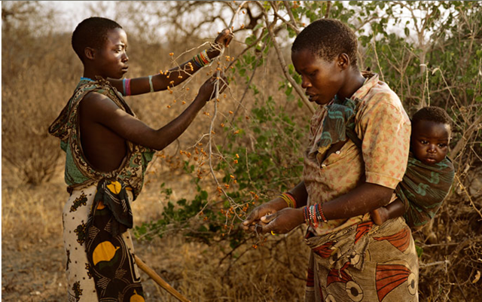
Slide #14

Slide 15
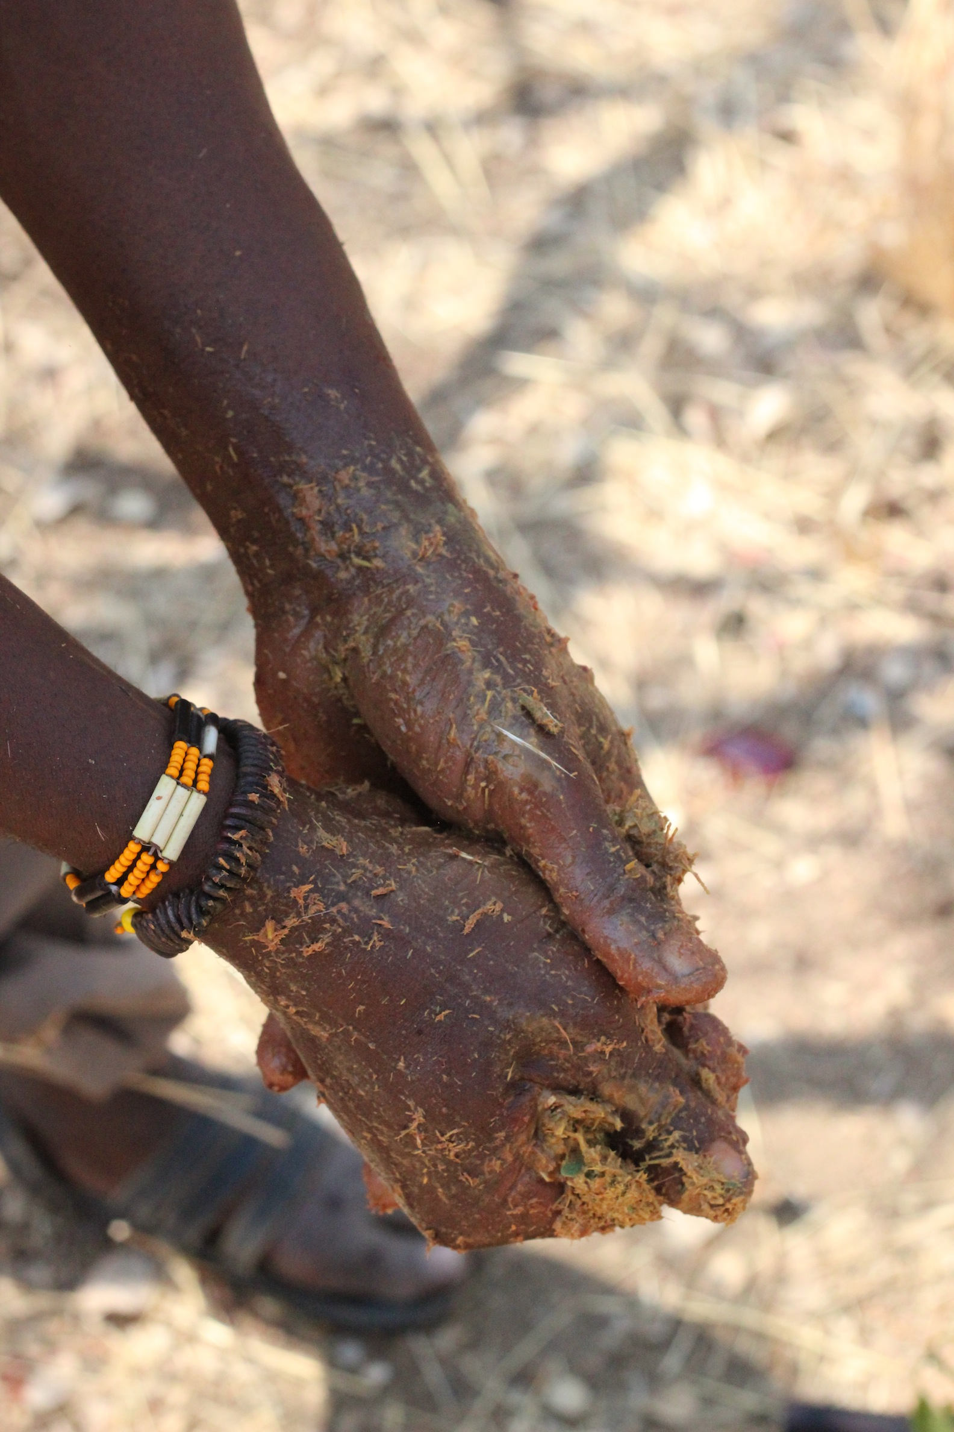
Slide #15

Slide 16
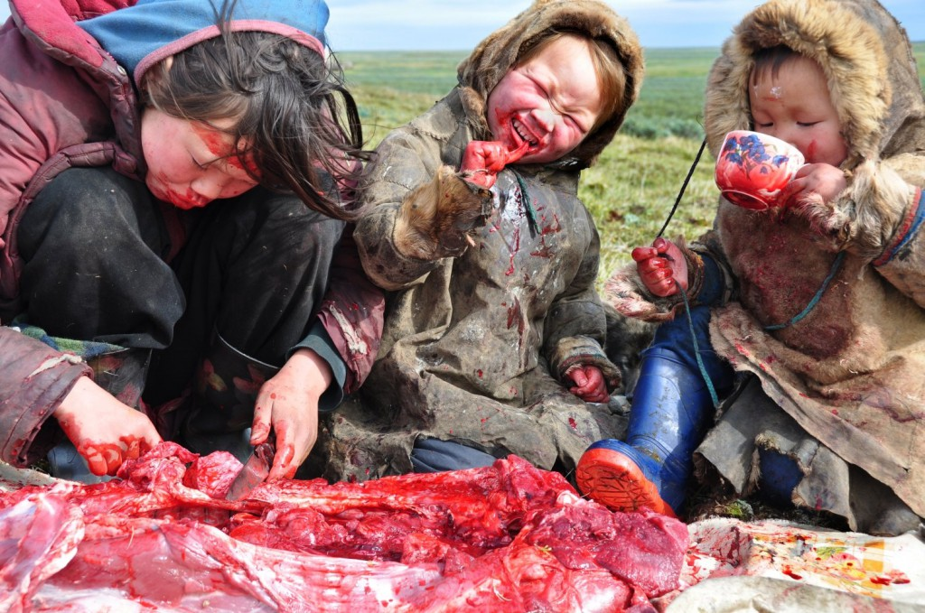
Slide #16

Slide 17
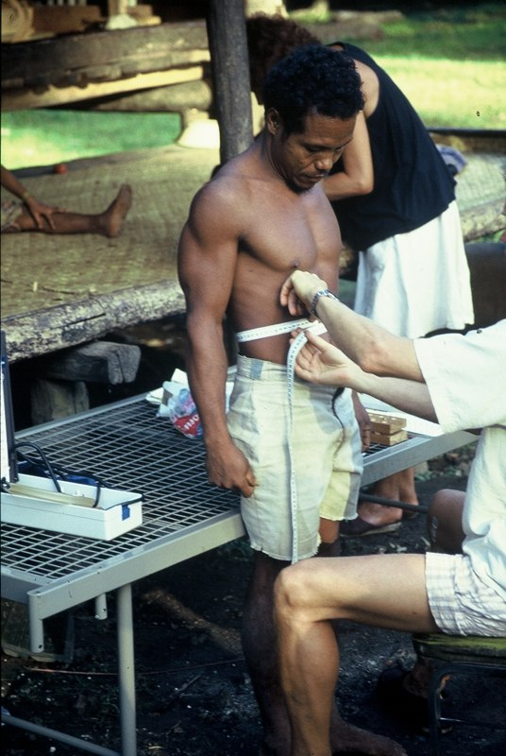

Slide 18
Spreadbury, I. Comparison with ancestral diets suggests dense acellular carbohydrates promote an inflammatory microbiota, and may be the primary dietary cause of leptin resistance and obesity. Diabetes, Metabolic Syndrome and Obesity: Targets and Therapy 2012;5:175–189
“The present hypothesis suggests that in parallel with the bacterial effects of sugars on dental and periodontal health, acellular flours, sugars, and processed foods produce an inflammatory microbiota via the upper gastrointestinal tract“

Slide 19
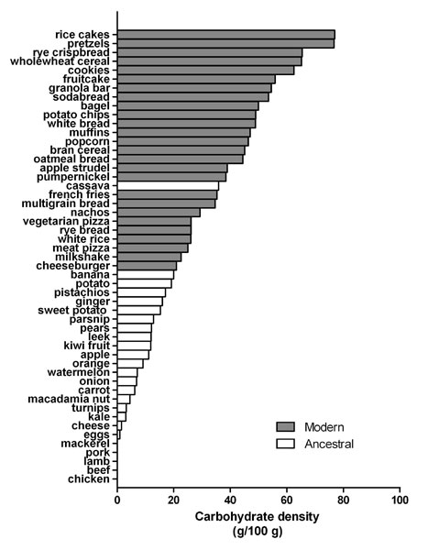

Slide 20
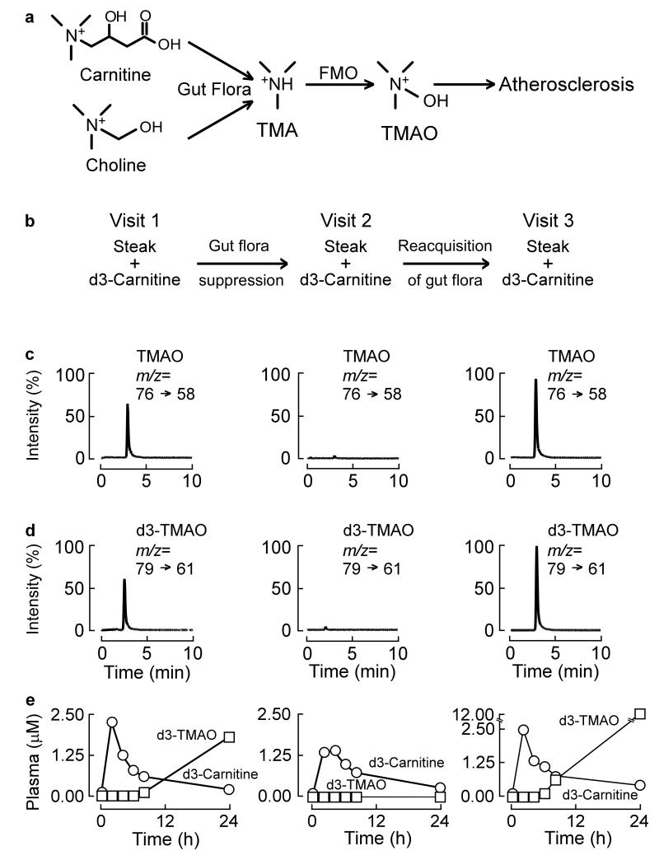
Koeth et al. Intestinal microbiota metabolism of L-carnitine, a nutrient in red meat, promotes atherosclerosis. Nature Medicine. 2013;19(5):576-85.
Slide #20

Slide 21
Top 20 Sources of Calories in the American diet (2013)
1. Grain-based desserts (138)
2. Yeast breads (129)
3. Chicken & chicken mixed dishes (121)
4. Soda/energy/sports drinks (114)
5. Pizza (98)
6. Alcoholic beverages (82)
7. Pasta & pasta dishes (81)
8. Tortillas, burritos, tacos (80)
9. Beef & beef mixed dishes (64)
10. Dairy desserts (62)
11. Potato/corn/other chips (56)
12. Burgers (53)
13. Reduced-fat milk (51)
14. Regular cheese (49)
15. Ready-to-eat cereals (49)
16. Sausage, franks, bacon & ribs (49)
17. Fried white potatoes (48)
18. Candy (47)
19. Nuts/seeds & nut/seed mixed dishes (42)
20. Eggs & egg mixed dishes (39)
TOTAL 68% OF CALORIES
NHANES 2013 USDA ANALYSIS

Slide 22
Clinical Implications
Frassetto et al. Metabolic and physiologic improvements from consuming a paleolithic, hunter-gatherer type diet. Eur J Clin Nutr. 2009 Aug;63(8):947-55. 2009 Feb 11.
Participants consumed a paleolithic type diet comprising fruits, vegetables, nuts, seeds, and lean sources of animal protein, and excluding nonpaleolithic type foods, for 10 days.
In all measured variables, 100% of participants had identical directional responses when switched to paleolithic type diet, that is, consistently significant improved status of circulatory, carbohydrate and lipid metabolism/physiology.”
Slide #22

Slide 23
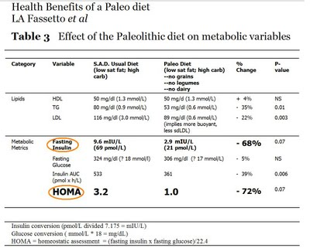
Slide #23

Slide 24
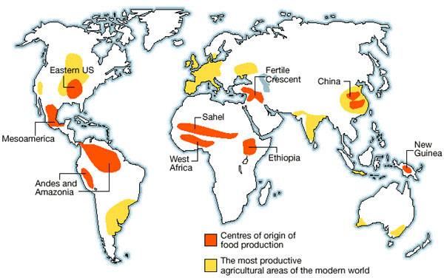
Slide #24

Slide 25
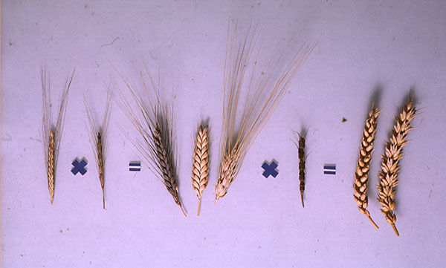
Slide #25

Slide 26
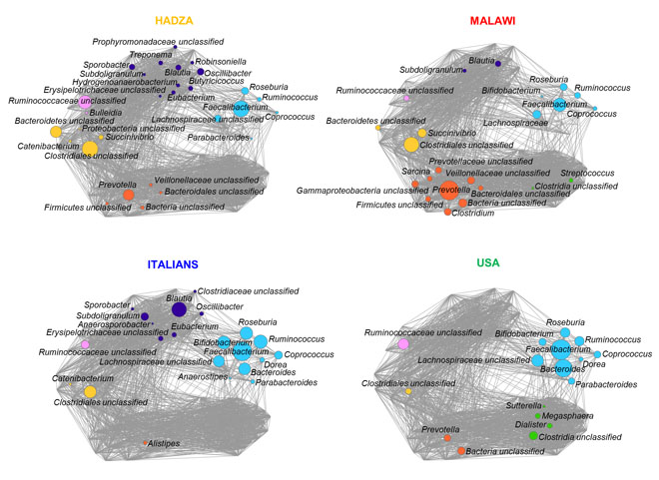
De Filippo et al. Impact of diet in shaping gut microbiota revealed by a comparative study in children from Europe and rural Africa. Proc Natl Acad Sci U S A. 2010;107(33):14691-6.
Slide #26

Slide 27
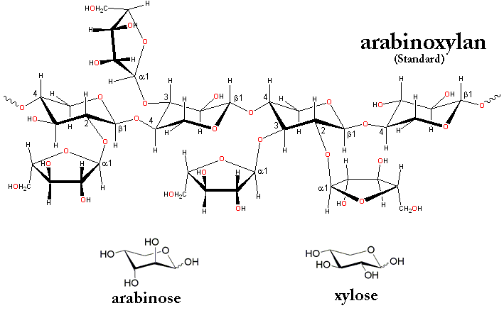
Slide #27

Slide 28
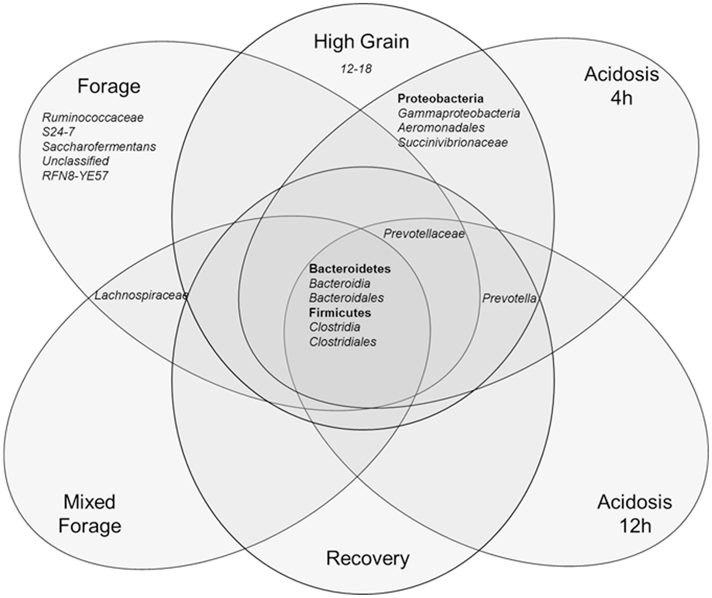
Petri RM et al. Characterization of the Core Rumen Microbiome in Cattle during Transition from Forage to Concentrate as Well as during and after an Acidotic Challenge.
Slide #28

Slide 29
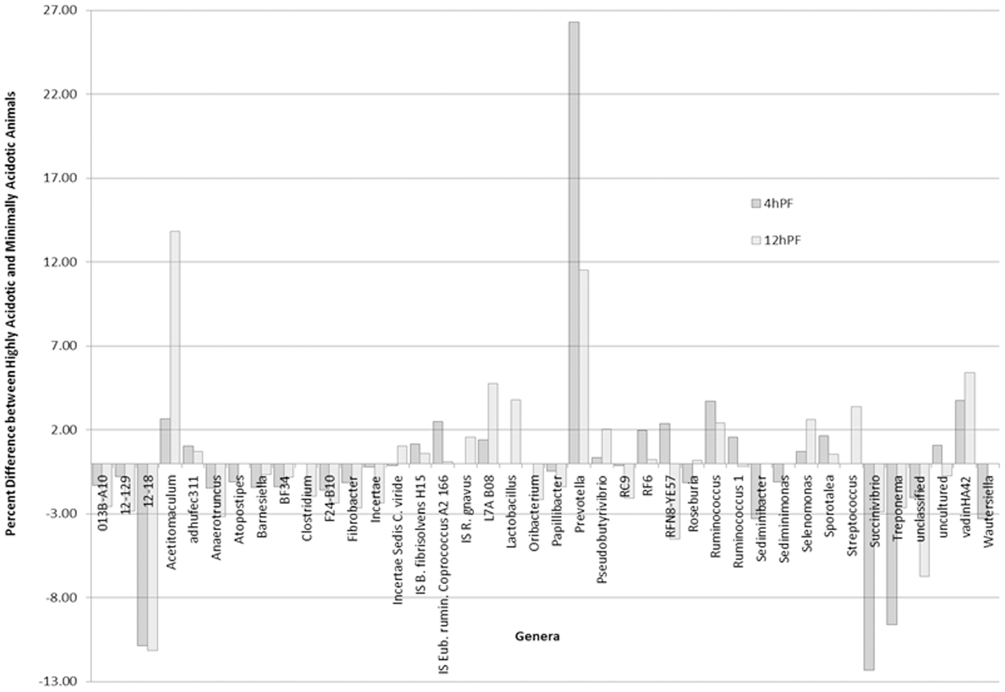
Petri RM et al. Characterization of the Core Rumen Microbiome in Cattle during Transition from Forage to Concentrate as Well as during and after an Acidotic Challenge.
Slide #29

Slide 30
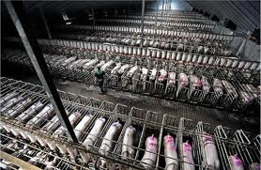

Slide 31
Risks Associated with Modern Grain-Fed Animal Agriculture
High levels of long chain omega 6 fatty acid arachidonic acid
High levels of systemic inflammation
Proteins less compatible with human physiology as a result of intensive breeding (modern Holstein and A1 beta casein) or feed rations (soy proteins in eggs and poultry meats)
Concentrated mycotoxins in animal fat and protein
Possible pharmaceutical content
Environmental damage

Slide 32
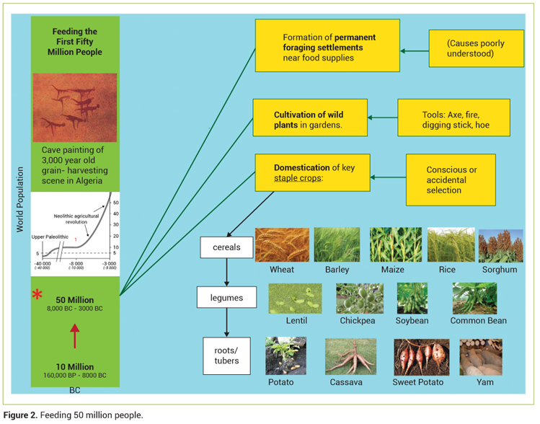
Phase I of Agriculture: Cultivation

Slide 33
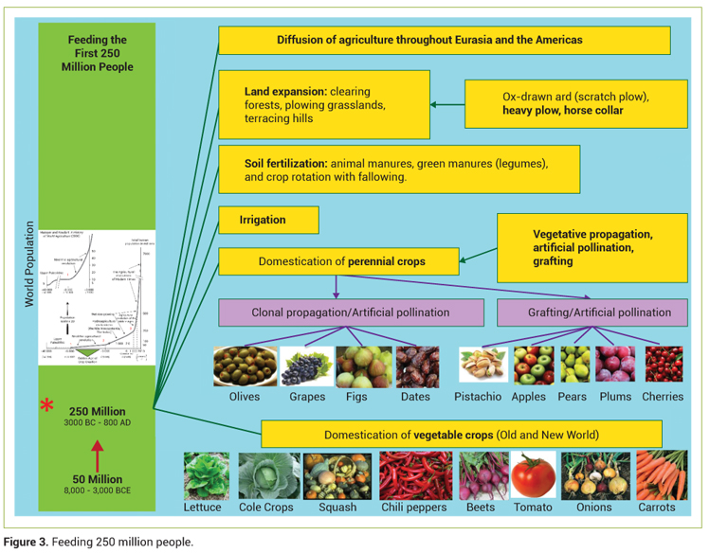
Phase II of Agriculture: Propagation

Slide 34
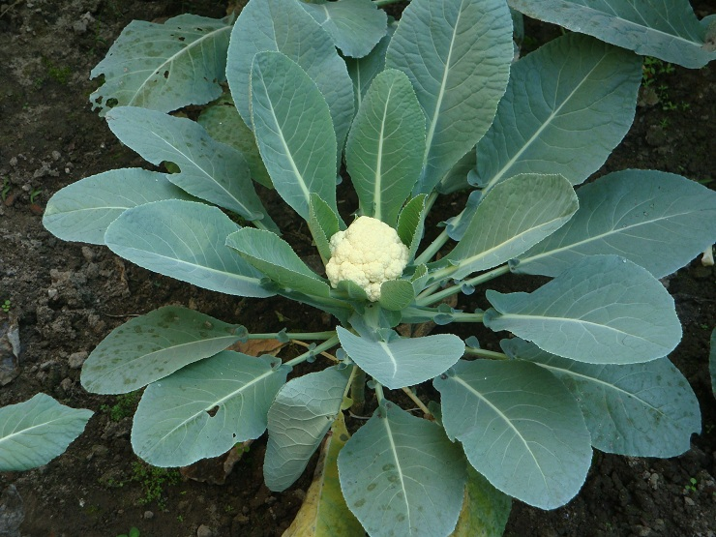

Slide 35
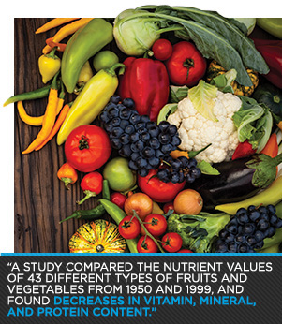
Davis, DR, Epp MD, Riordan HD. Changes in USDA food compositiondata for 43 garden crops, 1950 to 1999. Journal of American College of Nutrition 2004;23(6):669-82.

Slide 36
Agricultural Objectives: Past 60 yrs
Greater yields
Faster maturation
Greater resistance to bruising or damage in shipping
Longer shelf life
Less man power required for harvest
Less food processing required after harvest

Slide 37
Methods
Increased reliance on N-P-K fertilization methods using more and more soluble nitrogen
Increased development of yield or storage cultivars with and without direct genetic modification
Higher rates of chemical intervention
Food science technology such as ethylene gas in shipping

Slide 38
Additional Casualties
More monocultures, less diversity, decreased use of F1 hybrids
Loss of soil structure and soil microbial health
Increased agricultural run-off
Extinction of thousands of incredible fruit and vegetable varieties

Slide 39
Foods With Minimal Change and Maximal Nutrients
Small, wild, saltwater fish
Goat, sheep, and water buffalo cheese
Beans/lentils
Bitter greens (dandelion, chicory, escarole, endive, radicchio)
Nuts/seeds
Cranberries/small wild berries/black berries
Herbs, onions, garlic, leeks, scallions

Slide 40
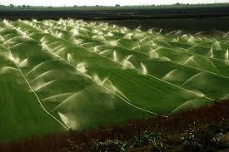
Agriculture Phase III
Chemically Intensive, Genetically Modified, Factory Farming

Slide 41
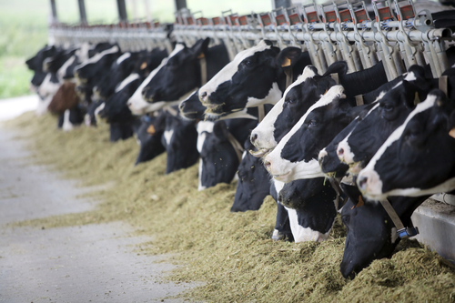
Yun AJ, Lee PY, Doux JD Are we eating more than we think? Illegitimate signaling and xenohormesis as participants in the pathogenesis of obesity. Medical Hypotheses 2006;67(1):36-40. Epub 2006 Jan 6.
“stressed animals produce hormones that exert unique influences on human endocrine function that ultimately increase risk for chronic diseases”

Slide 42
Aris A, Leblanc S. Maternal and fetal exposure to pesticides associated to genetically modified foods in Eastern Townships of Quebec, Canada. Reproductive Toxicology. 2011 May;31(4):528-33. Epub 2011 Feb 18.
“glyphosates and Bt toxins were found in the majority of pregnant women, their fetuses, and non pregnant women tested (93/100). This is the first study to reveal the presence of genetically modified toxins and GMO-associated toxins in humans”
Slide #42

Slide 44
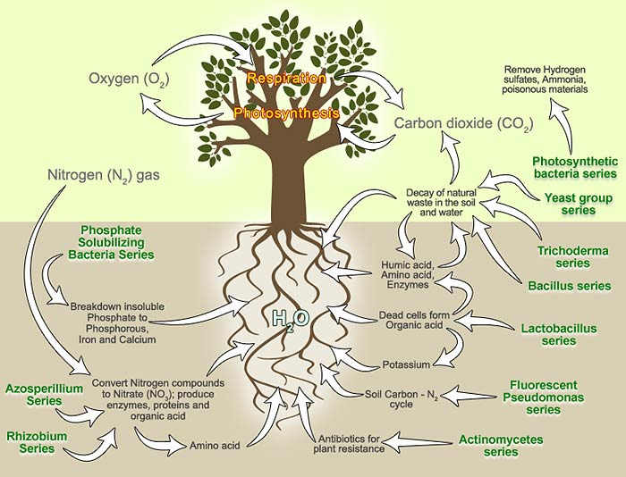

Slide 45
References
Frassetto et al. Metabolic and physiologic improvements from consuming a paleolithic, hunter-gatherer type diet. Eur J Clin Nutr. 2009 Aug;63(8):947-55. 2009 Feb 11.
Davis, DR, Epp MD, Riordan HD. Changes in USDA food composition data for 43 garden crops, 1950 to 1999. Journal of American College of Nutrition 2004;23(6):669-82.
Sanin LH, Carrasquilla G, Solomon KR, Cole DC, Marshall EJ Regional differences in time to pregnancy among fertile women from five Colombian regions with different use of glyphosate. Journal of Toxicology and Environmental Health 2009;72(15-16):949-60.
Aris A, Leblanc S. Maternal and fetal exposure to pesticides associated to genetically modified foods in Eastern Townships of Quebec, Canada. Reproductive Toxicology. 2011 May;31(4):528- 33. Epub 2011 Feb 18.
Yun AJ, Lee PY, Doux JD Are we eating more than we think? Illegitimate signaling and xenohormesis as participants in the pathogenesis of obesity. Medical Hypotheses 2006;67(1):36-40. Epub 2006 Jan 6.

Slide 46
Petri RM et al. Characterization of the Core Rumen Microbiome in Cattle during Transition from Forage to Concentrate as Well as during and after an Acidotic Challenge.
Pontzer H, Raichlen DA, Wood BM, Mabulla AZP, Racette SB, et al. (2012) Hunter-Gatherer Energetics and Human Obesity. PLoS ONE 7(7): e40503.
Koeth et al. Intestinal microbiota metabolism of L-carnitine, a nutrient in red meat, promotes atherosclerosis. Nature Medicine. 2013;19(5):576-85.
De Filippo et al. Impact of diet in shaping gut microbiota revealed by a comparative study in children from Europe and rural Africa. Proc Natl Acad Sci U S A. 2010;107(33):14691-6.
Schnorr et al. Gut microbiome of the Hadza hunter-gatherers. Nature Communications. 5:3654

