Slide 1
Light and Health

Slide 2
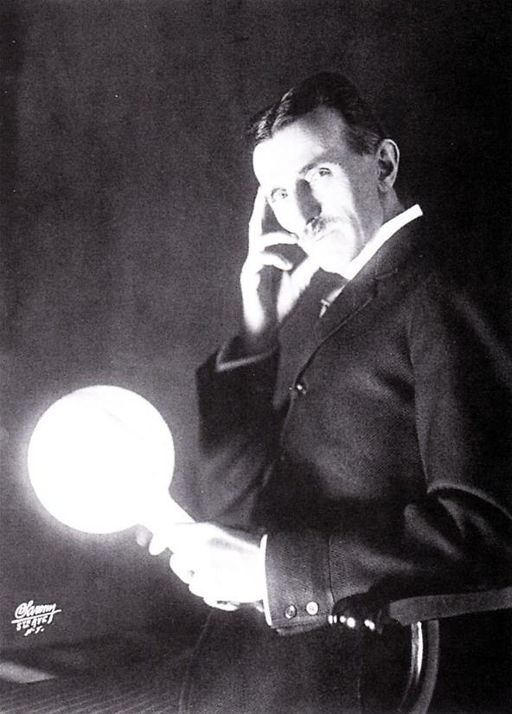
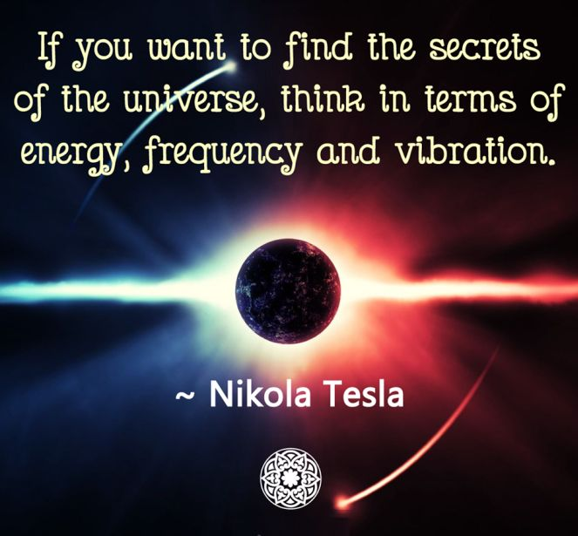

Slide 5
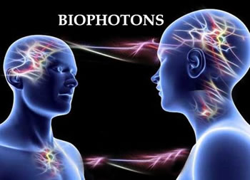

Slide 6
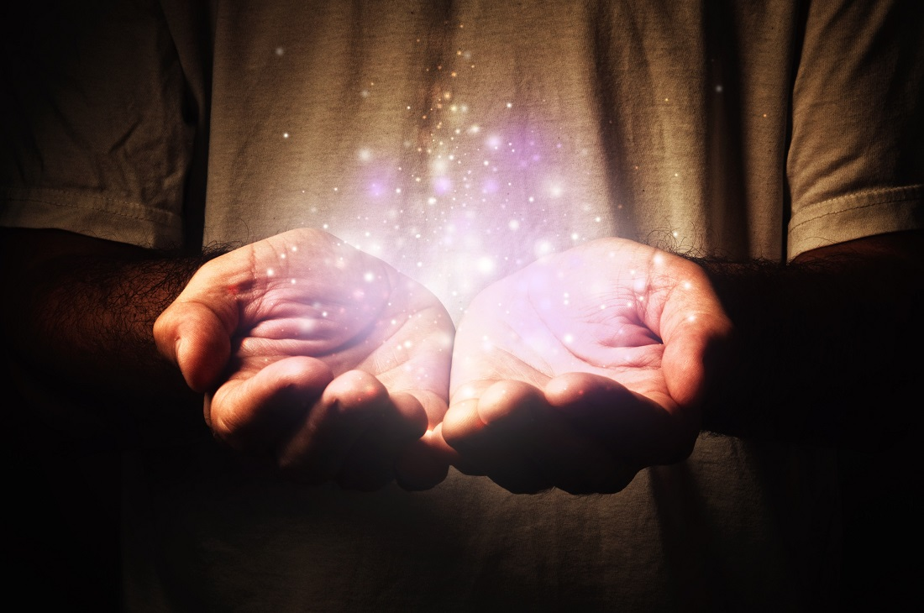

Slide 7
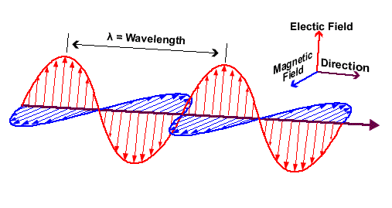

Slide 9
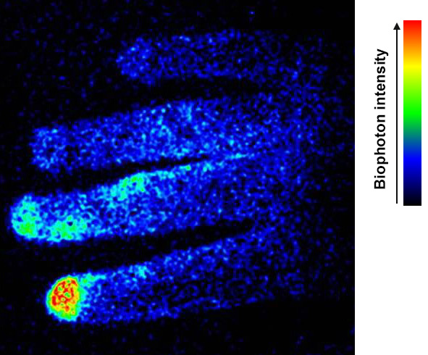

Slide 10
Dr. Alexander Wunsch
Light and Health Pioneer

Slide 13
Courtesy Dr. Alexander Wunsch

Slide 15
Courtesy Dr. Alexander Wunsch

Slide 17
Courtesy Dr. Alexander Wunsch

Slide 18
Courtesy Dr. Alexander Wunsch

Slide 19
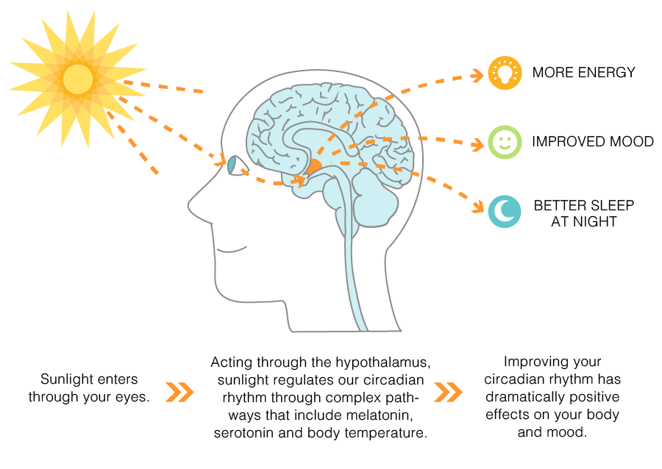

Slide 20
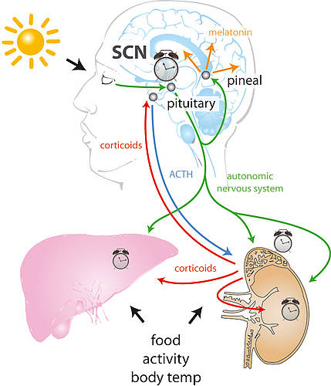

Slide 21
Courtesy Dr. Alexander Wunsch

Slide 22
Courtesy Dr. Alexander Wunsch

Slide 24
Courtesy Dr. Alexander Wunsch

Slide 26
Courtesy Dr. Alexander Wunsch

Slide 27
Courtesy Dr. Alexander Wunsch

Slide 28
Courtesy Dr. Alexander Wunsch

Slide 29
Courtesy Dr. Alexander Wunsch

Slide 30
Courtesy Dr. Alexander Wunsch

Slide 40
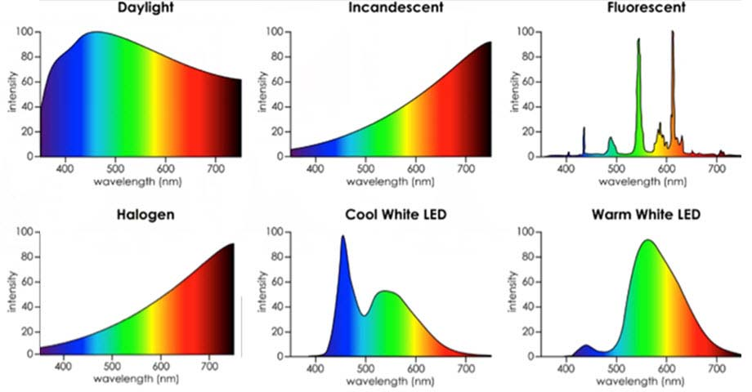
Color Rendering Index (CRI) 96+ %

Slide 42
Courtesy Dr. Alexander Wunsch

Slide 43
Courtesy Dr. Alexander Wunsch

Slide 46
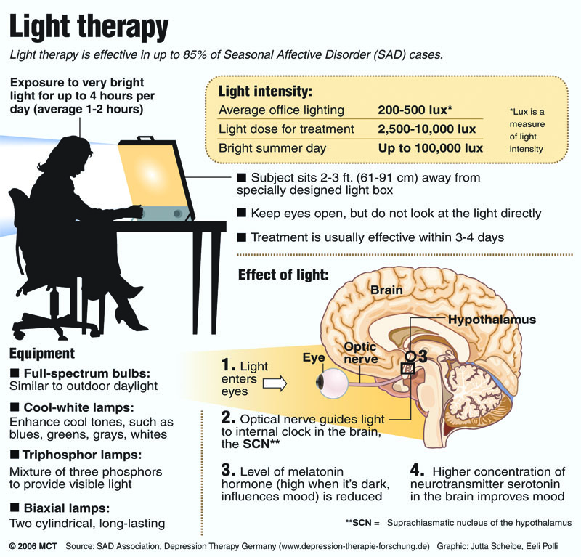
SAD
Full spectrum
10k lux
30”

Slide 51
Courtesy Dr. Alexander Wunsch

Slide 52
Courtesy Dr. Alexander Wunsch

Slide 53
Courtesy Dr. Alexander Wunsch

Slide 56
Courtesy Dr. Alexander Wunsch

Slide 57
Courtesy Dr. Alexander Wunsch

Slide 58
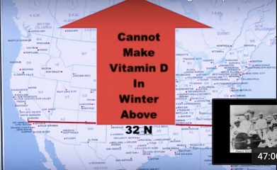

Slide 59
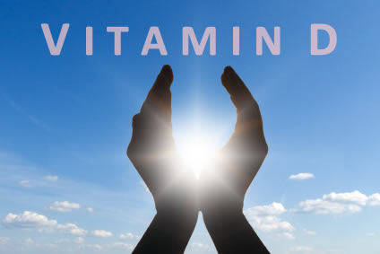
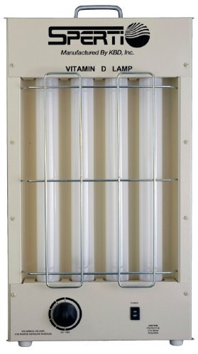
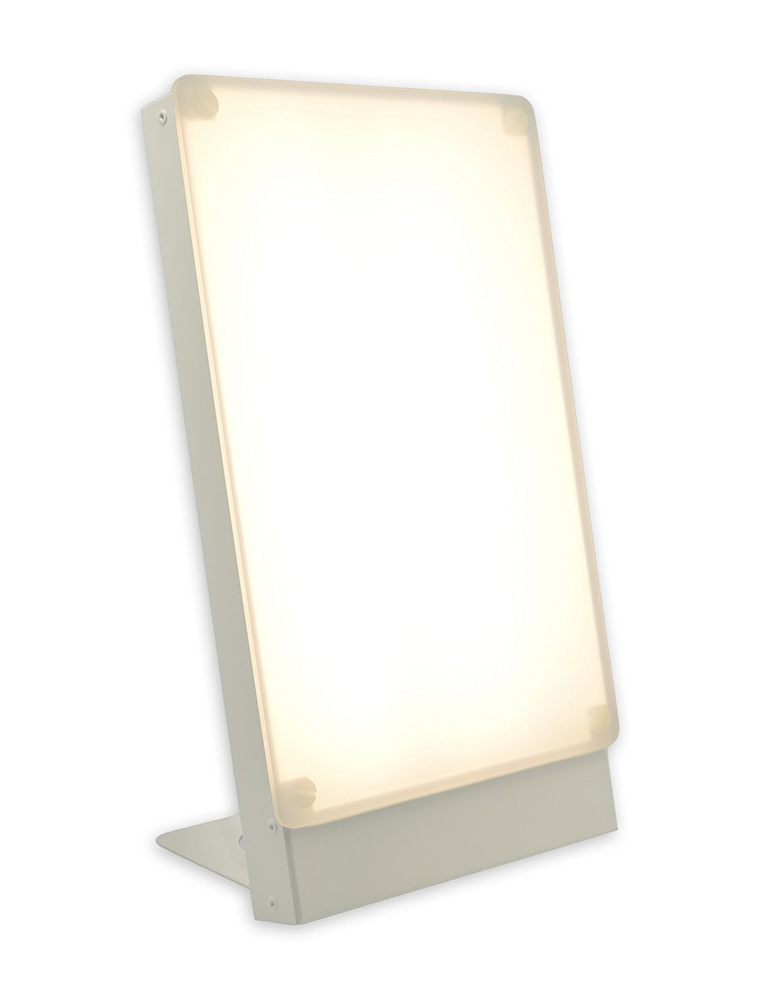
Many epidemiologic studies associate low vitamin D levels with most chronic, complex diseases including cancer.
Sunlight is the ultimate source
Studies suggest a desirable blood level of at least 30 - 50 ng/ml
? Sunlight vs. supplement

Slide 60
Courtesy Dr. Alexander Wunsch

Slide 63
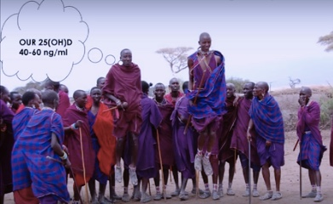

Slide 71
Disrupted Sleep
Loss of entrainment
15% Americans experience chronic insomnia
1 out of 3 has sleep disruption on one or more nights each week
Major risk factor for many chronic complex diseases including obesity
Neuro-endocrine-immune disruption
Obstructive sleep apnea underdiagnosed (neck circumfrence 16+” in women and 17+” in men)
Sleep hygiene

Slide 72
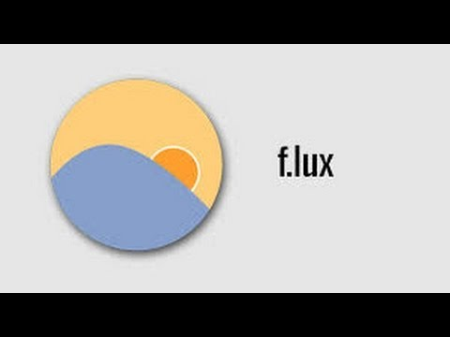
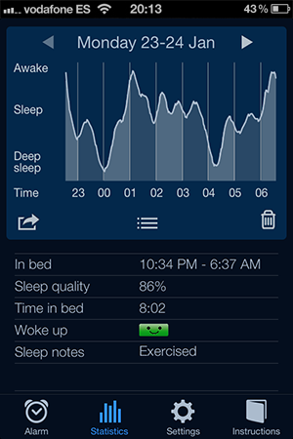
Apps
ewg.org Food Scores, Dirty Dozen, Skin Deep
Sleep Cycle
f•lux (filters blue light and reduces Kelvin)
Iris (filters blue light and reduces Kelvin

Slide 73
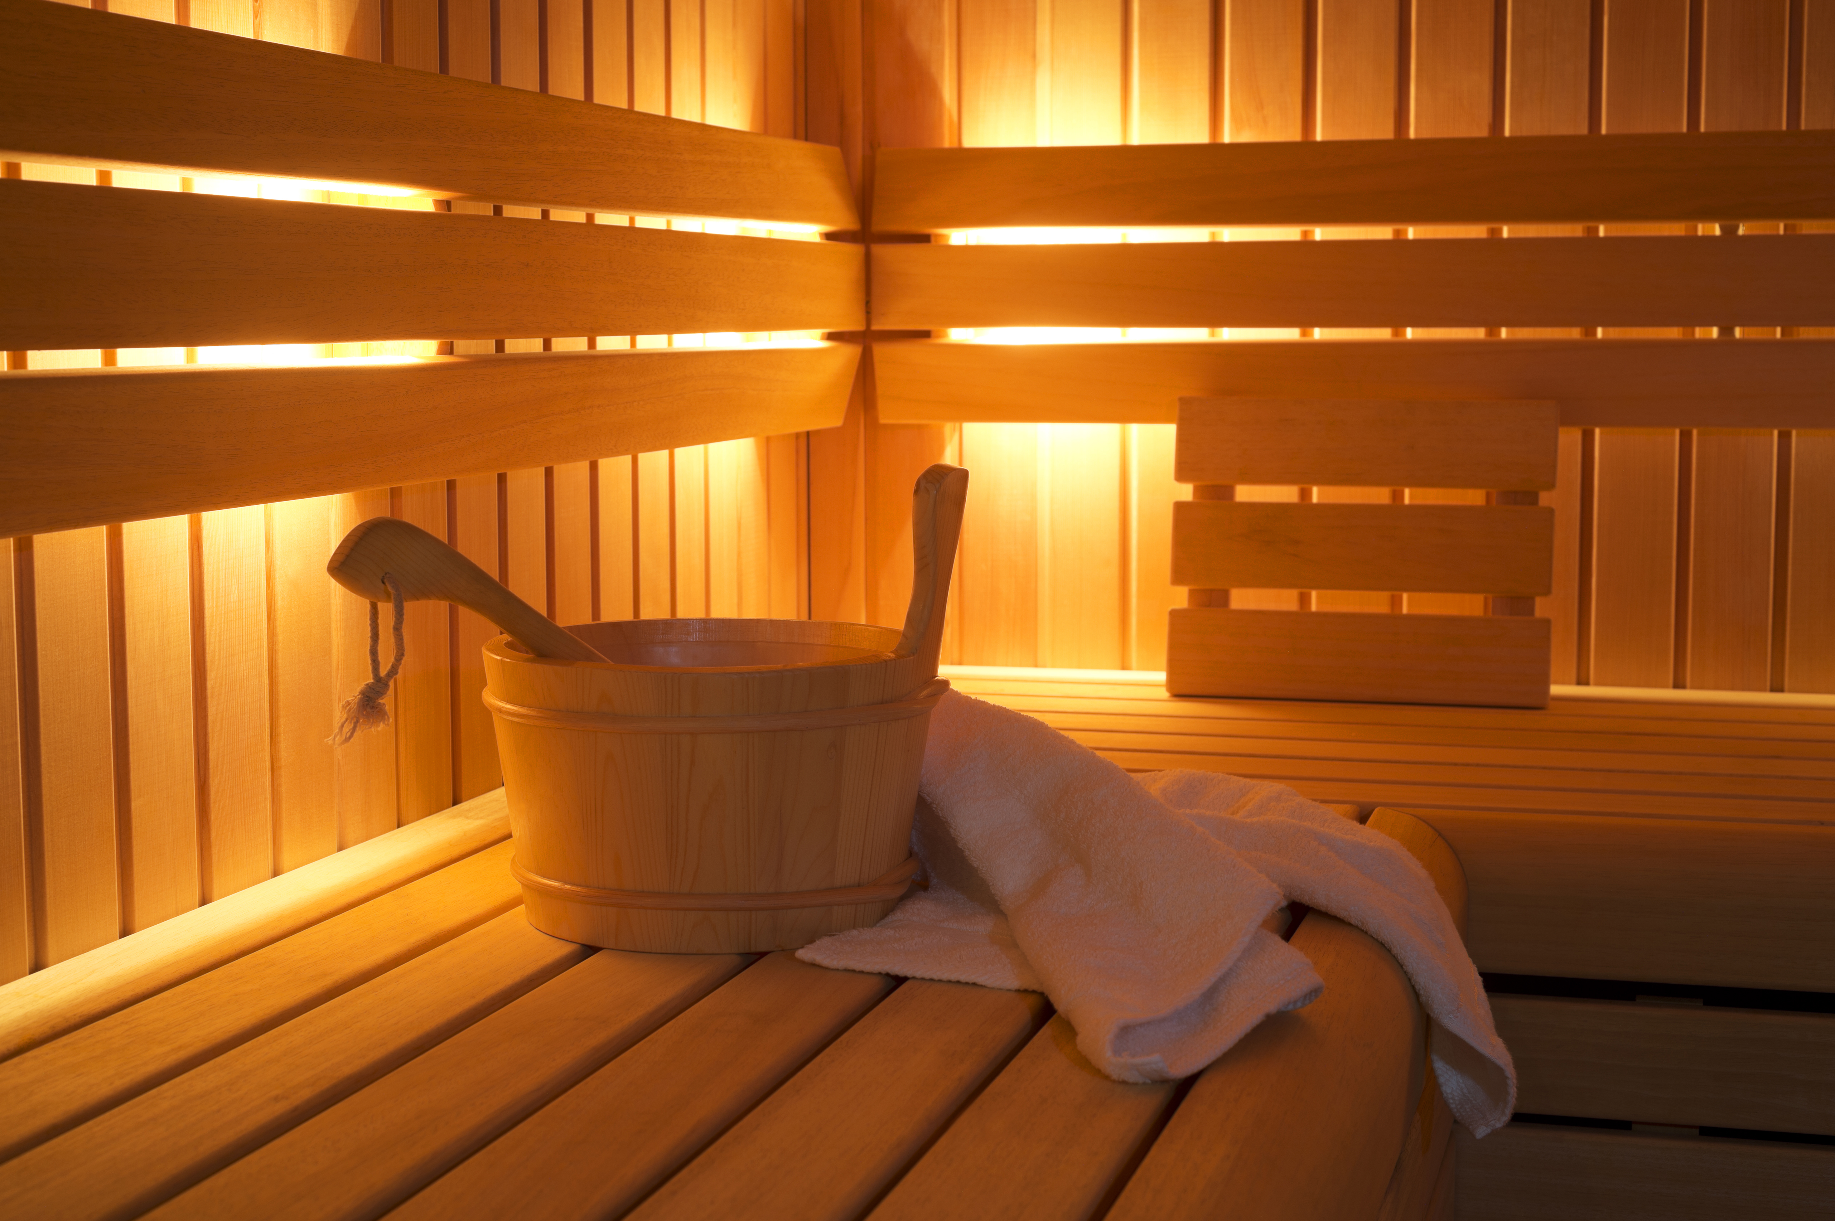
Saunas
Really good for health promotion and disease prevention
30” minutes 3-4x/week
Steam or infrared
Stimulates our bodies defense mechanisms

Slide 74
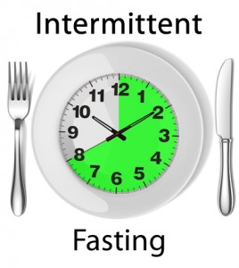
Time-Restricted Feeding
Time restricted feeding e.g. consume all food within 10-hour
Decreases in body weight and visceral fat
Significant reductions in breast cancer recurrence and improved prognosis (Patterson et al. UCSD)
Improved cardiovascular disease risk profile
Decreased inflammation (Biogerontology. 2015 Dec;16(6):775-88)
Decreased neuroinflammation (Neurobiol Aging. 2015 May;36(5):1914-23)
Autophagy (Autophagy, 2014;10:11, 1879-1882)

Slide 75
Summary
Decreased sunlight exposure and increased “junk light” exposure are major contributors to chronic complex disease.
Sensible sunlight e.g 1-hr day unprotected
Consider Vitamin D lamp (Sperti UVB 5 “/day)
Incandescent, halogen, warm LED
Ditch the CFUs, fluorescents
Blue blocker glasses after sunset
Full-spectrum light at 10k lux for 30” for seasonal affective disorder, sleep disruption, improved cognition.
F.lux or Iris apps for adjustment color temperature and blue blocking (2300 Kelvin an ideal setting for light intensity on computers, tablets, smart phones
Infrared saunas

Slide 76
Courtesy Dr. Alexander Wunsch

