Slide 1
Lifestyle Considerations for Cancer Prevention and Management
Mark C. Pettus MD
Director Medical Education, Wellness and Population Health
Berkshire Health Systems
Associate Dean of Medical Education
University of Massachusetts Medical School
December 8, 2017

Slide 2
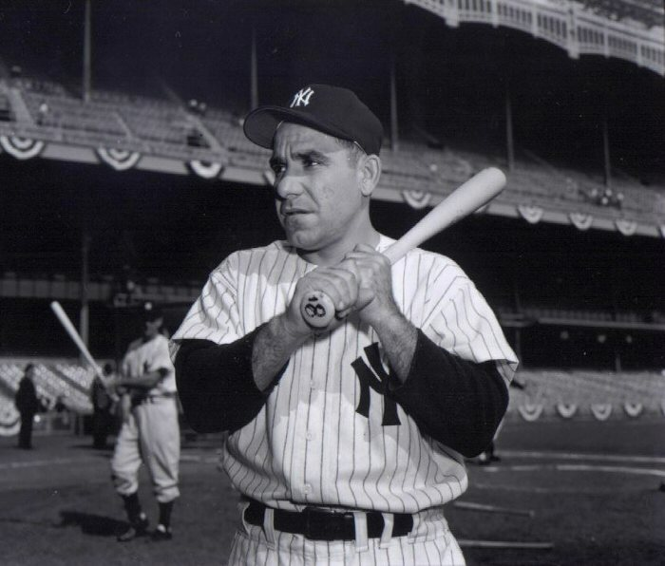
“The future ain’t what it used to be”
Yogi Berra

Slide 3
Learning objectives
To understand the lifestyle factors that are associated with cancer risk and cancer prognosis.
Review the research associating growing gene-environment mismatch with metabolic risk factors e.g. weight, inflammation, stress, insulin, and toxins and cancer.
To understand how lifestyle change can modify cancer risk and improve long-term response to treatment by mitigating these risks.

Slide 4
Prevalence up 3.7%/ year
Mortality up 1.7%/year
Notes:
Prevalence up 3.7%/ mortality up 1.7%

Slide 5
Lifestyle, Metabolic Fault-lines and Cancer
Weight
Inflammation (immune over-stimulation)
High Insulin levels
Detoxification
Low vitamin D – the sunshine vitamin
Stress and the fight-flight response

Slide 6
Cancer risk-response as byproducts of gene-lifestyle compatibility:
Creating a favorable “oncometabolic milieu”.

Slide 7
Life
Environment-Lifestyle
Genes-Epigenetics
Microbiome
Meaning-Love-Spirit

Slide 8
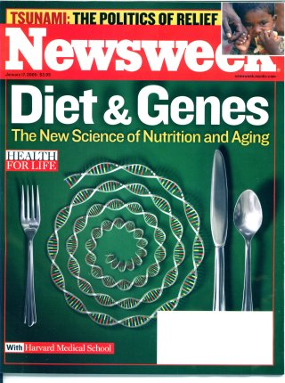

Slide 9
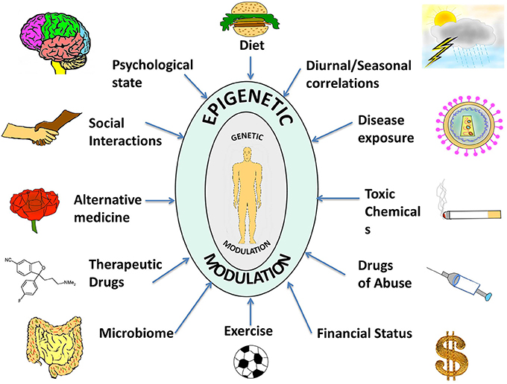

Slide 10
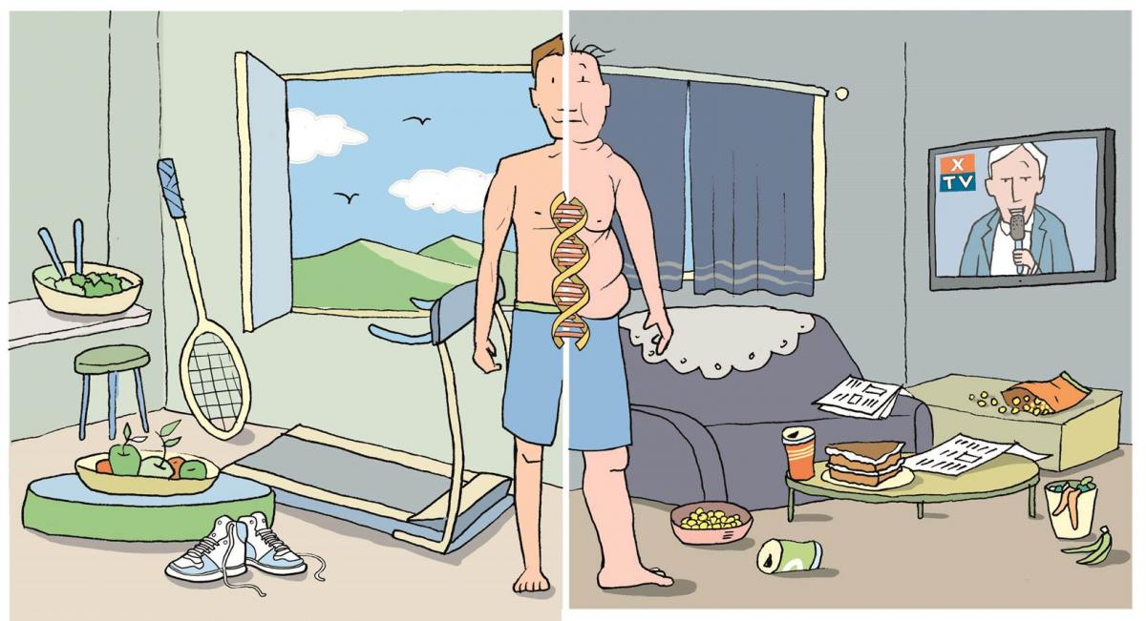

Slide 11
Cancer as a metabolic disease
Disease (how things appear)
Pre-diabetes, Diabetes, Obesity, Metabolic Syndrome, Heart Disease, Stroke, Depression, Autoimmunity, Alzheimer’s, Cancer
Core Metabolic Imbalances (what drives them) Insulin levels
Inflammation
Stress HPA Axis (fight-flight)
Detoxification
Root Causes (what are their origins)
Microbiome-Gene-Epigenetics-Environment
Nutrition Movement Stress Response Environmental toxins Sleep Social Connection Trauma Conflict Management Mindfulness Spirituality-Meaning in Work, Love, Play

Slide 12
Will the choice I am about to make…
Raise my sugar-insulin or lower my sugar-insulin?
Rev up my immune system (more inflammation) or relax my immune system?
Raise my stress levels (cortisol) or lower my stress levels (cortisol)
Increase or reduce to amount of toxins in my system?
Enhance loving and meaningful relationships?
Be forgiving or not?
Increase my steps/day or not?

Slide 13
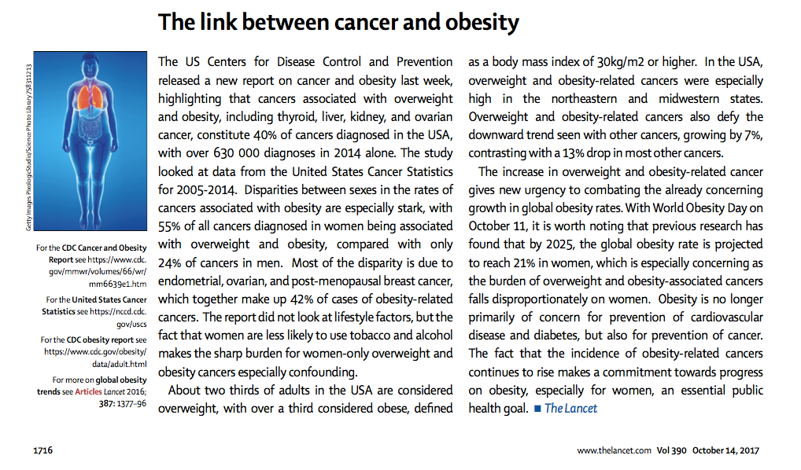
40 % all cancers in US linked to weight
70% US adults overweight
55% in women breast, ovarian, endometrial, liver, kidney, pancreas
Increased inflammation
Estrogen disruption
Higher insulin
Lower poor quality carbs/higher good quality fats
Time restricted feeding

Slide 14
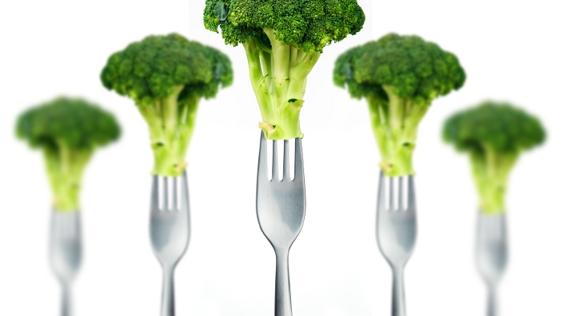
Nutrition

Slide 15
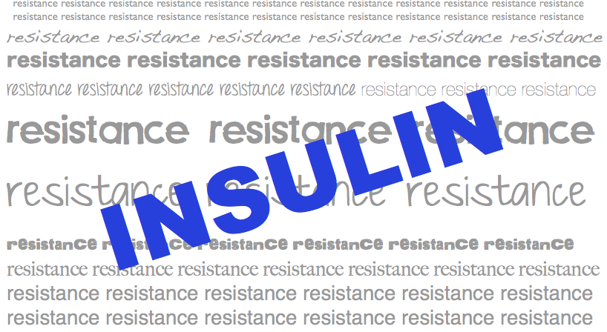
Insulin Resistance

Slide 17
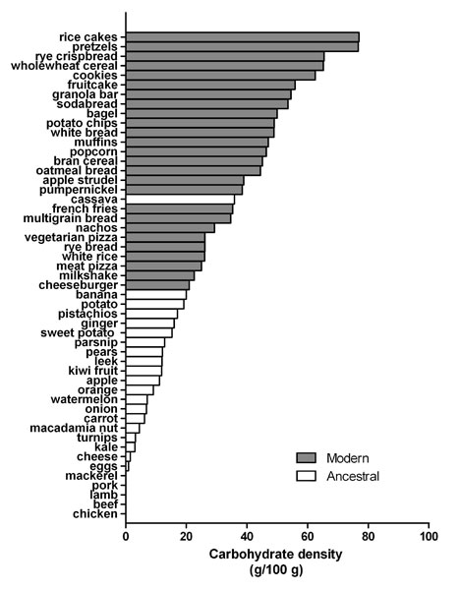
Reduce carbohydrate-dense foods
Major contributor of obesity, insulin resistance, changes in blood lipids, inflammation, and alterations of the organisms in the human microbiome
A huge area of opportunity in individuals with increased belly fat, pre-diabetes or diabetes…these are health features of carbohydrate intolerance.
For most, sugar and refined, grain-based foods are problematic: eliminate and observe.

Slide 18
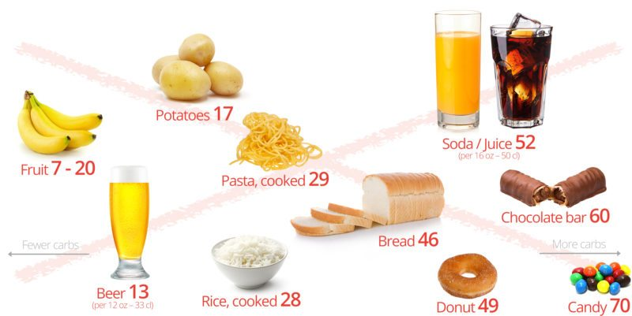
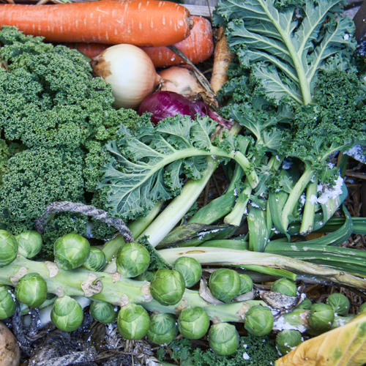
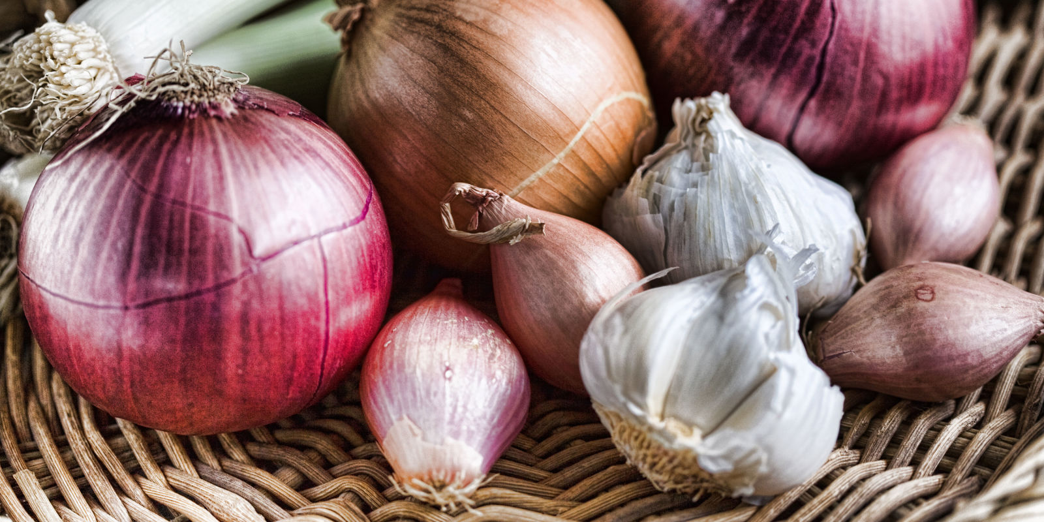
Sugar, Fructose and Carbohydrate-Dense Grains
High-Quality Plant-Based Carbs
Oral and Gut
Microbiome
Inflammation
Altered neurotransmitters
Insulin Resistance
Weight and Metabolism
Mitochondria-Oxidative stress
HPA axis –Stress Response
Protection from:
Inflammation
Diabetes
Cancer
Obesity

Slide 22
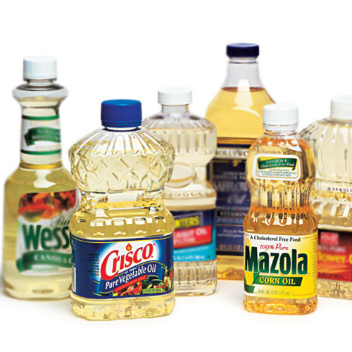
Frequent use of omega-6 processed vegetable oils increases inflammation.

Slide 23
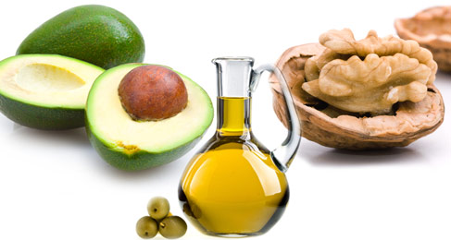
More quality fat sources
Pasture-raised eggs
Fatty fish e.g. salmon, sardines, anchovies, mackerel, trout
Grass fed meats, lamb, poultry
Grass-fed butter; ghee
Whole fat dairy, yogurt
Extra virgin olive oil
Extra virgin coconut oil
Avocados, olives
Nuts - macadamia, walnuts, pecans

Slide 25
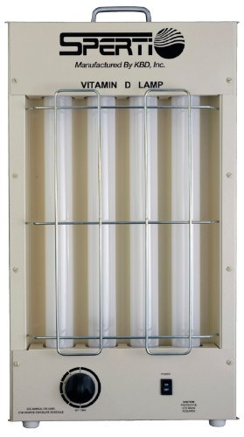
Many epidemiologic studies associate low vitamin D levels with most chronic, complex diseases including cancer.
Sunlight is the ultimate source
Studies suggest a desirable blood level of at least 30 - 50 ng/ml
? Sunlight vs. supplement

Slide 26
Quality of light and health
Circadian rhythm critical for health
Light Box 10,000 lux 20-30” in am
Vitamin D lamps 5-10”/day
Incandescent lighting after sunset
“Blue-Blocker” glasses, filters for smart phones, computers, tablets (f*lux, iris)
Infrared saunas
LED with CRI 95+

Slide 31
Environmental Working Group Ewg.org

Slide 32
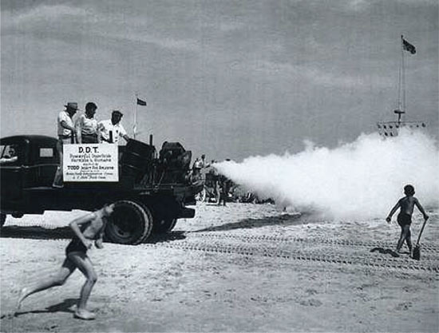

Slide 38
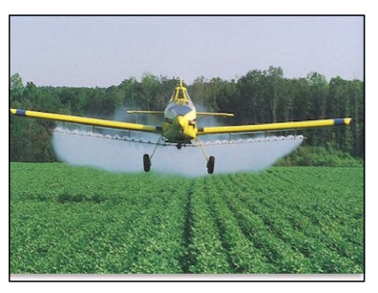

Slide 40
Principles of Healthy Detoxification
Minimize your exposure to toxins by eating organic foods, moderating processed foods with refined grain flour, and sugar.
Drink filtered water
Keep your bowels moving once or twice a day
Eat organic animal products.
Eat at least 5 servings of colorful vegetables and fruits
Eliminate nicotine and moderate alcohol intake (e.g. no more than 1 drink/day)
Sweat profusely at least 3 times a week e.g. IR sauna, steam sauna
Mindfulness practice

Slide 41
What else can a person to do to reduce toxic burden?
Buy and eat organic whenever possible
Consider glass or ceramic containers instead of plastic
Decline stain protection treatments for upholstery or floor coverings
Ask about VOCs (volatile organic compounds) in paints, new carpeting, furniture
Avoid polycarbonate plastics with “7” and “3” stamped on bottom. Consider aluminum instead.
Switch to stainless steel or hard-anodized aluminum pots and pans when Teflon cookware wears out

Slide 42
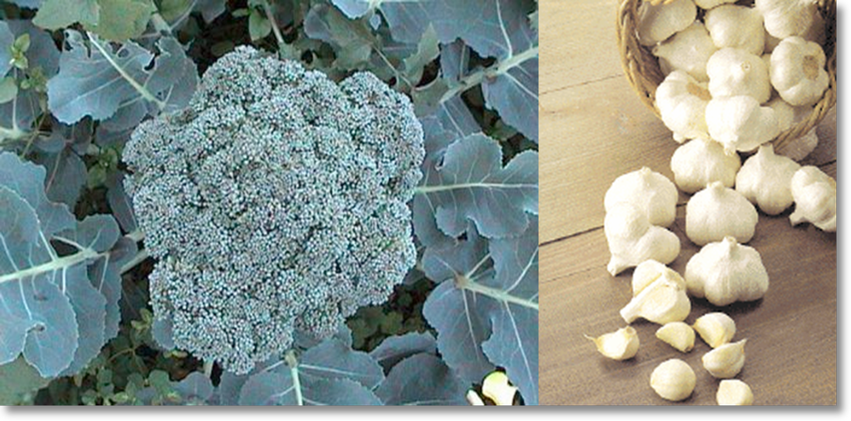
Cruciferous and Allium Vegetable Families

Slide 43
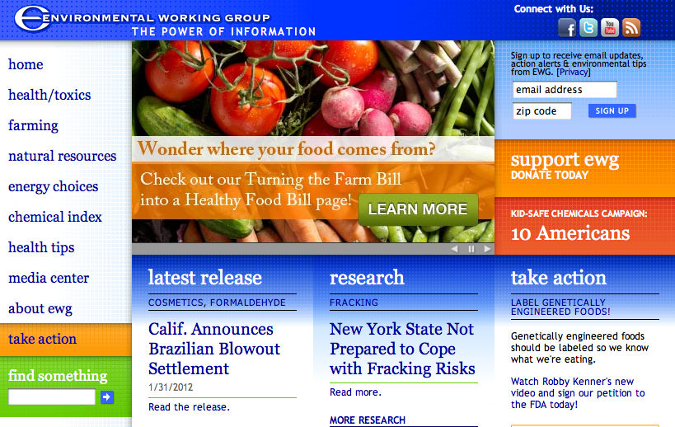
Ewg.org

Slide 44
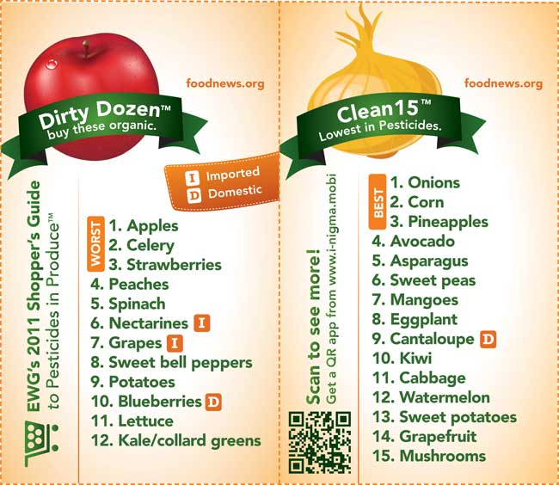

Slide 45
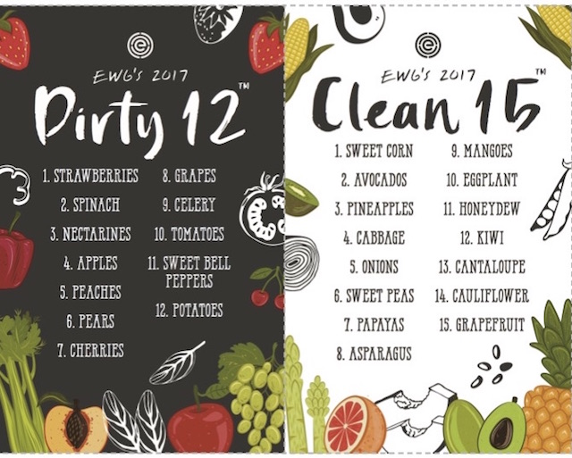
www.ewg.org

Slide 46
Stress Response

Slide 47
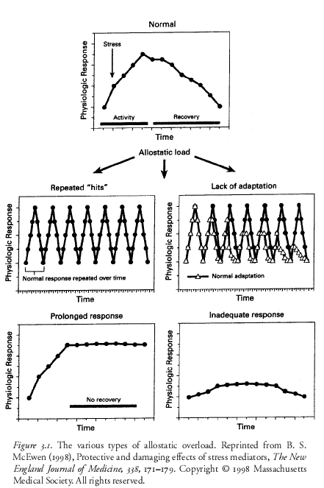

Slide 48
Fight-Flight or Sympathetic Tone

Slide 49
Calm or Parasympathetic Tone…..Get “Para”

Slide 50
From a health and well-being perspective…
Chest pounding is out.
Grooming is in!

Slide 52
Mindfulness
Meditation, prayer, slow-deep breathing, guided imagery, yoga, biofeedback, gratitude journal
Decreased cortisol, flight-fight response, BP
Increased parasympathetic tone
Improved mood, concentration, pain tolerance, resilience
Improved quality of life e.g. pain, anxiety, nausea
Decreased inflammation
Enhanced neuroplasticity

Slide 53
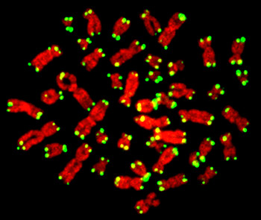

Slide 54
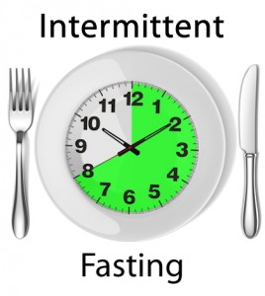
Time-Restricted Feeding
Time restricted feeding e.g. consume all food within 10-hour
Decreases in body weight and visceral fat
Significant reductions in breast cancer recurrence and improved prognosis (Patterson et al. UCSD)
Improved cardiovascular disease risk profile
Decreased inflammation (Biogerontology. 2015 Dec;16(6):775-88)
Decreased neuroinflammation (Neurobiol Aging. 2015 May;36(5):1914-23)
Autophagy (Autophagy, 2014;10:11, 1879-1882)

Slide 55
Saunas
Really good for health promotion and disease prevention
30” minutes 3-4x/week
Steam or infrared
Stimulates our bodies defense mechanisms

Slide 56
A Lifestyle Script for Health and Cancer Risk Reduction
Whole foods with reductions in sugar, refined grain-based flour, acellular carbohydrate dense foods
Plant-based foods are key (remember inflammation and your gut ecosystem)
More healthy fats e.g. olive oil, coconut oil, nuts, avocados, butter, fatty fish, eggs (yolks are best) grass-fed meats
Plant-based fiber for the microbiome
Cruciferous family, allium family, berries great for detoxification
Elimination trial e.g. grains, gluten-containing grains, sugar
USDA Organic
Notes:
(Stephanie Senef PhD: Entropy 2012, 14, 2265-2290; doi:10.3390/e14112265) GMO

Slide 57
A Lifestyle Script for Health and Cancer Risk Reduction
Time-restricted feeding e.g. 10 hours/day feed with 14 hrs/day fast
Liberal outdoor, full-spectrum light exposure; light box
Motion is the lotion!
Stress management e.g. yoga, tai chi, music, breath, meditation
Connection with others: we are born to bond !
Sauna use
Meaning in our work, love and play
Notes:
(Stephanie Senef PhD: Entropy 2012, 14, 2265-2290; doi:10.3390/e14112265) GMO

Slide 58
Thank you.
www.thehealthedgepodcast.com

Slide 59
You are the one you have been waiting for!
Thank You
www.thehealthedgepodcast.com

Slide 61
The HR for breast cancer from the lowest to the highest quartile of 25-oh Vitamin D was 2.5

