Slide 1
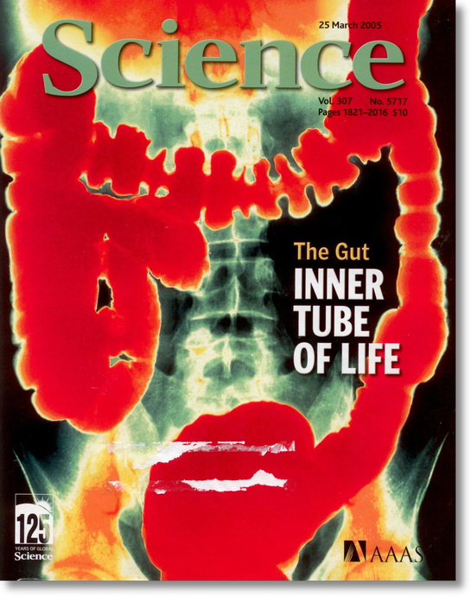
Gastrointestinal Balance: Do you have the guts for health?
Mark Pettus MD, FACP
March 4, 2015
www.thehealthedgepodcast.com

Slide 2
Spring is 16 days away

Slide 3
The Course
Epigenetics
Metabolism
Inflammation
Gut-microbiome barrier function
Environmental toxins- mitochondria
The science of mind
Social connection and health
Spiritual practice and health outcomes

Slide 4
Learning Objectives
Examine the role that gastrointestinal health plays in the broader context of health, disease, and quality of life.
Explore the connection between gastrointestinal health, your gut’s ecosystem, inflammation-immune regulation, and your nervous system.
Examine environmental inputs that lead to “leaky-ness” or increased permeability in the gut.
Review the “5R-Model” for gastrointestinal health

Slide 5
Health as a byproduct of gene-environmental compatibility

Slide 6
Environment
Life
Gene
Epigenome
Microbiome

Slide 7
Disease (how things appear)
Pre-diabetes, Diabetes, Obesity, Metabolic Syndrome, Heart Disease, Stroke, Depression, Autoimmunity, Alzheimer’s, Cancer, Autism, ADD, Hypertension, GERD, IBS
Core Metabolic Imbalances (what drives them)
Gut-Immune Barrier function
Inflammation-Immunomodulation
Fight-Flight (HPA axis)
Detoxification,
Insulin resistance
Root Causes (what are their origins)
Gene-Epigenome-Environment
Nutrition Movement Stress Response
Environmental -toxins Sleep Social Connection
Traumatic events Conflict Management Mindfulness Meaning in Work, Love & Play

Slide 9
Beyond Digestion
The gut contents are an inner world that is “outside” the cellular body. Its surface is a frontier of 100 square meters and a thickness of one cell.
Your gut flora are an organ (the microbiome) that contains 10 times more microbial cells than the body has mammalian cells
Our microbiome has 100x the DNA than all of human DNA combined
From a cellular perspective, you are 10% human and 90% microbial
The most sophisticated immunologic component in our body
Neuroendocrine connection

Slide 10
Digestive Disease in America
Impacts 60-70% Americans
GERD effects 45-60 million
7-10% Americans experience heartburn at least daily
20% (60 million) experience at least once monthly
Irritable bowel disease (IBS) effects 30-45 million
Gallstone disease 20-25 million
Diverticular Disease 20 to 40 million
Celiac estimated at 3 million (approx 1:100)
Gluten sensitivity as much as ? 5-8% of Americans
IBD 750,000 – 1 million
Colorectal Cancer approximately 260,000

Slide 11
Is your gut trying to tell you something?
100 million people with various GI problems e.g. IBS, bloating, gas, reflux, constipation, diarrhea, and crampy pain.
Some of the most popular prescription drugs
Americans now spend $ 3 billion/year on OTC on antacids, laxatives, acid blockers and fiber supplements
Common reason to seek medical care
Frequent reason for diagnostic testing

Slide 12
Problems with gut health can promote/worsen…
Allergy
Asthma
Autoimmunity
Arthritis
Metabolic Bone disease
Skin problems
Mood disorders
Dementia
Cancer
Inflammation

Slide 13
SIBO small intestinal bacterial overgrowth
Typically associated with carbohydrate intolerance and bloating after eating
Nausea, diarrhea, constipation
Contributes to food allergies
Intestinal permeability-systemic inflammation
Present in 75% of people with IBS, fibromyalgia, CFS
Eradicating SIBO often resolves Sx of IBS
Breath test

Slide 14
Irritable Bowel Syndrome
Most common GI functional disorder diagnosed by gastroenterologists affecting about 5-10% of the population with female predominance of 2-3:1
Symptom complex including abdominal pain, altered bowel function, bloating, mucosal inflammation, exaggerated stress response, increases in plasma pro-inflammatory cytokines
Stress (including early life stress) plays a major role in the onset
and exacerbation of symptoms in IBS
Dysbiosis, food sensitivities and SIBO (as many as 75%)

Slide 16
IBS associated with:
GERD
Interstitial cystitis
Fibromyalgia
Chronic Fatigue Syndrome
Disrupted sleep
Rosacea
Migraine headaches
Restless leg syndrome (RLS)

Slide 17
GERD: Do we have all wrong?

Slide 18
David Relman MD
Clin Prof Med-ID, Prof Microbiology-Immunology
Stanford
Ecology of human indigenous microbiology and relationship to health and disease.

Slide 19
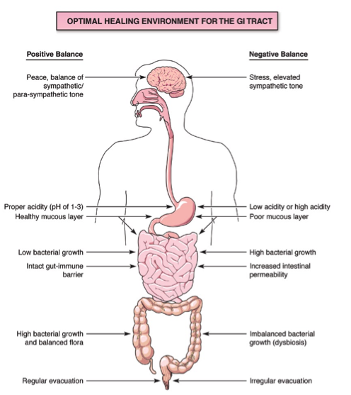

Slide 21
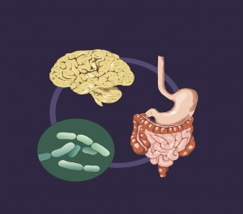
Intestinal Permeability
Uncontrolled Trafficking of Molecules
Food allergies, lectins
Dysbiosis
Acid suppression
Stress response
Environmental toxins
Medications

Slide 25
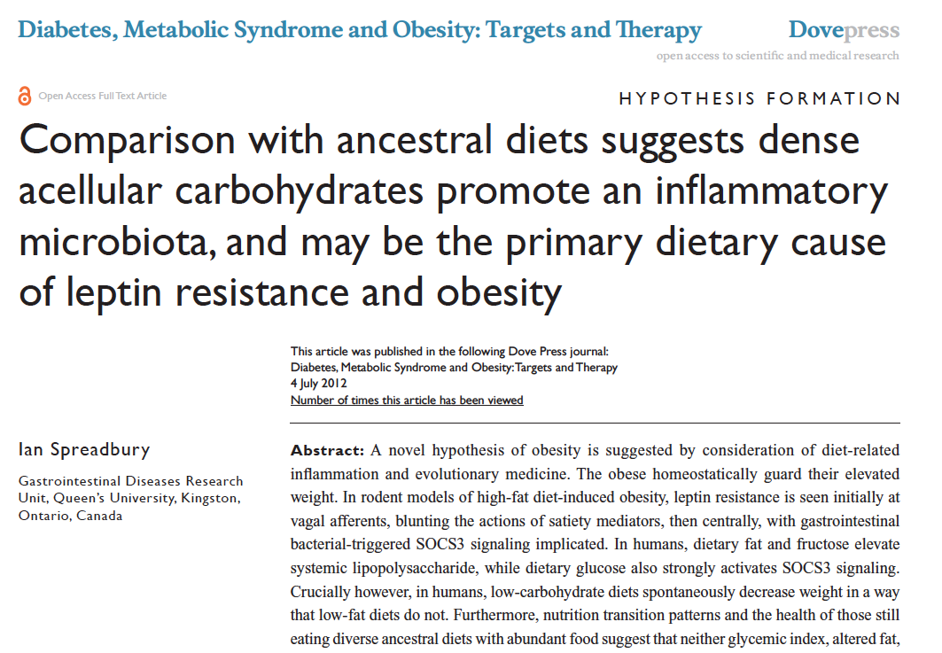

Slide 26
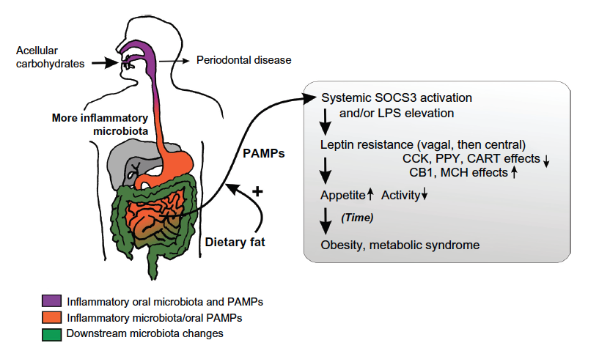
Inflammatory upregulation
Insulin fueling lipogenesis
Insulin resistance in muscle and liver
Inhibits mobilization of fat as a fuel
source
NF-kappa B turned on
Increased LPS
Cytokine upregulation
Leptin resistance
Shift to fat storage increases appetite
and decreases energy expenditure
Alter our circadian rhythms
Increased O-6/O-3

Slide 27
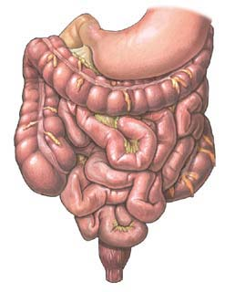
Stress and the gut
Stress
Activation of the HPA axis (ie CRF, ACTH, cortisol)
Increase in gut permeability
Increase in mucosal inflammation
Changes in GI motor function
Changes in gut flora

Slide 29
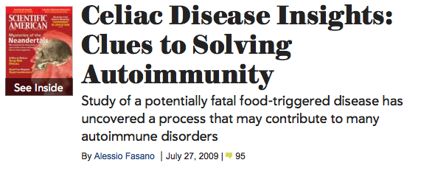
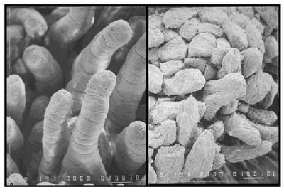
Wheat: A Triple threat ?
Amylopectin A (high glycemic carb)
Gluten (for some)/gluteomorphins
Fructans (FODMAP)
Notes:
References:(i) Ludvigsson JF, Montgomery SM, Ekbom A, Brandt L, Granath F. Small-intestinal histopathology and mortality risk in celiac disease. JAMA. 2009 Sep 16;302(11):1171-8.(ii) Rubio-Tapia A, Kyle RA, Kaplan EL, Johnson DR, Page W, Erdtmann F, Brantner TL, Kim WR, Phelps TK, Lahr BD, Zinsmeister AR, Melton LJ 3rd, Murray JA. Increased prevalence and mortality in undiagnosed celiac disease. Gastroenterology. 2009 Jul;137(1):88-93(iii) Green PH, Neugut AI, Naiyer AJ, Edwards ZC, Gabinelle S, Chinburapa V. Economic benefits of increased diagnosis of celiac disease in a national managed care population in the United States. J Insur Med. 2008;40(3-4):218-28.(iv) Farrell RJ, Kelly CP. Celiac sprue. N Engl J Med. 2002 Jan 17;346(3):180-8. Review.(v) Sedghizadeh PP, Shuler CF, Allen CM, Beck FM, Kalmar JR. Celiac disease and recurrent aphthous stomatitis: a report and review of the literature. Oral Surg Oral Med Oral Pathol Oral Radiol Endod. 2002;94(4):474-478.(vi) Margutti P, Delunardo F, Ortona E. Autoantibodies associated with psychiatric disorders. Curr Neurovasc Res. 2006 May;3(2):149-57. Review.(vii) Ludvigsson JF, Reutfors J, Osby U, Ekbom A, Montgomery SM. Coeliac disease and risk of mood disorders–a general population-based cohort study. J Affect Disord. 2007 Apr;99(1-3):117-26. Epub 2006 Oct 6.(viii) Ludvigsson JF, Osby U, Ekbom A, Montgomery SM. Coeliac disease and risk of schizophrenia and other psychosis: a general population cohort study. Scand J Gastroenterol. 2007 Feb;42(2):179-85.(ix) Hu WT, Murray JA, Greenaway MC, Parisi JE, Josephs KA. Cognitive impairment and celiac disease. Arch Neurol. 2006 Oct;63(10):1440-6.(x) Bushara KO. Neurologic presentation of celiac disease. Gastroenterology. 2005 Apr;128(4 Suppl 1):S92-7. Review.(xi) Millward C, Ferriter M, Calver S, Connell-Jones G. Gluten- and casein-free diets for autistic spectrum disorder. Cochrane Database Syst Rev. 2004;(2):CD003498. Review.

Slide 30
Courtesy Alessio Fasano MD

Slide 31
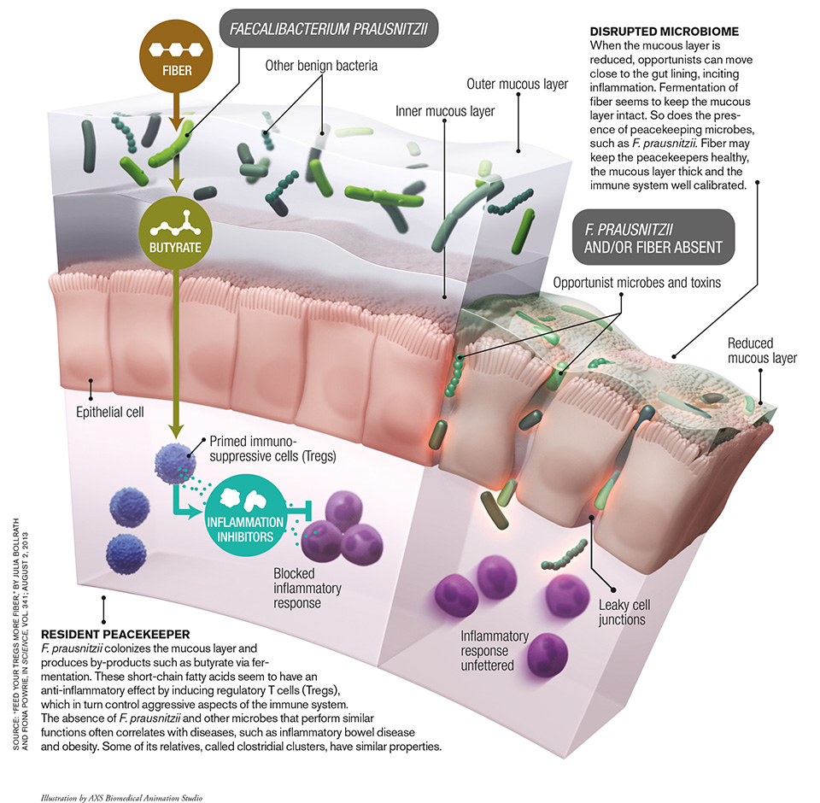

Slide 32
Celiac and gluten sensitivity associated with:
Thyroid disease
Neurologic diseases
Osteoporosis
Decreased fertility
Recurrent UTIs
Autoimmune disease
Skin disorders e.g. eczema, rosacea
RLS – restless leg syndrome

Slide 35
Changes in our modern food supply linked to chronic complex disease
Sugar and refined grain flours, processed - high glycemic foods with high “carbohydrate density”.
Fructose from sugar and HFCS (a dose response)
Increased processed-seed oils (Omega-6) relative to Omega-3 EFA intake
Food sensitivities such as gluten, grains or dairy
Insufficient vegetables (phytonutrients-epigenetics),
Insufficient fiber (microbiome)
Foods contaminated with environmental toxins such as game fish (mercury), non-organic fruits and vegetables with pesticide residues, BPA in plastics, GE

Slide 36
The Microbiome…an evolving story
The MB has evolved with humans to allow survival
The MB provides important functions in digestion, immunity, metabolism and detoxification
Increased diversity seen with decreased hygiene
Early and diverse exposure key to a “healthy microbiome”
Getting dirty may be good for you
Increased CHO digesting MB in populations with higher CHO intake
Reduced diversity seen in obesity, IBD, autism spectrum
Diet is a powerful factor that can shift the microbiome

Slide 43
Probiotics containing lactobacillus species reduce symptoms of bacterial dysbiosis in individuals on long-term PPIs

Slide 44
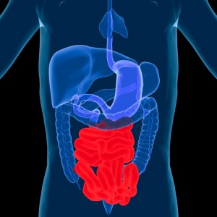
The 5R Model
Remove
Replace
Repair
Reinoculate
Rebalance

Slide 45
Remove
Elimination of disease causing microorganisms
(dysbiosis) e.g. SIBO, yeast, parasites. Rx with
appropriate agent e.g. Diflucan, Nystatin, Xifaxin
Foods that one may be intolerant to (elimination diet:
start with gluten and dairy).
Medications that may negatively influence an optimal
GI environment (such as PPIs, H2 blockers, NSAIDs,
antibiotics, steroids).
Stress: how we interpret and respond

Slide 46
Common FODMAPs include:
Fructose: A simple sugar found in many fruits, vegetables and added sugars.
Lactose: A carbohydrate found in dairy products like milk.
Fructans: Found in many foods, including gluten grains like wheat, spelt, rye and barley.
Galactans: Found in large amounts in legumes.
Polyols: Sugar ALCOHOLS like xylitol, sorbitol, maltitol and mannitol. They are found in some fruits and vegetables, and often used as sweeteners.

Slide 47
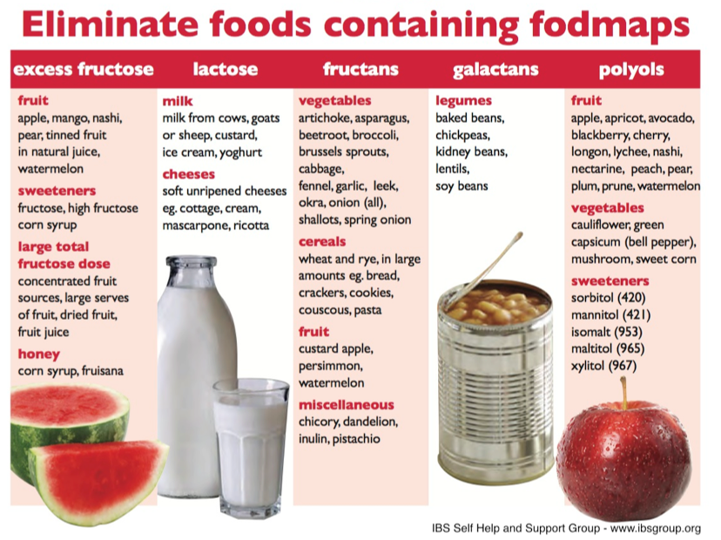

Slide 48
Replace
Stomach acid: apple cider vinegar, Swedish bitters, Betaine HCL tablets 30-60 minutes before meals
Digestive enzymes (plant-based), Pancreatic enzymes e.g. pancrease, Similase, GB digestion
Choleretics, Ox Bile, dandelion root

Slide 49
Repair
Nutrient support with whole-foods, minimally processed, e.g. elimination diet or FODMAPS
Zinc carnosine
DGL-Deglycerinated Licorice, Slippery Elm
Turmeric-Curcumin
Glutamine 1,000 mg three times/daily
Gelatin rich bone broths e.g. chicken, beef: Nourishing Broth by Sally Fallon and Kayla Daniels PhD

Slide 50
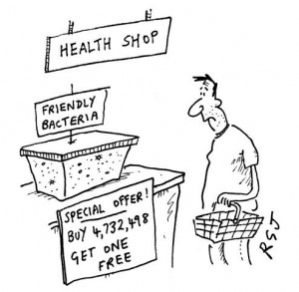
Reinoculate
Administer probiotics from the following three
families that have been found to be beneficial
for GI function: Bifidobacteria, Lactobacilli,
and Saccharomyces. Ther-biotic by Klaire
Administer prebiotics (food that promotes
beneficial bacterial growth) such as bananas,
plantains, onions, asparagus and garlic, most
vegetable-based fiber
Fermented foods like sauerkraut, cabbage,
kimchi, beets, yogurt, kefir

Slide 51
Rebalance
Rest and relaxation-response
Adequate sleep
Meditation
Yoga
Tai chi
Cognitive behavioral therapy
Health coaching

Slide 53
Thank you.

