Slide 1
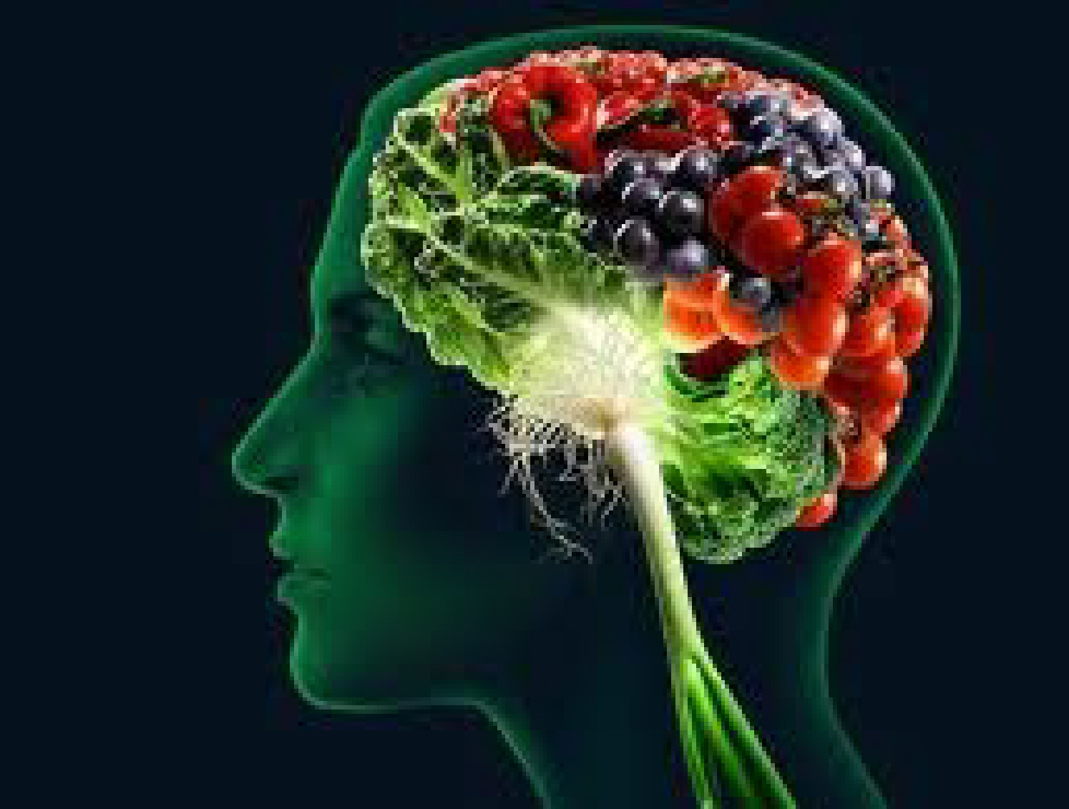
Inflammation: Are you playing with fire?
Mark Pettus MD
February 25, 2015

Slide 2
The Chapters
Epigenetics
Metabolism
Inflammation
Gut-microbiome barrier function
Environmental toxins- mitochondria
The science of mind
Social connection and health
Spiritual practice and health outcomes

Slide 3
Learning Objectives
Explore the root causes of inflammation that fuel chronic-complex disease.
Examine the connection between inflammation and brain health.
Examine the mechanisms that link many common environmental triggers with increased inflammation.
Consider lifestyle changes that can reduce-reverse inflammation to improve longevity and quality of life.

Slide 4
The proposition: how the outside gets inside
Health and disease are byproducts of complex individualized gene-environment interactions that may go back more than a generation before our conception and continue throughout our lives.
Your DNA i.e., your “Book of Life” still has a Stone Age imperative, not often adapted for 21st century environmental inputs e.g. the foods in our modern food supply.
This incompatibility creates a distorted metabolic trajectory e.g. inflammation that forms the basis of chronic complex disease and diminished quality of life.
Through mindful living that aligns conscious choosing with what are are most designed to be in relationship with, our biology can be transformed to promote-restore optimal function and health throughout the life continuum.
Notes:
Self care requires patience. Some of the problems you confront today may have their origins before your conception.

Slide 5
Environment
Life
Gene
Epigenome
Microbiome
Notes:
Human health as a form of ecology

Slide 6
Nature via Nurture

Slide 7
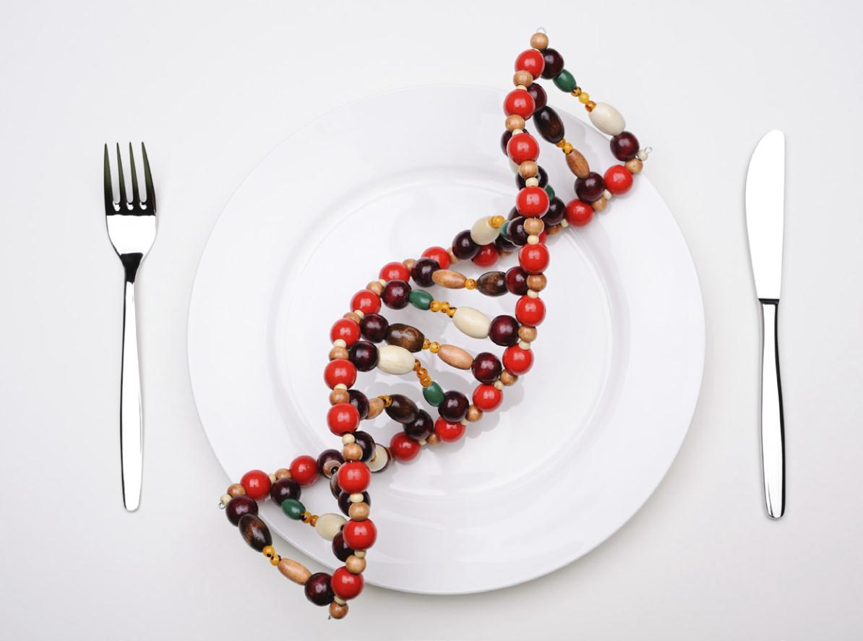
Nutrigenomics: beyond food as calories

Slide 9
Poor Quality Carbs
Inflammation
Visceral fat
Changes in food consumption
Stress
Sleep disruption
Altered gut-permeability/microbiome
Social isolation
Hormonal imbalances
Toxin excess
Excess Insulin
Fat storage
Down-regulation of insulin receptors
Insulin Resistance
Leptin resistance
Eat more and do less

Slide 10
Disease (how things appear)
Pre-diabetes, Diabetes, Obesity, Metabolic Syndrome, Heart Disease, Stroke, Depression, Autoimmunity, Alzheimer’s, Cancer, Fibromyalgia, Chronic fatigue
PS, MS,, GAD, PTSD, Autism spectrum
Core Metabolic Imbalances (what drives them)
Inflammation
Oxidative Stress-Mitochondria
Stress Response (HPA axis)
Microbiome (Gut-Immune-Barrier Function)
Root Causes (what are their origins)
Gene-Epigenome-Environment
Nutrition Movement Stress Response Environmental toxins Sleep Social Connection Trauma Conflict Management Mindfulness Meaning in Work, Love, Play
Notes:
Problems in the soil show up long before they appear as diseases

Slide 11
What are the conditions of your soil?
What am I getting too much of that is promoting inflammation and how can I reduce it?
What do I need more of that I am not getting to reduce inflammation and how can I bring more of it in?

Slide 12
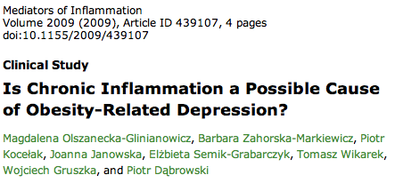
Inflammation

Slide 13
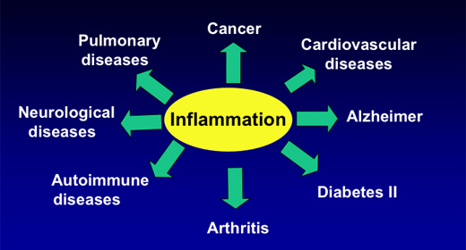

Slide 14
Slide courtesy Jeanne Wallace PhD
14

Slide 15
15

Slide 16
NF-κB: Inflammation’s “Master Switch”
Nuclear transcription factor
Triggered by diet, stress, environmental toxins, visceral fat, infections, intestinal barrier integrity disruption, oxidized LDL, free radicals, vitamin D deficiency, altered microbiome, LPS, inflammation from other sources
Up-regulates expression of 400+ genes involved with cytokine production, cell proliferation, apoptosis, angiogenesis
Exercise, meditation,Vitamin D, Spices e.g. turmeric and many plant flavonoids shown to inhibit NF-κB in vitro and in vivo
NF-κB
16

Slide 17
Nrf2 activation…a critical intracellular defense
Exercise
Meditation
EGCG
Resveratrol
Coffee
Sulfurophane
Curcumin

Slide 18
Food and Inflammation

Slide 19
Changes in Our Diet that Trigger Inflammation
Sugar and refined grain flours, processed poor quality carbs with high “carbohydrate density”.
Fructose from sugar and HFCS
Not enough vegetables and plant-based fiber – microbiome
Increased processed seed oils O-6/O-3 EFA intake
Insufficient healthy saturated, monounsaturated and O-3 fat intake
Food sensitivities such as gluten-grains, dairy
Foods contaminated with environmental toxins such as game fish (mercury), non-organic fruits and vegetables with pesticide residues, BPA in plastics, Abx, ? GMOs

Slide 22
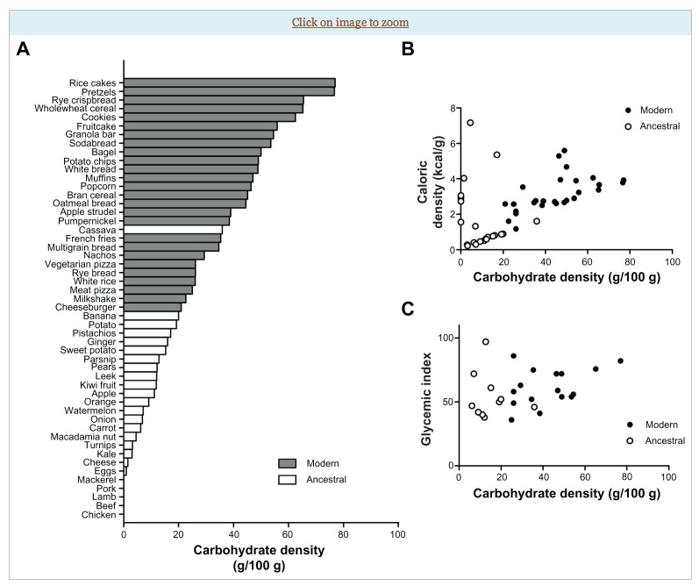
Source: Ian Spreadbury Diabetes, Metabolic Syndrome and Obesity DovePress 2012

Slide 23
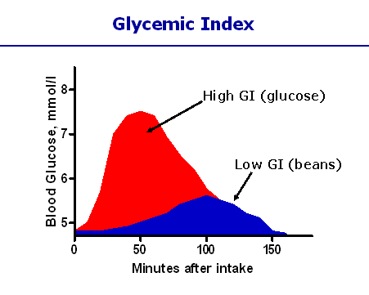
Different carbohydrates produce unique genomic responses!
High Glycemic Carbs Low Glycemic Carbs
62 genes regulating Same genes turned off;
Inflammation, stress, Genes regulating same insulin signaling production turned off. gene responses activated.
Kalle et al. Am J Clin Nutr;2007:851:1417-27

Slide 24
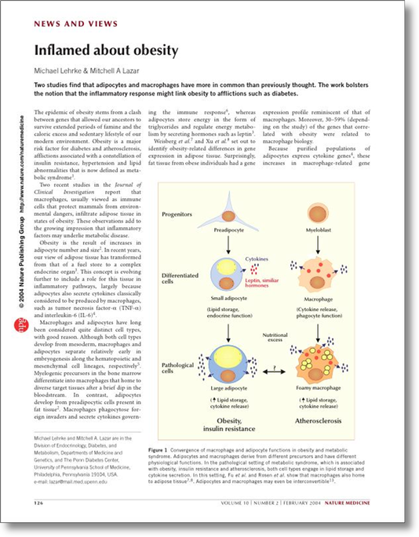
Visceral Adipose Stores
Insulin Resistance
Dyslipidemia (high TGA and low HDL)
Elevations of BP
Increased risk chronic complex disease
Origins of Health

Slide 25
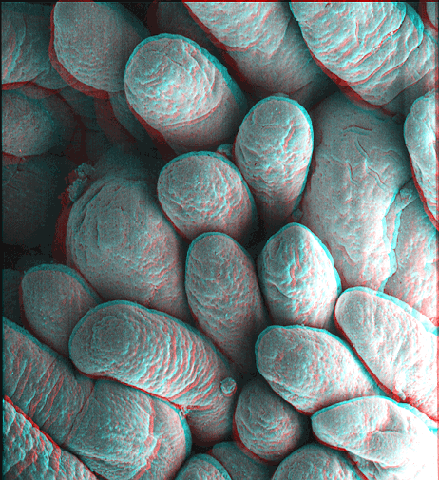
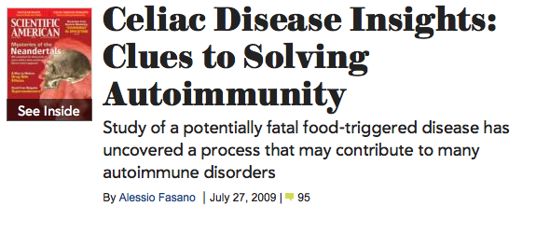
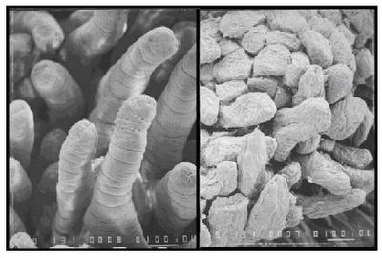
Notes:
References:(i) Ludvigsson JF, Montgomery SM, Ekbom A, Brandt L, Granath F. Small-intestinal histopathology and mortality risk in celiac disease. JAMA. 2009 Sep 16;302(11):1171-8.(ii) Rubio-Tapia A, Kyle RA, Kaplan EL, Johnson DR, Page W, Erdtmann F, Brantner TL, Kim WR, Phelps TK, Lahr BD, Zinsmeister AR, Melton LJ 3rd, Murray JA. Increased prevalence and mortality in undiagnosed celiac disease. Gastroenterology. 2009 Jul;137(1):88-93(iii) Green PH, Neugut AI, Naiyer AJ, Edwards ZC, Gabinelle S, Chinburapa V. Economic benefits of increased diagnosis of celiac disease in a national managed care population in the United States. J Insur Med. 2008;40(3-4):218-28.(iv) Farrell RJ, Kelly CP. Celiac sprue. N Engl J Med. 2002 Jan 17;346(3):180-8. Review.(v) Sedghizadeh PP, Shuler CF, Allen CM, Beck FM, Kalmar JR. Celiac disease and recurrent aphthous stomatitis: a report and review of the literature. Oral Surg Oral Med Oral Pathol Oral Radiol Endod. 2002;94(4):474-478.(vi) Margutti P, Delunardo F, Ortona E. Autoantibodies associated with psychiatric disorders. Curr Neurovasc Res. 2006 May;3(2):149-57. Review.(vii) Ludvigsson JF, Reutfors J, Osby U, Ekbom A, Montgomery SM. Coeliac disease and risk of mood disorders–a general population-based cohort study. J Affect Disord. 2007 Apr;99(1-3):117-26. Epub 2006 Oct 6.(viii) Ludvigsson JF, Osby U, Ekbom A, Montgomery SM. Coeliac disease and risk of schizophrenia and other psychosis: a general population cohort study. Scand J Gastroenterol. 2007 Feb;42(2):179-85.(ix) Hu WT, Murray JA, Greenaway MC, Parisi JE, Josephs KA. Cognitive impairment and celiac disease. Arch Neurol. 2006 Oct;63(10):1440-6.(x) Bushara KO. Neurologic presentation of celiac disease. Gastroenterology. 2005 Apr;128(4 Suppl 1):S92-7. Review.(xi) Millward C, Ferriter M, Calver S, Connell-Jones G. Gluten- and casein-free diets for autistic spectrum disorder. Cochrane Database Syst Rev. 2004;(2):CD003498. Review.

Slide 26
Courtesy Alessio Fasano MD

Slide 27
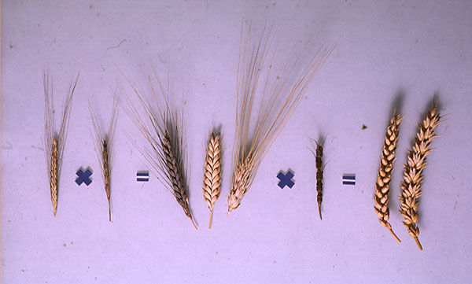
Slide #27

Slide 29
Courtesy Tom O’Brien MD- 2013 Gluten Summit

Slide 30
More on gluten, mind and mood
Celiac associated with many neuropsychiatric diagnoses e.g. ADHD seen in approx. 60%!
Celiac associated with white matter changes on MRI…similar to that seen with MS
Gluten increases insulin resistance in individuals who are sensitive
Brain wave patterns in ADHD improve consistently with gluten restriction
Gluten sensitivity enhances zonulin that increases intestinal permeability
Gluten sensitivity can alter blood flow to frontal lobes

Slide 32
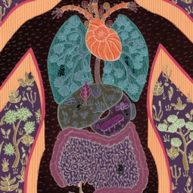
Intestinal Permeability
Food sensitivities
Dysbiosis
Acid suppression
Stress response
Environmental toxins
Medications e.g. regular NSAID use, steroids

Slide 33
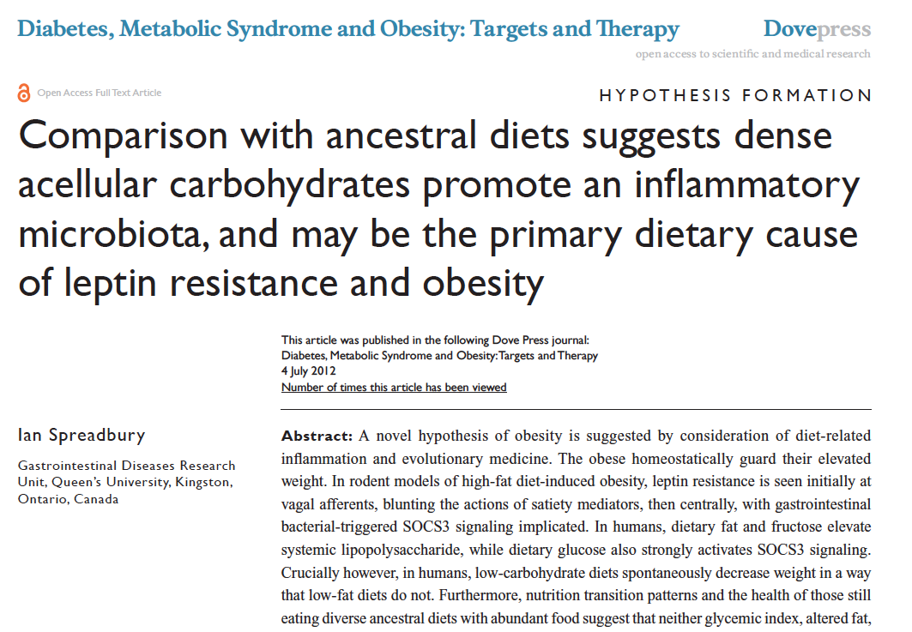

Slide 34
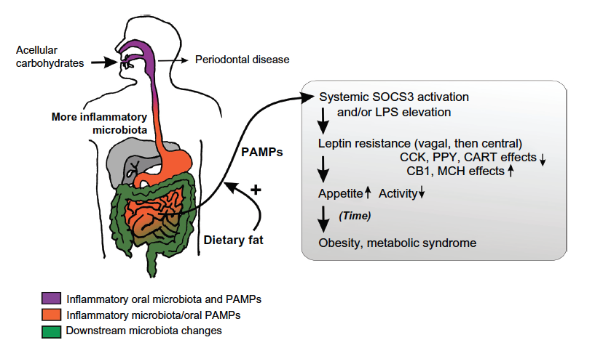
Increased Inflammation
Insulin fueling lipogenesis
Insulin resistance in muscle and liver
Inhibits capacity to burn fat
NF-kappa B goes up (bad)
Increased LPS (bad)
Cytokine upregulation (bad)
Leptin resistance (hungry and less energy)
A root cause of poor health and many
symptoms
Increased O-6/O-3

Slide 36
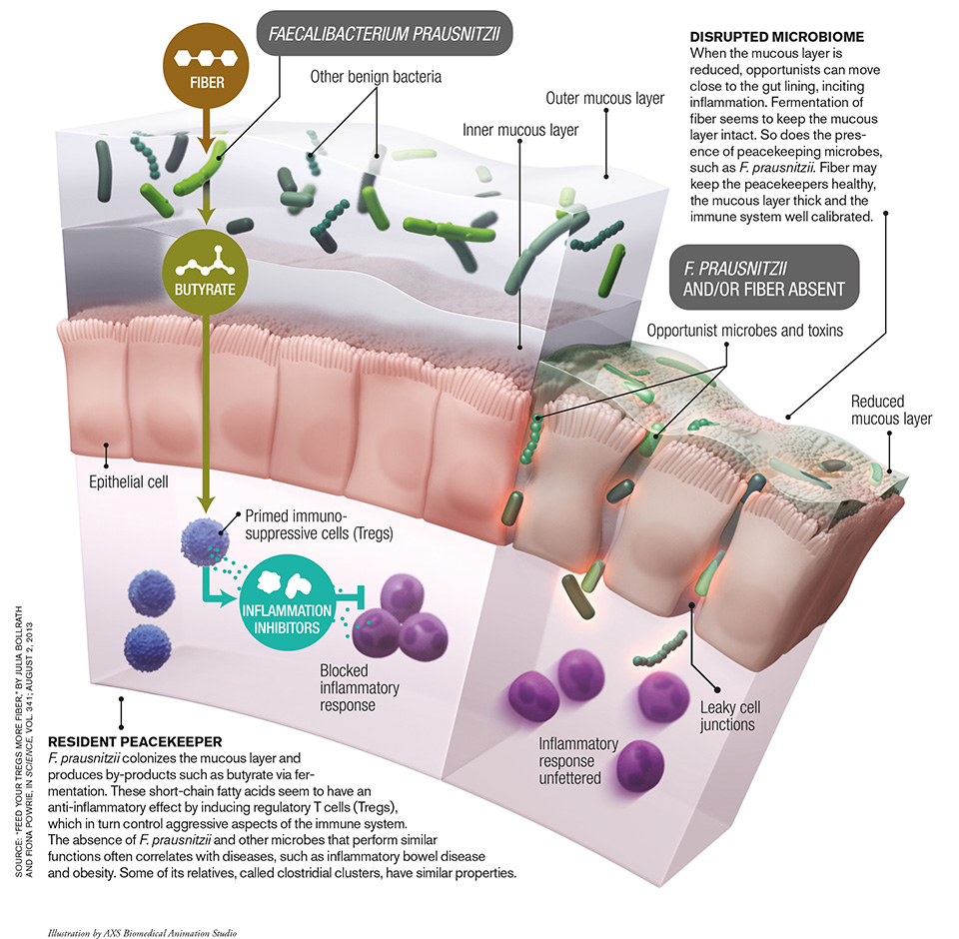

Slide 37
Speculative Interpretation of current research

Slide 38
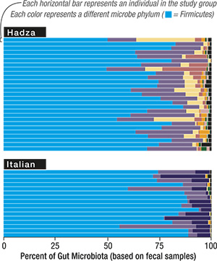
TAXONOMIC TREASURE TROVE: A survey of fecal
microbiota of 43 subjects revealed a more varied mix of gut
bacteria phyla among Hadza hunter-gatherers compared with
urban Italians. CREDIT: SOURCE: “GUT MICROBIOME OF
THE HADZA HUNTER-GATHERERS,” BY STEPHANIE L.
SCHNORR ET AL., IN NATURE COMMUNICATIONS, VOL. 5,
ARTICLE NO. 3654; APRIL 15, 2014; Graphic by Jen Christiansen

Slide 40
Because the critical issue is the intergenerational transfer of microbes and its timed assembly, three periods are relevant: before pregnancy, during pregnancy and in the child's early life. For all three periods, antibiotic use is relevant because it may directly change maternal microbes prior to transfer or the child’s microbes afterward. Elective cesarean sections mean that the child misses the birth canal transit, and antibacterials in soaps and foods directly affect microbiota composition. Infant formulas have not been constructed with the benefit of millions of years of mammalian evolution, because breast milk contains nutrients that specifically select for the growth of preferred coevolved organisms and inhibit opportunists and pathogens.
The aggregate of modern assaults on the early-life microbiome suggests that our progeny may not be inheriting their fair share. Exceeding the developing microbiome’s plasticity predictably leads to consequences, as growing evidence evinces. Studies have linked C-sections and exposures to prenatal and postnatal antibiotics to increased risk of obesity, diabetes, celiac disease, asthma and allergies, among other ailments that have their roots in development.

Slide 41
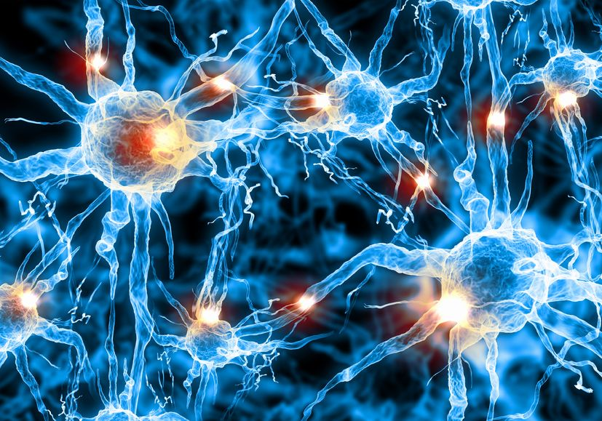
Psychobiotics
Protection of intestinal barrier function
Influence on local and systemic antioxidant status
Direct neurochemical production e.g. Gamma Amino Butyric Acid
Indirect influence on neurotransmitter function
Experimental evidence of links to depression, anxiety, and autism
Stress-induced alterations in microbiota
Direct activation of neural pathways between gut and brain
Regulation of immune response - inflammatory cytokines
Can influence production of brain derived neurotrophic factor (BDNF)
Loss of microbiome “heritage” a contributor to many modern diseases
Psychobiotics: a novel class of psychotropic.
Biol Psychiatry. 2013 Nov 15;74(10):720-6. doi: 10.1016/j.biopsych.2013.05.001. Epub 2013 Jun10.
Fermented foods, microbiota, and mental health: ancient practice meets nutritional psychiatry
Eva M Selhub1*†, Alan C Logan2† and Alison C Bested3
Journal of Physiological Anthropology 2014, 33:2

Slide 42
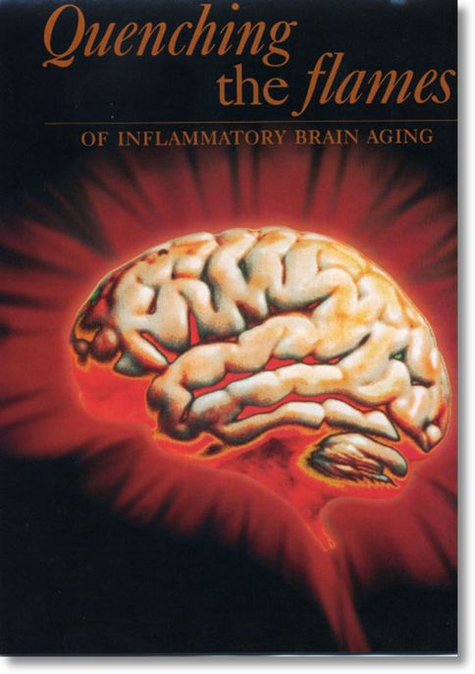
Evidence for increased inflammation in:
MCI/Alzheimer’s disease
Depression
Pain
PD
MS
ADD and ADDHD
Brain fog i.e., trouble with concentration, focus, memory
Anxiety and Panic
Autism spectrum

Slide 43
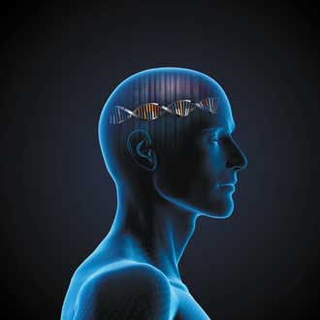
The Contemporary Convergence
Gene-Epigenome + Environment + Microbiome = Outcome
i.e. how the outside gets inside

Slide 44
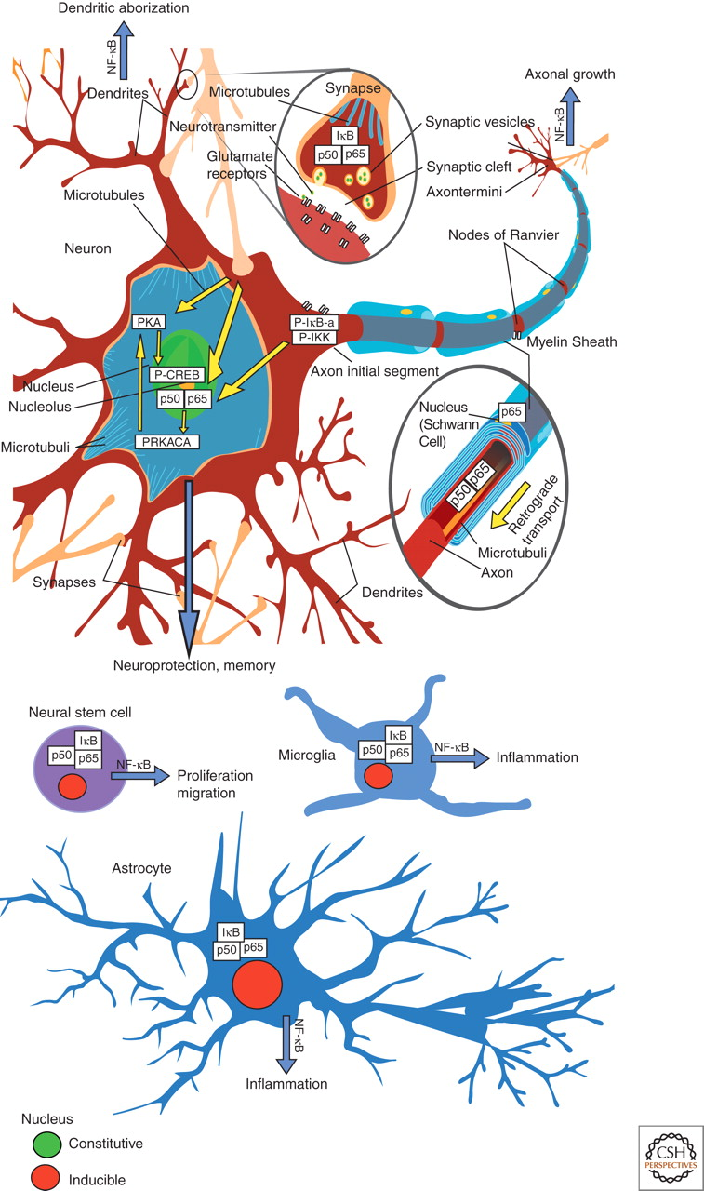
The role of NF-κB within the cellular context of the nervous system.
Upregulation of glutamate and impairment of myelin
Upregulation of pro-inflammatory cytokines with increased conversion of stem cells to activated microglia cells
Pro-inflammatory cytokine upregulation in astrocytes
Kaltschmidt B , and Kaltschmidt C Cold Spring Harb Perspect Biol 2009;1:a001271
©2009 by Cold Spring Harbor Laboratory Press
Notes:
The role of NF-κB within the cellular context of the nervous system. Constitutively activated NF-κB is detected mostly in glutamatergic neurons (green nuclei), whereas NF-κB in glia has a lower basal activity and is heavily inducible (red nuclei). For details, see text.

Slide 45
Brain Derived – Neurotrophic Factor (BDNF)
Decreased in depression, Alzheimer’s, epilepsy, schizophrenia and OCD
BDNF Increased with:
Exercise
Coffee (and other phytonutrients)
DHA-omega 3
Curcumin-turmeric
EGCG
Meditation
Reduction in gut permeability (microbiome)
Results of the MIDAS trial: Effects of docosahexaenoic acid on physiological and safety parameters in age-related cognitive decline. Karin Yurko-Mauro, Deanna McCarthyMIDAS Investigators
Alzheimer's & Dementia: The Journal of the Alzheimer's Association, July 2009 (Vol. 5, Issue 4, Supplement, Page P84).

Slide 46
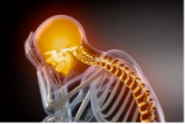
The Metabolic Syndrome, Inflammation, and Risk of
Cognitive Decline
5-year prospective observational study at two
community-based clinics
2632 black and white elders (mean age 74)
Modified Mini-Mental Status Exam at 3 and 5 years
Measurements of Interleukin 6 and C-reactive protein
Compared with those without features of metabolic
syndrome, elders with metabolic syndrome had risk-ratio
(RR) 0f 1.66 (95% CI, 1.19-2.32
Strongest association with elevated IL-6 and CRP
JAMA. 2004 Nov 10;292(18):2237-42.

Slide 47
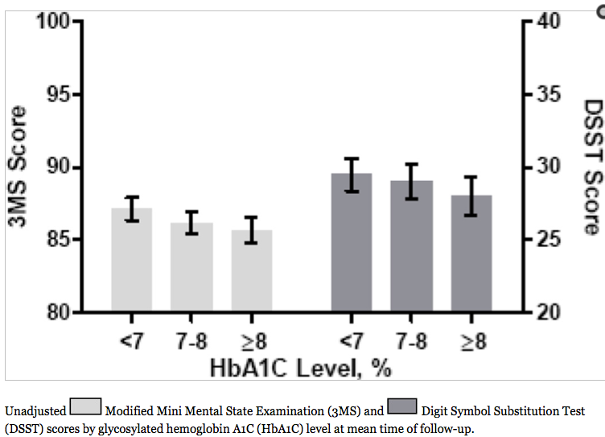
Diabetes, Glucose control, and 9-year Cognitive Decline Among Older Adults Without Dementia
K. Yaffe et al. Arch Neurology Sept. 2012

Slide 48
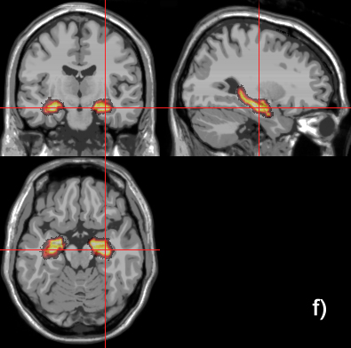
Higher Normal Fasting Glucose is Associated with Hippocampal Atrophy
266 Cognitive healthy adults
Baseline fasting glucose
Baseline MRI scan to measure hippocampus
Repeat MRI at 4 years

Slide 49
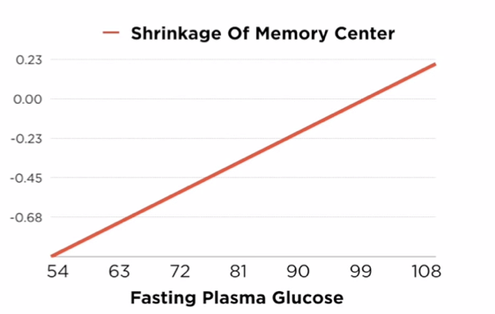

Slide 50
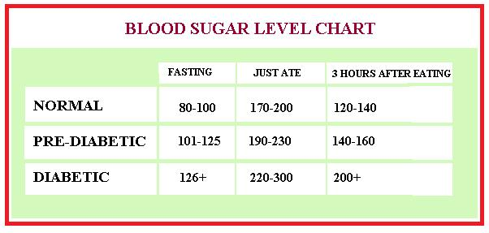
Glucose Levels and Risk For Dementia
2067 participants without dementia
Average age at baseline 76 years
Median follow-up 6.8 years
Baseline glucose
Cognitive assessment every 2 years

Slide 51
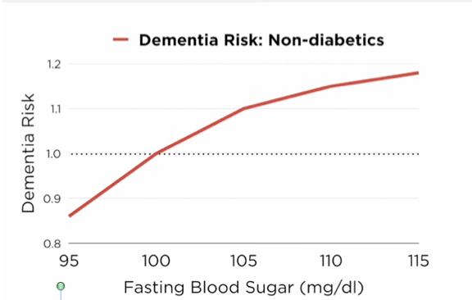

Slide 53
Diabetes in Midlife and Cognitive Change Over 20 Years
A Cohort Study
Prospective cohort study
13,351 black and white adult participants aged 48 to 67 years at baseline (1990-1992)
Measurements of diabetes including history, meds and HbA1c
Cognitive measures including word recall, digit symbol substitution, and word fluency testing.
Ann Intern Med. 2014 Dec 2;161(11)

Slide 54
Diabetes in Midlife and Cognitive Change Over 20 Years
A Cohort Study
Diabetes and pre-diabetes prevention and glucose control in midlife may protect against late-life cognitive decline.
Ann Intern Med. 2014 Dec 2;161(11)

Slide 55
Relative Intake of Macronutrients
Impacts Risk of MCI or Dementia
Mayo Clinic study
937 cognitively normal adults
Median age – 75.9 years
Follow-up averaged 3.7 years
Cognitive assessment at baseline and every 15 months
Food-frequency questionnaire at baseline

Slide 56
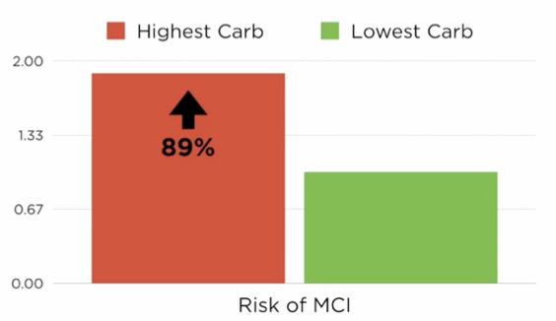

Slide 57
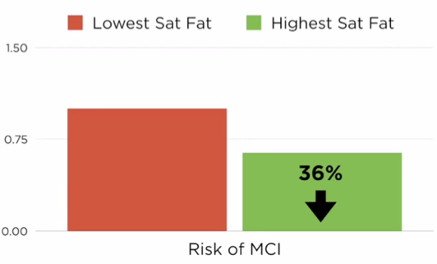

Slide 59
1,230 individuals age 70 and older
4-year follow-up
Individuals with higher carbohydrate intake had nearly
four times the risk of developing Mild Cognitive
Impairment (MCI)
Those individuals with the highest fat intake compared to
the lowest fat intake were 42% less likely to have MCI

Slide 60
Motion is the lotion !

Slide 61
Exercise training increases the size of the hippocampus and improves memory
120 older adults, 1 year, stretching vs. aerobic exercise
Measurement of hippocampal volume, BDNF and memory function at baseline, 6 months and 1 year

Slide 62
Exercise training increases the size of hippocampus and improves memory
After 1 year:
Exercisers had marked increase in BDNF
Exercisers showed substantial improvement in memory function

Slide 63
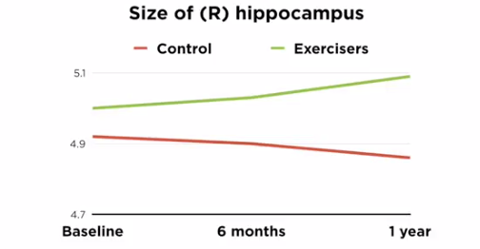
Exercise training increases the size of hippocampus and improves memory

Slide 64
Effect of physical activity on cognitive decline in older adults at risk for Alzheimer’s disease
138 participants
Complained of mild cognitive dysfunction
Intervention- 24 weeks of moderate exercise (142 minutes)
Assessment of ADAS cognitive scale over 18 months
JAMA , September 3, 2008, Vol 300. No 9

Slide 65
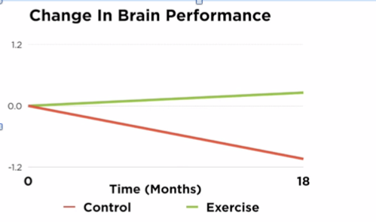
JAMA , September 3, 2008, Vol 300. No 9

Slide 66
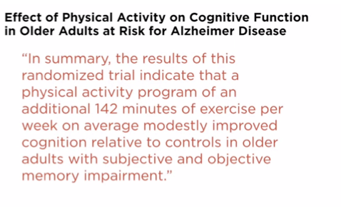
JAMA , September 3, 2008, Vol 300. No 9

Slide 67
A six month exercise intervention influences the genome-wide DNA methylation pattern in human adipose tissue.
24 healthy men with low level baseline activity levels before and after 6-month exercise program
30 controls
Genome-wide methylation patterns examined in adipose tissue
Several patterns changed in exercise group demonstrating reduced lipogenesis and a “silencing” of genes associated with obesity, inflammation and impaired insulin signaling.
Ronn T et al. PLoS Genet June 2013

Slide 68
Disrupted Sleep
Loss of entrainment
15% Americans experience chronic insomnia
1 out of 3 has sleep disruption on one or more nights each week
Major risk factor for many chronic complex diseases
Neuro-endocrine-immune disruption
Sleep hygiene
Obstructive sleep apnea
Avoid pitfalls of sleeping medications

Slide 69
Notes:
Jurgen Aschoff german physician-biologist; chronobiology-entrainment

Slide 71
Allostasis
The process of achieving stability or balance through physiological or behavioral change in response to changes in one’s environment.

Slide 72
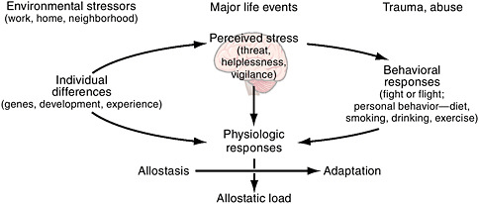
Allostasis
Ability to achieve stability through change

Slide 73
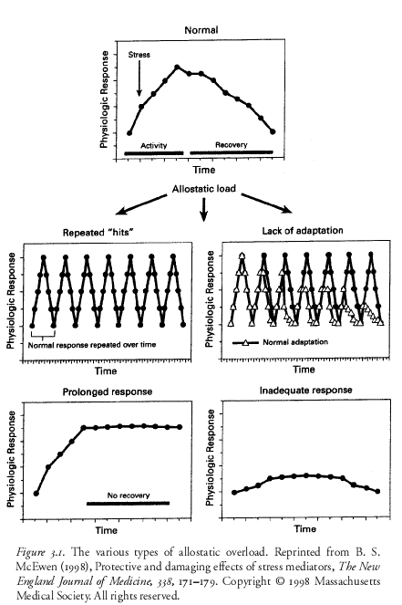

Slide 74
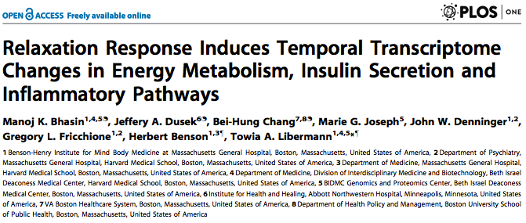
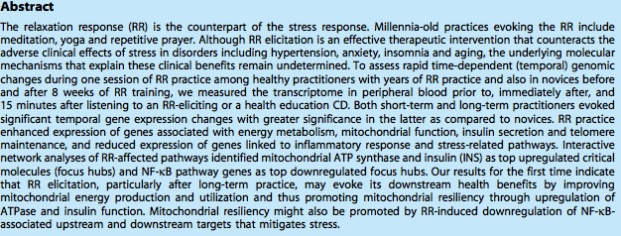
Meditation, deep breaths, yoga, guided imagery, prayer appears to quickly and effectively reduce inflammation and improve insulin sensitivity pathways

Slide 75
Vitamin D
CV Disease
Cancer
Autoimmunity
Depression
CHF
Osteoporosis
Fall risk
Pain syndromes
Sensible sun exposure each day!

Slide 76
Anti-inflammatory lifestyle
Whole foods always trump more processed foods
Reduce-eliminate sugar; fructose and refined-processed, grain-based flour (carbohydrate-dense foods) e.g. breads, pasta, bagels, chips, pretzels, muffins, donuts, and many cereal grains
Consider an elimination trial e.g. gluten, dairy, sugar
Eat lots of vegetables, plant-fiber, sweet potatoes, plantains, beans
Reduce processed seed-vegetable oils e.g. corn, safflower, sunflower, canola, peanut and introduce more healthy fats e.g. grass-fed butter, EVOO, coconut oil, lard, ghee, and an increase in O-3s fatty fish, nuts, seeds, avocados
Lean, red meat (grass fed-finished ideal), eggs
Eat organic for “dirty dozen” produce

Slide 77
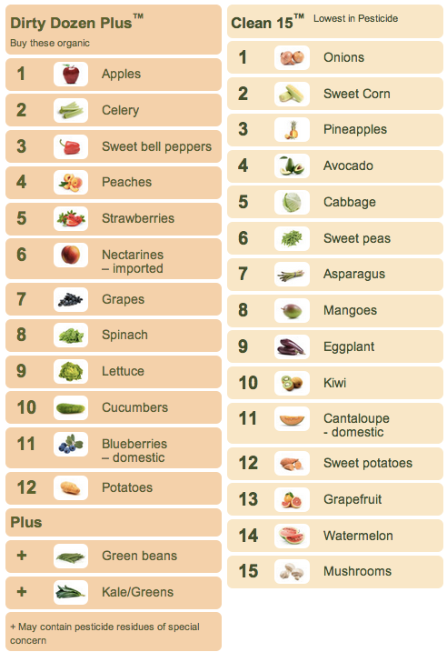
Environmental Working Group
Ewg.org

Slide 78
Anti-inflammatory Lifestyle continued
Movement…
Motion is the Lotion: walking, aerobic, resistance, yoga, tai chi
Mind-Body
Prayer, Breathing techniques, Relaxation Response, Meditation;
mindfulness-based stress reduction; HRV-Heartmath
Sleep hygiene-entrainment
Laughter
Volunteerism
Social connection
Cultivate meaning in work, love, and play
More time outdoors during sun season

Slide 79
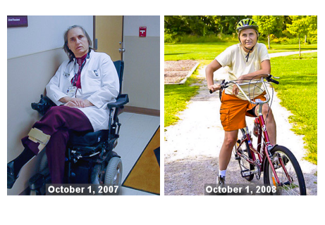
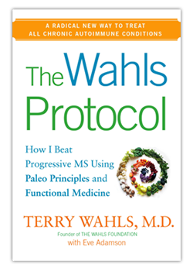
Terry Wahls MD University of Iowa

Slide 80
Thank you!

